Slide 1
2012 ARIN Elections
Number Resource Organization Number Council

Slide 2
What’s the NRO NC?
The Number Council advises the Number Resource Organization’s Executive Council on proposed global Internet number resource allocation policies and serves the function of the ICANN Address Supporting Organization Address Council (ASO AC). Learn more at: http://aso.icann.org/

Slide 3
Who Can Vote?
Eligible Designated Member Representatives (DMRs), ARIN XXX Attendees (remote and in person), and NANOG 56 Attendees that registered for their meeting by 10 October.

Slide 4
What Email Should I Use?
Voter Type | E-mail Address
ARIN Designated Member Representative | DMR email on file with ARIN Member Services
NANOG 56 Attendee Registered by 10 October | NANOG 56 registration email
ARIN XXX Attendee (in person or remote) Registered by 10 October | ARIN XXX registration email
Note: You may only cast one vote in the NRO NC Election

Slide 5
October 2012
Sunday | Monday | Tuesday | Wednesday | Thursday | Friday | Saturday
 | 1 | 2 | 3 | 4 | 5 | 6
7 | 8 | 9 | 10 | 11 | 12 | 13
14 | 15 | 16 | 17 | 18 | 19 | 20
21 | 22 | 23 | 24 | 25 | 26 | 27
28 | 29 | 30 | 31
Voting Opened
-NRO NC Representatives Announced
- Candidate Speeches
- NRO NC Voting Closes at 5pm ET

Slide 6
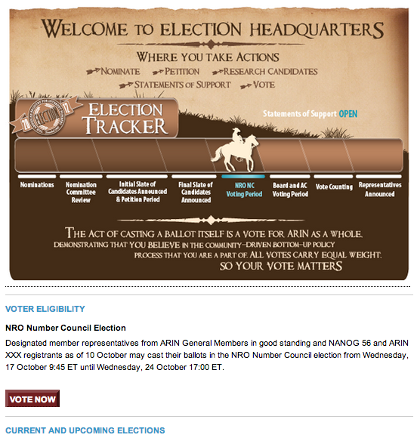
ARIN Election Headquarters
Read and Submit Statements of Support
Research Candidate Questionnaire Responses
Cast your Vote
https://www.arin.net/app/election/

Slide 7
Voting Closes Today,
Wednesday, 24 October at 5pm ET

Slide 10
NRO NC Candidates
Andrew Dul
Louis Lee

Slide 11
Andrew Dul
What differentiates you as a candidate, or makes you uniquely suited to serve on the NRO NC?
Active in the ARIN region since 1999
Served previously on the ARIN Advisory Council
Worked with a number of different sizes and types or organizations
I would like to serve on the NRO NC to support global Internet development and work toward promoting IPv6 as the next generation Internet.
Bio:
Cascadeo Corporation
Perkins Coie
The Boeing Company – Connexion by Boeing
Internap Network Services
Sacramento County Office of Education
Masters in Business Administration - Seattle University
Bachelors of Science, Electrical Engineering - University of California, Davis
http://www.ipaddressnews.com

Slide 12
Louie Lee
What differentiates you as a candidate, or makes you uniquely suited to serve on the NRO NC?
The members of the North American Network Operators Group and of the ARIN community saw fit to elect me for 3 terms to serve a total of 9 years so far. The members of the ASO Address Council allowed me the privilege of leading the group as Chair for the past 5 years. I have built and established a rapport with the leaders at ICANN and ICANN communities.
Bio:
2004-present: NRO Number Council / ASO Address Council • ASO AC Chair (2008-present), Co-Chair (2007) • ICANN Affirmation of Commitments Accountability & Transparency Review Team (2010) 2009-present: Internet Society SF Bay Area Charter Member 2007-present: IEEE Member 2000-present: Equinix Sr. Network Architect / Sr. Network Engineer 1995-present: active NANOG participant / member 1994-2000: Netcom Sr. Network Engineer

