Slide 1
IETF Activities Update
Cathy Aronson
cja@daydream.com
ARIN XXX
Report on IETF 84
Cathy Aronson
cja@daydream.com
ARIN XXVI
April 2011
San Juan, Puerto Rico
Cathy Aronson
cja@daydream.com
ARIN XXX
Report on IETF 84
Notes:
Read slide

Slide 2
Note
This presentation is not an official IETF report
There is no official IETF Liaison to ARIN or any RIR
This is all my opinion and my view and I am not covering everything just highlights
You should know I like funny quotes
I hope you enjoy it
Your feedback is greatly appreciated
If you were there and have an interesting item I missed please speak up
Notes:
Read slide

Slide 3
Highlights
World IPv6 Launch
IETF website was attacked the Friday before IETF and all the attach traffic was IPv6
New working group IPv4 Sunsetting

Slide 4
Some Things Haven’t Changed

Slide 5
IPv6 Maintenance -6man
Several docs advancing to the IESG. Many drafts to fix various problems with IPv6. Router Solicitation problems, etc.
Packet Loss Resiliency for router solicitations – trying to figure out the correct behavior if you don’t get an RA
Representing IPv6 Zone Identifiers in Uniform Resource Identifiers
IPv4 address imbedded in IPv6 Mcast
"I am all for documenting that bad ideas are indeed bad ideas" Lorenzo

Slide 6
Technical Plenary
Technical discussion of Software Defined Networks (SDN)
“Transmogrifier Gun”

Slide 7
Transport Area
Controlled Delay (CoDel) presentation by Van Jacobson
Deals with Bufferbloat using packet sojourn time through the queue
ACM Article is here http://queue.acm.org/detail.cfm?id=2209336
More on Bufferbloat is here http://www.bufferbloat.net/
Major performance problem of existing networks.
Competing proposal is DCTCP
http://www.stanford.edu/~alizade/Site/DCTCP.html
Also LEDBAT
http://datatracker.ietf.org/wg/ledbat/charter/

Slide 8
WORLD IPv6 Launch Lunch
2000 Websites went to IPv6
Sustained impact on traffic levels
Truly a global event
Comcast
2% provisioned native dual stack
100% increase since May
V6 on 50% of the network
Most traffic YouTube, Netflix, iTunes
Measuring v4 and v6 parity – comparing experience

Slide 9
WORLD IPv6 Launch Cont.
Google
IPv6 SMTP support
IPv6 adoption up 150% over the past year
AAAA filtering used by some to turn of v6
Time Warner
Huge deployment to get to the 1% actual traffic
Akamai
53 countries and 600 locations using v6
www.akamai.com/ipv6

Slide 10
IRTF
Internet Disruptions in North Africa
Interesting talk about the Internet in Egypt and Libya
Egypt has 51 ASNs and Libya has 3 so for example it was easier to turn off the Internet in Libya during the uprising.
Delay Tolerant Network Research Group
Interplanetary Internet
lots of interesting work on different high delay networks.

Slide 11
V6 Operations
Several good documents on transitioning to IPv6. Enterprises, Content and Application Service Providers.
Design Guidelines for IPv6 Networks
IPv6 Guidance for Internet Content and Application Service Providers
Service Provider WiFi Services over Residential Architectures
Enterprise Incremental IPv6
A Reference Framework for DC Migration to IPv6"transition" for data centers.

Slide 12
V6 Operations - Continued
Semantic IPv6 Prefix
Embed semantics into prefix
Can’t stop folks from doing this even if it is a bad idea.
Operational experience with NAT 64
Tmobile
Quotes from v6 Operations
"it's an example of how a pig can fly if there's enough economics behind it”
"you're going to lose a lot of information and you're probably going to screw yourself"

Slide 13
V6 Operations - Continued
464XLAT
Limited IPv4 connectivity over a v6 only network
There is a class of applications that don't work.. stuff with IPv4 literals like skype.
BCP: IPv6 over ATM interworking Function

Slide 14
Internet Area
NAT Reveal Analysis
The engineering problem is that if there are bad guys and good guys behind CGN and there are attacks they all get cut off
IEEE Registration Authority Committee (RAC)
Manages MAC addresses.
Proposal oddly like IPv4 A, B and C addresses
Don’t want to run out of MAC addresses
How to re-use addresses that are assigned dynamically.

Slide 15
Dynamic Host Configuration
A lot of work being done in DHCP to accommodate various v4 and v6 issues. Several drafts are there to accommodate issues that softwire needs solved. Also drafts of other problems that need to be solved.
DHCPv4 and DHCPv6 Options for Access Network Query Protocol Servers
DHCP Options for Port Set Assignment
DHCPv6 Option Guidelines
Port Restricted IP Address Assignment
DHCPv6 Options for Mapping Address and Port
Guidelines for Creating new DHCPv6 Options

Slide 16
Dynamic Host Configuration
MAP Provisioning over DHCPv6
DHCPv4 and DHCPv6 Access-network Identifier Options
DHCPv6 Class Based Prefix
Client Hardware Address Option in DHCPv6
DHCPv4 over v6 tunnel..
Mitigating Aggregation Traffic of DHCP Discover Messages
Prefix pool Option for DHCPv6 Relay Agents on Provider Edge Routers
Radius Option for DHCPv6 Relay Agents on Broadband Access Server
Multiple Stateful DHCPv6 Options Issues

Slide 17
DNS Operations (DNSOP)‏
Omniscient AS112 Servers
in-addr.arpa servers get a lot of junk
AS112 is a distributed sink to answer the queries. Authoritative replies. Anycasted. Stops queries because replies are cached
Proposal to make these authoritatve for “.” or “.arpa”?
Notes:
DNSOP
The DNS Operations Working Group will develop guidelines for the operation of DNS software servers and the administration of DNS zone files. These guidelines will provide technical information relating to the implementation of the DNS protocol by the operators and administrators of DNS zones.

Slide 18
V6 RENUM
"One man's rogue is another man's renumbering event” how to prepare a renumbering event - timers etc.RFC4192

Slide 19
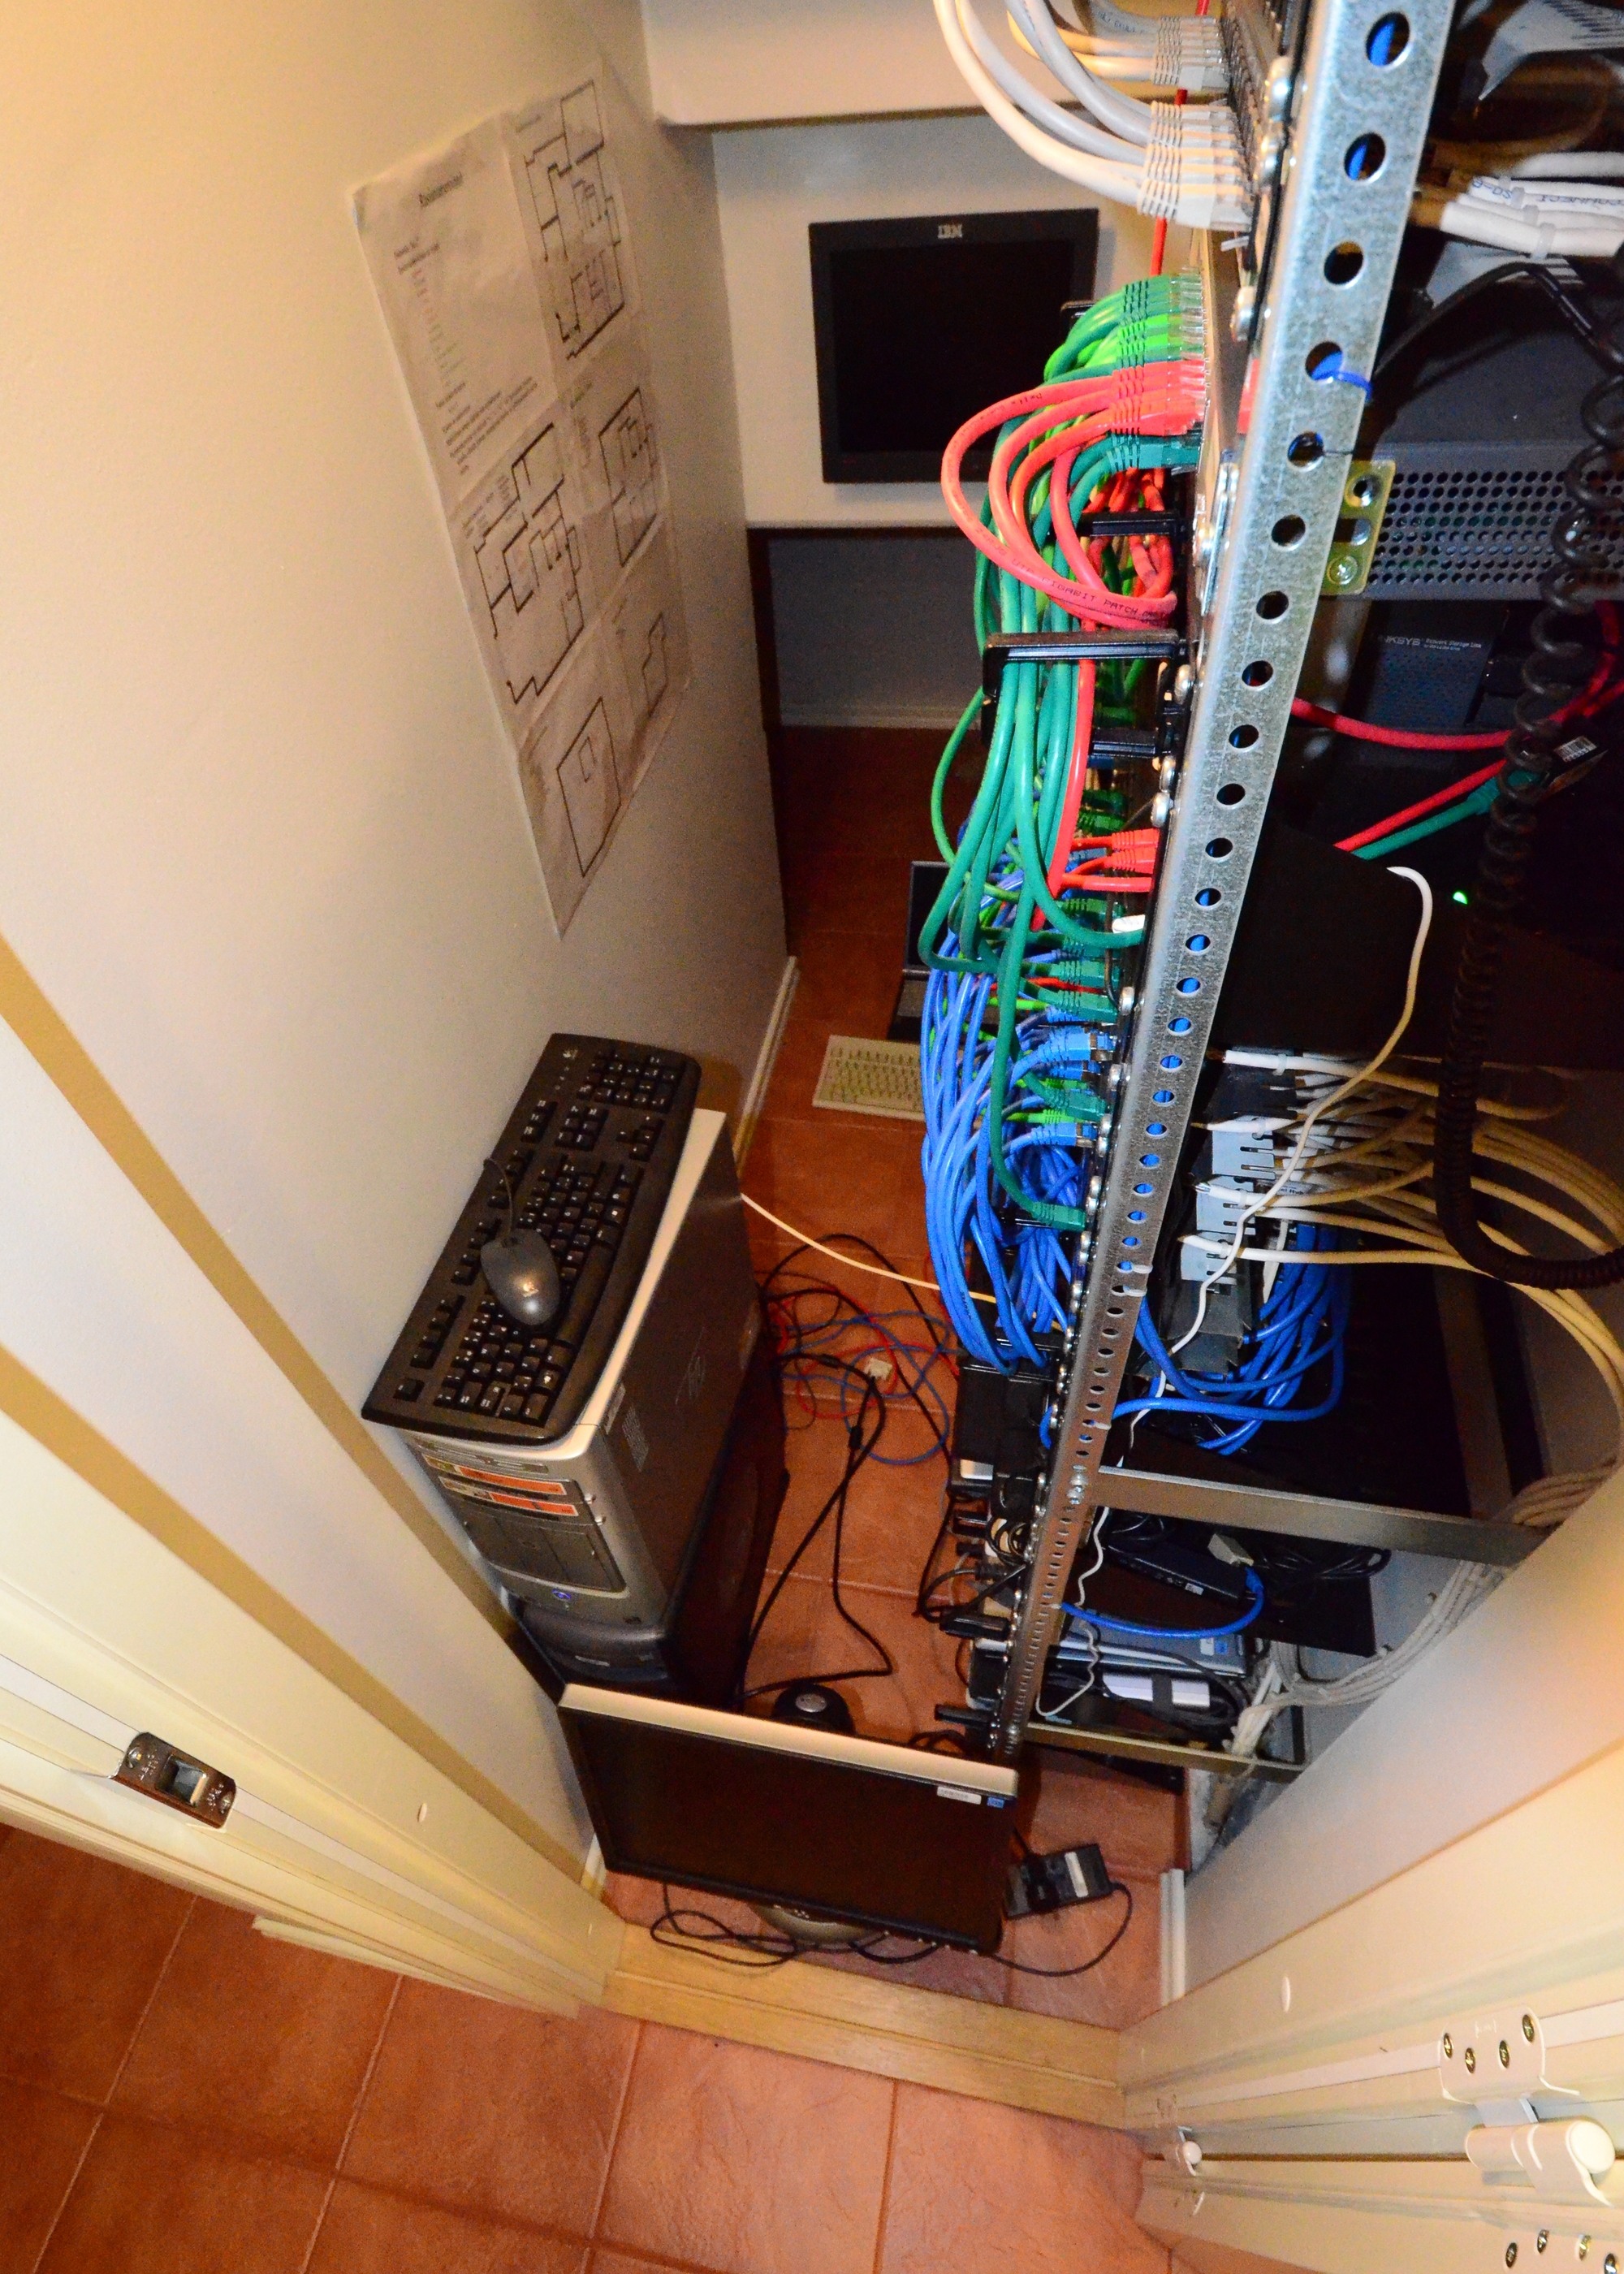
HOMENET – your Mother’s net?
Photo by
Jari Arkko

Slide 20
HOMENET
AKA “Arbitrarily Complex Home Networks Because We’re Geeks WG”
"what if I take my router to my neighbor's house because there's a party and they need a router?" "what prefix will the router get?”
Prefix Assignment in the home with OSPFv3

Slide 21
IPv4 Sunsetting WG
Purpose of the group
Central place to discuss IPv4 specific IETF work, ensure it's justified before proceeding.
what is the minimum work that IETF needs to finish so that standards work on IPv4 work is "done”
A WG to consider how to turn IPv4 OFF.NOT IPv6 Deployrment Deniars Anonymous
Does not harm or delay deployment of IPv6
"I like sunsets. Sunsets are pretty. Sometimes I like sunsets to last longer" Lee Howard

Slide 22
IPv4 Sunsetting
IPv6 Support within IETF work
future IPv4 work limited to solving documented operational problems indentified by multiple organizations
IPv6 is not optional
Gap Analysis – what’s missing for turning off v4?
"if you don't have v4 you don't have a v4 problem"

Slide 23
Ops & Mgmt Area
FLOW OAM document
improve traditional tools such as ping and traceroute to work in large scale data centers where there is lots of multipath and ECMP
trace packets need to go through the same processing as the actual application flow that is being traced
"The problem is you're trying to write a MIB. You should be writing a virtual MIB then the problem would be solved" Kireeti

Slide 24
References
General WG Info:
http://datatracker.ietf.org/wg/ (Easiest to use)
Internet Drafts:
http://tools.ietf.org/html
IETF Daily Dose (quick tool to get an update):
http://tools.ietf.org/dailydose/
Upcoming meeting agenda:
http://tools.ietf.org/agenda
Upcoming BOFs Wiki:
http://tools.ietf.org/bof/trac/wiki
Also IETF drafts now available as ebooks
http://www.fenron.net/~fenner/ietf/ietf-ebooks
Notes:
USE SLIDE ITSELF
NEW http://datatracker.ietf.org/wg/

Slide 25
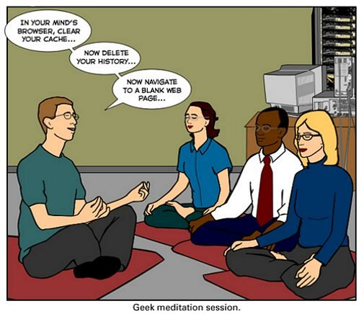
?
Questions?

