Slide 1
Chief Financial Officer
Robert “ Tex” Stratton

Slide 2
Summary
Staff
ARIN OnLine Experience
Possible New Fee Schedule
2012 Operational Experience
Balance Sheet – August 2012
Data Point

Slide 3
Staff
Val Winkelman
Michael Abejuela
Tammy Rowe
Amaris Wang
Tanya Gomez
Amy Sanchez

Slide 4
ARIN OnLine Experience
Communication
Message Center
Invoice Lookup
Billing POC Administration
Processing
Efficiency
Transparency

Slide 5
Planning for Possible New Fee Schedule
Planning on how to Implement if New Fee Schedule is adapted
Working with Engineering to Automate the interaction between databases
Details were presented at yesterday’s PPM
Plan with CMSD for communicating about any changes throughout the year

Slide 6
Operational Experience in 2012
Revenue and Expense Trends – Treasurer to present
Working with Engineering on improved Credit Card OnLine process – just released in October
Managing Investment Reserves is challenging in “Financial Repression” i.e. low interest rates

Slide 7
Payment Types YTD through August

Slide 8
2012 Invoicing Structure through August

Slide 9
Registration Revenue Mix by %

Slide 10
ARIN Asset Balance Sheet August 2012
ASSETS
Current Assets
 | Cash and cash equivalents | 2,173,780
 | Investments
 | Legal Reserve | 2,089,103
 | Operating Reserve | 3,588,083
 | Long Term Reserve | 20,500,461
 | Trade Receivables | 338,612
 | Nontrade Receivables | 24,642
 | Note Receivable | 43,800
 | Prepaid Expenses | 524,090
 | Property & Equipment net | 1,018,850
 | Software Costs | 4,109,193
Total Assets |  | 34,410,614

Slide 11
ARIN Liabilities Balance Sheet August 2012
LIABILITIES
Current Liabilities
 | Accounts payable and accrued expenses | 1,131,570
 | Deferred Rent | 37,723
 | Deferred Revenue | 6,228,906
 | Other Current Liabilities | 1,765
 | Total current liabilities | 7,399,964
Net assets unrestricted |  | 27,010,650
Total Liabilities |  | 34,410,614

Slide 12
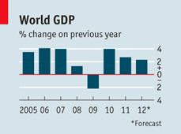
Chart of World GDP Economist Magazine October 2012

Slide 13
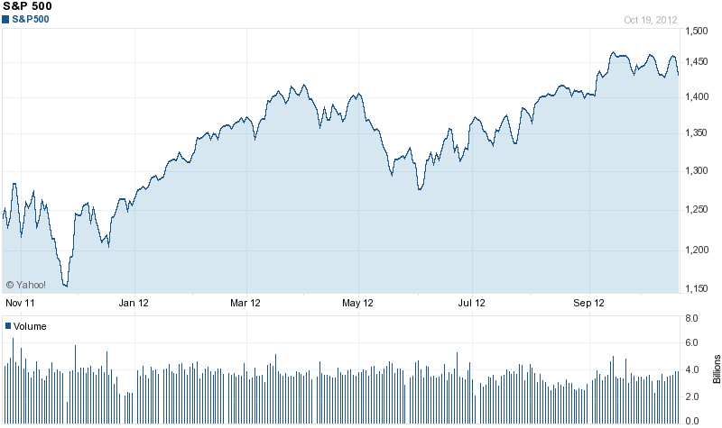
S&P 500 Stock Index 1 Year Results

Slide 14
Thanks Partners

