Slide 1
The RIPE NCC Update
Axel Pawlik
Managing Director

Slide 2
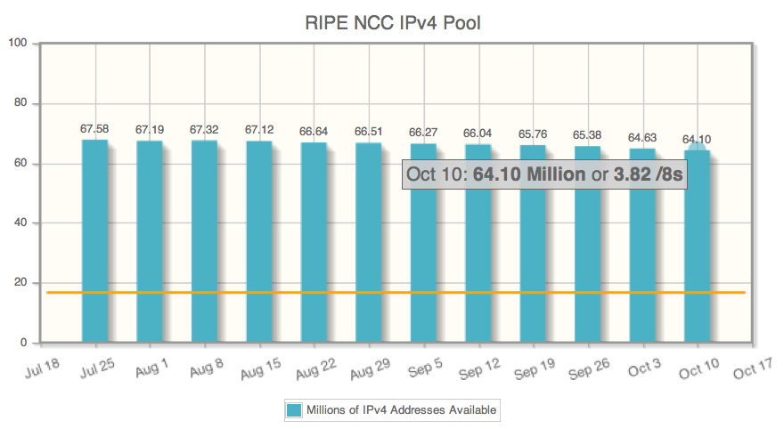
Operations: Registration Services Changes
Allocations now for three months only
Servicing requests: Clarifications go back to end of waitlist…
High ticket load, although…
Pronounced summer hole
Membership growth significantly above budget

Slide 3
Consolidation of Activities
Information Services merged into DNS and Science Group
-> Global Information Infrastructure
Wolfgang Nagele
-> Research & Development
Robert Kisteleki

Slide 4
Certification – The Discussion
Early attempts in Lisbon, October 2009
Focus on business impact, policies
Deployment 2011
Ca. 600 members requested certificates
Discussion of Principles and Dangers in May 2011
Clear concerns about “Red Button” and related impact on routing system
Retraction of Certification Policy Proposal
Way forward
More presentations & discussion at next RIPE Meeting
General Meeting

Slide 5
Preserving Financial Stability
A New Charging Scheme is needed
Current scheme based on (mostly IPv4-) allocations
Propose to set Fee proportional to Benefit
How to measure “benefit from RIPE NCC services”?
Proposal published
Feedback from members-discuss mailinglist
Smaller jumps, Sliding scale, …
Adjusted model
to be formally adopted during General Meeting

Slide 6
Member & Stakeholder Survey
Previous surveys in 2002, 2005, 2008
Goals
Find out views of members on RIPE NCC services
Hear about members’ needs
Gather input for strategic development
Focus group meetings throughout region
Desiree Miloshevic, John Earls
Analysis by Oxford Internet Institute
Awaited “any day now”…

Slide 7
Membership & Community Development
Working with regional communities since 2003
Moscow, Middle East
Now also South Eastern Europe
Great success
Encouraged setup of MENOG / ENOG
Intensifying membership development
Deploying Paul Rendek
Hired Serge Radovcic
Regional Meetings:
Dubrovnik, 6 – 9 Sep, Muskat, 3 – 4 Oct, Moscow, 28 – 30 Nov

Slide 8
Come: RIPE 63
8

Slide 9
Questions?

