Slide 1
2011 ARIN Elections
Advisory Council and Board of Trustees

Slide 2

“The pessimist complains about the wind; the optimist expects it to change;
the realist adjusts the sails.”
- William Arthur Ward

Slide 3
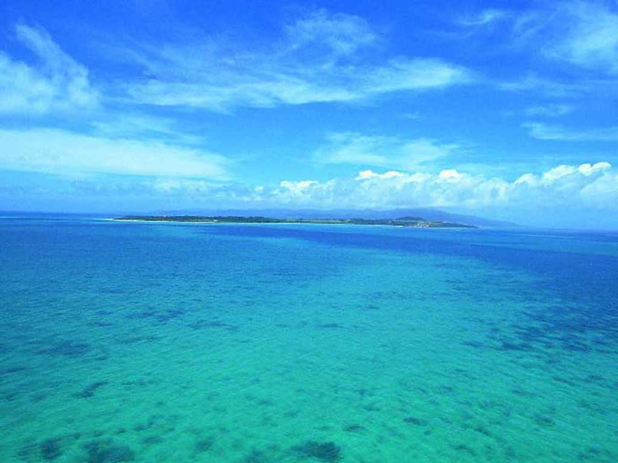
October 2011
Sunday | Monday | Tuesday | Wednesday | Thursday | Friday | Saturday
 |  |  |  |  |  | 1
2 | 3 | 4 | 5 | 6 | 7 | 8
9 | 10 | 11 | 12 | 13 | 14 | 15
16 | 17 | 18 | 19 | 20 | 21 | 22
23 | 24 | 25 | 26 | 27 | 28 | 29
- Candidate Speeches
- Voting Opens at 5pm ET
- Candidate Speeches Posted Online
- Voting Closes at 5pm ET
-Representatives Announced

Slide 4
Who Can Vote?
Eligible Designated Member Representatives (DMRs) as of 27 September.

Slide 5
What Makes a DMR Eligible?
Member on Record as of 1 January 2011
DMR’s email has name/initials and Organization’s Domain
Be in Good Standing (no overdue invoices)

Slide 6
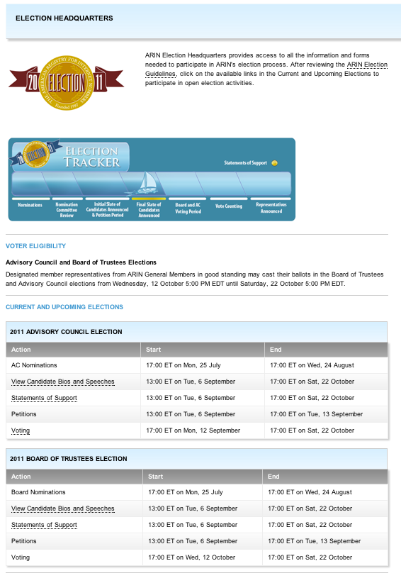
ARIN Election Headquarters
Read and Submit Statements of Support
Research Candidate Questionnaire Responses
Cast your Vote
https://www.arin.net/app/election/

Slide 7
How Do You Vote?
Click “Voting”

Slide 8
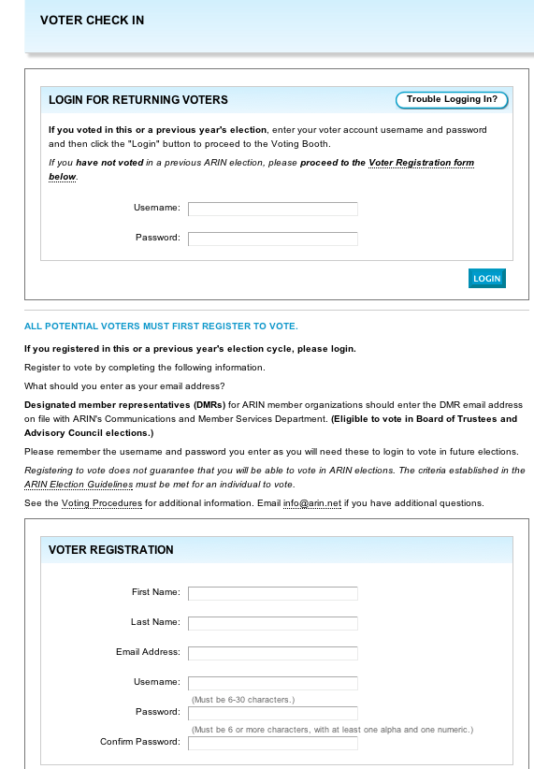
Voted
Before?
Then Login
First Time Voting?
Then Register

Slide 9
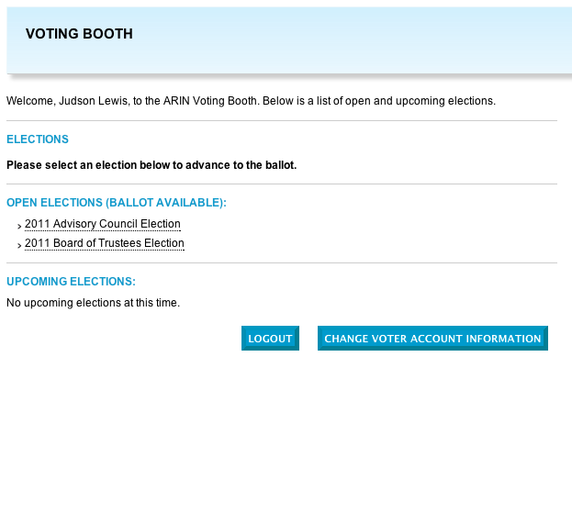
Select an Election

Slide 10
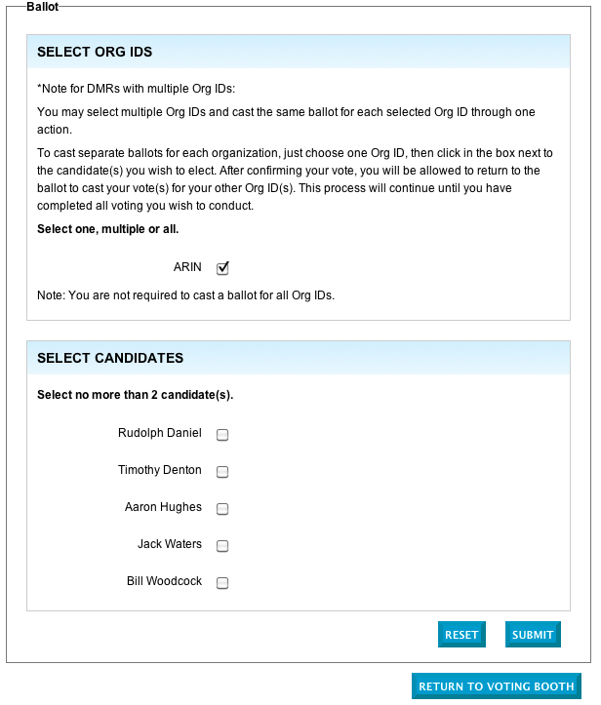
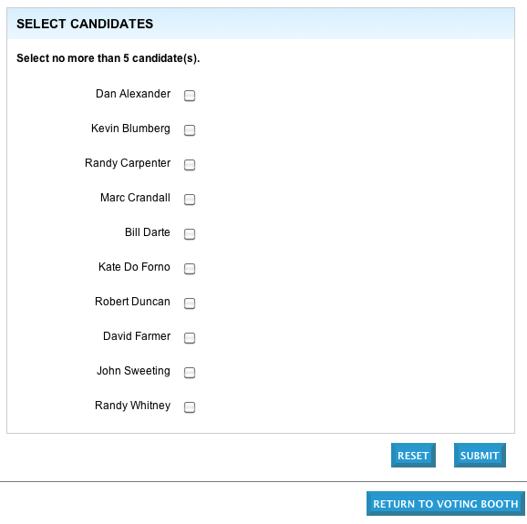
Sample Ballots
Board of Trustees
Advisory Council
Select up to 2
Select up to 5
Then Click
All Candidates are listed alphabetically

Slide 11
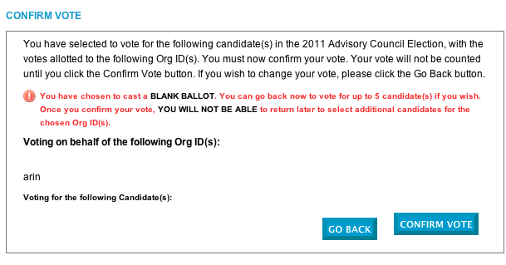
Then Click
Ready to Cast your Ballot?

Slide 12
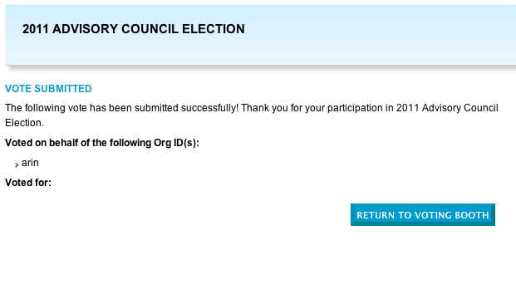
Success!
Click
Now Return and Vote in Other Election

Slide 13
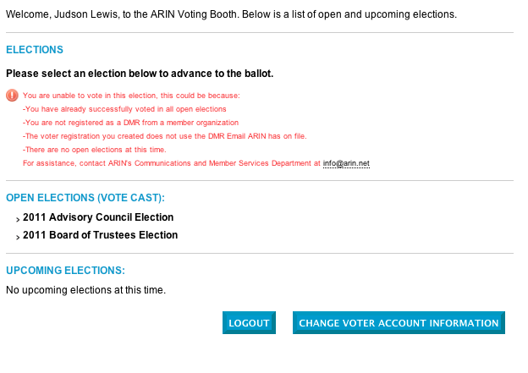
If You See This You Have Voted in Both Elections
Thanks for Voting!

Slide 14

Remember the Voting Deadline:
Saturday, 22 October at 5pm ET

Slide 15


Slide 17
Advisory Council Candidates
Dan Alexander *
Kevin Blumberg
Randy Carpenter
Marc Crandall
Bill Darte
Kate do Forno
Robert Duncan
David Farmer
John Sweeting
Randy Whitney
* = Not in Attendance (V) = Video Speech

Slide 18
Dan Alexander
Motivation to Serve:
Because my work is not done. The past six years have been preparing for the depletion of IPv4 resources and driving the deployment of IPv6. This work has included efforts in multiple forums and one more term on the AC is desired to reach the tipping point of these efforts, so the deployment of IPv6 can occur sooner rather than later.
Biography:
Served two terms on the ARIN Advisory Council. Served on US Delegation to ITU IPv6 WG. Attended and contributed to ITU Plenipotentiary meeting last August. Manage IP resources and addressing architecture for largest US cable ISP. Involved in other Internet governance bodies. (ICANN, IETF, ITU, RIRs) Served on ARIN's PDP committee revising the process used to define ARIN policy.

Slide 19
Kevin Blumberg
Motivation to Serve:
I want to serve on the Advisory Council to help the community through the last phase of IPv4 exhaustion and the growth in IPv6 adoption. While the exhaustion phase has some known concerns I strongly believe that as IPv6 adoption increases there will be a need for increased work in tuning for IPv6.
Biography:
I have been the Co-Owner and CTO of The Wire Inc. in Toronto Canada for the past 10 years. I currently sit on the Board and the Executive Committee for the Canadian Network Operators Consortium Inc. as well as the Board of the Toronto Internet Exchange. I have been an ARIN member and the DMR for a number of years and have been to the past three ARIN Policy meetings.

Slide 20
Randy Carpenter
Motivation to Serve:
I hope to work on policies that will make it easier and more fair for organizations to get the address space they need. I also want to be involved as we go forward with the IPv6 transition.
Biography:
I work with a number of small ISPs, mostly independent telephone companies. Working with these companies gives me a unique view of the operational challenges that smaller ISPs face.

Slide 21
Marc Crandall
Motivation to Serve:
Policy is critical to the proper management of IP resources and therefore the stability of the Internet. I would like to maintain my involvement with this via the AC.
Biography:
I serve with Google as Senior Manager of Global Compliance, Enterprise. I address regulatory and policy issues - especially those involving privacy - concerning the development and deployment of Google technology to hundreds of millions of users. Prior to joining Google in 2006, I worked for the United States Federal Bureau of Investigation (FBI) serving as Assistant General Counsel with the Science and Technology Law Unit. There, I served as principle legal advisor to the FBI Cyber Division, addressing issues such as cybercrime, counterintelligence, counterterrorism, and infrastructure security. In that capacity I helped begin US Government participation in ARIN's public policy process. Before joining the FBI in 2003, I served as Corporations Counsel and Lead Counsel of Internet Compliance and Enforcement with the California Department of Corporations, California's investment and finance authority, to help combat online fraud.

Slide 22
Bill Darte
Motivation to Serve:
Why do you want to serve on the Advisory Council?
I am nearing the end of my career at Washington University in St. Louis. I would like to serve another term on the AC because this is the time of transition in the Internet Protocol that I have looked toward since I joined the AC in 1997. I bring great organizational experience, commitment and objectivity to the process.
Biography:
I am a staff employee of the Center for the Application of Information Technology and adjunct Professor in the Sever Institute within the School of Engineering and Applied Science at Washington University in St. Louis. I have served the Internet community continuously as an Advisory Council member since ARIN's inception in 1997. In addition, I have taught and had technical roles within Washington University in St. Louis since 1991 and have worked in industry doing IT and network services since 1984 following my MBA. Distantly, in another life, I was a District Conservationist and Conservation Planner for the Soil Conservation Service, US Department of Agriculture.

Slide 23
Kate Do Forno
Motivation to Serve:
I am eager to serve on the ARIN Advisory Council. My foremost motivation is to give back to the Internet community that has treated me so well by volunteering my time on the AC. I believe the skills that I possess will assist the AC in shaping sound policy for today and the foreseeable future.
Biography:
Employed by a large Independent Internet Service Provider
Extensive experience working in a collaborative environment like the Advisory Council
Significant policy development experience
I have spent many years volunteering in the non-profit world; I am a passionate and committed community builder
If you have any questions, please feel to contact me at katedoforno@gmail.com
I would sincerely appreciate your trust and your vote

Slide 24
Robert Duncan
Motivation to Serve:
I am interested in bringing the experience of the Merit organization as well as the point of view of an R&E network provider to ARIN.
Biography:
I have been with Merit Network for 4 years. Merit is a nonprofit member based network services provider located in Ann Arbor Michigan. In that time I have been responsible for strategy and design of optical, Ethernet and IP network systems. This includes management of IPREG and DNS support. Merit manages IP address space for the .EDU TLD in Michigan and internal IP assignments for over 400 member organizations. For the past 16 years I have been involved in strategic planning functions for all Information Technology sectors, including LAN, WAN, server, desktop and voice systems. I worked for Nortel Networks, a network hardware vendor, for 26 years prior to Merit Network.

Slide 25
David Farmer
Motivation to Serve:
I hope to continue to bring the views and sensibilities of an end-user organization to the ARIN Advisory Council. Moreover, I would like to help guide the ARIN community through IPv4 exhaustion and the transition to IPv6 that I was allowed to start 3 years ago.
Biography:
David Farmer is a Senior Network Design Engineer at the University of Minnesota. He has been a member of the University's Office of Information Technology, in varying roles, for the last 17 years. He is the chair of the BOREAS-Net Technical Team. David was elected to the ARIN AC in October of 2008.

Slide 26
John Sweeting
Motivation to Serve:
There are 2 main reasons that I want to continue serving on the Advisory Council:
to help ensure that all voices are heard
to help ensure that all options are fully explored.
Biography:
I have been active within the ARIN community for several years. I have served on the Advisory Council for 9 years (2000-2005, 2009-2011) and have been the Chair of the Advisory Council for the last 3 years.

Slide 27
Randy Whitney
Motivation to Serve:
I want to have a positive impact not only the ARIN region but also in service to the Global community. I'd like to see ARIN gain in reputation among the other RIRs and I'd like to help facilitate further Cooperation among the RIRs. Specifically focusing on ARIN's direct customers, I have many years of experience in the industry and feel that I can use this to add many highly relevant contributions to both policy work and to the organization.
Biography:
My current role is Principal Engineering and Manager of Global Peering for Verizon, covering ASNs AS701, AS702, AS703, AS14551 and AS19262. I have grown this role over the years to include participation within the three RIRs covering the majority of Verizon's Operational Network: ARIN, RIPE, and APNIC. Within the ARIN region, I had previously chosen to remain in the background as it has been ably covered for Verizon by Heather Schiller and also until just recently Jason Schiller, who both kept me informed of active areas of debate and on updates to policy.

Slide 29
Board of Trustees Candidates
Rudolf Daniel * (V)
Timothy Denton
Aaron Hughes
Jack Waters
Bill Woodcock
* = Not in Attendance (V) = Video Speech

Slide 30
Rudolph Daniel
Motivation to Serve:
It is an honor to serve the Internet community. It is another opportunity to further the interests of the Caribbean region as a whole, to bring the region to the table and to highlight the importance of participation in the IG process at all levels. Personally, it is a learning experience and an opportunity to meet a wider Internet community. At a deeper level, the multi stakeholder consensus model of governance is, I believe, a game changer in the affairs of humans and the the way in which we view innovation and creativity.
Biography:
Participant last 4 years in IG forums Caribbean region: Caribbean Telecommunications Union and LACNIC forums. Participate in IG courses at Diplo. Member of the Government of St Vincent and the Grenadines ICT advisory forum as civil society representative. Attended ICT policy and briefing sessions with the Commonwealth Secretariat and the World Bank as a member of the ICT advisory forum. World Software Awards country expert for mobile e-content and mobile Applications. Ex board member of SVG Coalition of Service Industries. Member of CIVIC, Caribbean ICT virtual Community. ISOC member currently organizing national ISOC application. Select committee member for e-commerce legislation St Vincent & the Grenadines. Appointed back-up Crypto officer for ICANN root zone security.

Slide 31
Timothy Denton
Motivation to Serve:
You mean, apart from the privilege of representing the Internet community and working with such great people? I believe that ARIN does great work in sustaining the stability and utility of the numbering system and the Internet which depends on that system. I have reached a stage in my life when the sum of my working experiences permits me to contribute effectively on the work of a Board member.
Biography:
I have served as a Member of the Board of Trustees of ARIN since 2009. I was elected as Chairman of the Board of Trustees of ARIN in January 2011. In the past I served on the Board of Directors of the Canadian Internet Registration Authority as a representative of registrars, and in various consulting positions in the ICANN structure. I am currently a Commissioner at the Canadian radio-Television and Telecommunications Commission, Canada’s federal telecom and broadcasting regulator. The relevance of this position to the ARIN Board lies in a) working cooperatively as a judge and policy maker on a panel of similar people, and b) understanding and operating in a complex policy environment.

Slide 32
Aaron Hughes
Motivation to Serve:
My knowledge and experience is perfectly suited for the ARIN BoT and I am always eager to give time for the greater good and longevity of the Global Internet community.
Biography:
President & CTO of 6connect. Strong participation with Internet community organizations such as ARIN, NANOG, RIPE, GPF, EPF, EuroIX. Member: 6connect Board, TelX IX Advisory Board. With over 15 years of experience in advanced systems and network designs, Aaron has built and deployed IPv6 networks for the last 10 years for various organizations including branches of the Federal Government. Aaron teaches network automation and management strategies at conferences around the world, and is a well recognized thought leader in the IPv6 space.

Slide 33
Jack Waters
Motivation to Serve:
I believe that ARIN plays a very important role in the efficient transfer of IPv4 addresses and IPv6 adoption, and I would like to participate in the decisions that drive the organization’s effectiveness. This is also an opportunity to help further the interests of the industry as a whole to better serve customers. I would like to continue to stay on the forefront of development and improvement of Internet issues and technologies.
Biography:
For over 23 years, I have held roles in the development of Internet-based technologies and telecommunications services. I joined Level 3 Communications in 1997, and am currently President of Global Network Services and Chief Technology Officer with responsibility for global network architecture, engineering, and operations.
I earned my Bachelor of Science degree in Electrical Engineering from West Virginia University and my Master of Science degree in Electrical Engineering from Johns Hopkins University. In 2010, I accepted an appointment to the Federal Communication Commission’s (FCC’s) Technical Advisory Council, which provides guidance to the FCC on matters of telecommunications technology. I still currently serve on the FCC council.

Slide 34
Bill Woodcock
Motivation to Serve:
Biography:
ARIN Board of Trustees, 2003-Present
Packet Clearing House, 1996-Present
Zocalo, 1989-2002
I know many of you are amused to see me in a suit and tie. I do so for two reasons:
First, as a gesture of respect to you as I ask for your vote for a fourth
term on the ARIN Board. Second, because there's a side of me that you don't see in these meetings. Unlike most forms of top-down governance, Internet governance is done by the people who show up.
For the past twenty five years, I've been showing up, and representing the interests of Internet operators. First at the Regional Techs, and
ISOC and IETF meetings, then at all five RIRs, twenty different NOGs, and the IGF.
Like batman, I put on this suit when duty calls, and fly off to represent Internet operators' interests. When the ITU decided to have their first policy meeting outside of Geneva, I put on this suit and flew to Uganda, bringing a dozen African ISPs with me to tell the ITU that their help was not necessary in setting addressing and routing policy.
When the FCC and the OECD decided to put together IPv6 transition strategies, I put on this suit and flew to D.C. and Paris, and put pen to paper to make sure that network operators' perspectives were included.
When the ITU appointed the United Arab Emirates to chair a working-group on how to take responsibility for IPv6 from the RIRs, I put on this suit
and flew to Dubai to call in favors with the UAE communications ministry and show them how the success of the Internet benefited them.
In my nine years on the ARIN board, I've put more than five million miles on these suits. More than 90% at my own expense, but all of it representing the interests of ARIN and Internet operators.
So I'd like to ask for your vote. Both for myself, and for my colleague Tim Denton, who has done a tremendous job as board chairman this past
year. I hope you'll vote for both of us. Thank you.

Slide 35
Polls are Now Open
Thanks for Voting!
Questions? Contact info@arin.net

