Slide 1
Welcome to Your
First ARIN Meeting

Slide 2
Handouts for you
Basic information
Acronym list
ARIN fact sheets
  ARIN at a Glance
  Policy Development Process
  ARIN Participation
  Internet Ecosystem

Slide 3

Self- Introductions

Slide 4
Introduction to ARIN and
the Internet Registry System
John Curran

Slide 5
Regional Internet Registries (RIRs)
The system began in 1992
There are five RIRs
  - LACNIC formed in 2002 out of ARIN region
  - AfriNIC formed in 2005 out of ARIN and RIPE NCC regions.
All RIRs are nonprofit, community-driven organizations

Slide 6
Internet Registry System
ICANN(IANA) | Top level coordination of the Internet identifiers (domain names, numbers) Manage global unallocated IP address pool Allocate number resources to RIRs
RIR | Manage regional unallocated IP address pool Allocate number resources to ISPs/LIRs Assign number resources to End-users
ISP/LIR | Manage local IP address pool for use by customers and for infrastructure Allocate number resources to ISPs Assign number resources to End-users

Slide 7

Number Resource Provisioning Hierarchy
ICANN / IANA
(Internet Assigned Numbers Authority)
Manage global unallocated IP address pool
Allocate
RIRs
(AfriNIC, APNIC, ARIN, LACNIC, RIPE NCC)
Manage regional unallocated IP address pool
Allocate
Assign
ISPs
End Users
Re-Allocate
Re-Assign
ISPs
End Users

Slide 8
RIR Structure
Nonprofit | Membership Organization | Community-regulated
Fee for services, not number resources 100% community funded | Broad-based - Private sector - Public sector - Civil society | Community developed policies Member-elected executive board Open and transparent

Slide 9
RIR Services
Number Resources | Organization | Policy Development
IP address allocation & assignment ASN assignment Directory services Whois IRR Reverse DNS | Elections Meetings Information dissemination Website Newsletters Roundtables Training | Facilitate the policy development process Maintain email discussion lists Conduct public policy meetings Publish policy documents

Slide 10
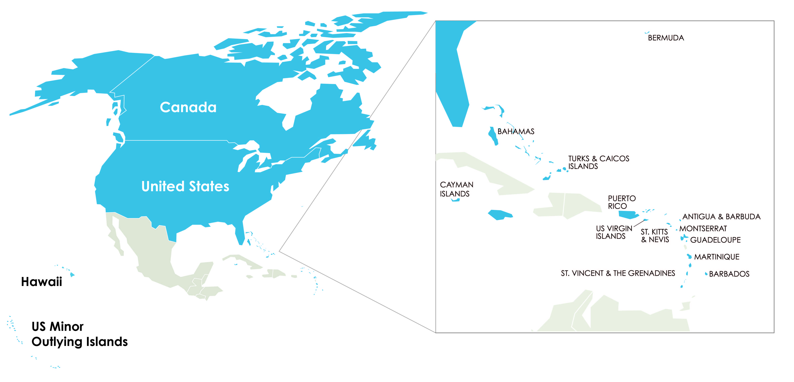
About ARIN
Established December 1997
100% community funded
ARIN’s region includes Canada, many Caribbean and North Atlantic islands, US Minor Outlying Islands and the United States.

Slide 11
ARIN’s Mission
Applying the principles of stewardship, ARIN, a nonprofit corporation:
  allocates Internet Protocol resources;
  develops consensus-based policies; and
  facilitates the advancement of the Internet through information and educational outreach.

Slide 12
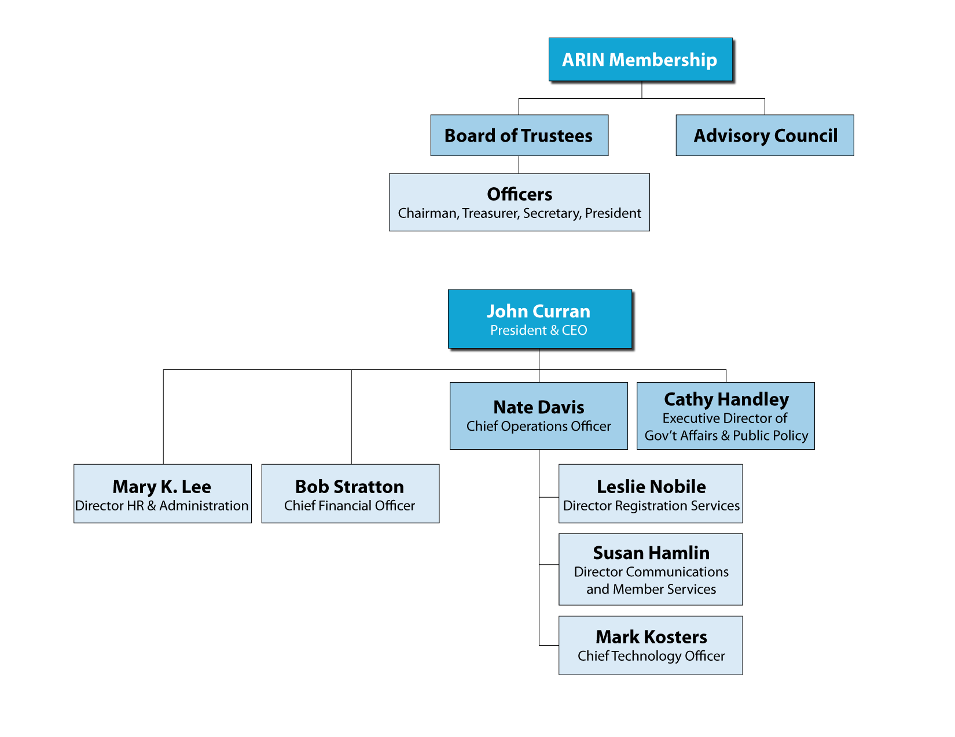
Organizational Chart

Slide 13
Registration Services
Coordination & management of Internet number resources
Internet number resource transfers
Directory Services
Registration transaction information (Whois)
Record maintenance
Routing information (Internet Routing Registry)

Slide 14

Technical Services
ARIN Whois/RWhois
ARIN Online
Internet Routing Registry
Reverse DNS Services
IT support for organization
Emerging Technologies: DNSSEC, RPKI

Slide 15
Organization Services
Public Policy & Members Meetings
Information publication and dissemination
Executive Board Elections
Education & Outreach

Slide 16
Policy Development Services
Manage the Policy Development Process
Maintain email discussion lists
Publish policy documents

Slide 17
What’s Ahead this week
Tonight:
ARIN Online Users Forum, 6-7 PM Millennium Ballroom
Pie in the Sky Social, 7 – 9 PM, 33rd Floor
Wednesday:
NANOG/ARIN Joint Programming, 9:30 AM – 12:15 PM
ARIN Public Policy Meeting, 1:30 AM – 5:30 PM
ARIN Social at The Franklin Institute, 7:00 – 11:00 PM
Thursday: ARIN Public Policy Meeting, 9:00 AM - 5:30 PM
Friday: ARIN Members Meeting (open to all),9:00 AM – Noon

Slide 18
ARIN Policy Development Process and Draft Policy Preview
Einar Bohlin

Slide 19
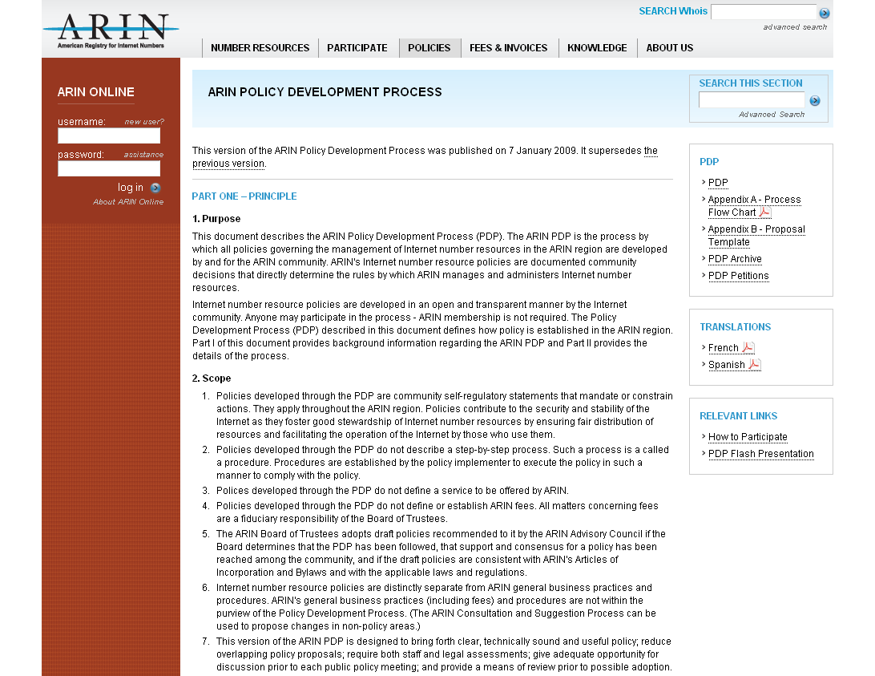
Policy Development Process (PDP)
Flowchart
Proposal Template
Archive
Movie
https://www.arin.net/policy/pdp.html

Slide 20
Policy Development Principles
Open
  Developed in open forum
    Public Policy Mailing List
    Public Policy Meetings
  Anyone can participate
Transparent
  All aspects documented and available on website
    Policy process, meetings, and policies
Bottom-up
  Policies developed by the community
  Staff implements, but does not make policy

Slide 21
Who Plays a Role in the
Policy Process?
Community
  Participate in discussions and petitions
  Submit proposals
Advisory Council (elected volunteers)
  Develop policy from proposals; goal is “clear, technically sound and useful” policy
  Determine consensus based on community input

Slide 22
Roles…
ARIN Board of Trustees (elected volunteers)
  Provide corporate fiduciary oversight
  Ensure the policy process has been followed
  Ratify policies
ARIN Staff
  Provide feedback to community/AC
    Clarity and Understanding Reports
    Staff and legal assessments
    Policy experience reports
  Implement ratified policies

Slide 23
Basic Steps
Community member submits a proposal
Community discusses the proposal on the “List”
AC creates a draft policy
Community discusses the draft policy on the “List” and at the meeting
AC conducts its consensus review
Community performs last call
Board adopts
Staff implements

Slide 24
Petitions
Anyone dissatisfied with a decision by the AC can petition in order to keep a proposal moving forward
  Occurs between proposal and draft policy stage
  5 day petition period
  Needs 10 different people from 10 different organizations to publicly support the petition
*8 petitions to date

Slide 25
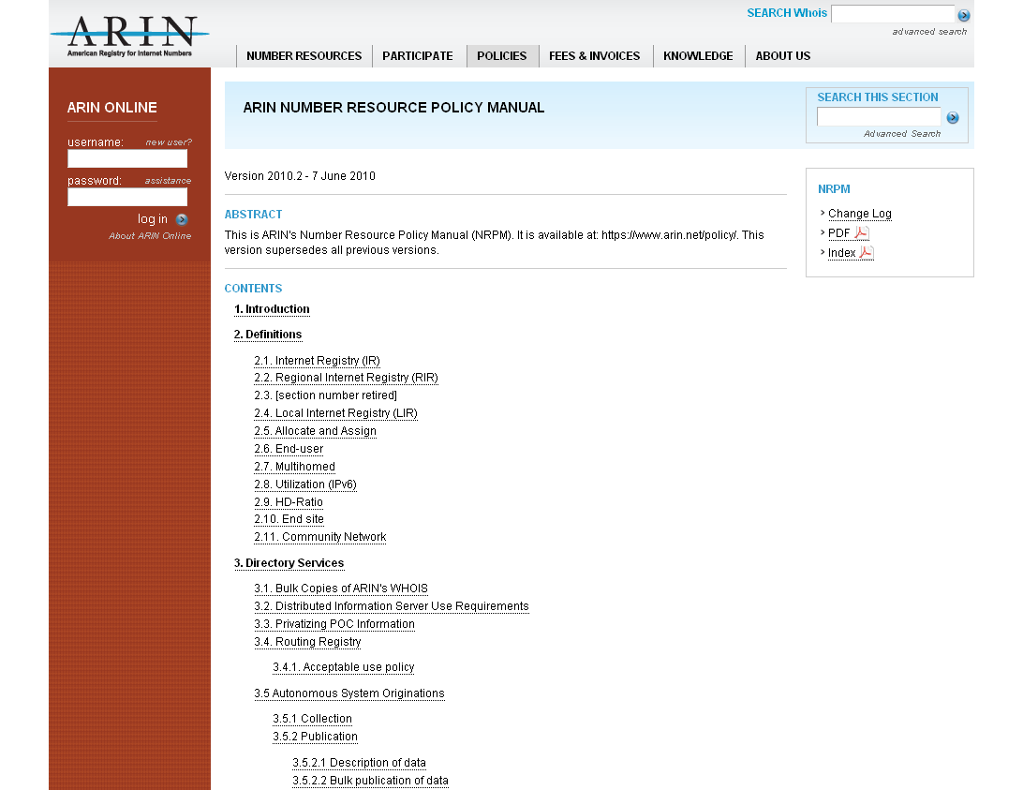
Number Resource Policy Manual
https://www.arin.net/policy/nrpm.html
NRPM is ARIN’s policy document
  Version 2011.4 (27 September 2011)
  24th version
Contains:
Change Logs
Available as PDF
Index

Slide 26
Policies in the NRPM
IPv4 Address Space
IPv6 Address Space
Autonomous System Numbers (ASNs)
Directory Services (WHOIS)
Reverse DNS (in-addr)
Transfers
Experimental Assignments
Resource Review Policy

Slide 27
Draft policies at this meeting:
ARIN-2011-1: ARIN Inter-RIR Transfers
ARIN-2011-7: Compliance Requirement
ARIN-2011-8: Combined M&A and Specified Transfers
ARIN-2011-9: Global Policy for Post Exhaustion IPv4 Allocation Mechanisms by the IANA
Notes:
Similar to 6to4

Slide 28
Draft policies at this meeting:
ARIN-2011-10: Remove Single Aggregate Requirement from Specified Transfer
ARIN-2011-11: Clarify Justified Need for Transfers
ARIN-2011-12: Set Transfer Need to 24 months
ARIN-2011-13: IPv4 Number Resources for Use Within Region
Notes:
Similar to 6to4

Slide 29
How to monitor and not be overwhelmed?
Once a month:
Front page of the website leads to proposals and draft policies under discussion
  New proposals need feedback for the AC’s initial decision
  Web site can help you focus on what’s important to you and your company
Twice per year:
Check the ARIN Public Policy Meeting site in the weeks leading up to the meeting
  Proposals/Draft Policies on Agenda
  Discussion Guide (summaries, text, staff assessments)
  Attend in Person/Remote
AC meeting last day: Watch list for AC’s decisions, Last Calls –
State your opinion, are you For or Against?

Slide 30
References
Policy Development Process
https://www.arin.net/policy/pdp.html
Draft Policies and Proposals
https://www.arin.net/policy/proposals/index.html
Number Resource Policy Manual
https://www.arin.net/policy/nrpm.html

Slide 31
Questions?

Slide 32
Don’t Forget Your Survey
Please complete the survey form and drop it in the bowl.
Tomorrow morning at the start of the meeting there will be a drawing for a $100 Think Geek gift certificate.

