Slide 1
ARIN Advisory Council
John Sweeting

Slide 2
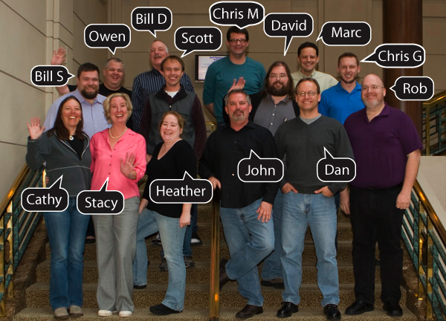
The Advisory Council
15 elected members, 3 year terms

Slide 3
15 elected members
3 year terms

Slide 4
2011 Advisory Council Election
AC members serve 3 year terms, with 5 members up for reelection each year
Terms ending December 31, 2011:
Dan Alexander
Marc Crandall
Bill Darte
David Farmer
John Sweeting
10 nominated individuals for 5 positions

Slide 5
AC Role in the PDP
Evaluate policy proposals.
Develop draft policy.
Present draft policy at Public Policy Meetings.
Determine that draft policy meets community needs and requirements.
Recommend draft policy which meets requirements to the Board of Trustees for adoption.

Slide 6
Advisory Council 2011
33 New Proposals (16 in 2010)
4 Pending
16 Abandoned
2 Unsuccessful Petitions
13 moved to Draft Policies
4 recommended for adoption
1 abandoned
8 Pending at this meeting

Slide 7
Advisory Council 2011
Meetings
2 ARIN meetings - All
3 NANOG meetings – Chris M, Stacy, All
2 RIPE – Dan, Bill S.
2 APNIC – John, David
1 LACNIC – Heather, Chris G.
2 AFRINIC – Marc, Rob
8 Outreach Events

Slide 8
Advisory Council 2011
Fellowship Program
Participate on selection committee
Mentor selected Fellows during meetings
Outreach Program
Participate in ARIN booth
Focus on IPv4 depletion & IPv6 education
Promote ARIN Meetings
Nomination Committee
PDP Committee
Other programs as requested

Slide 9
Thank you!
Please Remember to VOTE!

