Slide 1
ARIN Advisory Council
ARIN XXVII
April 10-13, 2011
San Juan, PR

Slide 2
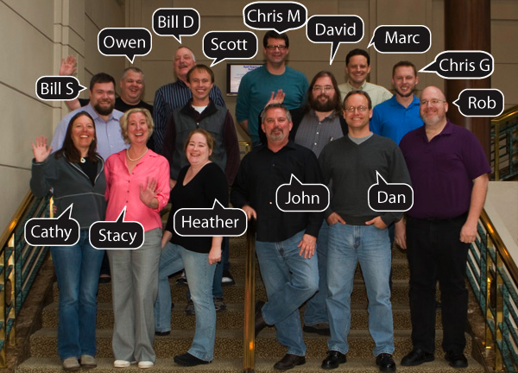
The Advisory Council
15 elected members, 3 year terms

Slide 3
AC Role in the PDP
Evaluate policy proposals.
Develop sound draft policy.
Present draft policy at Public Policy Meetings.
Determine that draft policy meets community needs and requirements.
Recommend draft policy which meets requirements to the Board of Trustees for adoption.

Slide 4
2010 in Review
Meetings
Attended 2 ARIN meetings
3 NANOG and 8 other RIR meetings
Volunteered at 23 outreach events
3 IETF meetings
12 AC meetings: 3 in person, 9 conference calls
Proposal and Draft Policy Activity
Recommended adoption of 6 draft policies
Abandoned 8 proposals & 6 draft policies

Slide 5
Advisory Council 2011
14 Proposals
3 accepted on docket
8 abandoned
3 pending
Status
2 Draft Policies
1 being developed

Slide 6
Advisory Council 2011
Meetings
2 ARIN meetings- All
3 NANOG meetings –Stacy, Chris M., All
2 RIPE – Bill S, Dan
2 APNIC – John, David
2 LACNIC – Heather, Bill D.
2 AfriNIC – Marc, Rob
11 Outreach Events

Slide 7
Advisory Council 2011
Fellowship Program
Participate on selection committee
Mentor selected Fellows during meetings
Outreach Program
Participate in booth
Focus on IPv4 depletion & IPv6 education
Promote ARIN Meetings
Nomination Committee
PDP Committee
Other programs as requested

Slide 8
Thank you

