Slide 1
FSD Update
Bob Stratton

Slide 2
Overview
Staff
Finishing up Financial Audit
Beginning to Work in ARIN OnLine
Monitoring Accounts
Supporting Board Committees
In House Legal Work

Slide 3
Staff
Tammy Rowe – Accounting Supervisor - AR
Amaris Wang
Tanya Gomez
Amy Sanchez
Maria Choinere
Val Winkelman – Staff Accountant
Michael Abejuela – Staff Attorney

Slide 4
Financial Audit
Draft Completed
Review underway by Audit Committee
Beginning to work on 990 filing
Implementing some Audit Suggestions for Improving Controls

Slide 5
FSD Beginning to work in ARIN Online
Interaction with Customer related to initial requests that have been approved by Registration
Approval message being sent from FSD staff with instructions
RSA
Payment requirements
Existing clients are being acknowledged by providing an invoice with the approval message
FSD and RSD seamless interaction

Slide 6
Monitoring Accounts
Bank Accounts
Credit Cards
Operating and Payroll Accounts
Lockbox
Reserve Investments
Market Returns reflected in results for 2010

Slide 7
Support of Board Committees
Finance Committee Work presented by Treasurer
Audit Committee work under way
Continue to fund Green Initiative of Carbon Offsets

Slide 8
In House Legal Work
Michael Abejuela
Coordinating Work with General Counsel
RSA and LRSA negotiator
Contracts Review
Insurance Liaison
Internal Process Review

Slide 9
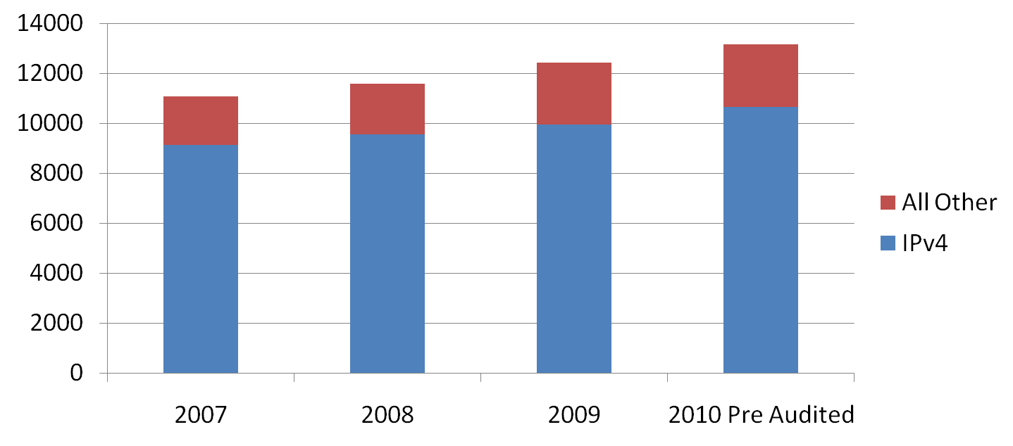
ARIN Registration Revenue

Slide 10
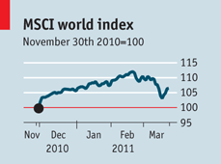
World Economic Growth Economist Magazine – March 24th, 2011

Slide 11
Questions?

