Slide 1
Registration Services Update
Leslie Nobile

Slide 2
RSD Team
Principal Resource Analyst
Cathy Clements
Technical Specialist
David Huberman
Senior Resource Analyst
Jon Worley
Resource Analysts
Doreen Marraffa
Sue Dobert
Mike Pappano
Lisa Liedel
Chad Eastman

Slide 3
Current Focus
IPv4 Depletion & IPv6 Uptake
Developing, adapting, and improving processes and procedures
Working hard to keep pace with increased v6 requests and more complex v4 and transfer requests
Implementation of New Policies and Services
Fraud and non-compliance work, resource reclamation where appropriate
ARIN on-line
Learning new features, working on bugs, enhancements and new requirements

Slide 4
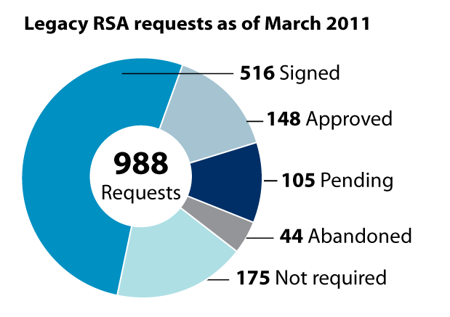
Legacy RSA Status
Total Resources and Organizations covered under Legacy RSA:
ASNs 177
IPv4 Blocks 1,441 totaling 8.17 /8 equivalents
OrgIDs 516

Slide 5
Recovered Resources Jan 1, 2005 – Mar 31, 2011
 | /16 equivalents | ASNs
*Returned | 455.84 | 1,517
*Revoked | 122.20 | 4,635
*Reclaimed | 7.06 | 15
*Returned = Voluntarily by registrant
*Revoked = For non-payment
*Reclaimed = For fraud, misappropriation, or business dissolution

Slide 6
Current IPv4 Inventory (as of 31 Mar 2011)
5.16 /8 equivalents in the pool of “available addresses”
9.22 /16 equivalents in the “returned bucket”
(voluntarily returned)
1.80 /16 equivalents in the “revoked bucket”
(revoked due to non-payment of fees)
262.08 /16 equivalents in the “held bucket” (de-registered from Whois, but still routed)
254 /16s are Interop, the remaining 8.08 /16s are held (because still routed)

Slide 7
IPv4 Depletion and IPv6 Uptake

Slide 8
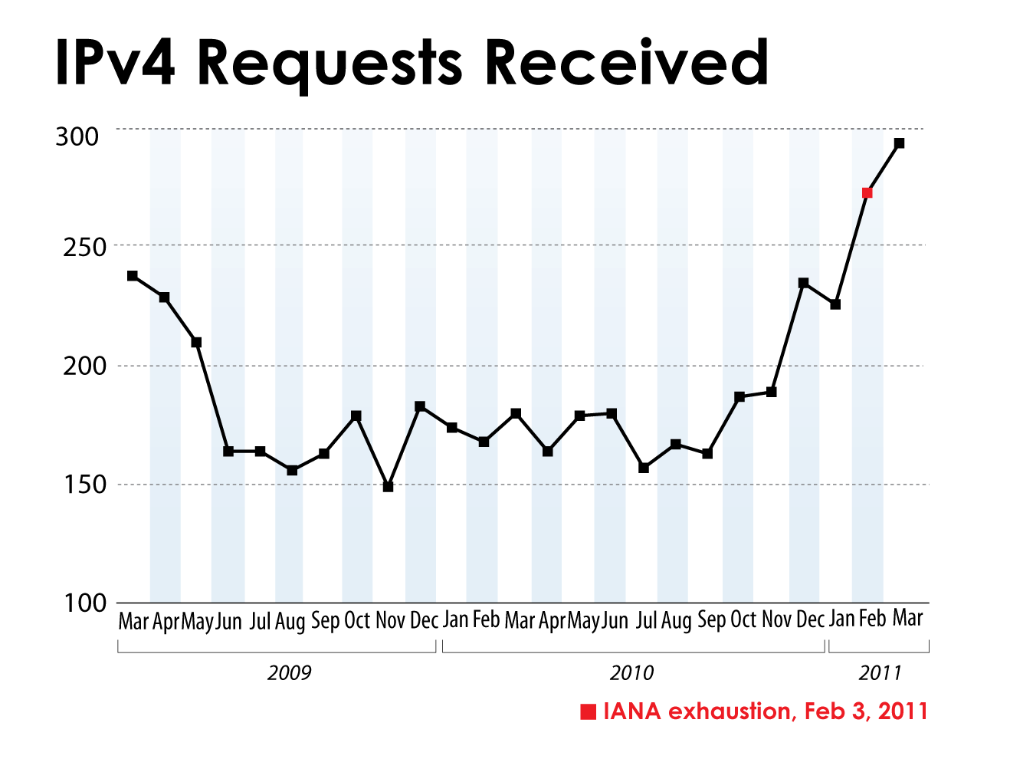

Slide 9
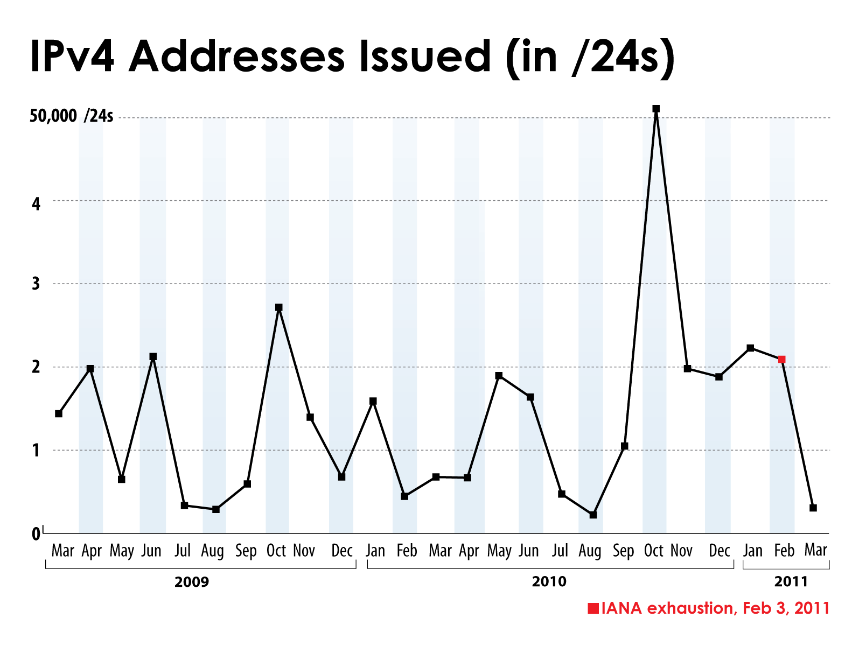

Slide 10
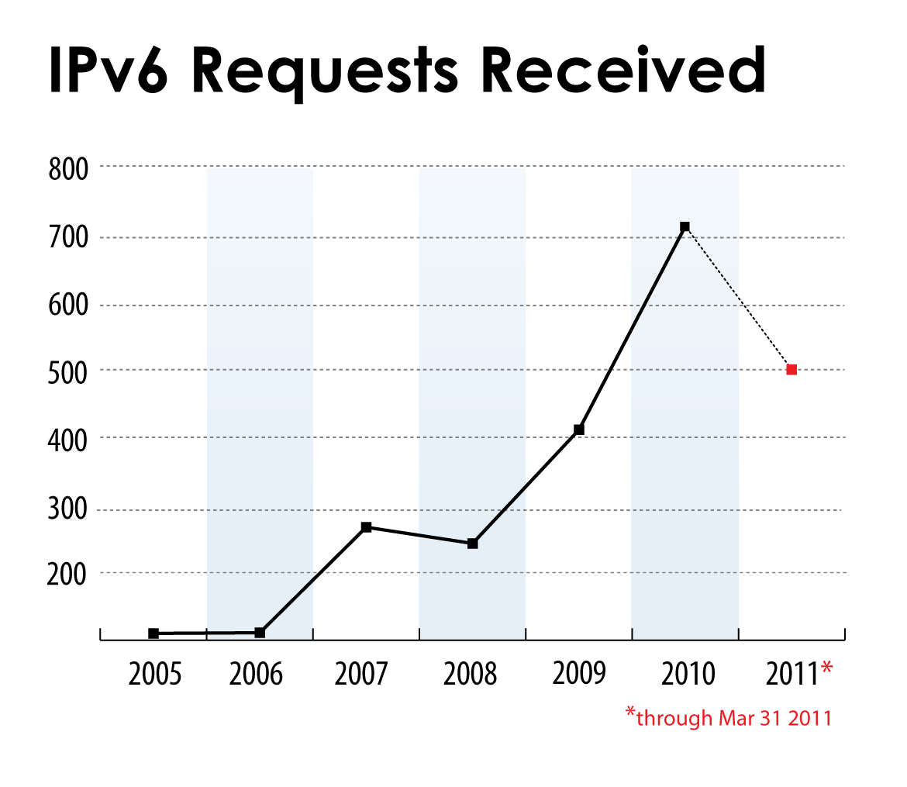

Slide 11
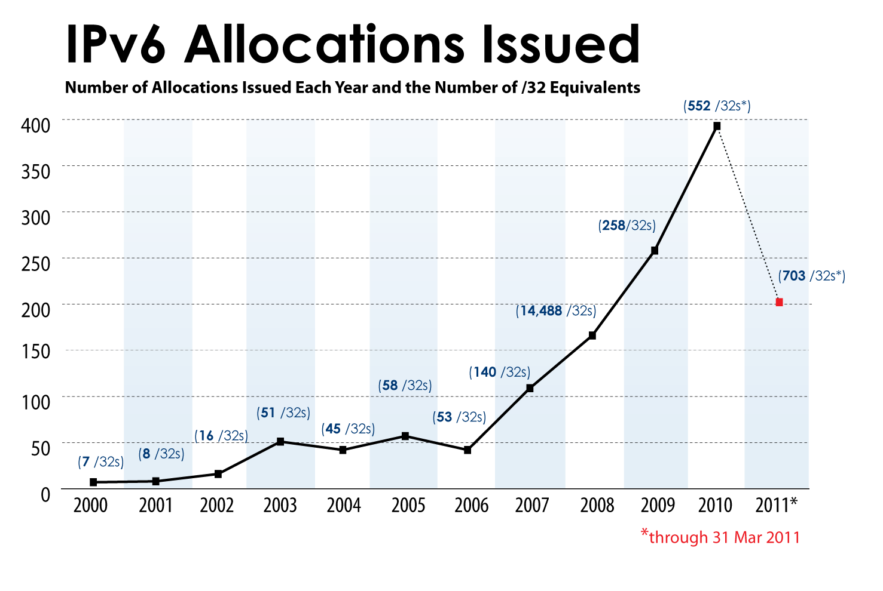

Slide 12
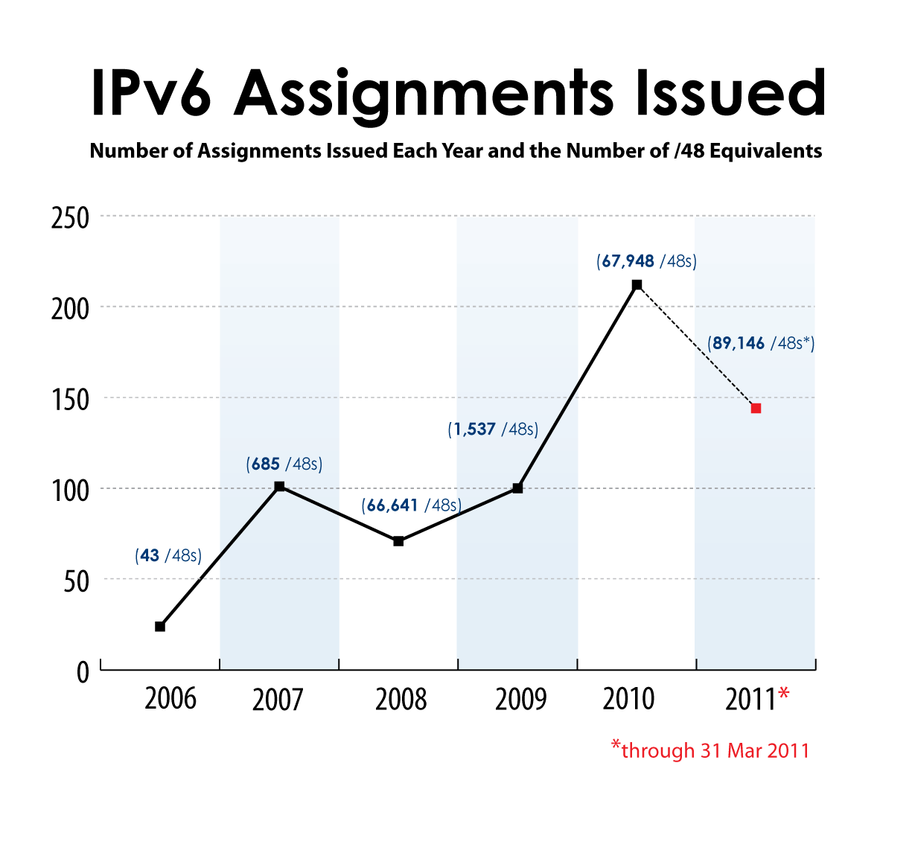

Slide 13
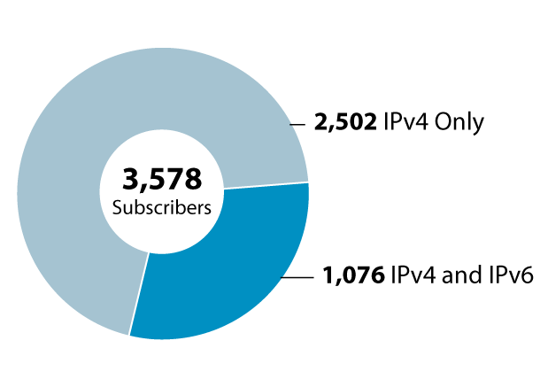
IPv4 vs IPv6 Subscribers
3,578 IPv4 ISP subscribers today
2,502 (70%) do not have IPv6 allocations

