Slide 1
Communications and Member Services
Susan Hamlin, Director

Slide 2
ARIN Members

Slide 3
CMSD Projects & Activities
PROJECTS:
ARIN XXVII video interviews
Content Management System
2011 NRO and ASO Secretariat
ACTIVITIES:
Public Policy and Members Meetings, Fellowship Program, ARIN on the Road
www.arin.net - content and design to educate and inform
Outreach Events - scheduling and booth logistics
New education materials - info sheets, multi-media, graphic design

Slide 4
CMSD Projects & Activities
ACTIVITIES:
Social media support – Team ARIN, Twitter, Facebook, LinkedIn, blogging, speakers bureau
Public Relations – media queries, interviews
Advisory Council support
The Policy Development Process
Facilitate the ARIN Consultation and Suggestion Process
info@arin.net in queries
Membership database, new member communications
DMRs and Elections (Board, Advisory Council, NRO NC)

Slide 5
Multi-media New Releases
Using ARIN Online for Delegation Management and DNSSEC
https://www.arin.net/knowledge/dnssec/
Deploying IPv6
https://www.arin.net/knowledge/
deploying_ipv6/index.html

Slide 6
Multi-media New Releases
2010 Annual Report
https://www.arin.net/
about_us/corp_docs/annual_rprt.html
ARIN XXVII Draft Policies
http://teamarin.net/2011/04/04/
podcast-arin-xxvii/

Slide 7
Video Project

Slide 8
ARIN Consultation and Suggestion Process
Open for business September 2006
As of 31 March 2011
14 community consultations
all closed
https://www.arin.net/participate/acsp/acsp_consultations.html
127 suggestions
16 remain open
https://www.arin.net/participate/acsp/acsp_suggestions.html

Slide 9
ARIN Outreach
ARIN:
Staff participates in technical meetings each year, including ICANN, IETF, NANOG, APRICOT, INET
Gives presentations, onsite, to ISP trade associations
Gives press interviews on IP related issues
Attends RIPE and APNIC meetings
Hosts working groups and mailing lists
Is an ASO member and participant

Slide 10
Outreach & Public Relations
Why we do this:
Raise awareness of ARIN and key messages
Provide education
Contact varied stakeholders beyond traditional ARIN community

Slide 11
Messages
ARIN and the RIRs
PDP and participation
IPv4 depletion and IPv6 adoption
Other targeted messages as needed
Legacy RSA
4-byte AS Numbers

Slide 12
Audiences
Providers
ISPs
Content providers
Application service providers
Equipment and software vendors
Enterprise companies
Education and research organizations
Governments (State and Federal)
Media / Press / Social media

Slide 13
Methods & Materials
Presentations – slide decks
Exhibits (direct and reverse)- fact and information sheets, giveaways, CDs
Media interviews
Advertisements / Contributed articles
Event attendance and participation
Microphone time
Hallway outreach

Slide 14
Exhibit and Speaking Events
Recent Events
Game Developers Conference
Texas IPv6 Task Force Summit
Interop
IT Roadmap
gogoNET Live!
LISA
ICT Roadshow Events
SC’10
Real Web Con
CES
Satellite 2011
Enterprise Connect
Upcoming Events
Internet2
Ottawa IPv6 Summit
Rocky Mountain IPv6
IT Roadmap
Interop
CANTO
FOSE
Open Source Convention
HostingCon

Slide 15
Public Relations
Working with LEWIS Public Relations since July 2009
PR strategy and planning
Social media strategy and tactics
Securing:
Media interviews
Speaking engagements

Slide 16
Upcoming Media Outreach
ARIN Runs Out of IPv4
Specified Transfers (NRPM 8.3)
IPv6 adoption awareness
Open Internet governance process participation

Slide 17
Social Media at ARIN
Promoting presence at exhibit and speaking events, advertising upcoming ARIN events, sharing industry and ARIN news, etc.
Interact with ARIN members, Internet technical community, and others interested in ARIN activities

Slide 18
ARIN Is Social
Facebook - Apr 2011: 1,214 fans
www.facebook.com/TeamARIN
Twitter - Apr 2011: 1,704 followers
www.twitter.com/TeamARIN
LinkedIn -
Group ID 834217
YouTube - www.youtube.com/TeamARIN
Notes:
Twitter
Oct 2010: 833 followers
Apr 2011: 1,704 followers
Facebook
Oct 2010: 779 fans
Apr 2011: 1,214 fans

Slide 19
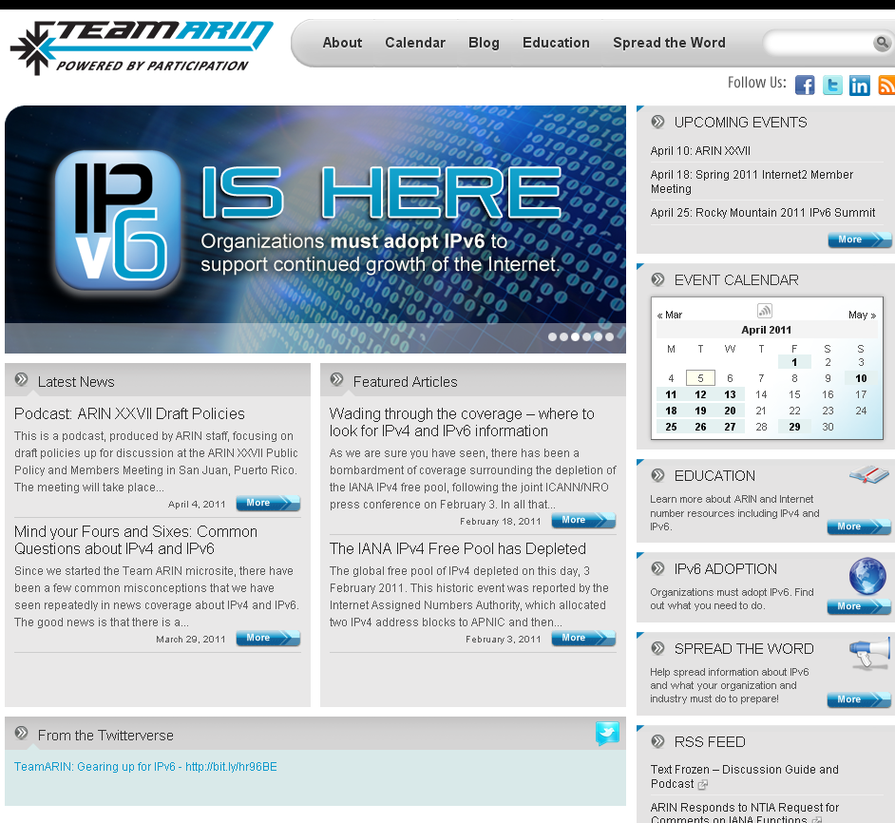
The TeamARIN Microsite
http://TeamARIN.net
Event Calendar
Education
Blogs
Social Media Interaction

Slide 20
Upcoming ARIN Meetings
Network Sponsor
Network Sponsor

Slide 21
Get your camera ready!
Snap a photo of:
What you hope will be IPv6 enabled in the next 5 in the next 5 years
The most unusual place to see IPv6
Contest begins May 2, 2011
More information coming soon to www.TeamARIN.net

Slide 22
Communications & Member Services Staff
Susan Hamlin, Director
Einar Bohlin, Policy Analyst
Jason Byrne, Communications Strategist
De Harvey, Meeting Planner
Jud Lewis, Membership Coordinator
Hollis Kara, Communications Manager
Jennifer Bly, Outreach Coordinator
Sean Hopkins, Communications Writer
Erin Sellers, Graphic Designer

