Slide 1
Engineering Report
Mark Kosters, CTO

Slide 2
Engineering Theme
Continue to work on a surge
Lots of work to do
Supplementing staff with contractors

Slide 3
Staffing
Operations
8 people
Development
14 people (8 contractors)
Quality Assurance
7 people (3 contractors)
Requirements
1 person
Management
Me

Slide 4
Operations
Keeping up with Whois-RWS traffic
Upgrading end-of-life equipment
Installed a PFS-lite site in Canada
Looking to install a PFS-lite site in the Caribbean for Q4
Maintaining the various environments we have running (dev/qa/staging/testing)

Slide 5
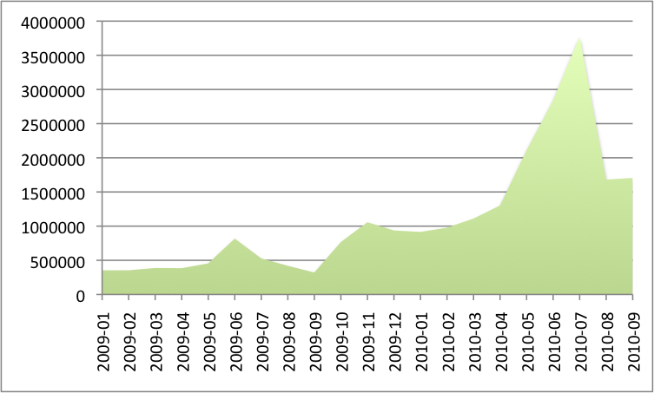
Whois-RWS Statistics – v6
Cumulative Per month

Slide 6
Whois/Whois-RWS Traffic Loads
Interesting traffic loads
Now versus 6 months ago
At ARIN XXV
50% of the queries are self-referential
192.168.2.5 asking for 192.168.2.5
Most are singleton queries
Was increasing over the last year
Started noticing decrease after ARIN XXV

Slide 7
Whois-RWS Statistics- Uptick

Slide 8
Whois-RWS Traffic Loads
In September
Saw a rise in traffic day after Google announced OpenID collaboration with Yahoo
Traffic spiked 300%
Top ten sites being login sites for various providers – Yahoo, AOL, and Facebook
Approximately 5600 queries per second doing the height of the day

Slide 9
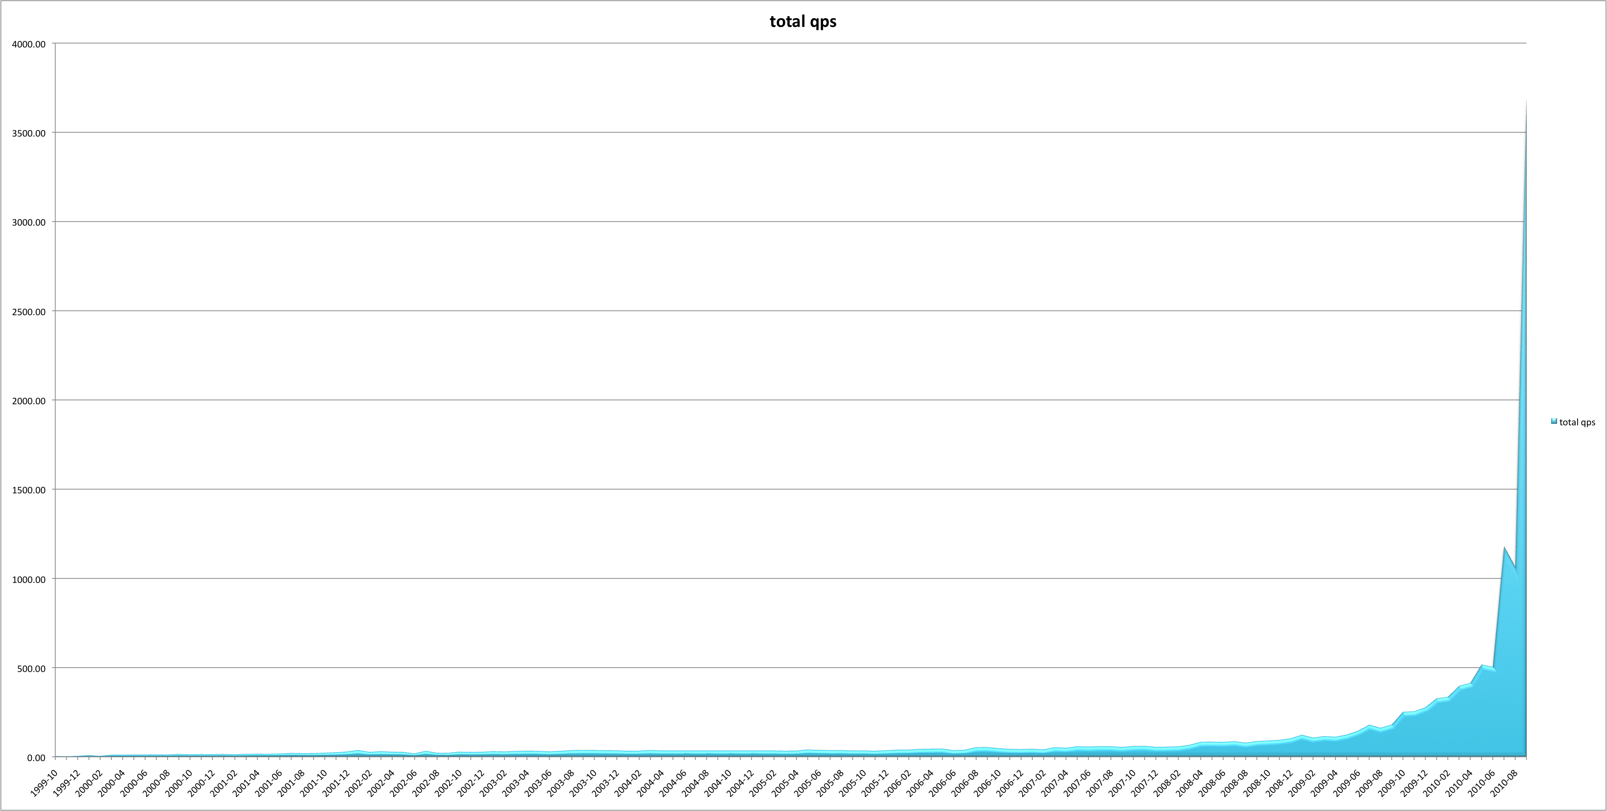
WHOIS Statistics
Whois Queries
Queries Per Second
Months

Slide 10
Development/QA
Improvements to existing systems
Whois-RWS Rollout
Four ARIN Online releases since ARIN XXV

Slide 11
ARIN Online Releases
Improved organization record handling
POC Validation - implementation of policy
Bulk Whois report download
RESTful web service for Whois data
API Key generation
Specified Transfer Listing Service

Slide 12
Changes are Coming!
Big structural changes are in the works
Because dual systems (serving both legacy and modern provisioning) would be expensive, confusing, and time-consuming
DNS Name server requests need to be done online – no more templates
API-Keys on templates

Slide 13
Upcoming ARIN Online Release
Next Public release will incorporate multiple critical features:
Improved provisioning
More secure templates using API Key
RESTful API
Zone Management
UI for name server management
DNSSEC Provisioning

Slide 14
Upcoming ARIN Online Release
RPKI Services
ARIN to sign (assert) directly assigned/allocated resources
Other related services such as storing signatures/assertions for downstreams under review
Board of Trustees, along with ARIN General Counsel, are evaluating risks associated with these services
ARIN seeking input from community regarding the these services

Slide 15
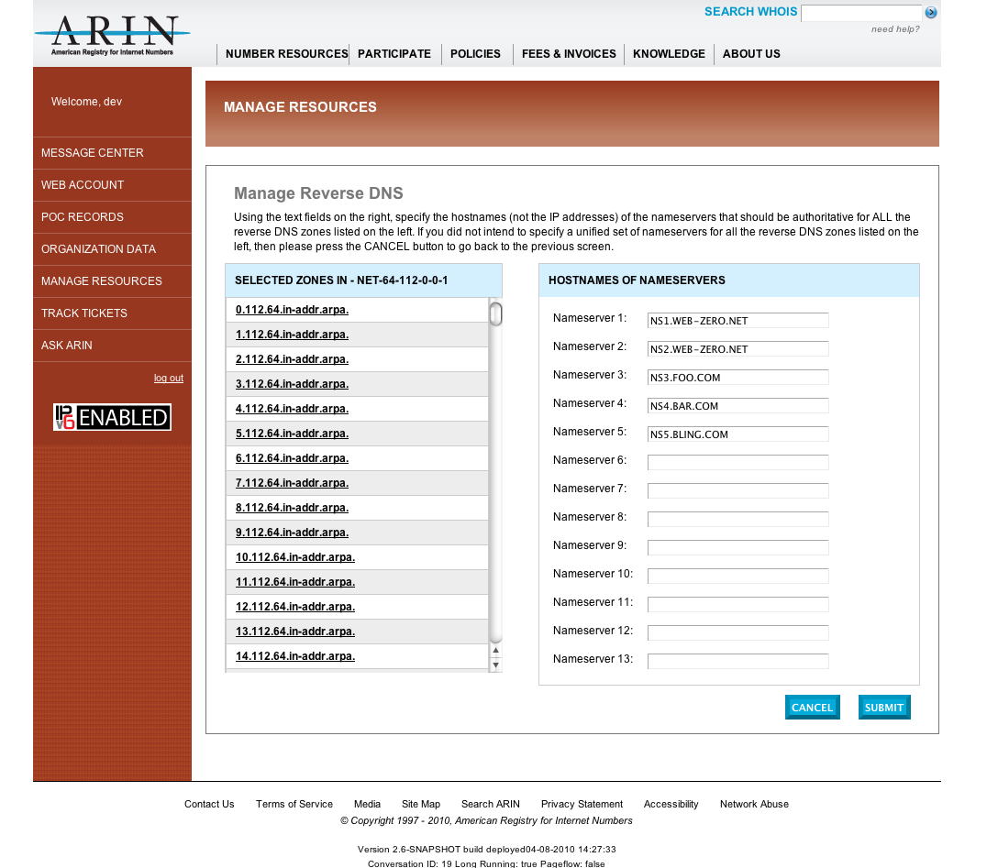
ARIN Online - Zone Management

Slide 16
Upcoming Challenges/Research
Large Release coming
RPKI moving from pilot to production
DNSSEC to be fully implemented
ARIN Online IPv4 and IPv6 resource management
RESTful provisioning
Finding out cause of Whois-RWS traffic growth
Improving the integration of IRR
Completing some outstanding member service requests (ie. whowas service, operational test and evaluation environment)
Replacement of legacy gear

Slide 17
Thank You for your Time and Attention Questions?

