Slide 1
Communications and Member Services
Susan Hamlin

Slide 2
Let’s Review:
Staff and department
Membership statistics
Resources and programs
What’s ahead

Slide 3
Communications & Member Services

Slide 4
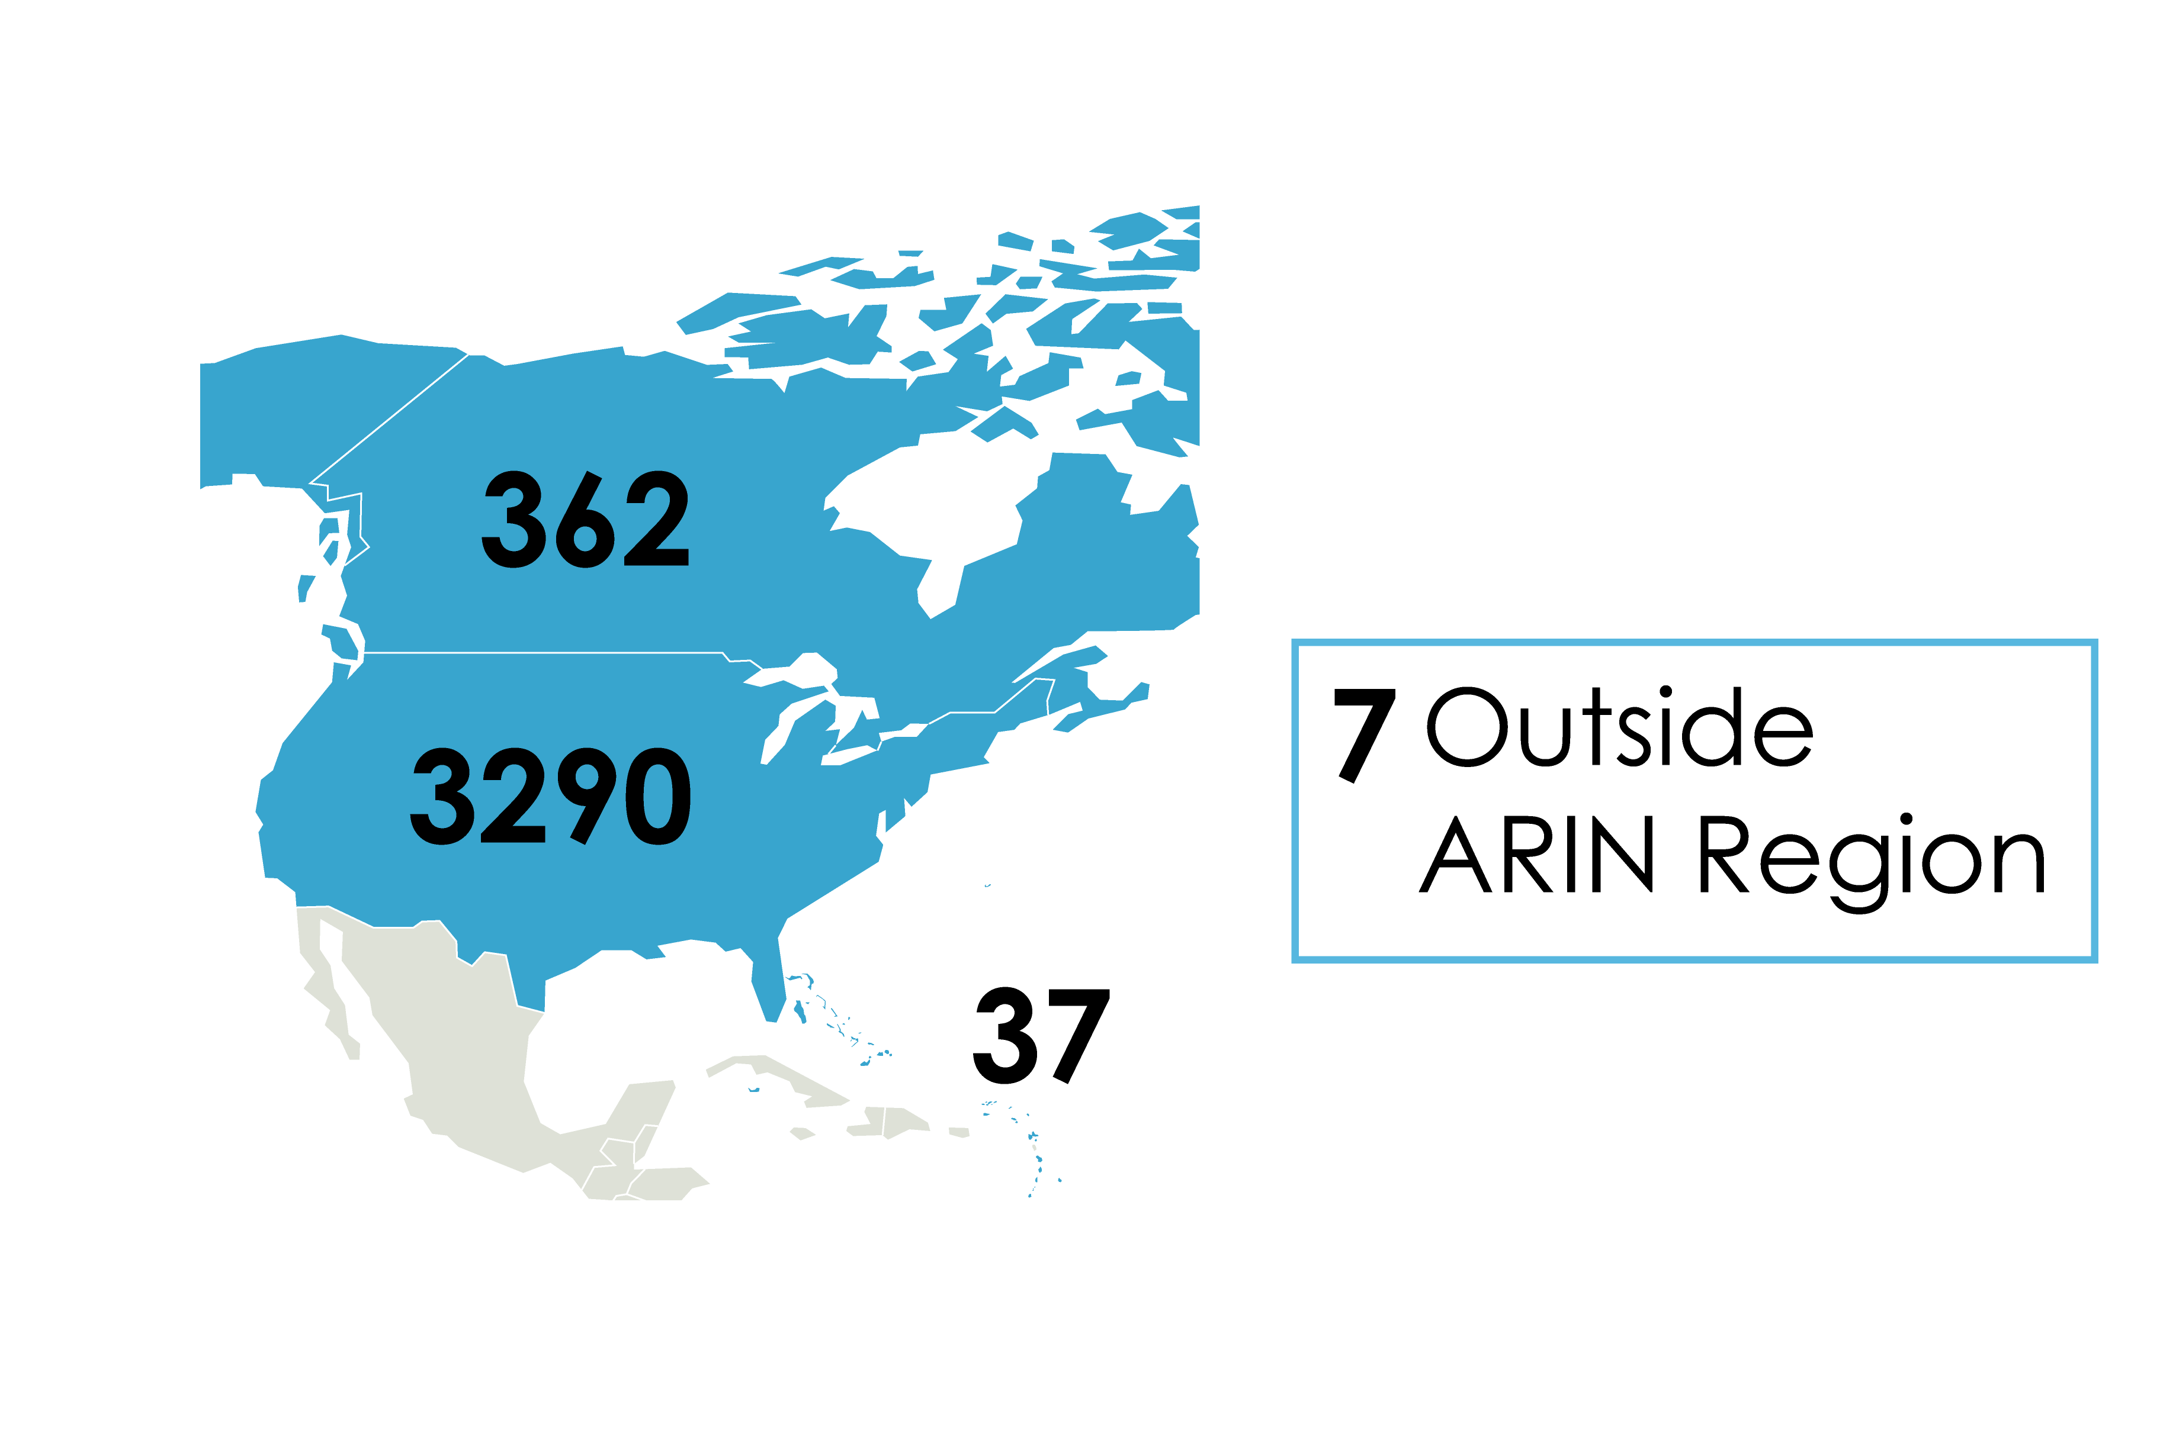
Membership Statistics
3696 General Members
09/30/10

Slide 5
2010 Election Process
Changes/Improvements
1 January cutoff for eligible voters
Nomination Committee Charter
Signatures for candidate petitions – Percentage lowered from 5 to 2 percent
NRO NC Election –NANOG and ARIN meeting registrants (by 21 September) extended to one week
New graphics at https://www.arin.net/app/election/
What’s ahead: Certified Letters to DMRs

Slide 6
ARIN on the Road
Phoenix -- 17 August 2010
Raleigh -- 19 August 2010
Covered:
-- The latest IPv6 adoption and IPv4 depletion information
-- ARIN policy development updates
-- Status of ARIN and the RIR system
-- ARIN Online features
Attendees were eligible to receive a registration fee waiver for either this meeting or ARIN XXVII in Puerto Rico
Notes:
Shout out to Jason and Jack who attended our Raleigh program and are attending this meeting remotely.

Slide 7
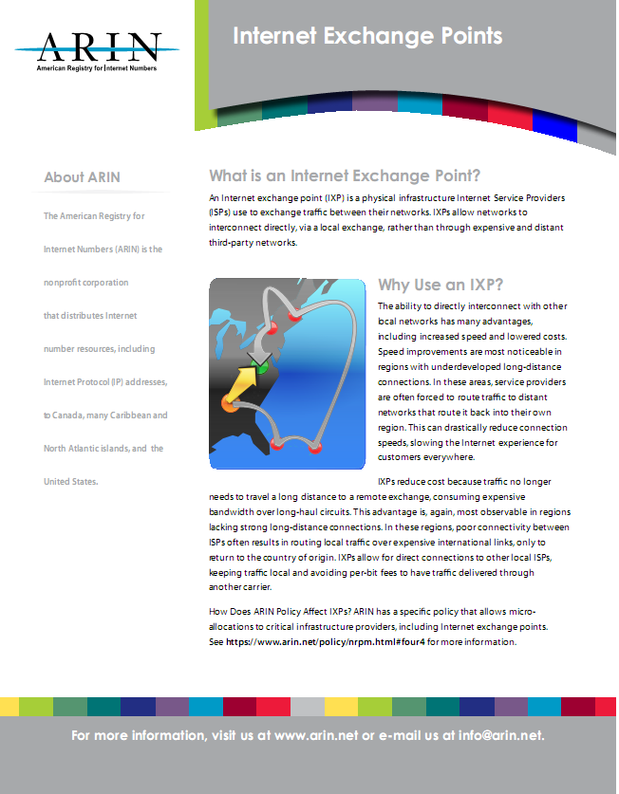
New Features
https://www.arin.net/knowledge/general.html

Slide 8
Coming Soon
“Deploying IPv6” – a flash presentation you can use in explaining the need to move to IPv6
Apply between:
11 Jan. & 25 Feb., 2011
for ARIN XXVII in San Juan, PR

Slide 9
Participate
Mailing list interaction
Meetings - in person and remotely
Spread the word – social media,IPv4-IPv6 slide deck, other knowledge tools
VOTE
Send feedback about any services to info@arin.net

Slide 10
Upcoming Meetings
Network Sponsor:
Sponsorships still available:
The ARIN Social or any part of it
A social of your own
A meal or break
Equipment in the Info Center
Contact info@arin.net

Slide 11
Thank You

