Slide 1
Leslie Nobile
Director, Registration Services

Slide 2
RSD Team
Principal Resource Analyst
Cathy Clements
Principal Technical Analyst
David Huberman
Senior Resource Analyst
Jon Worley
Resource Analysts
Doreen Marraffa
Sue Dobert
Mike Pappano
Lisa Liedel
Chad Eastman
Eddie Diego
Notes:
What do we do – issue v4, v6 and asns, handle all transfers, do all modifictions and updates, maintain the integrity of the database, run the irr, run a helpdesk,run services like stls, do outreach, act as smes to all departments, particularly cmsd and to john as he receives many external inquiries.

Slide 3
Current Focus
IPv4 Depletion Planning
8.3 Transfers
Resource Classification Project
Identifying which resources are covered under RSA
ARIN On-line
Continue work on enhancements, new requirements, and prioritization

Slide 4
Current IPv4 Inventory
4.87 /8 equivalents in the pool of “available addresses”
4.82 /16 equivalents in the “RRH” bucket
(RRH = returned, revoked, held)
1 /10 reserved
For NRPM 4.10 “Dedicated IPv4 block to facilitate IPv6 Deployment”

Slide 5
Recovered Resources
Year | IPv4 blocks (/16 equivalents) | ASNs
2007 | 101.2 (85% returns) | 1552 (12% returns)
2008 | 178.6 (87% returns) | 704 (28% returns)
2009 | 133.10 (86% returns) | 462 (40% returns)
2010 | 44.5 (49% returns) | 1446 (32% returns)
2011 | 284.4 (96% returns) | 365 (39% returns)

Slide 6
Resource Classification Project Stats
47,103 total network registration records in ARIN’s db
19,294 (41%) are covered under RSA
30,469 total ASN registration records in ARIN’s db
17,451(58%) are covered under RSA

Slide 7
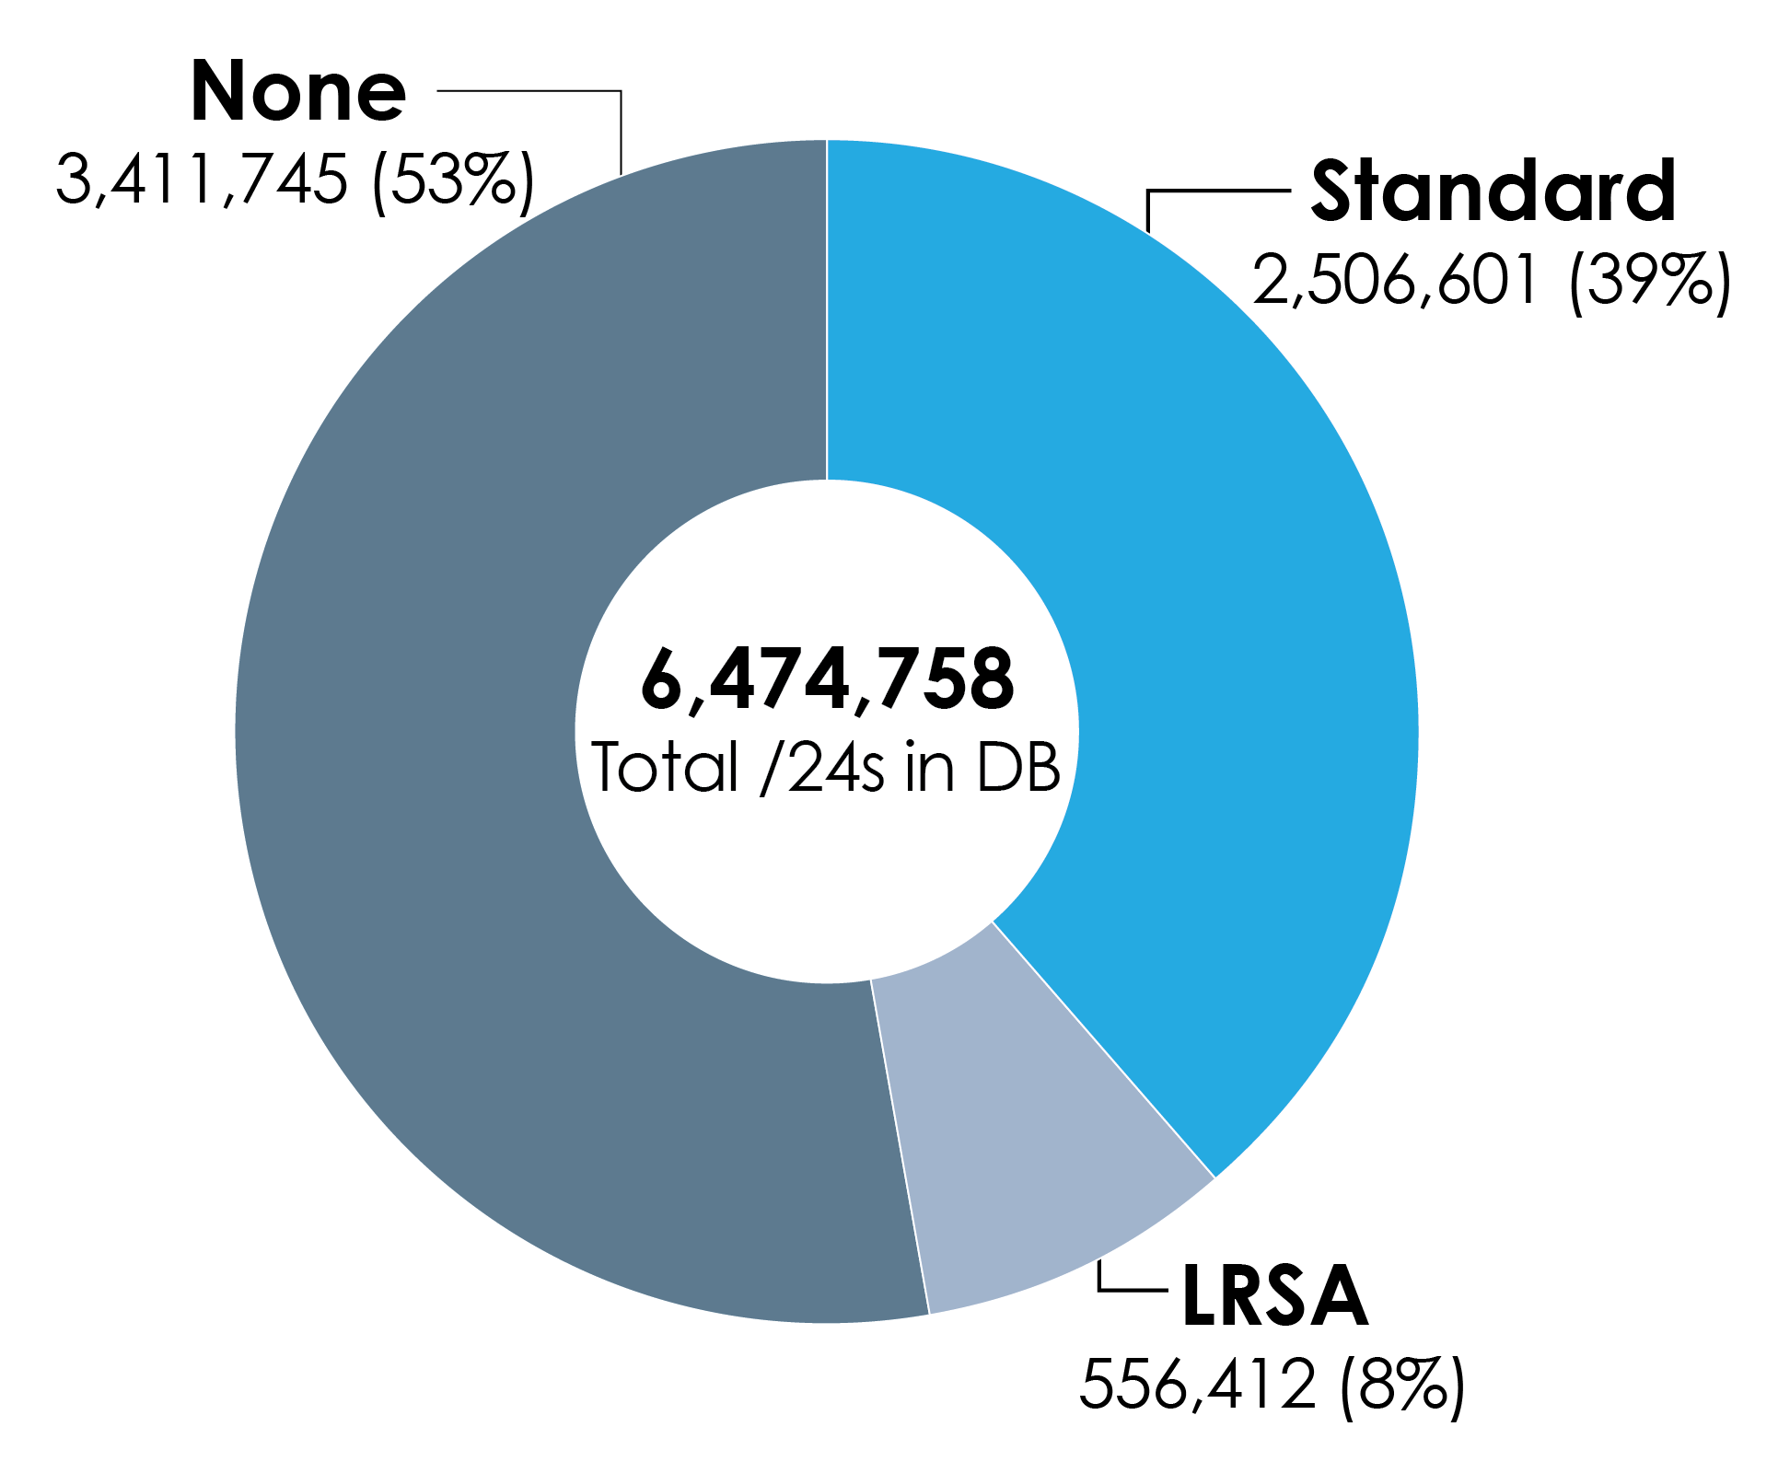
IPv4 RSA Coverage
/24s Covered Under RSA, LRSA, or no RSA

Slide 8
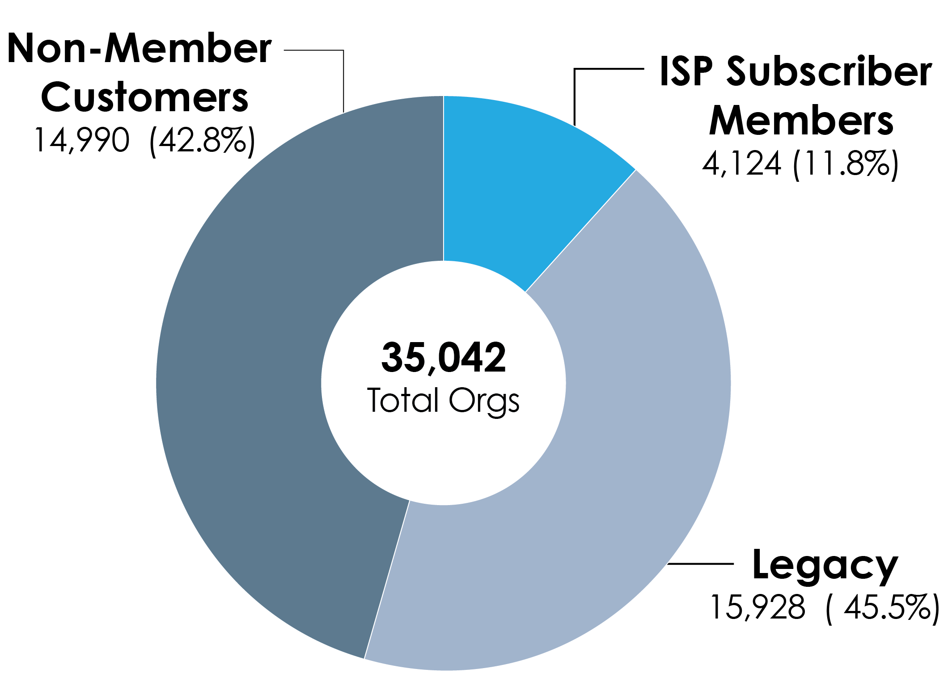
Total Organizations Served by ARIN

Slide 9
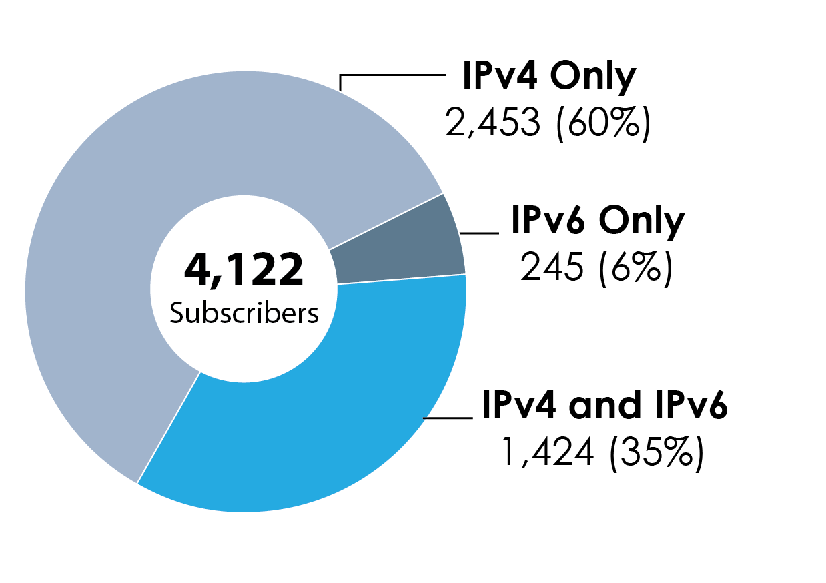
IPv4 vs IPv6 Subscribers

