Slide 1
Communications and Member Services
Susan Hamlin

Slide 2
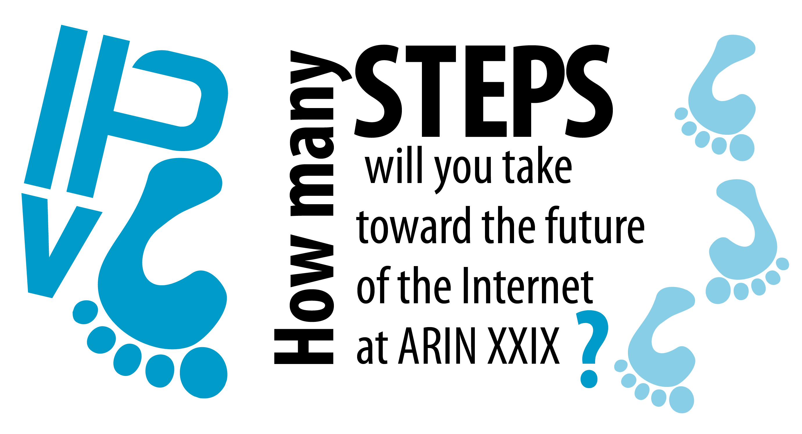

Slide 3
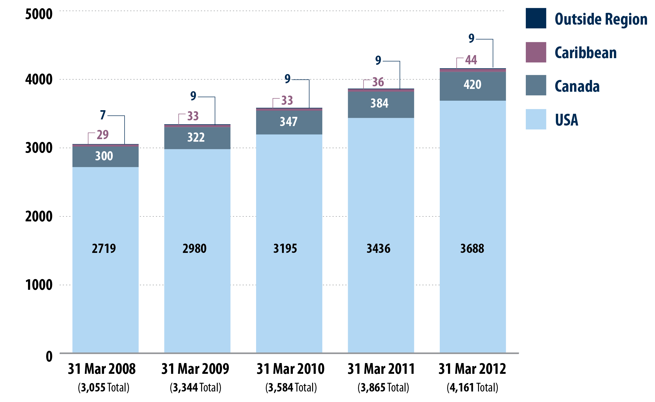
ARIN Members

Slide 4
CMSD Activities:
www.arin.net - content and design to educate and inform
Public Policy and Members Meetings, Fellowship Program,
ARIN on the Road
Outreach Events - scheduling and booth logistics
New education materials - info sheets, multi-media presentations
Social media support – Team ARIN, Twitter, Facebook, LinkedIn, blogging, speakers bureau
Public Relations – media queries, interviews
Advisory Council support
Facilitate the Policy Development Process
Facilitate the ARIN Consultation and Suggestion Process
info@arin.net queries
Membership database, new member communications
Facilitate elections

Slide 5




CMSD Projects:
Voter turnout in 2011 – highest ever!
15% of eligible voters cast a ballot
in the Board and/or AC election.

Slide 6
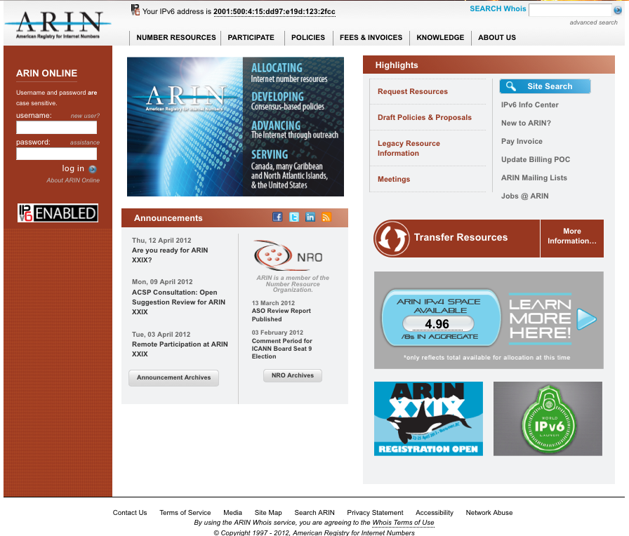
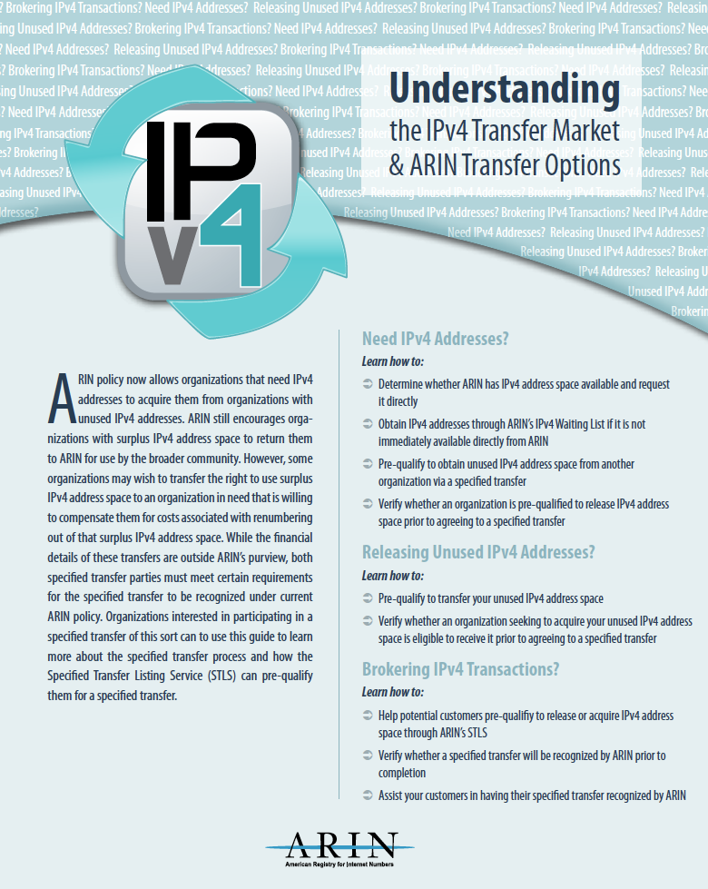
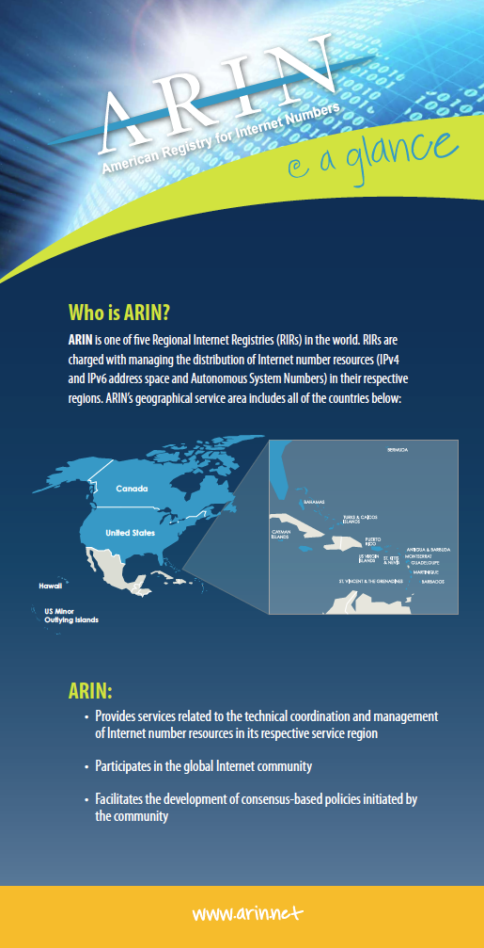
CMSD Projects:

Slide 7


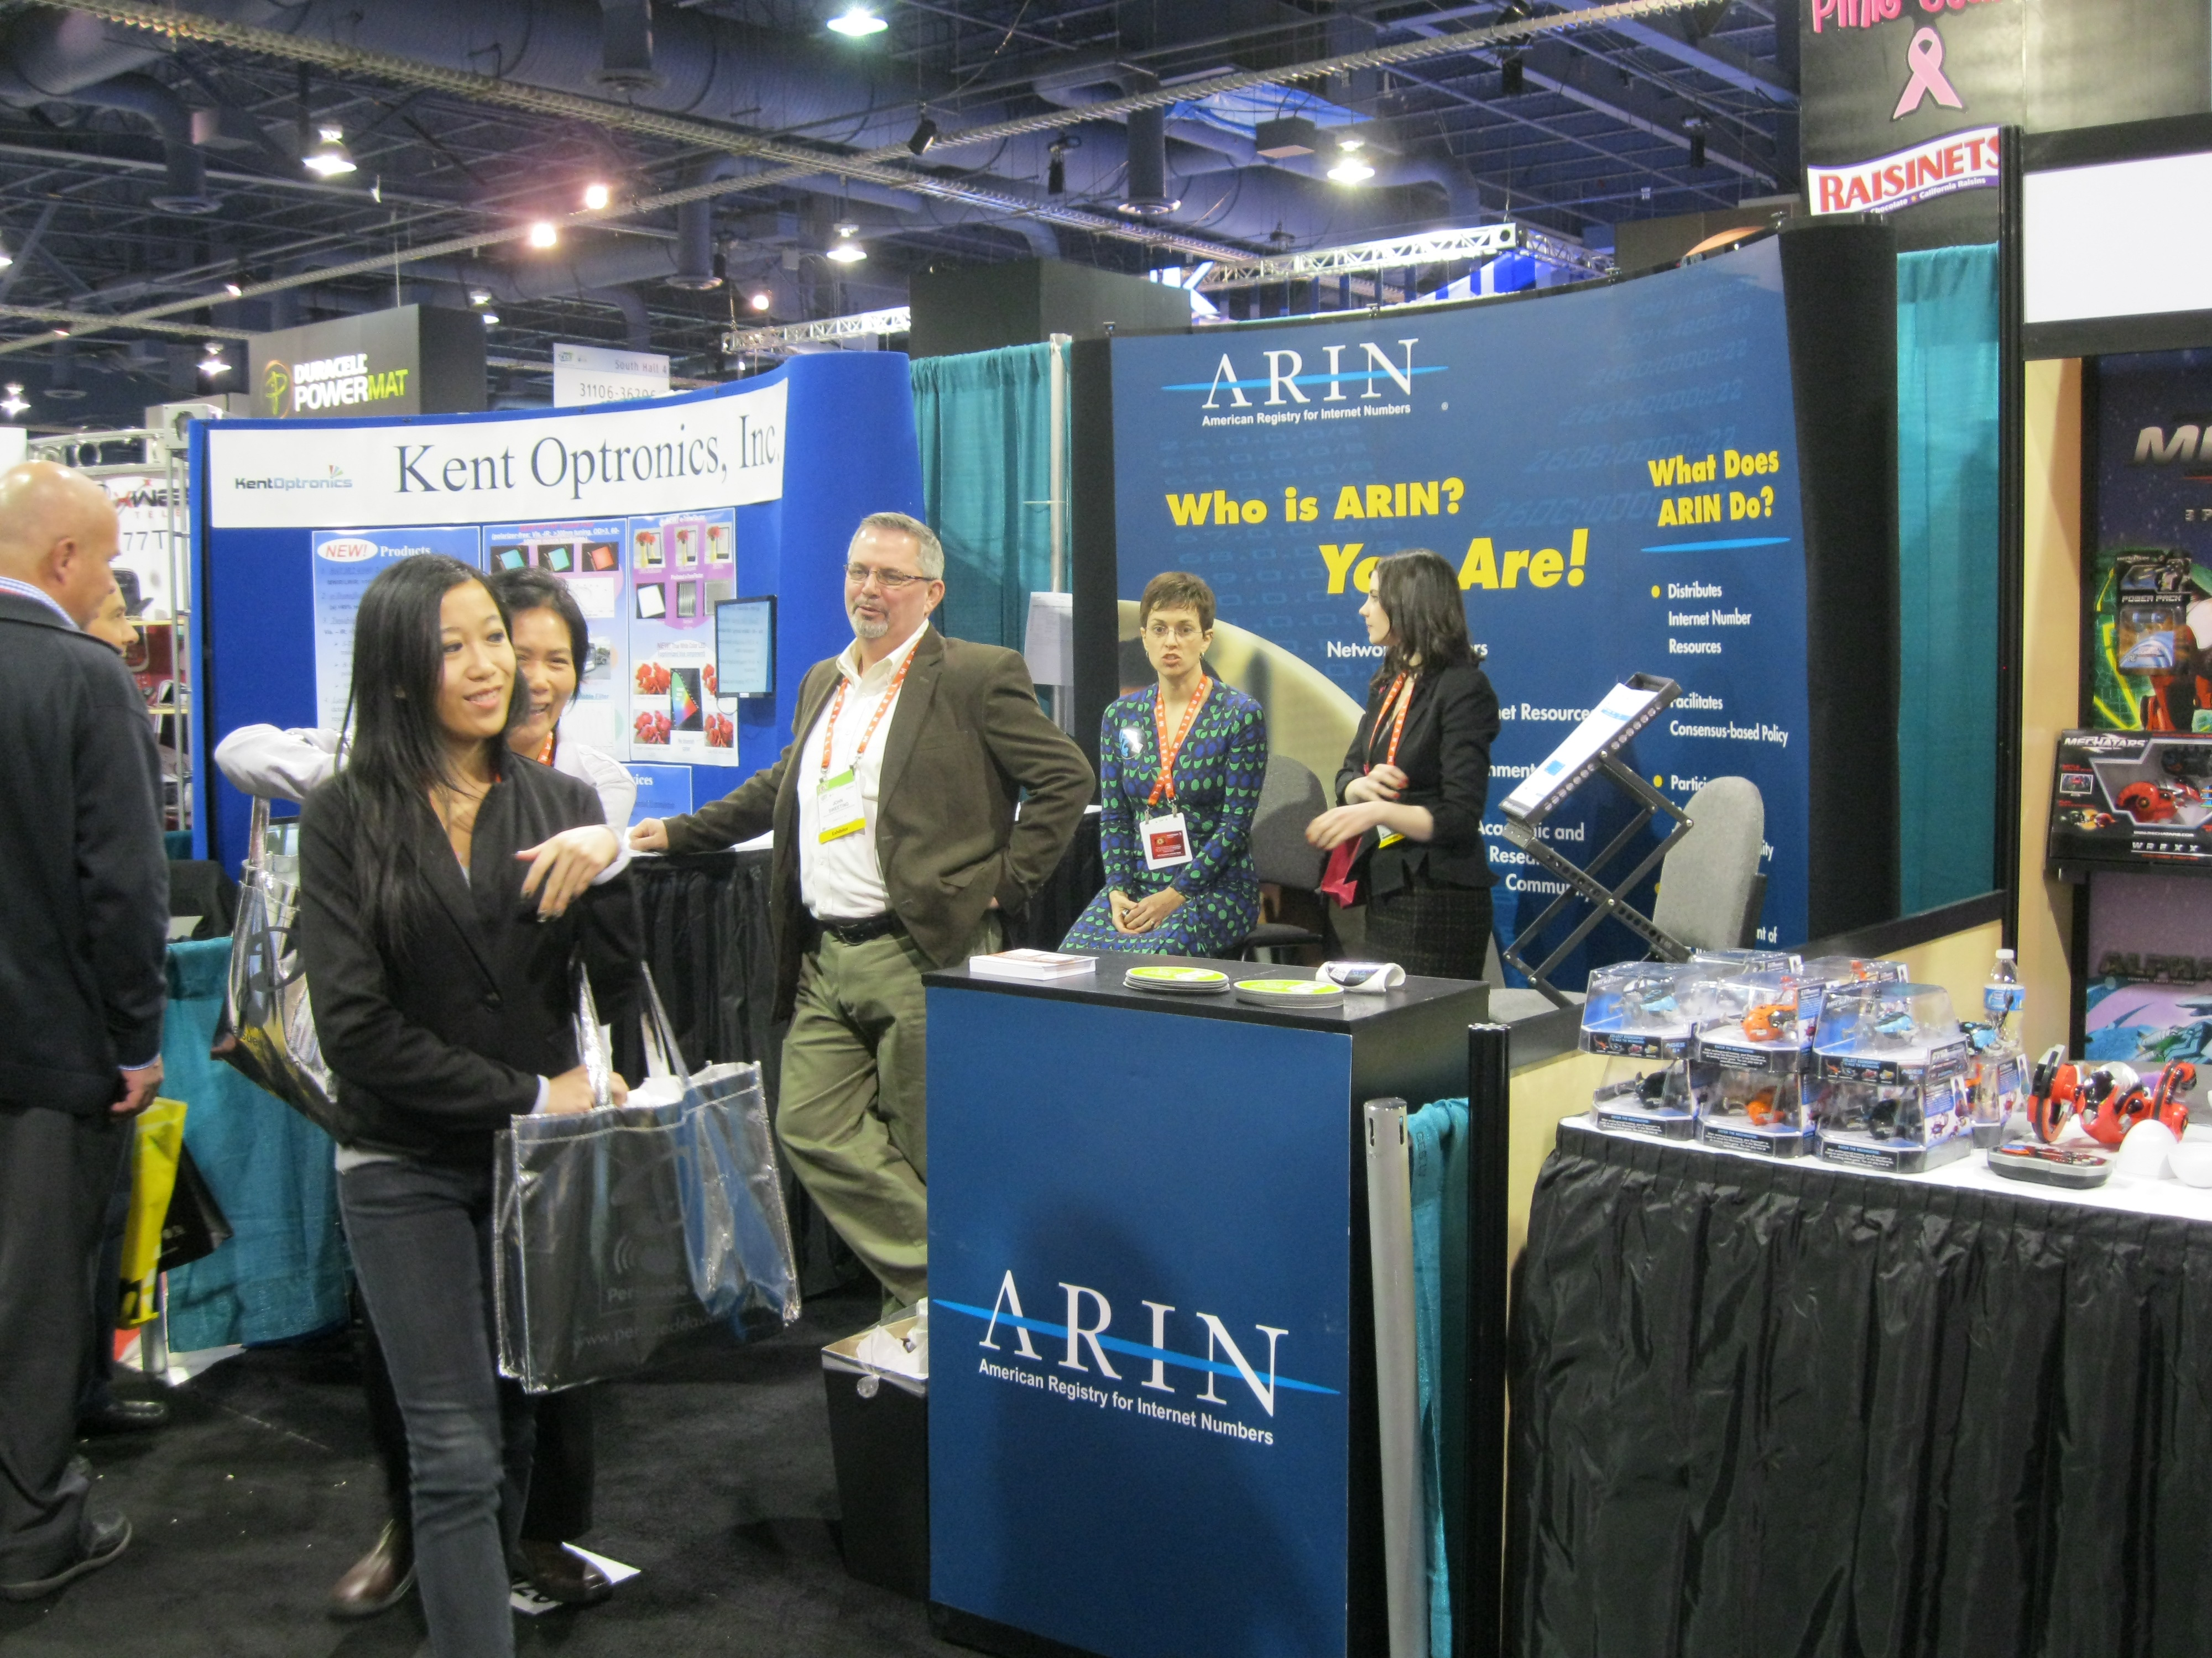
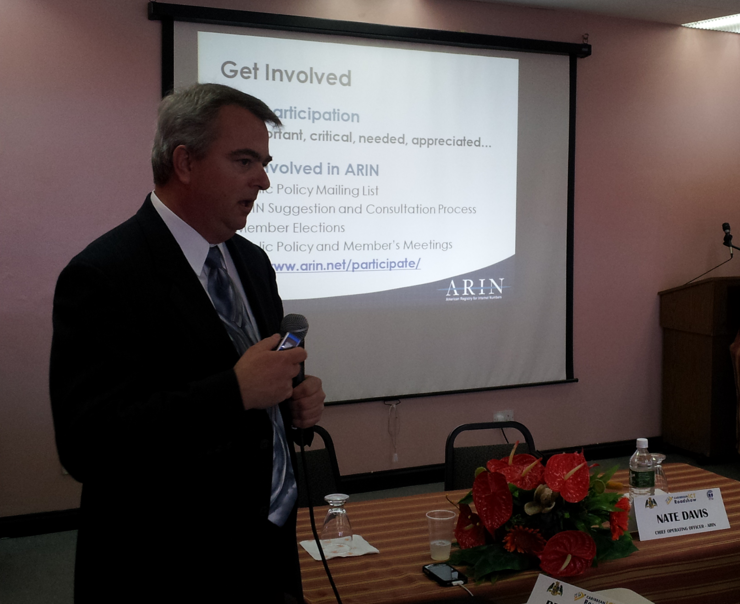
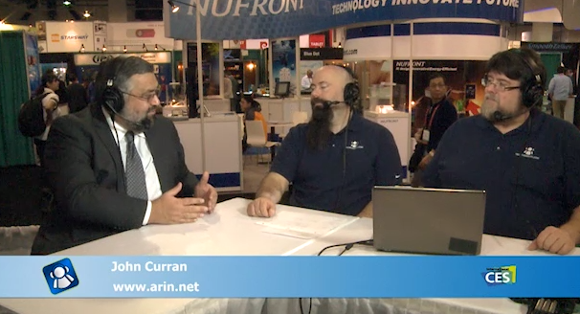
Outreach
Jt. Techs
Canadian ISP Summit
Consumer Electronics Show
CTU ICT Roadshow in Dominica
v6 World Congress
ARIN on the Road Brooklyn
IT Roadmap Chicago
ARIN on the Road Chicago
Light Reading Cable Live
2012 North American IPv6 Summit
Interop Las Vegas
The Cable Show 2012
CaribNOG
CANTO
Interop New York

Slide 8




ARIN Is Social
  Facebook Apr 2012: 1,538 fans
www.facebook.com/TeamARIN
    Twitter Apr 2012: 2,913 followers
www.twitter.com/TeamARIN
LinkedIn Apr 2012: 374 group members
Group ID 834217
YouTube Apr 2012: 4,157 video views
www.youtube.com/TeamARIN
Notes:
Over 500 new Twitter followers since our October meeting and over 150 new Facebook fans
ARIN has been mentioned on Twitter over 900 times since November 2011
ARIN’s social networks have driven over 1,600 visits to the TeamARIN.net site since Nov 1, 2011. (This is the result of including links to the education page, etc, on Twitter, Facebook, and other sites)
What are we tweeting about – where we are exhibiting or speaking, IPv6 articles, blogs about important ways to participate in ARIN… what would you like us to be tweeting?

Slide 9


Your participation:
get4byteasn.info
getipv6.info
ACSP – suggestions & consultations
www.arin.net/participate/acsp/acsp.html

Slide 10
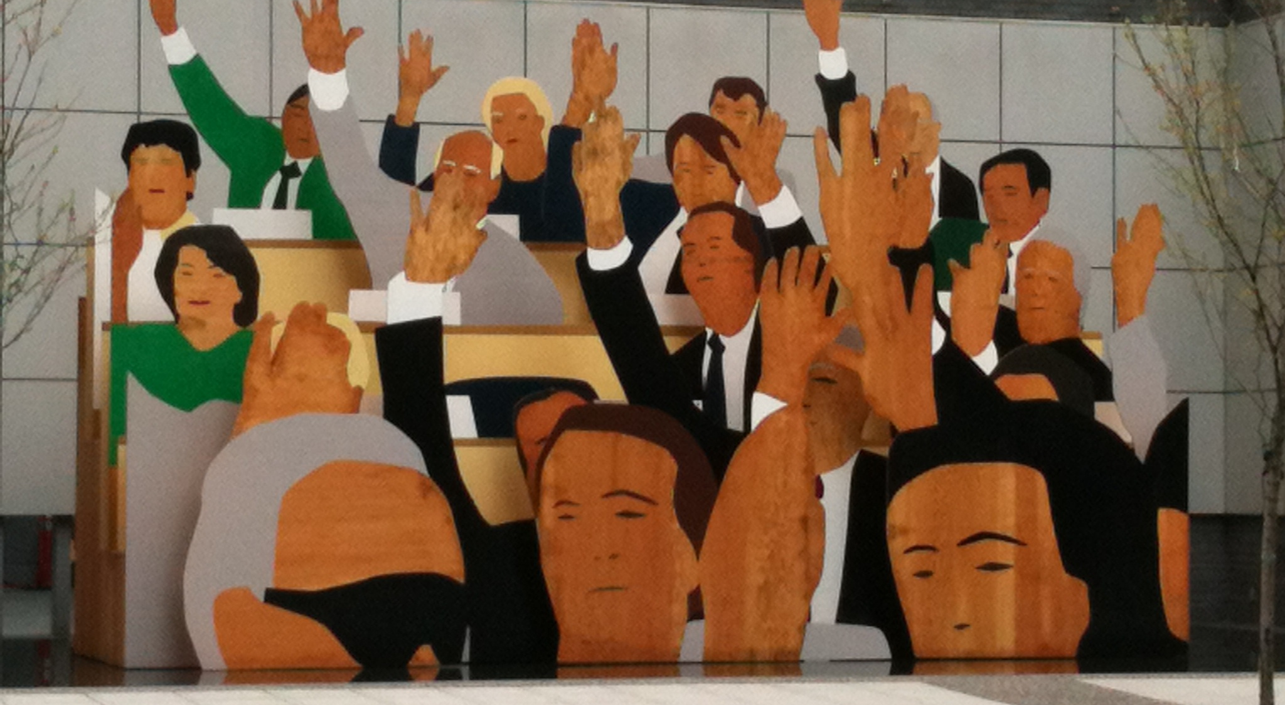

Slide 11
Your Participation: Mailing Lists
ARIN Mailing Lists
ARIN Consultation - arin-consult@arin.net
Open to the general public. Used in conjunction with the ARIN Consultation and Suggestion Process (ACSP) to gather comments, this list is only open when there is a call for comments
ARIN Issued - arin-issued@arin.net
Read-only list open to the general public. Used by ARIN staff to provide a daily report of IPv4 and IPv6 addresses returned and IPv4 and IPv6 addresses issued directly by ARIN or address blocks returned to ARIN's free pool.
ARIN Technical Discussions - arin-tech-discuss@arin.net
Open to the general public. Provided for those interested in providing technical feedback to ARIN on experiences in the use or evaluation of current ARIN services and features in development.
http://www.arin.net/participate/mailing_lists/index.html
Open to the public:
ARIN Announce: arin-announce@arin.net
ARIN Issued: arin-issued@arin.net
Suggestions: arin-suggestions@arin.net
ARIN Public Policy: arin-ppml@arin.net
ARIN Technical Discussions: arin-tech-discuss@arin.net
ARIN Consultation: arin-consult@arin.net
Members only:
ARIN Discussion: arin-discuss@arin.net

Slide 12

Upcoming ARIN Meetings
Spring 2013 – in progress

Slide 13
It takes a team effort:
Susan Hamlin, Director
Einar Bohlin, Senior Policy Analyst
De Harvey, Meeting Planner
Hollis Kara, Communications Manager
Jennifer Bly, Outreach Coordinator
Jason Byrne, Communications Strategist
Sean Hopkins, Communications Writer
Erin Sellers, Graphic Designer
Jud Lewis, Membership Coordinator

Slide 14


