Slide 1
Update from the RIPE NCC
Axel Pawlik
ARIN XXIX, Vancouver

Slide 2
Policy Proposals Update
2012-01 Inter-RIR IPv4 Address Transfers
Mixed feelings, mainly on terminology used
Policy proposal being abandoned
2012-xx Inter-RIR IPv4 Address Transfers
Not formally in PDP yet, presented at RIPE 64
Transfer to the RIPE NCC Service Region
Transfer is in line with originating RIR policy
Destination LIR qualifies according to RIPE transfer policy
Inter-RIR IPv4 transfer policy must exist in originating RIR

Slide 3
Policy Proposals Update (continued)
Transfer from the RIPE NCC Service Region
Transfer is in line with destination RIR policy
Originating LIR and transferred IPv4 address space comply with the RIPE transfer policy
Inter-RIR IPv4 transfer policy must exist in destination RIR
2012-xx Amendment to RIPE NCC transfer policy
Not formally in PDP yet, presented at RIPE 64
For the purpose of determining need for a transferred allocation, a period of 24 months is used in the evaluation (currently 3 months)

Slide 4
Policy Proposals Update (continued)
2011-04 Extension of the Minimum Size for IPv6 Initial Allocation
PDP Phase: Last Call
Modifies the eligibility for an organisation to receive an initial IPv6 allocation up to a /29
2011-05 Safeguarding future IXPs with IPv4 space
PDP Phase: Last Call
A /16 from the final /8 will be held in reserve IXPs
An IXP will can receive one number resource (from /24 to /22)

Slide 5
Policy Proposals Update (continued)
2011-06 Abuse Contact Management in the RIPE NCC Database
PDP Phase: Open for Discussion
Introduce of a new contact attribute named "abuse-c”

Slide 6
Also heard…
IPv4 Maintenance Document
Priority: high quality registry
All you ever wanted to know about IPv4 address stewardship in one document
Services for Legacy Resource Holders
Community policies – applicable or not?

Slide 7
Business Process Change
Reaching Last /8 Phases
Phase 0
Phase 1
Phase 2
1 month or /10 left
Reaching last /8

Slide 8
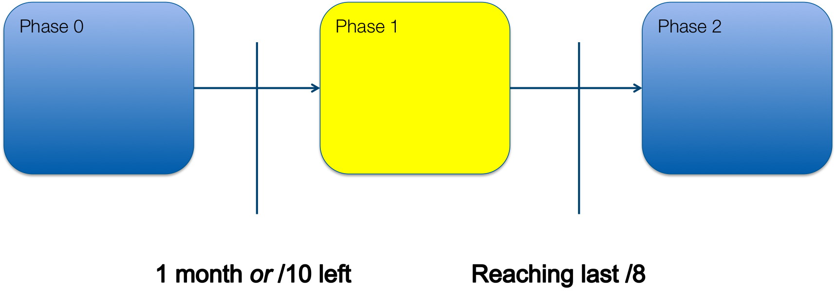
Phase 1
When the RIPE NCC has 1 month or a /10 left of IPv4 address space
IPRAs will work in pairs
Fairness, consistency and transparency
Longer response times
Change in ‘call back’ procedure
Requester called only when ticket at top of the queue
‘Approvable’ tickets moved to a separate queue
Approval artificially delayed until 9:00 next morning
Allows for additional checks

Slide 9
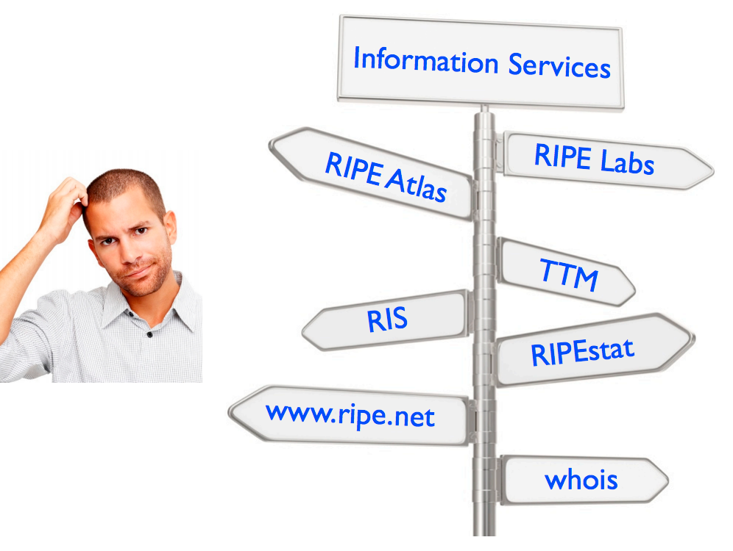
Clean-Up of Information Services

Slide 10
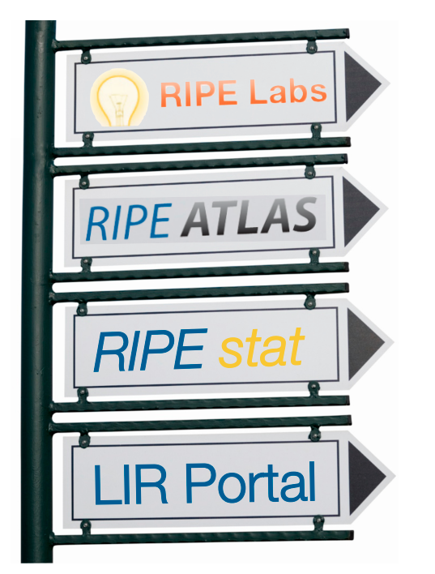
Clearly Defined Names

Slide 11
Clearly Defined Sections
Stories / General Statistics
State of the Network
Big Picture & Individual Measurements
Specifics on any IP/ASN
Real Time & History
Members’ Own Resource Mgmt & Related Services

Slide 12
TTM / DNSMON
Test Traffic Measurement
Deployed Equipment Aging Rapidly
Limited usefulness
Cease service and fold into RIPE Atlas
Coordinate with users so that measurement needs are taking into concern
DNSMON currently based on TTM machines
Will move to RIPE Atlas with increased utility

Slide 13
Resource Certification
At RIPE 63 GM – Member Vote

Slide 14
Addressing Concerns - The Roadmap
Q1/Q2: Test system, better Validator, better UI
Q2/Q3: Strengthen Operator Autonomy
Build monitoring infrastructure prototype
Q3/Q4: Strengthen Security
Authentication, periodic auditing
Q4/Q1: Strengthen Resilience
Service and data set distribution
Gradual: Expand eligible address space

Slide 15
Resource Certification Adoption

Slide 16
Charging Scheme Task Force
At RIPE 63 members voted on Charging Scheme 2012: Not Approved
Currently running on CS 2011
CS TF set up, reported at GM last week
Executive Board to consider
Decider further action

Slide 17
Timeline for Charging Scheme 2013
2012
May June July August September October
Board meeting
Decide on principles, Propose Charging Model
Propose Service Fees
Board meeting
Decide on Charging Model
Decide on Service Fees
GM
Vote on Charging Scheme 2013
4 Weeks ahead of GM
Final Charging Scheme 2013
Notes:
Board meeting 8 June

Slide 18
Where Is Rendek?

Slide 19
Where Is Rendek?

Slide 20
Intensified Regional Outreach
Our man in Dubai
To liaise with Arab and CIS Communities
Helping with coordinating Arab IGF
Organising Regulators’ Orientation Event in Amsterdam
CIS area is very complex and opaque

Slide 21
You’d be welcome at…

Slide 22
Questions?

