Slide 1
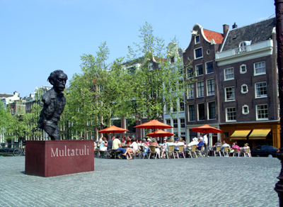
Update from the RIPE NCC

Slide 2
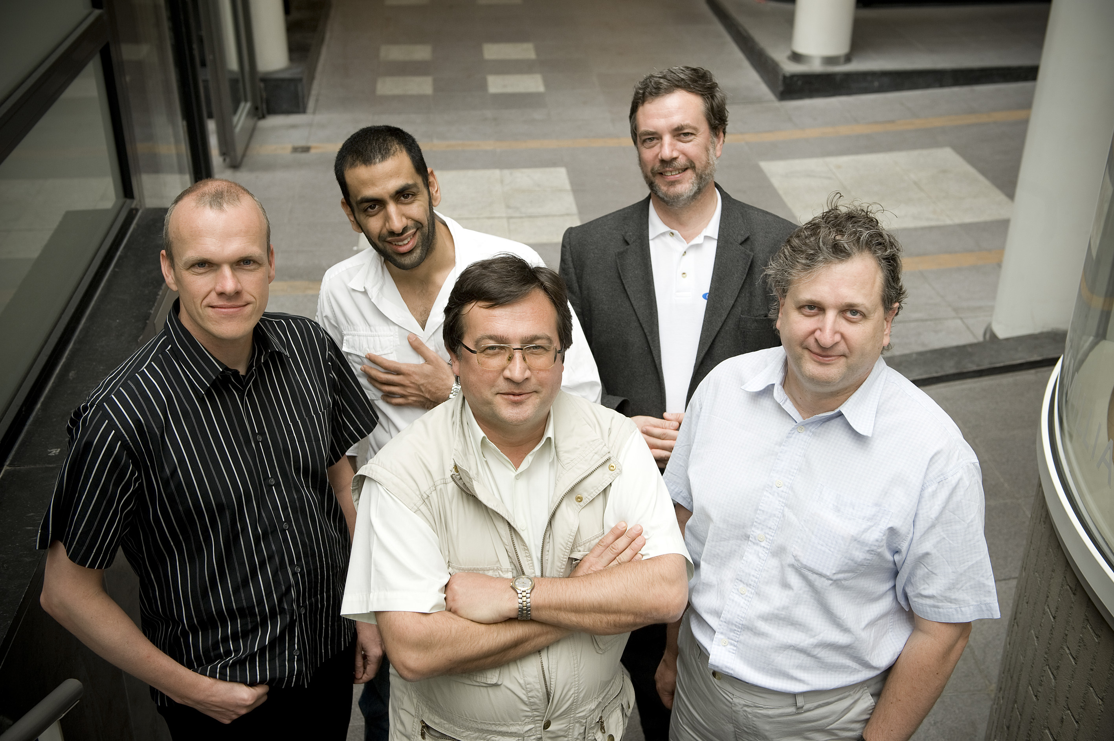
Vital Statistics
Members: 6388 (end of Aug)
Budget: 15.2 M EUR
Staff: 112
Stable board composition
Long term improving efficiency

Slide 3
Planning for 2010
General Meeting October
Draft Activity Plan / Budget (17.5 MEUR)
Draft Charging Scheme
incl 2007-01: 50 EUR per PI assignment (via LIR)
Articles of Association Change
Simplify election procedure
Enable e-voting

Slide 4
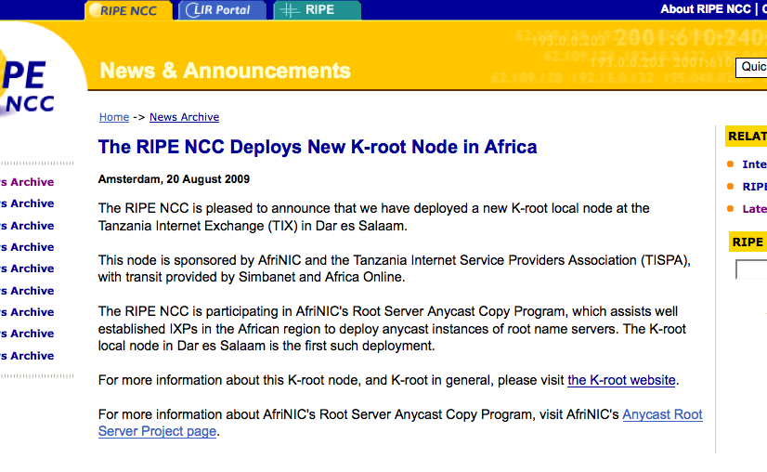
Yet another k

Slide 5
Information Services Developments
TTM Partnership with APNIC
New node in Pakistan, more to follow
RIS backend architecture improvements
Most queries 10x faster, some up to 35x faster
New BGP visualisation tool, BGPviz:
http://www.ris.ripe.net/bgpviz/
Hard at work on a new portal system
Combine most useful elements from RIS/TTM etc
“NetSense” v0.1 available through RIPE Labs

Slide 6
Customer Service Highlight
Remember 2007-01?
“Get a grip on those PI-Assignments!”
Phase 1 Implementation:
From 3 March 2009: New PI assignments require contractual relationship
Phase 2 Implementation:
May to 20 September 2009: Contacting End Users of PI assigned before 3 March, through the requesting LIR
Phase 3 Implementation:
In 2010 contacting ‘orphaned’ End Users directly…

Slide 7
2007-01 Implementation Status
As per 24-08-2009:
1935 (out of ca 4900) Registries have participated
9101 (out of ca 27k) Resources have status set
Timeline:
LIRs to declare until 20 Sept
to deliver contracts until 31 Dec

Slide 8
Training & IPv6
IPv6 testimonials (interviews with members from the community about their experiences with IPv6)
published on IPv6ActNow website and on YouTube
short per-topic cuts used during training courses, proven to be very popular, will also be published on our e-learning centre
IPv6 full day training course
launched in July in Russia
big success, all courses fully booked until end 2009

Slide 9
E-Learning News
DNS SEC e-learning
first module published: DNS Basics
under construction: DNS Vulnerabilities
IPv6 e-learning
in preparation

Slide 10
Science Group
Making progress on quality and consistency of (mostly historical) registration data
will need to make progress with the few inconsistencies that remain inter-RIR, need support of other RIRs
Big “Thank You” to Geoff!

Slide 11
New Tools Taking Shape
”Rex": (Internet Number) Resource Explainer
information about specific Internet number resources
registration data, DNS, BGP Routing (RIS)
for any time in the past (this decade or more)
Netsense
“Status of the Internet”
Based on Information Services Tools
TTM, RIS, …
INRDB
“The ultimate number resource DB” ☺

Slide 12
RIPE Labs? Which RIPE Labs?
Preparing launch of new community "RIPE Labs"
Credit for idea to Róbert Kisteleki
Forum for presenting new ideas and tools
Experimental, no service guarantees
Contemporary tools for community discussion
Was launched at October RIPE meeting
Essential for future of RIPE NCC
http://labs.ripe.net

Slide 13
External Relations and Communications
Donated sizeable amount of Paul Rendek’s time to NRO for PR & Comms efforts
Also, secretariat support for ASO (heavy hit on resources)
Strong support for EU IPv6 survey
Received more than 600 responses!
Similar to previous ARIN survey
Recently completed by APNIC

Slide 14
Outreach
17-18 September: Regional Meeting, Moscow
21 September: Roundtable for Governments & Regulators
22 September: LEA Workshop
5-9 October RIPE 59, but also…
ITU Telecom World, Geneva

Slide 15
Meetings
Regional Beirut (28/29 September)
RIPE 60 (3-7 May 2010)

Slide 16
Questions?

