Slide 1
Engineering Report
Mark Kosters, CTO

Slide 2
Staffing
Operations
6 people (one was an intern)
Development
10 people (four are contractors)
Quality Assurance
3 people
Requirements
1 person
PHB
Me

Slide 3
Operations
Disaster recovery replication
Diversity in serving up /8’s under in-addr.arpa
Site operational for west coast
Peering with 4Byte AS
DNSSEC operational
V6 support for IRR in pilot
IT – 589 administrative requests answered

Slide 4
Whois Statistics- v4

Slide 5
Whois Statistics – v6

Slide 6
Development
ARIN Online Releases
Improvements to existing systems
Improved Process Flows with Business Process Re-Engineering
Resource Certification Pilot
DNSSEC
Whois-RWS (Restful Web Services)
IRR (Give me better name) v6 support in pilot

Slide 7
ARIN Online 2.1 Release
POC updates performed with direct database updates
POC Recovery
Improvements over e-mail submitted POC templates
real-time validation
better instructions
improved processing

Slide 8
ARIN Online 2.2 Release
Estimated Delivery after Thanksgiving
New Functionality
Resources Record
Display
Reassignments Report
Associations Report

Slide 9
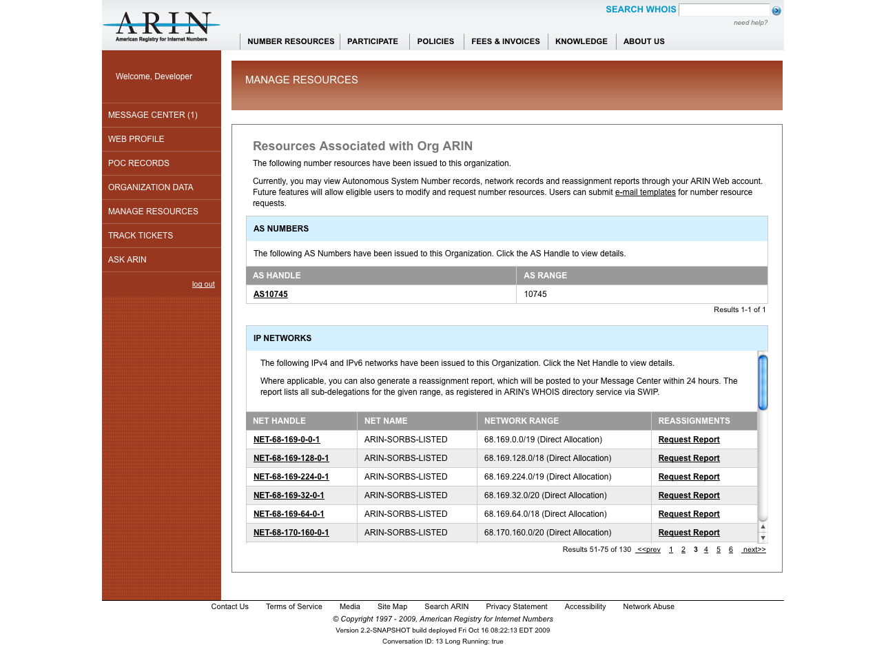
ARIN Online 2.2 -Resources

Slide 10
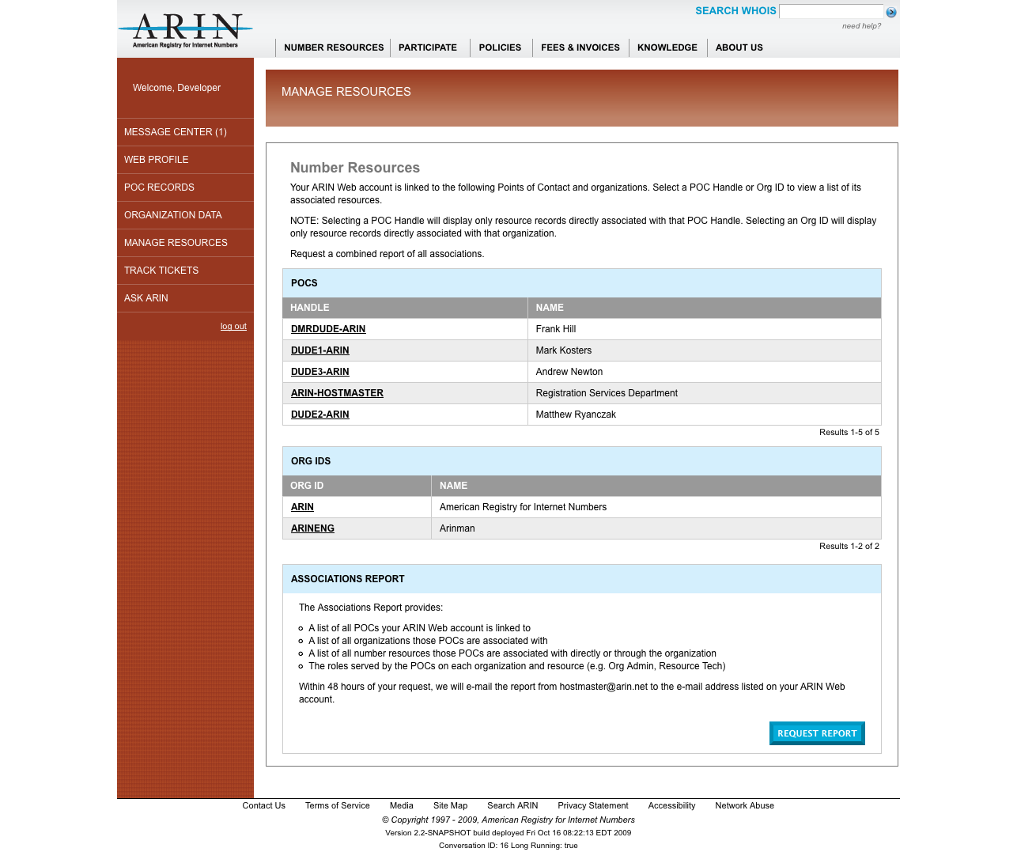
ARIN Online 2.2 - Associations

Slide 11
ARIN Online (as of 10/12/09)
Active accounts = 10,878 (registered and confirmed, with active status)
Active accounts with a profile = 9,918 (customer logged in and created a profile)
Confirmed POC links = 9,036
POC requests = 6,346
ORG requests = 3,313
Overall a 2x increase over ARIN XXIII

Slide 12
Agile Methology
Used Waterfall method – slow release cycles
Working on strengths of the organization
Integration of QA within Development
More frequent releases

Slide 13
Quality Assurance
Every update working through QA
Focusing on the Customer Experience
Broad browser support
Full regression testing

Slide 14
Requirements
Testable systems
Trying to stay faster than development

Slide 15
Upcoming Challenges/Research
Additional ARIN Online features
RESCERT to be moved from pilot to production next year
DNSSEC will be a phased approach
Integration with ARIN Online in 2010 for signing your zones
Document Management/Retention Systems
Replacement of Legacy Gear
LISP participation

Slide 16
Thank You for your Time and Attention
Questions?

