Slide 1
IPv4 Distribution Options for the Last Eights
Choice of Risks and Assumptions

Slide 2
Previous Observations about Adoption
What is a reasonable, available measure?
Can the diffusion uncertainty be bound and quantified?
Is there a feasible path which results is short IPv4/IPv6 co-existence?
What are the implications in terms of possible actions?

Slide 3
Previous Findings
What is a reasonable, available measure?
Routes and ASNs yield similar near-term results
The diffusion uncertainty was bound and quantified given this data.
There is no feasible path which results is less than years of IPv4/IPv6 co-existence. Decades is not unreasonable.
Observations from economics of security applied to IPv6; implications are that normal market measures may not result in diffusion.

Slide 4
Options
Do Nothing
Government leads
This has been tried …
RIR Lead: Market
RIR Lead: Other

Slide 5
RIR Lead: Other
Only allocate to organizations with a small address space previous allocated
Only allocate a given amount of the v4 space per year
Provide only a minimal routable allocations per organization per year

Slide 6
Policy Requirements (Potaroo)
Address policies are intended to be applied uniformly
Addresses are made available from the unallocated pool to meet demands for their use in networks
The prevailing address policy regime characterizes addresses as a network attribute
Notes:
Potaroo IP4 report argues for these points, which I believe we are consistent
(……and fairly?) no making this claim
, and are intended to be assigned for as long as the need condition continues…. But that is the question
rather than as an asset or tradeable good in its own right. (or it is a market as soon as it is a tradeable good regardless of if it is publicly priced. Peering and interconnection are clearly markets if they are priced

Slide 7
Not Policy Requirements
Market requirements: Strong convexity requirement
16 * Price (/24) < Price(/20) in all cases
This fails if IPv4 becomes a gateway technology or critical facility
Avoidance of destructive market behaviors
speculation
Notes:
And these are the assumptions that we do NOT require
1 /16 = 16 /20
1/12 = 16/16
1/8 = 16/12

Slide 8
Data and Assumptions
Consistency over time
IANA splits remaining blocks equally
Whois is roughly correct
Notes:
The idea that exhaustion will not speed up is a bold and unproven one and rather unlikely
Also, IANA may have no reason to support the careful and historically could argue that there is a basis for being parsimonious to ARIN

Slide 9
Data Foundation
Regional Internet Registry (RIR) stats file
IPv4 address allocation history of ARIN.
ARIN Whois and Cymru Whois
Associate AS to IPv4
Notes:
Each line in the file represents a single allocation (or assignment) of a specific range of Internet number resources (IPv4, IPv6 or ASN), made by the RIR identified in the record. In the case of IPv4, the records may represent non-CIDR ranges or CIDR blocks
CIDR Classless Inter-Domain Routing address
AS - Autonomous System (AS)

Slide 10
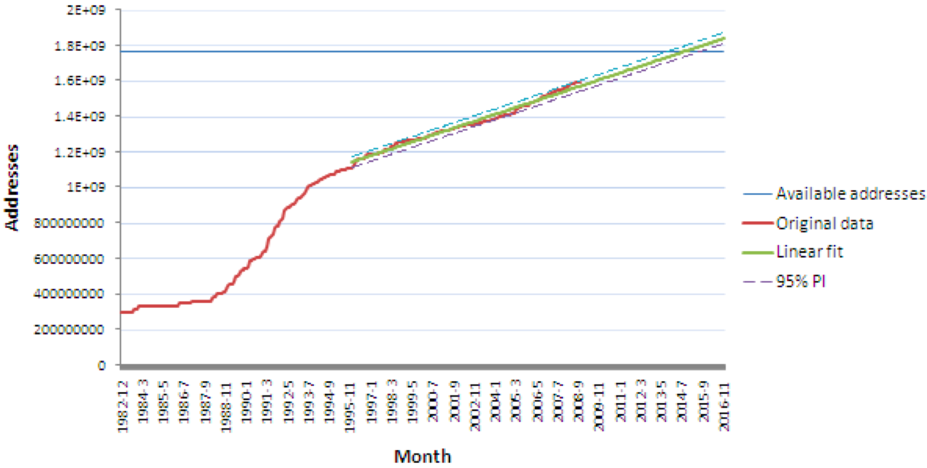
Data Modeling Trends
Notes:
at to currently exhaustion date of between 2012 and 2014
Notice that there is an apparent jump, where historical v4 address holders moved under the ARIN umbrella. This means that data before 1996 is not useful.

Slide 11
Data Modeling Result
Allocation Range | Organizations in Range | Equivalent in /16s
/8 block < Allocation | 34 | 395 /16s
/12 block < Allocation < /8 block | 103 | 49 /16s
/16 block < Allocation < /12 block | 1268 | 712 /24s
/20 block < Allocation < /16 block | 3207 | 48 /24s
/24 block < Allocation < /20 block | 4302 | 5 /24s
Allocation < /24 block | 8202 | 1 /24s

Slide 12
Policy 1: Organization Threshold
Organizations above a certain threshold receive no additional addresses
Justification
Larger organizations have tended to request large additional block
Larger organizations have more aggregate networking expertise to move to v6
Experience in translation at large scale could hasten v6 adoption, mitigating uncertainty for all parties
Capacity, motivation, and impact

Slide 13
Modeling
Subtract residual addresses from historical data.
Use this data to form a projection, calculating linear and polynomial fits.
Add the residual addresses back into projection for a starting or initial point for the projection.
Use the curve generated to project exhaustion.
Imagine this policy had always been in place
Use this imagine the implications of the policy for the future
Begin 1997

Slide 14
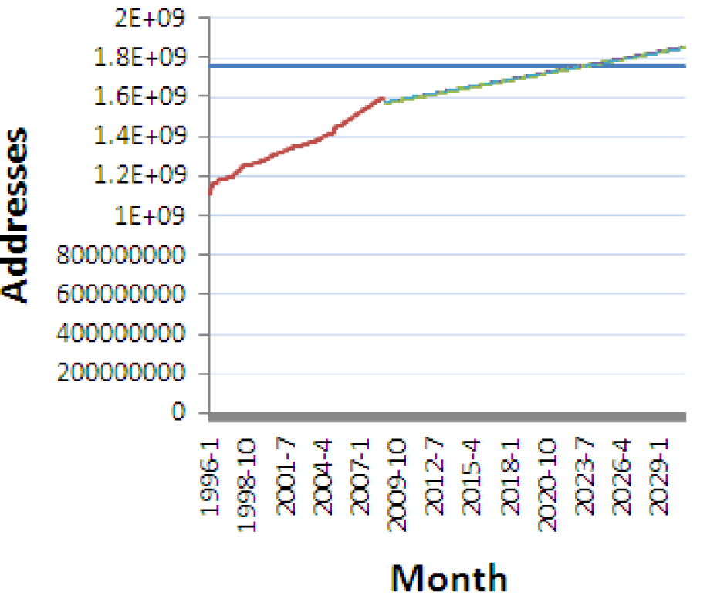
Implications
Using /12 as a threshold, a crossover in 2024 (or 2019)
Notes:
Polynomial projection gave a larger window before exhaustion

Slide 15
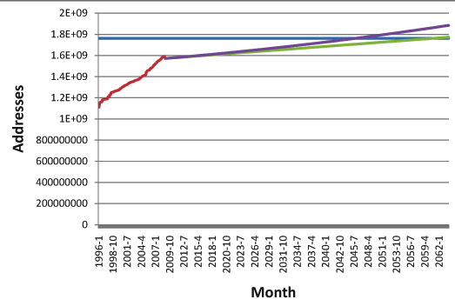
Implications
Using /20 as a threshold, exhaustion approaches 2045
Notes:
Blue - addresses
Original data - red
Linear fit is green
Polynomial is purple
The reason this looks so good is the assumption is that if anyone wants too much, they are chased away.
So replace the big boys with zeroes, so this is idealized
Those who would connect might not want to contribute to v6 but they will want to connect

Slide 16
Summary of Policy 1 Simulations
Assuming yesterday predicts tomorrow….

Slide 17
Policy 2: Per organization annual threshold
Provide any organization that requests an allocation exactly one minimal routable block
Justification
Fairness
Politics

Slide 18
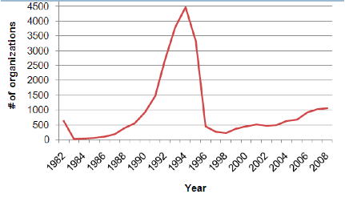
Past Organizational Patterns

Slide 19
Resulting Per Organization Results
Multiply number of organizations times allocations
Select allocation size as minimally routable
/24?
Determine exhaustion date by organizational count

Slide 20
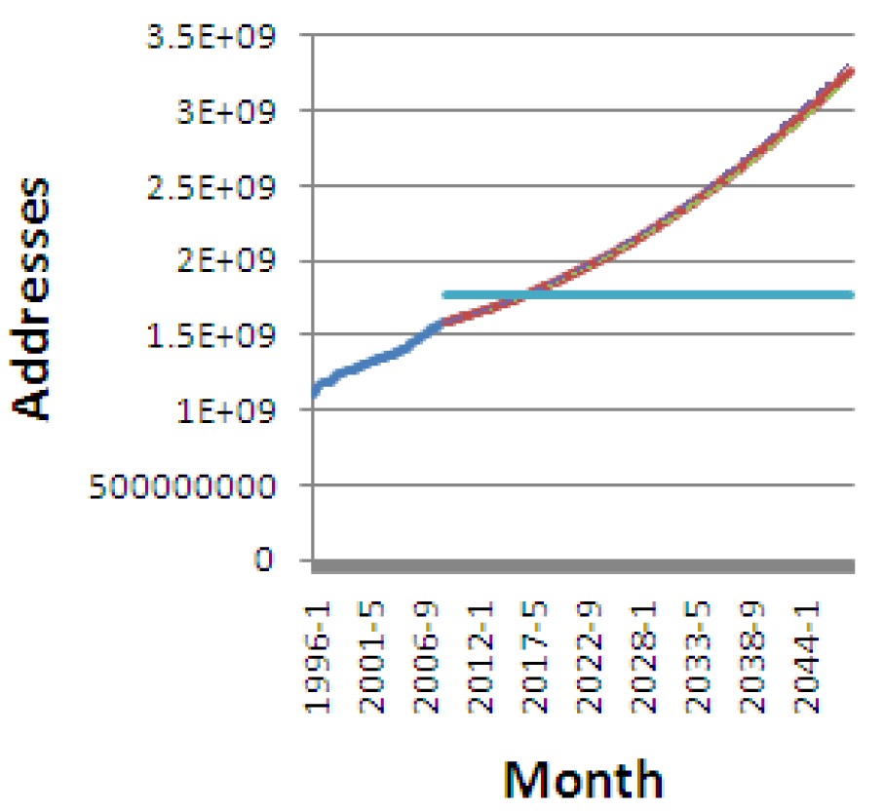
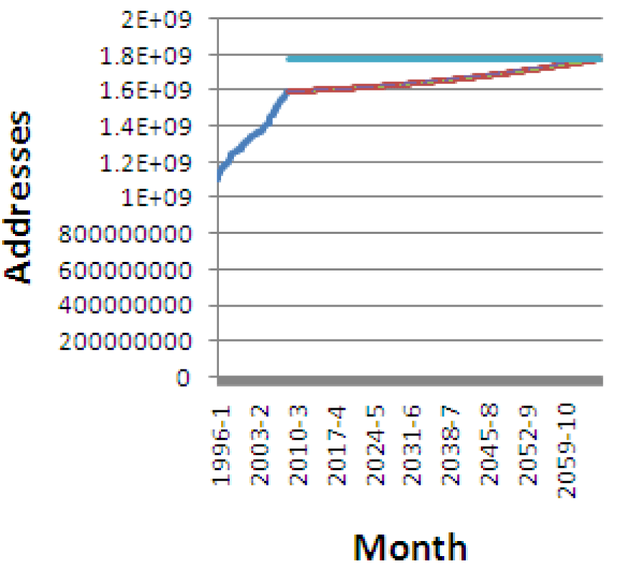
Results for Policy 2
Results with a /18 and /20 as maximum allocations
Notes:
Clearly the /18 makes less of a difference and in fact assumes that some organizations increase their allocation request
Makes sense if there is a standard allocation size in the face of exhaustion.
/20 very few organizations are increasing their request size and it is clearly routable UNLESS everyone has one

Slide 21
Results for Policy 2
Allocation Size | /22 | /20 | /18
Estimated exhaustion | 2060 | 2030 | 2017
Notes:
Linear projection of number of organizations

Slide 22
Policy 3: Predetermine Exhaustion
More of a thought experiment
Pick a year
Divide pool by time to that year
Allocate pool at a rate to make it to that year

Slide 23
How Low Could You Go?
How small an allocation can you place in any given year before the allocations become impossible to route?
How many allocations are you getting, per year, per average?
Who would be refused?
You can make this decision later than others.

Slide 24
As Low as You Like
3 /8 =~ 200k /24s
2000 24/s per year the result is 98 years
30 years the meet requests of 95\% of applicants could in theory, be met.
50 years the meet requests of 75\% of organizations could in theory, be met.

Slide 25
It is Up To You….. For Now
RIR decisions could choose to manage exhaustion multiple ways
This will determine the transition
IPv4 will become in the next years
A critical facility?
A traded good?
A high level interconnection, backbone technology?
Notes:
Notice that no set of 2 of these is exclusive.

Slide 26
Top Holders of IPv4 Blocks
DoD Network Information Center
DDN-ASNBLK1 - DoD Network Information Center
ATT Internet Services
Comcast Cable Communications, Inc.
Cogent/PSI
AT&T WorldNet Services
Headquarters, USAISC
Cellco Partnership
Merit Network Inc.
AT&T Global Network Services
E.I. du Pont de Nemours and Co.
University of California at San Diego
HP-INTERNET-AS Hewlett-Packard Company
SITA
Massachusetts Institute of Technology
Ford Motor Company
Notes:
Organization name and IP allocation. Notice that if there is a subsidiary (e.g., Global Services) with an Autonomous System designation it is listed as its own organization Notice that if these go into bankruptcy then the judiciary will decide if v4 is an asset that is to be sold or something to be returned to ARIN.
Here comes the judge,
where is Nortel’s? MCIs?

