Slide 1
API Software and Tools
Andy Newton, Chief Engineer

Slide 2
Progress(ion)
Legacy / Inherited
Programmatic / REST
ARIN has limited Engineering resources
Creating featureful APIs enables others to create good tools instead of relying on ARIN
ARIN is dedicated to keep this APIs stable and highly available so as to empower the community
http://projects.arin.net
arin-tech-discuss@arin.net

Slide 3
APIs
LEGACY
NEW
Email
Templates
Require
API Key
for
authorization
Reg-RWS
Bulk Whois
Whois
Whois-RWS
RDAP
Tools
NicInfo
RDAP Bootstrap
ARINcli

Slide 4
Public vs Provisioning
LEGACY
NEW
Email
Templates
Require
API Key
for
authorization
Reg-RWS
Bulk Whois
Whois
Whois-RWS
RDAP
Provisioning
of data into
ARIN’s
registration
database
Public data /
Read-only

Slide 5
Getting an API Key
* API Keys are secrets.

Slide 6
Provisioning (Classic)
Email templates are not going away. - usage is up
Hand-editing of SWiP templates happens every day
Templates can cheat by associating an email address
* Deactivate API Keys if you no longer need them.

Slide 7
Reg-RWS
Very popular – usage greater than templates and continuing to grow
XML using RESTful HTTP
Only programmatic way to
Do simple reassigns of IPv6
Manage reverse DNS
Access ARIN X-* tickets
Manage Hosted CA ROAs in RPKI (new)
https://www.arin.net/resources/restful-interfaces.html

Slide 8
Testing Your Reg-RWS Code
We offer an Operational Test & Evaluation environment for Reg-RWS
Your real data, but isolated
Helps you develop against a real system without the worry that real data could get corrupted.
https://www.arin.net/resources/ote.html

Slide 9
Reg-RWS Transactions
* Does not include RESTful GETs

Slide 10
Bulk Whois
You must first sign an AUP
ARIN staff will review your need to access bulk Whois data
Also requires an API Key
More information
https://www.arin.net/resources/request/bulkwhois.html
Can be accessed RESTfully via www.arin.net

Slide 11
Whois & Whois-RWS
Port 43
Classic, but not formally structured/standardized and everybody does it differently
Whois-RWS
XML and/or JSON over RESTful HTTP
Only an ARIN “standard”
Higher query load than Port 43
https://www.arin.net/resources/whoisrws/index.html

Slide 12
Whois/Whois-RWS Q/S

Slide 13
ARINcli - @projects.arin.net

Slide 14
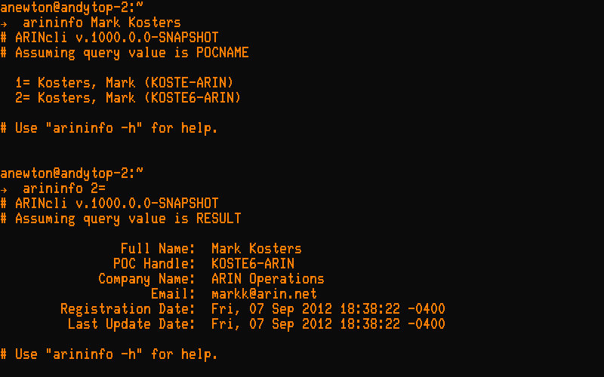
arininfo – Whois-RWS client

Slide 15
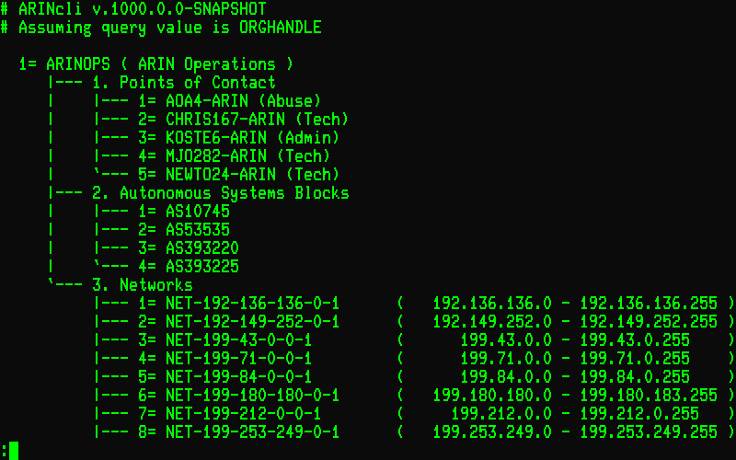
arininfo – sorted, tree form

Slide 16
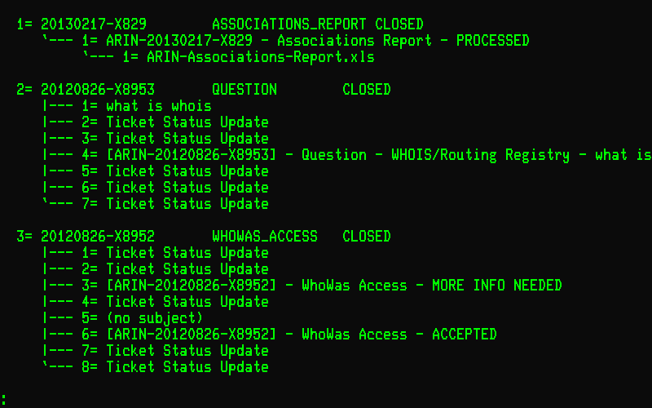
tickets – Manage X* Tickets

Slide 17
rdns – Manage Reverse DNS
$TTL 86400 ; 24 hours could have been written as 24h or 1d
$ORIGIN 136.136.192.IN-ADDR.ARPA.
@ 1D IN SOA ns1.example.com. mymail.example.com. (
2002022401 ; serial
3H ; refresh
15 ; retry
1w ; expire
3h ; minimum
)
IN NS ns1.example.com.
IN NS ns2.example.com.
; server host definitions
1 IN PTR ns1.example.com.
2 IN PTR www.example.com.
; non server domain hosts
3 IN PTR bill.example.com.
4 IN PTR fred.example.com.

Slide 18
ARINcli - …and more
Manage POCs
Request Association, Reassignment, and WhoWas reports
Manage RPKI ROAs (for Hosted CAs)

Slide 19
RDAP
Registry Data Access Protocol
Upcoming IETF standard from the WEIRDS working group
http://datatracker.ietf.org/wg/weirds/
JSON over RESTful HTTP
ALL 5 RIRs have RDAP pilots (and VeriSign, Afilias, & NeuStar)
http://rdappilot.arin.net/rdapbootstrap
ICANN requiring it in new TLD contracts
And have contracted with CNNIC to create an open source server for DNRs and RIRs and an open source client. Not yet available.

Slide 20
ARIN’s RDAP Pilot & Code
ARIN Registry Pilot
http://rdappilot.arin.net/restfulwhois/rdap
A pilot bootstrap server
http://rdappilot.arin.net/rdapbootstrap
Aim your RDAP client here and it will refer to the proper RIR or DNR
Code is open sourced @projects.arin.net
NicInfo
Command-line RDAP client
Only RDAP client currently availalbe
Open sourced @projects.arin.net

Slide 21
Questions?

