Slide 1
First Timers’ Orientation
Richard Jimmerson
Chief Information Officer

Slide 2
First Timers’ Orientation
Brief introductions
ARIN and the Internet registry system
Policy development at a glance
What’s ahead and how to participate
Q&A at your table

Slide 3

Self-introductions

Slide 4
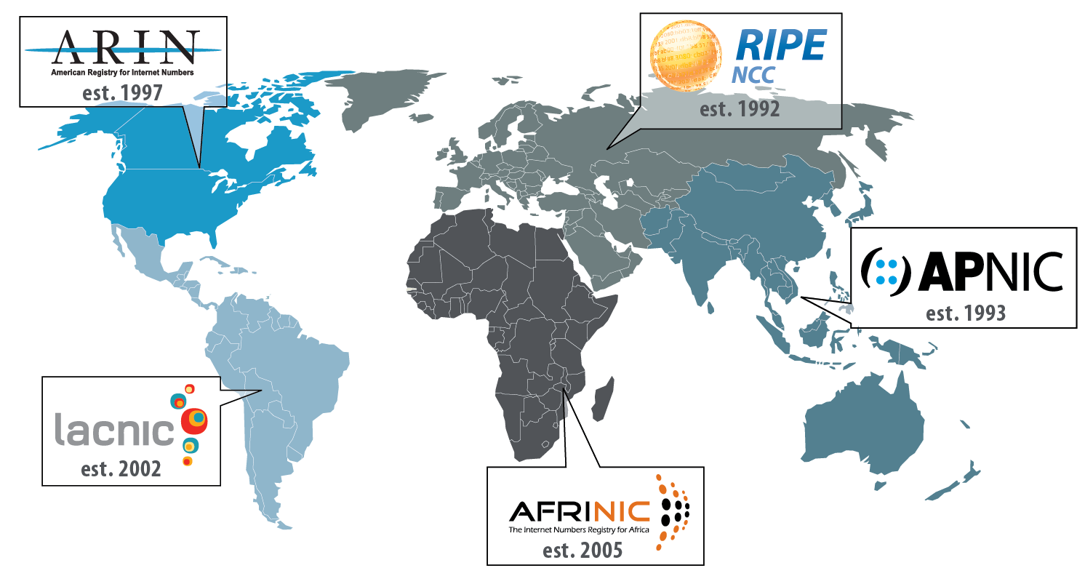
Regional Internet Registries (RIRs)
The system began in 1992
There are five RIRs:

Slide 5
Who Provisions IP Addresses and ASNs?
ICANN IANA | Top level technical coordination of the Internet Names, Numbers, Root Servers Manage global unallocated IP address pool Allocate number resources to RIRs
RIR | Manage regional unallocated IP address pool Allocate number resources to ISPs/LIRs Assign number resources to End-users
ISP/LIR | Manage local IP address pool for use by customers and for infrastructure Allocate number resources to ISPs Assign number resources to End-users

Slide 6
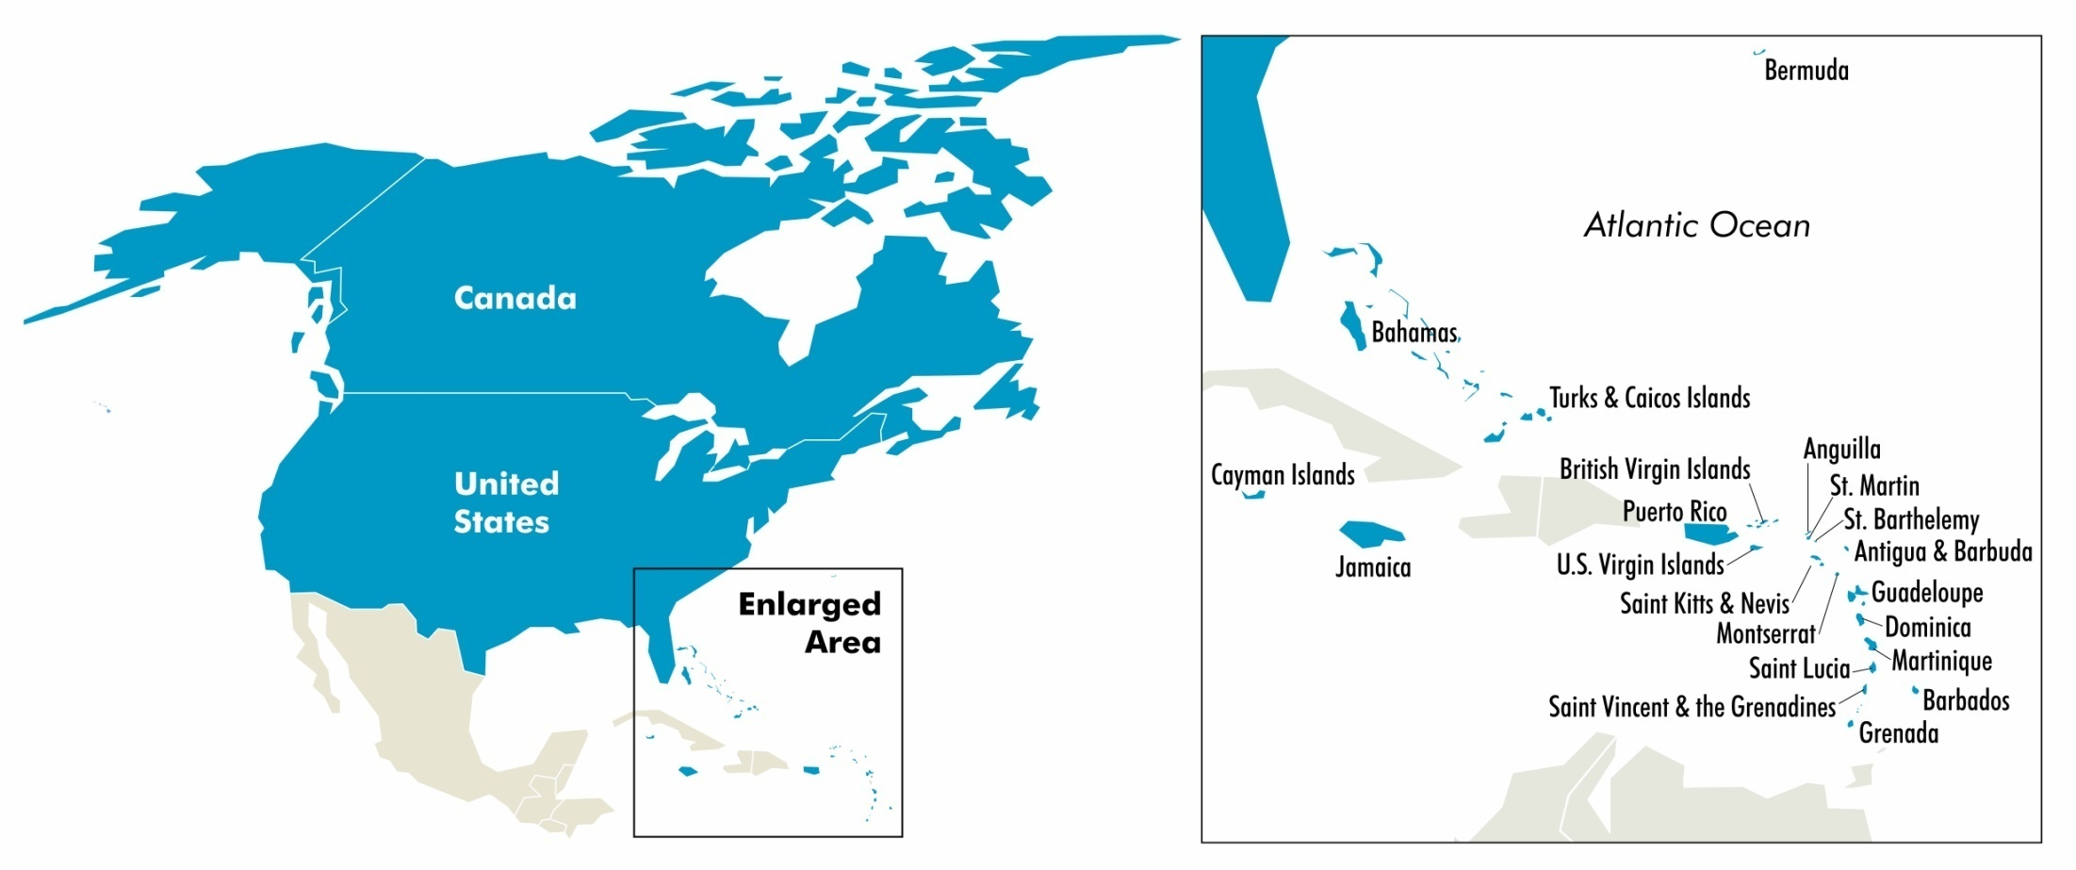
ARIN’s Service Region
ARIN’s region includes Canada, many Caribbean and North Atlantic islands, US Minor Outlying Islands and the United States.

Slide 7
ARIN’s Mission
ARIN, a nonprofit member-based organization supports the operation of the Internet through:
  the management of Internet number resources throughout its service region;
  coordinates the development of policies by the community for the management of Internet Protocol number resources; and
  advances the Internet through informational
  outreach.

Slide 8
ARIN Structure
Nonprofit | Membership Organization | Community-regulated
Fee for services, not number resources 100% community funded | Broad-based - Private sector - Public sector - Civil society | Community developed policies Member-elected executive board Open and transparent

Slide 9
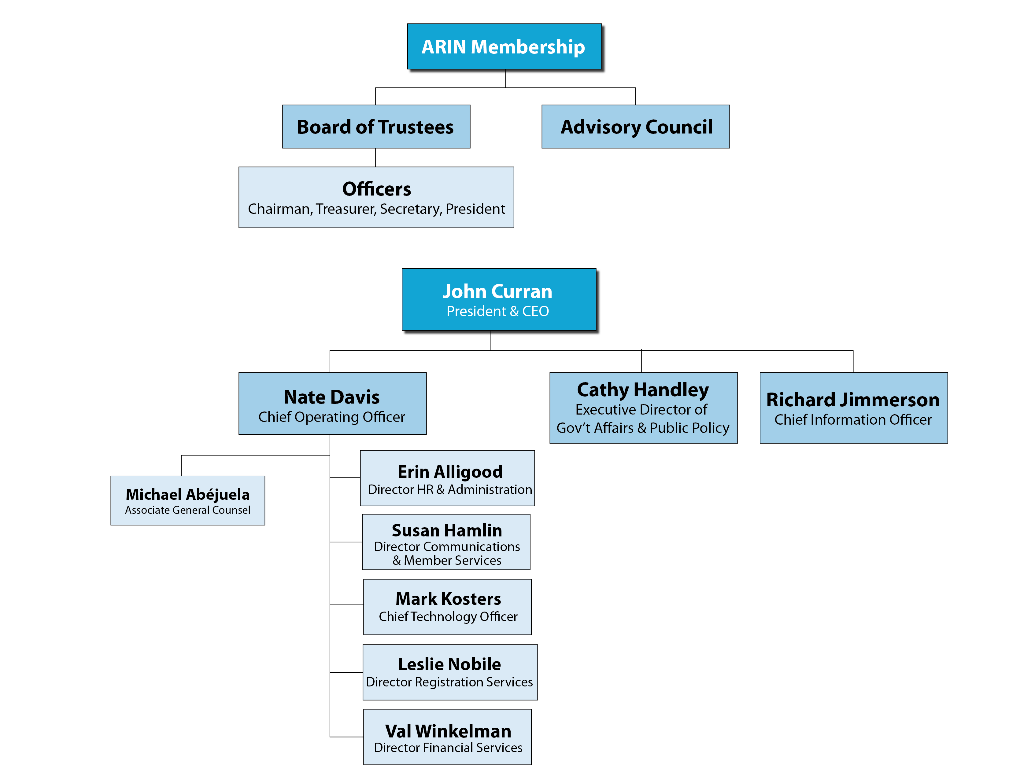
Organizational Chart

Slide 10
Registration Services
Coordination & management of Internet number resources (IPv4, IPv6, AS Numbers)
Internet number resource transfers
Directory Services
Registration transaction information (Whois)
Record maintenance
Routing information (Internet Routing Registry)

Slide 11

Technical Services
ARIN Whois/Whois-RWS
ARIN Online
Internet Routing Registry
Reverse DNS Services
DNSSEC
RPKI
IT support for organization

Slide 12
Organization Services
Information publication and dissemination and public relations
Education & Outreach events
Elections (Board, AC, NRO NC)
Policy development process – facilitation and documentation
Public Policy and Member Meetings

Slide 13
Policy Development Principles
Open
  Developed in open forum
    Public Policy Mailing List
    Public Policy Meetings
  Anyone can participate
Transparent
  All aspects documented and available on website
    Policy process, meetings, and policies
Bottom-up
  Policies developed by the community
  Staff implements, but does not make policy

Slide 14
Who Plays a Role in the Policy Process?
Community
  Submits proposals
  Participates in discussions and petitions
Advisory Council (elected volunteers)
  Facilitates the policy process
  Develops policy:
    Enables fair and impartial resource administration
    Technically sound
    Supported by the Community
  Determines consensus based on community input

Slide 15
Roles…
ARIN Board of Trustees (elected volunteers)
  Provides corporate fiduciary oversight
  Ensures the policy process has been followed
  Ratifies policies
ARIN Staff
  Provides feedback to community
    Staff and legal assessments for all proposals
    Policy experience reports
  Implements ratified policies

Slide 16
Policy Development Process - Basic Steps
Community member submits a Proposal
AC works with submitter to ensure clear problem statement and suggested policy change
AC puts Draft Policy on PPML for community discussion/feedback (possibly presented at PPC/PPM)
AC decides: continue work or abandon
AC recommends fully developed Draft Policy (fair, sound and supported by community) for adoption
Recommended Draft Policy presented at PPC/PPM
If AC still recommends adoption, then Last Call and review of last call
Board review
Staff implements

Slide 17
Petitions
Petitions available for:
  Delay by the AC
    Proposal to Draft Policy (after 60 days)
    Draft to Recommended Draft (after 90)
    Last Call (after 60)
    Board (after 60)
  Abandonment
  Rejection (proposals out of scope)
Petitions begin with 5 day duration, needing support from 10 people from 10 different organizations (later stages require more people)
Despite low bar, attempted petitions are rare

Slide 18
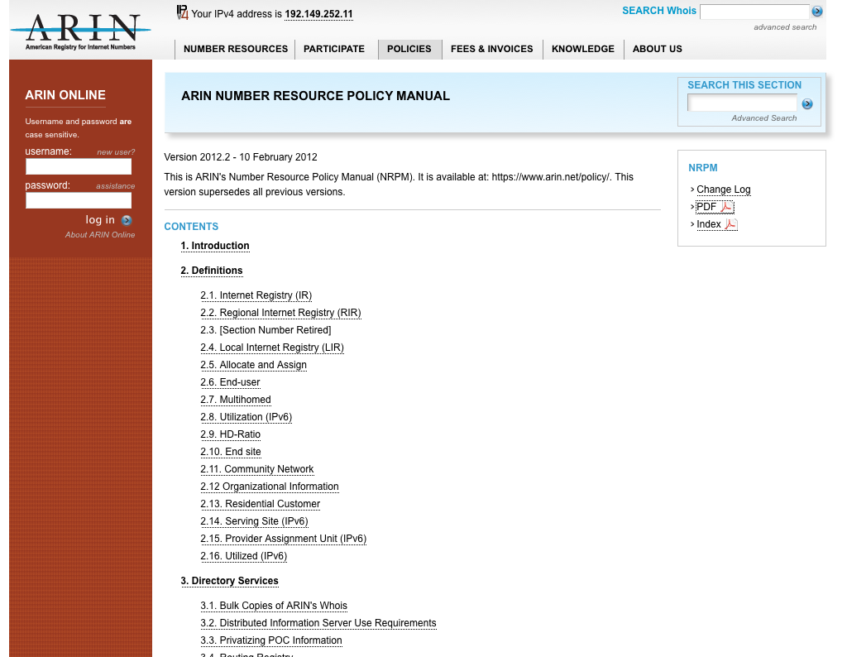
Number Resource Policy Manual
http://www.arin.net/policy/nrpm.html
Policies Covered:
IPv4 Address Space
IPv6 Address Space
Autonomous System Numbers (ASNs)
Directory Services (WHOIS)
Reverse DNS (in-addr)
Transfers
Experimental Assignments
Resource Review Policy

Slide 19
Policy discussions at this meeting
R ARIN-2013-7: NRPM 4 (IPv4) Policy Cleanup
Clean up of IPv4 policy text that will not really change anything
ARIN-2013-8: Subsequent Allocations for New Multiple Discrete Networks
Would remove the connectivity requirement text from the policy, and allow new discrete networks to get the minimum allocation
ARIN-2014-1: Out of Region Use
Will make it okay to use some address space outside of the region
ARIN-2014-2: Improving 8.4 Anti-Flip Language
Makes it easier for organizations to use the inter-RIR transfer policy to move space to themselves. - Full staff/legal requested

Slide 20
Policy discussions at this meeting
ARIN-2014-3: Remove 8.2 and 8.3 and 8.4 Minimum IPv4 Block Size Requirements
Removes the minimum prefix size (/24) for all types of transfers. [OD intends to abandon]
R ARIN-2014-4: Remove 4.2.5 Web Hosting Policy
Removes the policy about collecting information about web hosting
ARIN-2014-5: Remove 7.2 Lame Delegations
Removes the reverse DNS lame delegation policy
ARIN-2014-6: Remove 7.1 [Maintaining IN-ADDRs]
Removes the IPv4 reverse DNS policy

Slide 21
Policy discussions at this meeting
R ARIN-2014-7: Section 4.4 Micro Allocation Conservation Update
Exchange points would need to have three organizations connected for the exchange to be recognized as such (instead of just two)
ARIN-2014-8: Alignment of 8.3 Needs Requirements to Reality of Business
Would make it easier to get a real two-year supply of address space during an in-region transfer. - Full staff/legal requested
ARIN-2014-9: Resolve Conflict Between RSA and 8.2 Utilization Requirements
This is still a work in progress. - Full staff /legal requested
R ARIN-2014-10: Remove Sections 4.6 and 4.7
Removes the amnesty and aggregation policies.

Slide 22
Policy discussions at this meeting
ARIN-2014-11: Improved Registry Accuracy Proposal
Ensures services to legacy resource holders
ARIN-2014-12 Anti-hijack Policy
Prohibits the allocation of the same address space to more than one customer at a time

Slide 23
Proposals at Public Policy Meetings
(AC workload)
Notes:
Graph illustrates number of proposals (draft policies) presented at PPMs, basically shows the workload of the Advisory Council.
Example, 2001 saw 7 proposals discussed/presented at meetings with 5 ultimately adopted and 2 abandoned.
2007 spike saw community/AC dealing with IPv4 depletion.

Slide 24
How to monitor and not be overwhelmed?
Once a month:
Front page of the website leads to proposals and draft policies under discussion
  New proposals need feedback for the AC’s initial decision
  Web site can help you focus on what’s important to you and your company
Twice per year:
Check the ARIN Public Policy Meeting site in the weeks leading up to the meeting
  Proposals/Draft Policies on Agenda
  Discussion Guide (summaries, text, staff assessments)
  Attend in Person/Remote
AC meeting last day: Watch list for AC’s decisions, Last Calls –
State your opinion, are you For or Against?

Slide 25
What’s Ahead this week
Today: 5:30 – 7:00 PM Happy Hour – Club International
Monday: Grand Ballroom
ARIN Public Policy Meeting 9:00 AM – 5:00 PM
ARIN social – Field Museum (Buses depart starting at 6:30 PM)
Tuesday: Grand Ballroom
ARIN Public Policy Meeting 9:00 AM – 5:00 PM
NEW - Dine Around –DIY - Sign up at the Registration Desk
Wednesday: Grand Ballroom
ARIN Members Meeting (open to all), 9:00 AM – Noon

Slide 26
Ways to participate this week:
Membership is not required ☺
Meet your fellow attendees at meals and during breaks
Join a lunch table topic discussion led by an Advisory Council member
ARIN Board, Advisory Council, NRO Number Council and Staff all have ribbons on our name tags – seek us out and ask questions
Go the floor microphones in the meeting room, be sure to state name and organization upfront
Raise your hand to voice your opinion when votes are taken during policy discussions

Slide 27

Participate in ARIN
  Contribute your Opinions and Ideas:
    Public Policy Mailing List
    IPv6 Wiki
    Attend Public Policy and Members Meetings, Public Policy Consultations, outreach events
    Submit a suggestion
    Participate in community consultations
    Write a guest blog
    Members – Vote in annual elections

Slide 28
Don’t Forget Your Survey
Please complete the survey form and drop it in the bowl.
Be present in the meeting room tomorrow morning at the start for the drawing – you might win a $100 Think Geek gift certificate.

Slide 29
Questions?

Slide 30
Reference Material

Slide 31
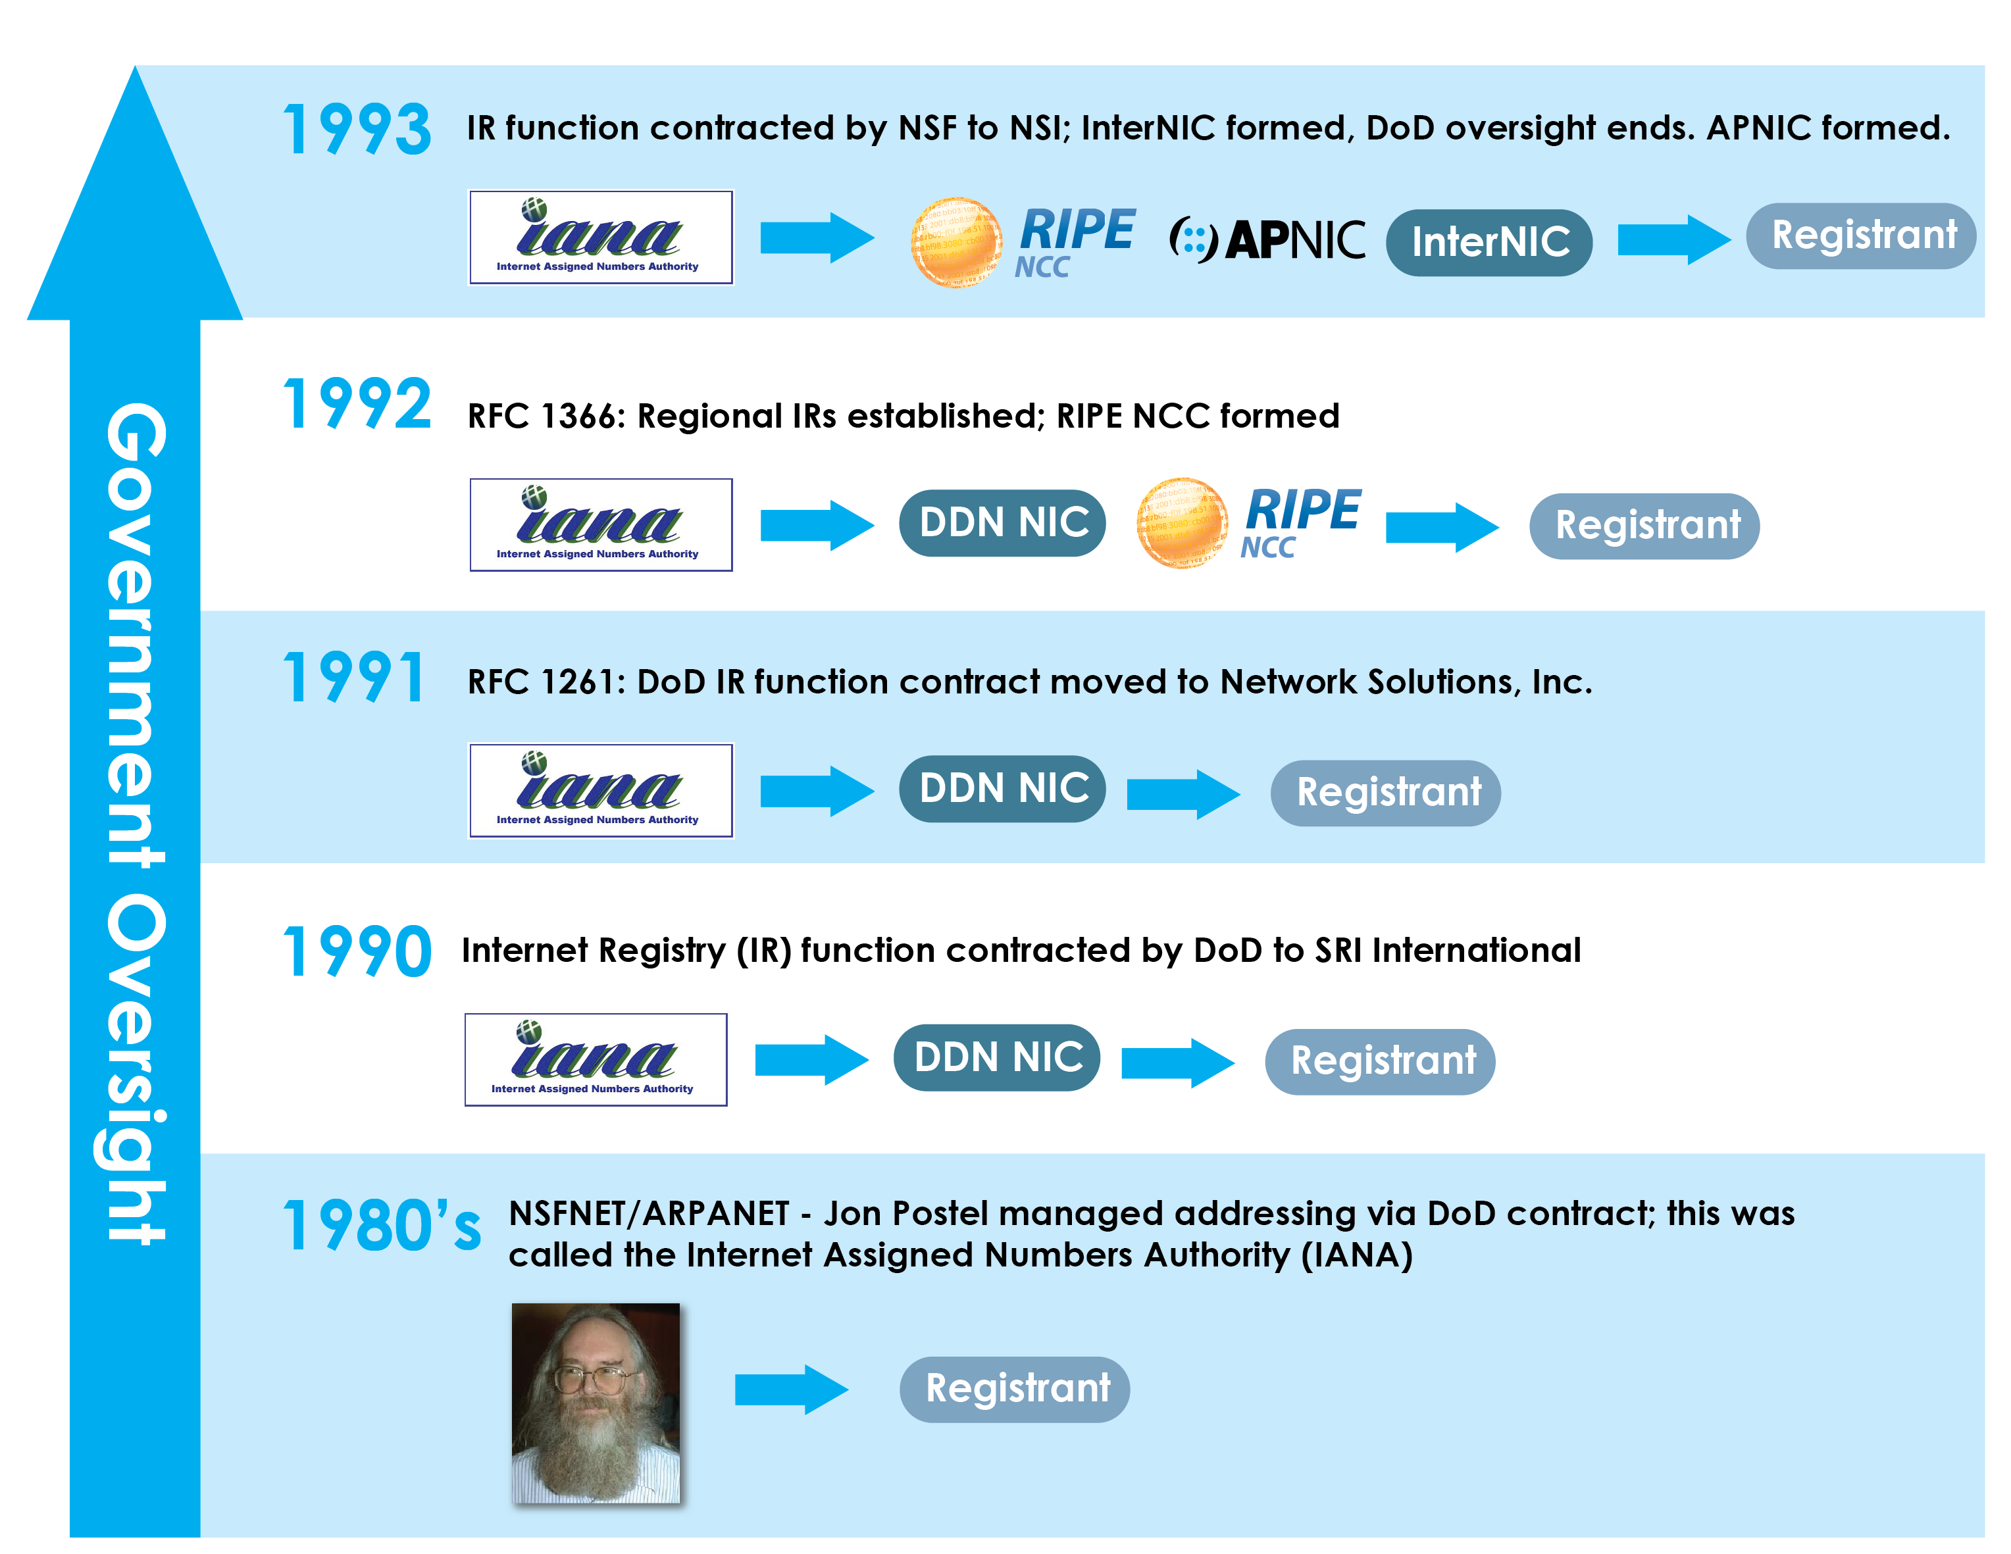
Historical Timeline

Slide 32
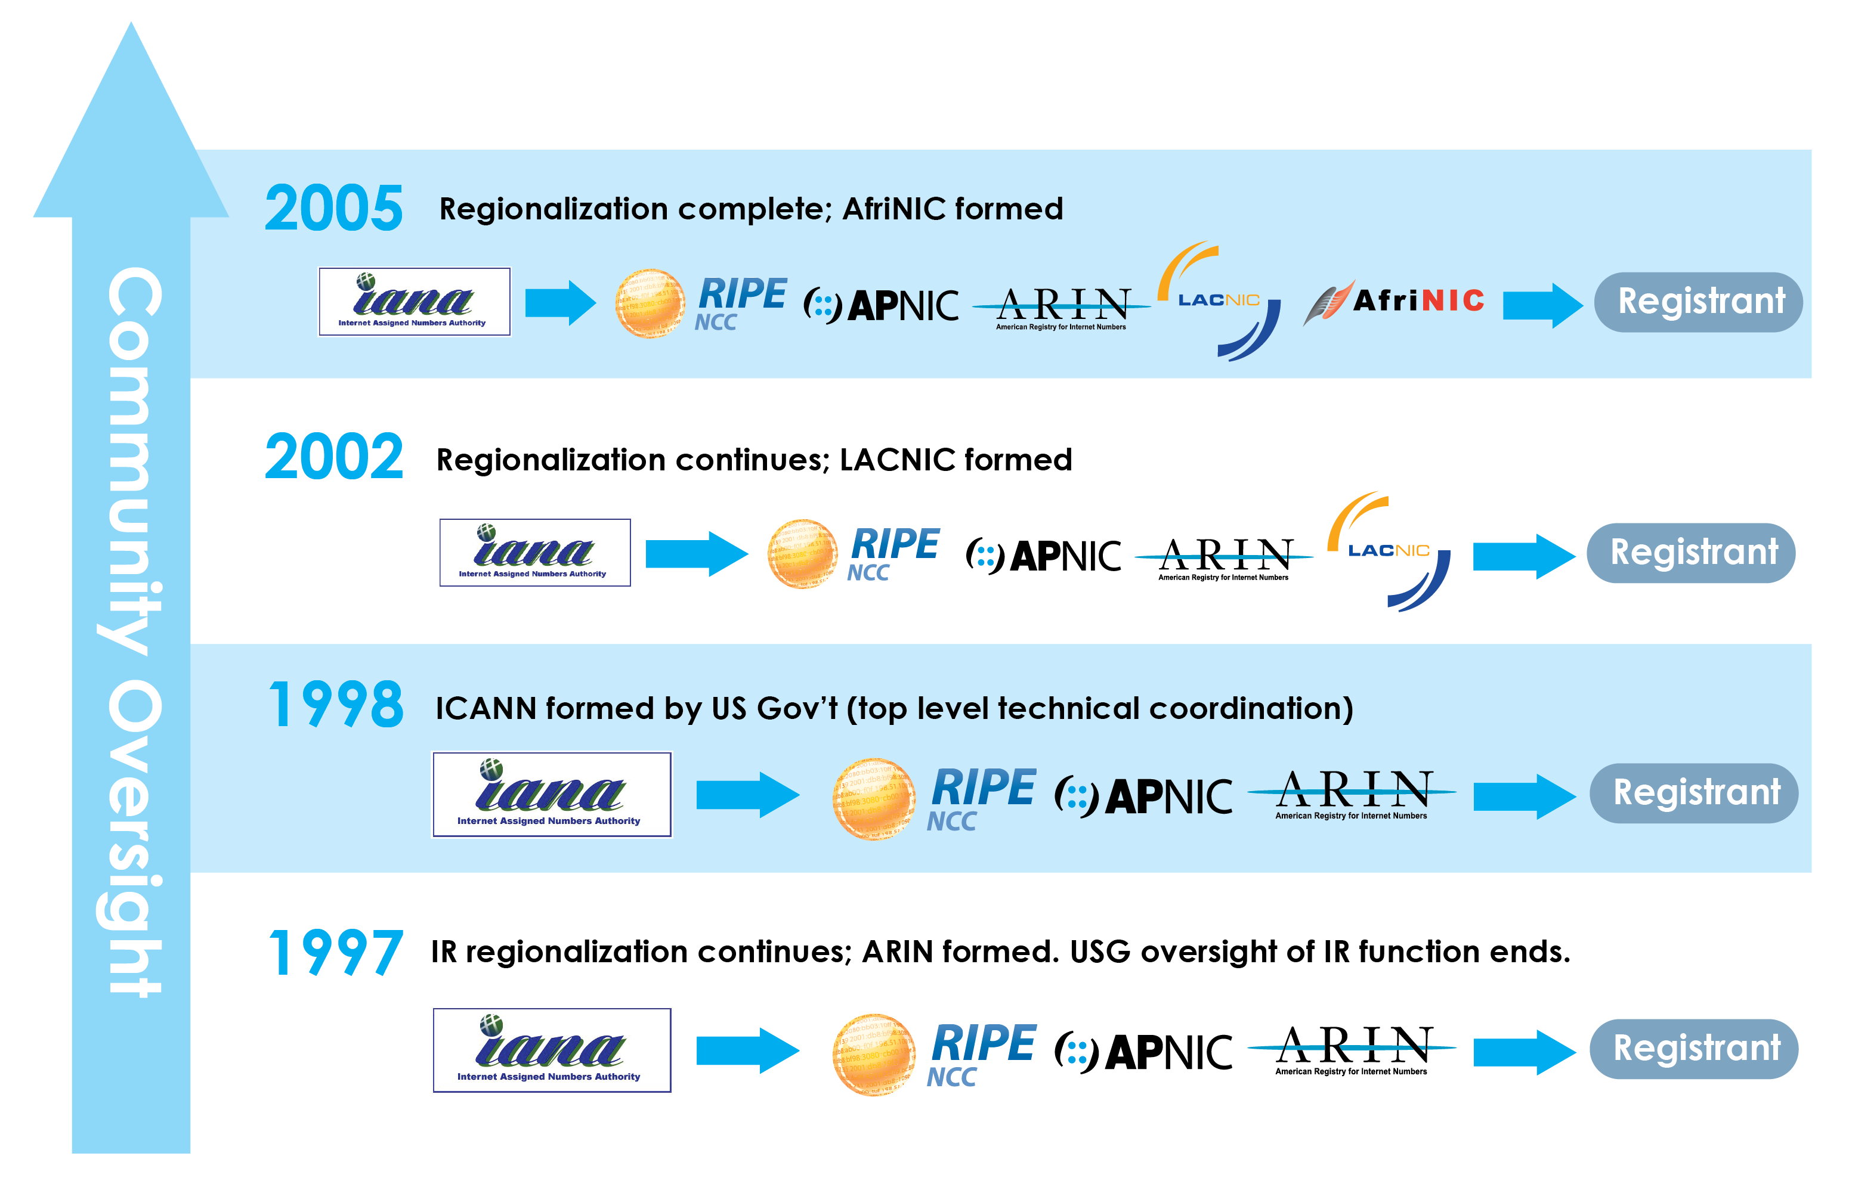
Historical Timeline

