Slide 1
Director, Financial Services
Valorie Winkelman

Slide 2
Summary
Staff
ARIN Online
Updating Billing Point of Contact
Fee Calculator – ARIN Online
Payment/Invoicing Statistics

Slide 3
Finance Department Staff
Nate Davis, COO, assumed executive responsibilities for Finance Department
Valorie Winkelman, Director of Finance
Tammy Rowe, Accounting Supervisor
- Tanya Gomez, Senior Account Service Rep
- Amaris Wang, Senior Account Service Rep
- Amy Sanchez, Senior Account Service Rep
- Mursal Attai, Jr. Account Service Rep

Slide 4
Billing Management in ARIN Online
It is important to keep your Billing POC (BPOC)up to date for several reasons:
The BPOC is the only contact point for sending initial invoices
Reminders are sent to the BPOC as well as the Admin, Tech and DMR POC
Contact point for ARIN staff should there be questions regarding the account

Slide 5
Billing Management in ARIN Online
If you have an ARIN Online web account linked to an organization (ORG) as an Admin, Tech, Billing or DMR Point of Contact (POC), you may modify billing contact information within ARIN Online. To access this information:
- Log into your ARIN Online account
- Select BILLING INFO from the left-hand menu
- Click the Org ID from the List that you want to review
- At the Billing Information Page, if the information is incorrect, click modify from the Manage Billing section on the right- hand menu
- Proceed to provide the new contact information and submit

Slide 6
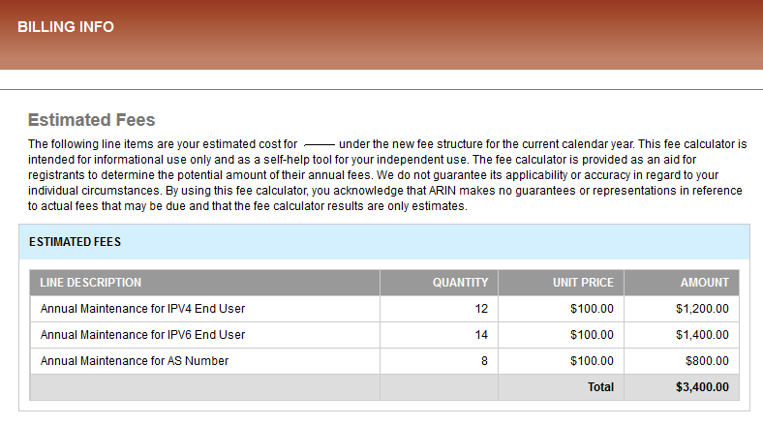
ARIN Fee Calculator
ARIN Online features a fee calculator for ARIN resource holders wishing to view an estimate of annual fees.

Slide 7
ARIN Fee Calculator (cont’d)
Users linked to at least one ORG with billable resources may view an estimate of their annual ARIN fees by navigating to the Billing Info section, selecting an ORG, and selecting the "fee" button on the right. This table will list that ORG's fees as they apply to their current resource holdings, and list them by category with a total on the bottom row. This table is populated via queries to Navision.

Slide 8
Payment Types YTD August 2013

Slide 9
Registration Revenue

Slide 10
Registration Revenue by Mix %

Slide 11
Questions?

