Slide 1
Registration Services Department Update
Leslie Nobile

Slide 2
RSD Team
Principal Resource Analyst
Cathy Clements
Senior Resource Analysts
Jon Worley
Lisa Liedel
Resource Analysts
Doreen Marraffa
Sue Dobert
Mike Pappano
Eddie Diego
Shawn Sullivan
Misuk Kwon
Notes:
What do we do – issue v4, v6 and asns, handle all transfers, do all modifictaions and updates, maintain the integrity of the database, run the irr, run a helpdesk,run services like stls, do outreach, act as smes to all departments, particularly cmsd and to john as he receives many external inquiries. RSD runs the core function of the registry by issuing resources, implementing policies, running a helpdesk, maintainingg whois and the irr, etc. but we also act as sme within the company, provide support to many outreach events, etc. They are at the forefront of this changing world we live in and are doing a great job at adapting and excelling. And I just want to recognize them for all of their hard work.

Slide 3
Recent Trends
IPv4:
No measurable increase in total space issued
Slight increase in requests, particularly end user
Transfers:
No measurable increase in requested transfers
IPv6:
Slight increase in IPv6 ISP requests, decrease in end user
ASNs:
Slight increase in total ASNs issued
32 4-byte ASNs issued, none returned
Notes:
13% increase in iPv6 ISP requests
14% increase in total ASNs issued

Slide 4
Recent Trends…
POCs of legacy resources registered to companies dissolved long ago requesting to transfer these resources; not always clear they are authorized
Increase in out of region requests from both APNIC and RIPE regions

Slide 5
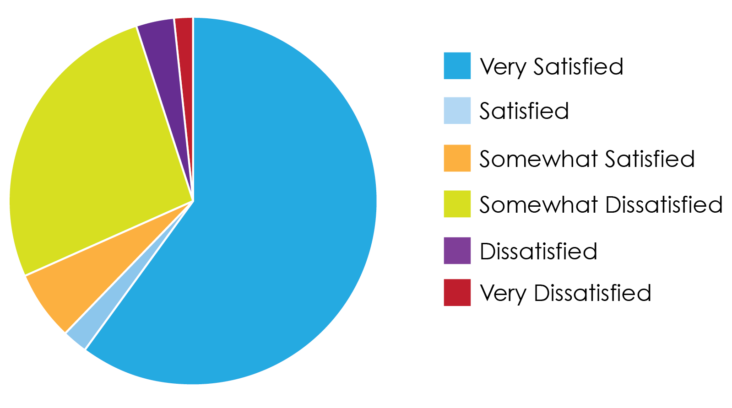
Customer Transaction Survey Results Overall, how satisfied were you with the entire request process?
*93.1% were either very satisfied, satisfied or somewhat satisfied

Slide 6
Current IPv4 Inventory
1.74 /8 equivalents in the pool
of available addresses
7.02 /16 equivalents in the “RRH” bucket (number fluctuates)
(RRH = returned, revoked, held)
1 /10 reserved
For NRPM 4.10 “Dedicated IPv4 block to facilitate IPv6 Deployment”
1.74
*As of Oct 1, 2013

Slide 7
Block Size Distribution of Remaining IPv4 Inventory
Total /8: 1 Total /10: 2 Total /13: 2 Total /14: 2 Total /15: 1 Total /16: 9 Total /17: 11 Total /18: 16 Total /19: 24 Total /20: 10 Total /21: 97 Total /22: 72 Total /23: 623 Total /24: 1372
When Might ARIN break into the last /8?
~.74 /8 equivalents remaining not including the last /8
Based on current issuance rates of blocks /22 and larger, It could be 6-7 months before we need to break up the last /8
Dependent upon the number of larger prefixes issued
https://www.arin.net/resources/request/ipv4_countdown.html

Slide 8
ARIN’s IPv4 Countdown Plan
Defined process for final IPv4 requests, divided into 4 phases
Currently in Phase 3; will move into Phase 4 once ARIN has one /8 equivalent remaining
First in, first out
All IPv4 requests team reviewed
Hold period for recovered resources moves to 30 days
60 days from approval to complete payment and RSA
https://www.arin.net/resources/request/ipv4_countdown.html
Notes:
ARIN has reviewed and refined its procedures to create an IPv4 Countdown Plan explaining how IPv4 requests will be processed as the remaining IPv4 address pool is distributed. There are a number of variables that could accelerate or slow the rate at which ARIN moves through each phase. Some IPv4 space may be returned to IANA in accordance with global policy and new policies and/or larger requests could change intended plans and lead to faster depletion of the remaining IPv4 address pool.
**Working with CMSD on communications planning for next phase

Slide 9
Recovered Resources
Year | IPv4 blocks (/16 equivalents) | ASNs
2007 | 101.2 (85% returns) | 1552 (12% returns)
2008 | 178.6 (87% returns) | 704 (28% returns)
2009 | 133.10 (86% returns) | 462 (40% returns)
2010 | 44.5 (49% returns) | 1446 (32% returns)
2011 | 284.4 (96% returns) | 365 (39% returns)
2012 | 7 (45% returns) | 852 (41% returns)
2013* | 4.4 (4% returns) | 390 (33% returns)
*As of Sep 30, 2013
Notes:
Overall, we recover about two thirds of the total number of 2 byte asns that we issue each year
Issuing on average 1400 2 byte ASNs per year

Slide 10
Common Problems with Resource Requests
First time requestors don't have IPs reassigned (swipped) to them by their upstream(s)
/24s being requested for anycast/multi-homing requirements with no host counts to support the request (no policy to support this)
Not multi-homed or won’t be for many months, want IP addresses in advance in order to be ready to deploy
Notes:
Multi-homed policy – says that you must have intent to mulit-home immediately (we use 30 days as a measure and require connectivity agreements)

Slide 11
Common Problems…
Block size requested is larger than justified for three month need based on demonstrated historical utilization rate
Customer justification data not well understood (they would like a standard form)
Don't want to provide customer information due to privacy concerns
Customers want their requests expedited

Slide 12
Phone Stats (Jan-Sept 2013)
Phones staffed 7am to 7pm ET
Average # of calls per month: 776
Highest call volume time: 2:00 – 3pm
Lowest call volume time: 7:00 – 8am
Busiest call day of the week: Tuesday
Least busy day: Friday

Slide 13
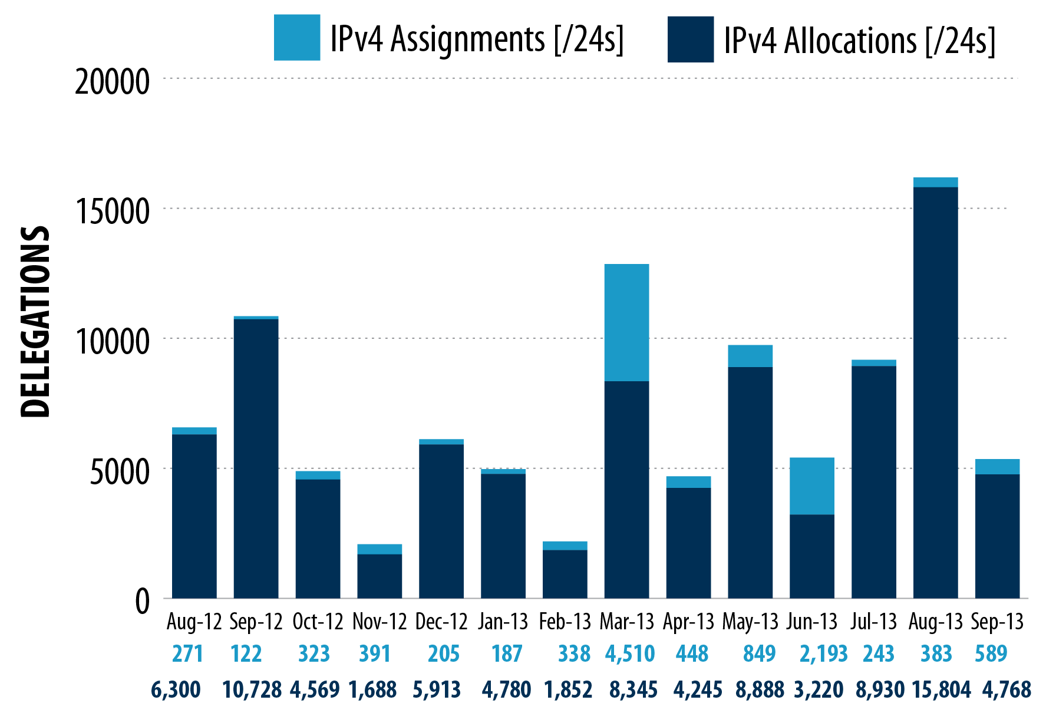
IPv4 Space Issued
*1.07 /8s issued as of Sept 30, 2013
Notes:
Issued 1.47 /8s in 2012

Slide 14
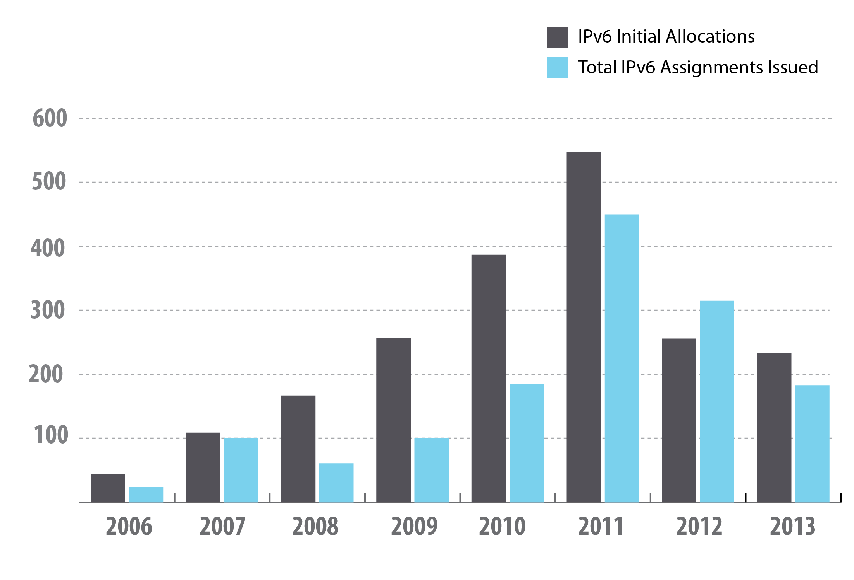
IPv6 Space Issued
*2013 data through Sept 30
Notes:
218 allocations and 161 assignments through August 2013.
**ERIN - Need to add September stats – 15 IPv6 allocations, 22 IPv6 assignments, Total 2013 ytd = 233 IPv6 allocations and 183 IPv6 assignments
ERIN - **Can you add a box around the 2013 stats?? Leslie – not sure what you mean here?

Slide 15
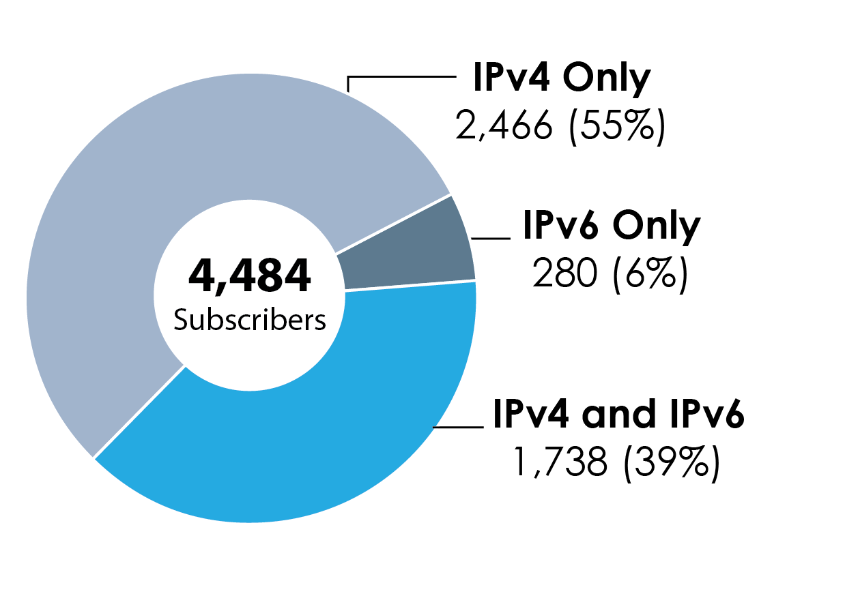
IPv4 vs IPv6 Subscribers
Notes:
**ERIN - Need to update as follows:
As of Oct 1, 2013:
Total subscribers: 4484
Total IPv4 only: 2466 (55%)
Total IPv4:IPv6: 1738 (39%)
Total IPv6 only: 280 (6%)

Slide 16
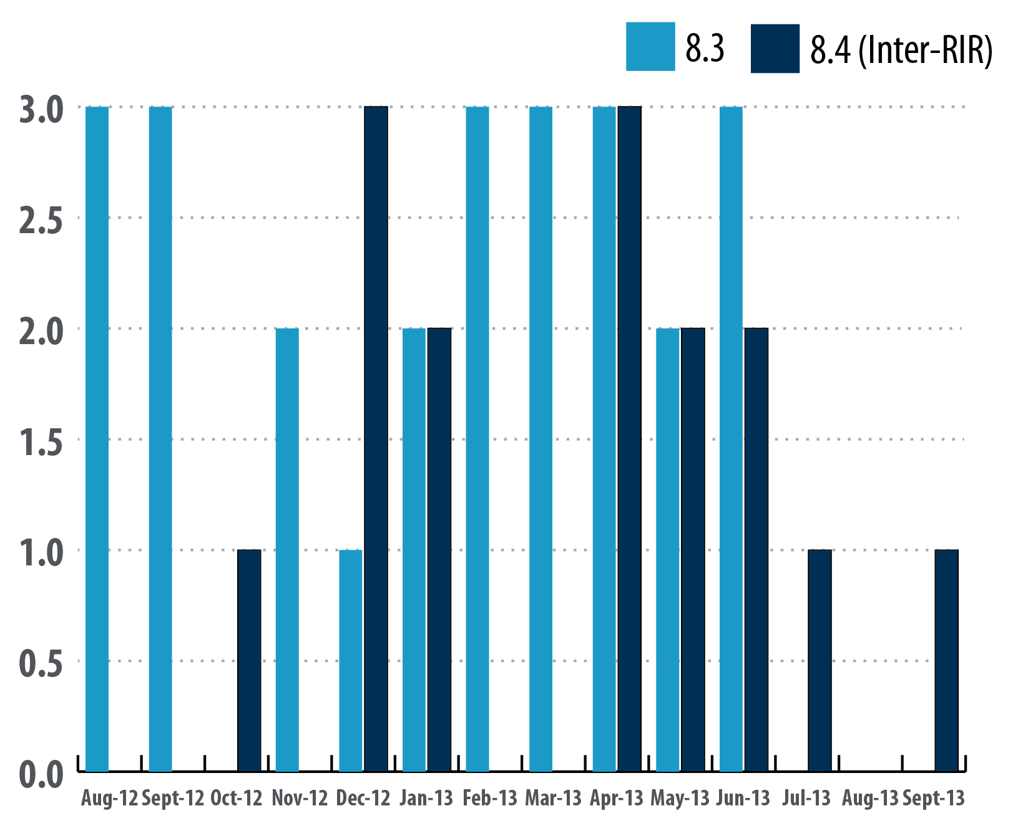
8.3 (Specified) & 8.4 (Inter-RIR) Transfers
*18 completed
Inter-RIR transfers
from ARIN to
APNIC region to date
16
Notes:
All stats need to be updated as follows:
Remove Jan 2012 through July 2012

