Slide 1
Policy Implementation & Experience Report
Leslie Nobile
Director, Registration Services

Slide 2
Policy Implementation Report

Slide 3
Purpose
Present a quick overview of recently implemented policies
Provide relevant operational updates or statistics on existing policies

Slide 4
Recently Implemented Policies
ARIN-2011-1 “ARIN Inter-RIR Transfers” on July 31
Inter-regional transfers may take place between RIRs who agree to the transfer and share reciprocal, compatible, needs-based policies
ARIN-2012-1 “Clarifying Requirements for IPv4 Transfers” on July 31
Added criteria to prevent “flipping” of IPv4 space during an 8.3 transfer
ARIN-2012-3 “ASN Transfers” on July 31
Added ASNs to “8.3. Transfers between Specified Recipients within the ARIN Region”

Slide 5
NRPM 8.3 and 8.4 Transfers
First inter-RIR transfer was successfully completed on October 9, 2012
/24 went to a company in Australia
2nd inter-rir transfer in progress
2 ASNs have been transferred under NRPM 8.3 since the policy was implemented in July

Slide 6
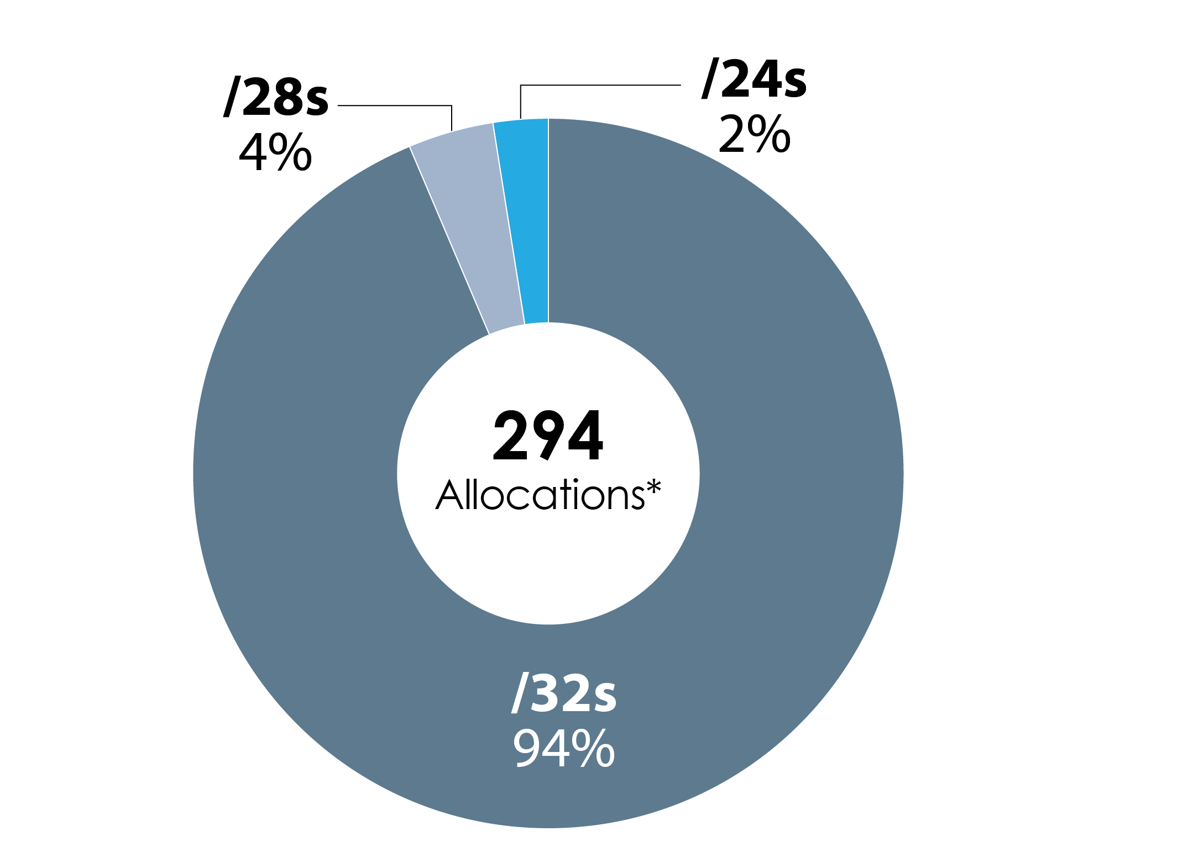
IPv6 ISP Block Sizes
* Since new policy implemented 9/27/2011

Slide 7
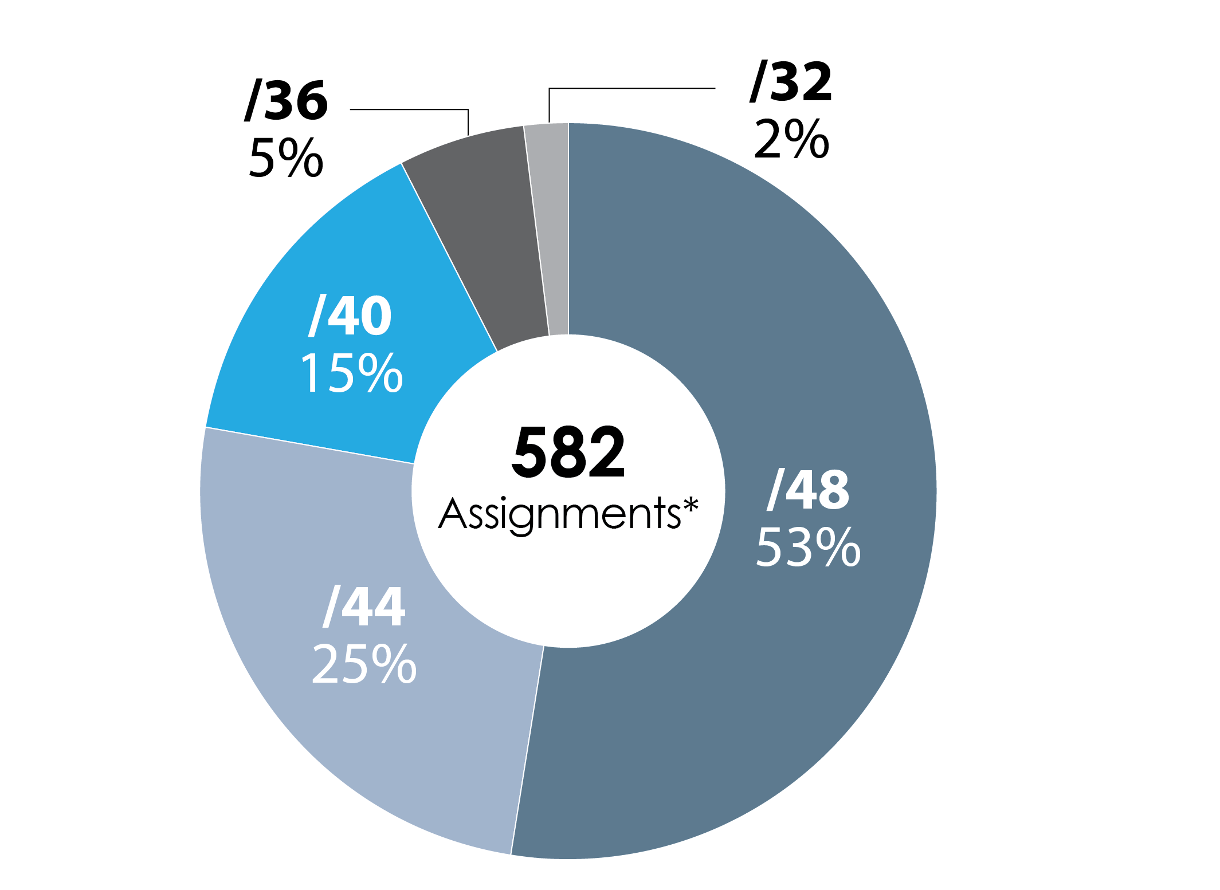
IPv6 End User Block Sizes
* Since new policy implemented on 3/16/2011

Slide 8
Policy Experience Report

Slide 9
Purpose
Review existing policies
Ambiguous text/Inconsistencies/Gaps/Effectiveness
Identify areas where new or modified policy may be needed
Operational experience
Customer feedback
Provide feedback to community and make recommendations when appropriate

Slide 10
Policies Reviewed
Efficient utilization (referenced in NRPM 4.2)
Initial vs Additional allocation policies for legacy holders (initial and additional referenced in NRPM 4.2.2 and 4.2.4)

Slide 11
Efficient Utilization

Slide 12
Question for the Community
Is the use of IP addresses in bulk to avoid email filtering considered to be efficient use?
Notes:
Normally, if someone is saying "I assigned this customer a /24 under the
multi-homed customer policy", we would check route servers to verify that
the customer is announcing the addresses from their own AS number and it
appears to have two upstreams.

Slide 13
Problem Statement
ARIN is receiving requests from small and new email marketers for several thousand IP addresses (or more) based on:
Separate IP address per marketing campaign for IP based reputation
Limiting volume of email sent per IP address to avoid filtering
Rotating IP addresses to avoid filtering
Yet many legitimate email marketers send out a large amount of email using only several hundred IP addresses

Slide 14
Problem Statement (cont’d)
If successful marketing companies are able to run their entire business with only a few hundred IP addresses, should ARIN accept numbering plans from the same types of organizations who plan to consume thousands of addresses in order to accomplish the same goal?

Slide 15
Current Staff Practice
We typically consider one IP address per device or customer to be acceptable, even if multiple customers per IP address are possible
Although this may not necessarily be efficient utilization, we have no policy basis to deny if indeed they will be utilized
Is clearer guidance from the community possible with respect to IP address usage for bulk email?

Slide 16
Initial vs Additional Allocation Policies for Legacy Holders

Slide 17
Question for the Community
Should a legacy space holder who comes to ARIN to request space for the first time be reviewed under the Initial policies or Additional Request policies ?

Slide 18
Problem Statement
Existing policies do not provide any guidance in this area

Slide 19
Current Staff Practice
If a legacy space holder comes to ARIN for the first time:
They are reviewed under Initial allocation policies
Legacy space is counted towards policy justification requirements
All previous space must be 80% utilized

Slide 20
Issues
An organization with legacy space may have efficiently used all of it, but still not qualify for an initial allocation:
Multi-homed ISP has a /24 (policy requires at least a /23 to qualify)
Single-homed ISP has a /21 (policy requires at least a /20 to qualify)

Slide 21
Issues
Reviewing under additional allocation policies would provide an advantage to legacy holders:
Legacy /24 holder could qualify for a /22 by showing 80% utilization
Yet an ISP with a provider assigned /24 would be unable to qualify for a /22 under any policy

