Slide 1
IPv4 Allocation Implications
Wholesale TPIA Service in Canada
Stephan Meyer
Manager, Network Technology
CRTC, CANADA

Slide 2
Who Are We?
The Canadian Radio-television and Telecommunications Commission (CRTC) regulates and supervises Canada’s communication system in accordance with the mandate entrusted to it by Parliament, including achieving the policy objectives established in the Broadcasting Act and the Telecommunications Act
CRTC regulates the players and the markets, NOT the technologies
The CRTC is largely the Canadian equivalent of the U.S. Federal Communications Commission with some notable differences
CRTC Mission: The CRTC seeks to ensure that Canadians have access to a world-class communication system

Slide 3
Why am I Here?
First and Foremost: To Learn and Interact!
CRTC does not have any direct involvement in IP numbering as it does with telephone numbering
Nonetheless, stakeholders raise issues related to IP numbering implementation to us

Slide 4
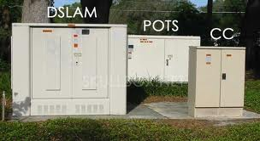
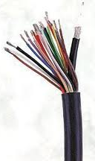
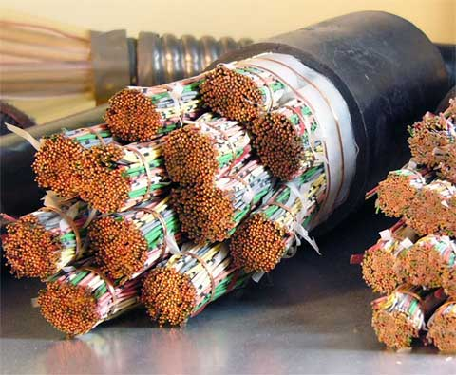
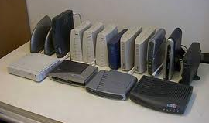
Canadian Access Market
Like the US, the Canadian access market is characterized by two separate wireline networks entering most homes and many businesses: copper loops and co-axial cable. [And yes, a smattering of optical fiber.]

Slide 5
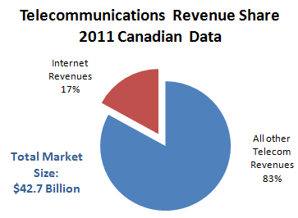
Market Characteristics
With limited facilities-based players, there are concerns about the control they may exert in specific markets.
Source: CRTC 2012 Communications Monitoring Report

Slide 6
Regulatory Climate
To foster a competitive market for the provision of Internet services, the CRTC has implemented a wholesale regime for the underlying access services
Both incumbent telcos and cablecos have unique offerings, which they implement differently
These differences lead to both regulatory and technical challenges; the CRTC is technologically neutral, preferring to rely on the industry to address problems as they arise

Slide 7
Impact on IP Addressing
In wholesale DSL offering, competitors manage their own IP address pools
In wholesale DOCSIS offering, known as Third Party Internet Access (TPIA), competitors generally hand over their IP address allocations to the incumbent to distribute
Incumbents often sub-net their network at the CMTS level, sometimes stranding IP addresses
With unequal growth throughout network, this could lead to seemingly inefficient IPv4 utilization

Slide 8
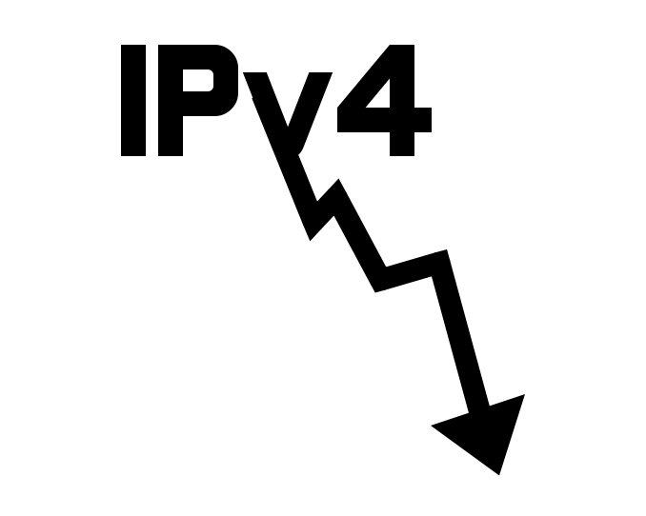
Commission Involvement
Shortage of IPv4 addresses at CMTS locations could lead to DHCP issues and customers unable to get access to the Internet through their chosen provider
CRTC strives to ensure a competitive market and access to a world-class communications system
Although not directly involved in this numbering issue, it is in our interest to monitor the discussion and ensure any problems can be resolved
We welcome discussion of Draft Policy ARIN-2012-7, and are confident that parties with a stake in its outcome will take part
Key question for ARIN to explore is what is the appropriate response?
Must ensure IPv4 space is efficiently used, but also ensure that citizens can access Internet through provider of choice

Slide 9
What is the Bottom Line?
Communications networks are vitally important
Canadians’ (and global) usage and reliance continues to grow
Need to facilitate competitive market
Revenue concentrated in a few major service providers
Affordable, competitive rates for Canadians requires mix of regulation and market forces (including policies such as ARIN's)
Innovation and investment balanced with appropriate regulatory regimes will ensure growth and adoption of services
Canada will continue to follow regulatory and standards developments in other jurisdictions
Policies are flexible and should adapt to accepted best practices

Slide 10
Thanks!

