Slide 1
AFRINIC Update
Ernest Byaruhanga
ARIN-XXX
Dallas, Texas

Slide 2
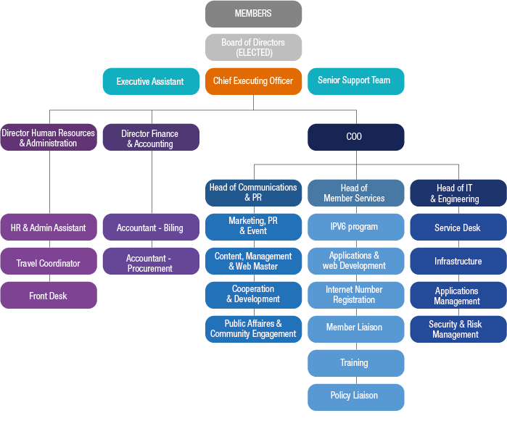
New Structure

Slide 3
AFRINIC at Glance
33 full time staff (11 joined in 2012)
3,134,028 IPv4 addresses issued in 2012
67,393,008 IPv4 addresses (4.01 /8s) available
107 New members in 2012 making our total membership 866 (excluding legacy)
15 training events in 2012 (14 countries)
66 new IPv6 prefixes allocated (100%+ growth in IPv6 Allocations)
5 Policy Proposals under discussion

Slide 4
Policies under discussion
Proposal | Status
Definition of “Core DNS Service Provider” | Under Discussion
Privacy For Regional Internet Registry Data | Under discussion
Anycast Assignment Policy in AFRINIC region | Under discussion
No rDNS unless prefix is ‘assigned’ | Under Discussion
Periodical AFRINIC Database Cleanup | Under Discussion

Slide 5
IPv4 Statistics
Total Allocation Trend:
50 million IPv4 addresses allocated in the region since ‘84
Allocation Trend:
2008 – 2011: 28 million (57%) issued in the last 4½ years.

Slide 6
IPv6 Allocation Growth
Yearly IPv6 Allocation (/48)
Top 5 Leading Countries
Notes:
IPv6 Allocation Trend (/32)
Year : 2005 2006 2007 2008 2009 2010 2011 2012
/32 : 4 21 40 54 67 121 250 304
Top 10 Leading Countries
Country: RSA KEN NGR TAN GHA ANG MRU UGN EGY ZAM Other
/32 : 78 28 24 19 14 13 13 12 10 9 84

Slide 7
Extended Stats
Enhancement to the usual FTP resource stats to include:
Available Resources
Reserved Resources
Now online:
ftp://ftp.afrinic.net/pub/stats/afrinic/delegated-afrinic-extended-latest

Slide 8
Communication & Outreach
New Logo
New web site
New Meeting Management tool
Join the wave of Social Media use for outreach
TO

Slide 9
Dedicated Training Portal
learn.afrinic.org

Slide 10
FIRE Initiative
www.fireafrica.org

Slide 11
Africa Internet Summit

Slide 12
Next AFRINIC meeting

Slide 13
Questions

