Slide 1
Human Resources and Administration Department
Mary K. Lee
Director

Slide 2
Update
About Us section
Current Items
Staffing

Slide 3
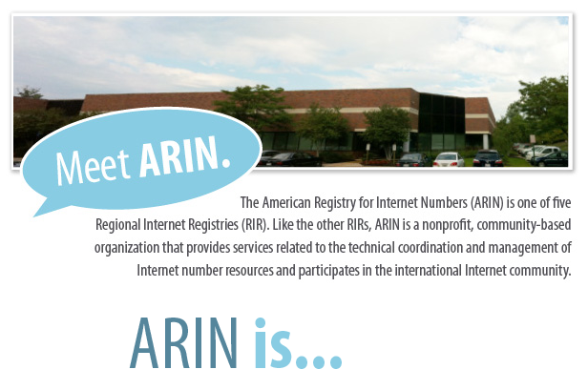
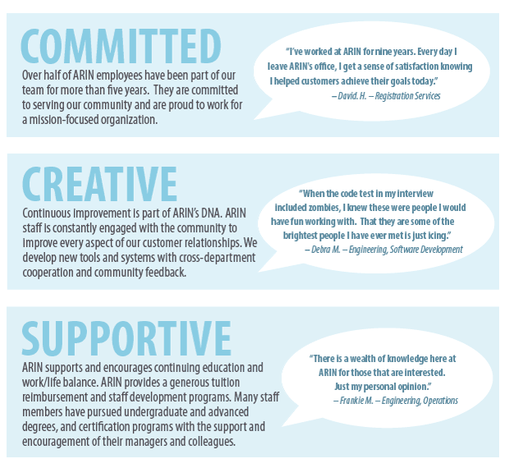
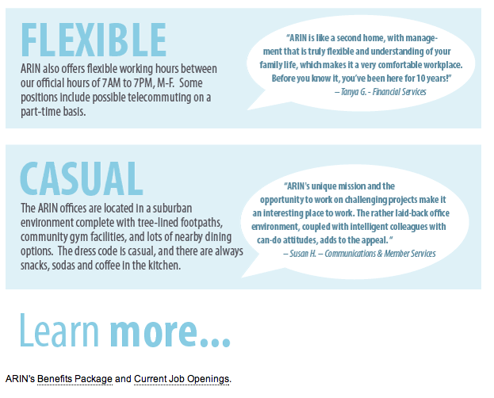
About Us – jobs section

Slide 4
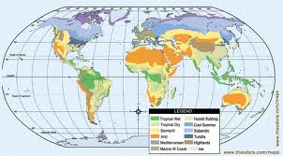
Current Items
New travel company
401K retirement plan improvements
Support annual budget process

Slide 5
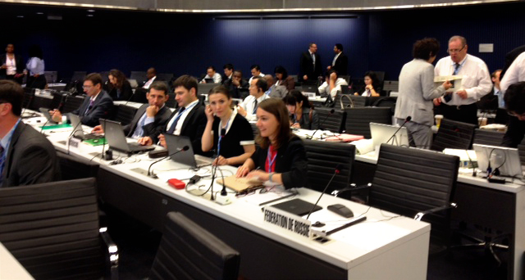
Current items
New phone system
HVAC replacement
WCIT preparatory meetings

Slide 6
Employee Tenure

Slide 7
Staffing
Tenure
Staffing and recruitment
Anniversaries

Slide 8
And one more anniversary!
ARIN’s 15 year anniversary is in December
Thanks to Everyone!

Slide 9
Thank you!

