Slide 1
Communications and Member Services
Susan Hamlin
Director

Slide 2
The CMSD Team that “kicks boot”
Einar Bohlin – Senior Policy Analyst
De Harvey – Meeting Planner
Jud Lewis – Membership Coordinator
Hollis Kara – Communications Manager
Jennifer Bly – Outreach Coordinator
Jason Byrne – Communications Strategist
Sean Hopkins – Communications Writer
Erin Sellers – Graphic Designer

Slide 3
Participation Statistics
4255 ARIN Members
434 Canada
48 Caribbean and North Atlantic
3764 United States
9 Outside region
2046 subscribers to PPML
3637 Subscribers to ARIN-announce
2528 Subscribers to ARIN-discuss

Slide 4
Organization Services
Information publication and dissemination
www.arin.net
www.teamarin.net
social media
media relations, LEWIS PR
supports external relations
Conducting Members Meetings
New member orientation
Elections
Outreach and training
ARIN Consultation and Suggestion Process

Slide 5
Policy Development Services
Facilitating the Policy Development Process
Maintaining discuss email lists
Publishing policy documents
Supporting the Advisory Council
Conducting Public Policy Meetings

Slide 6
Social Media Update
Guest blogs
New blog series
1,654 likes
3,337 followers
419 group members
70 +1s

Slide 7
New Materials & Information
Notes:
New content on Reg-RWS and DNSSEC too

Slide 8
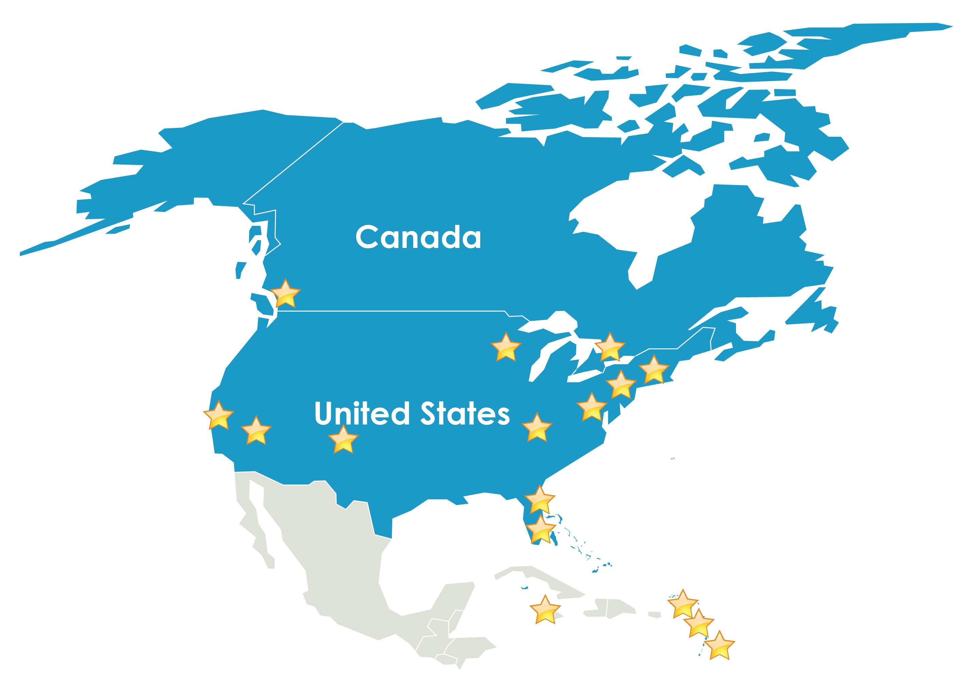
Outreach since ARIN XXIX in April
Notes:
Interop – Las Vegas, New York
ARIN on the Road – Louisville & Minneapolis
ICT Roadshow – Barbados, Belize
CTIA Wireless – Las Vegas
HostingCon – Boston
NANOG - Vancouver
So. Florida Tech Alliance: IPv6 – Fort Lauderdale, FL
Canto – Miami
IGF USA – Washignton, DC
Caribbean Interview Governance Forum – St. Lucia, Trinidad
CaribNOG 3
National ICT Day – Montserrat
GDC Online
Internet 2/Joint Techs – Palo Alto, CA
The Cable Show
UCC Internet Day - Jamaica
iNet/IPv6 Day – Curacao
Canadian ISP Summit – Toronto in November

Slide 9
2013 Outreach Activities
CES, Interop, North American IPv6 Summit, CANTO, Canadian ISP Summit,
Caribbean ICT Roadshows, CaribNOG
Check out ARIN’s Speakers Bureau:
TeamARIN, Spread the Word
Coming to a location near you…

Slide 10
New community consultations:
Changes to the ARIN Fee Schedule
Coming soon: A revised Policy Development Process
Open until 26 November
Join arin-consult@arin.net to make your opinion known and to offer constructive comment
http://lists.arin.net/mailman/listinfo/arin-consult

Slide 11
2013 Meetings
Changes coming:
ARIN is eliminating meeting registration fees for advance online meeting registration.
Fees for social guests will still be charged

Slide 12
2013 Meetings
21-24 April 2013

Slide 13
https://www.arin.net/app/election/

Slide 14
“The two words information and communication are often used interchangeably, but they signify quite different things. Information is giving out; communication is getting through.”
Sydney Harris
Are we succeeding?

Slide 15
Let us hear from you!
info@arin.net

