Slide 1
APNIC Update
ARIN XXVIII
13 October 2011
Philadelphia
Geoff Huston,
APNIC
Notes:
Check the actual name of the RIR meeting. Coming meetings
- LACNIC XVI
- ARIN XXVIII
RIPE 63
AFRINIC 15

Slide 2
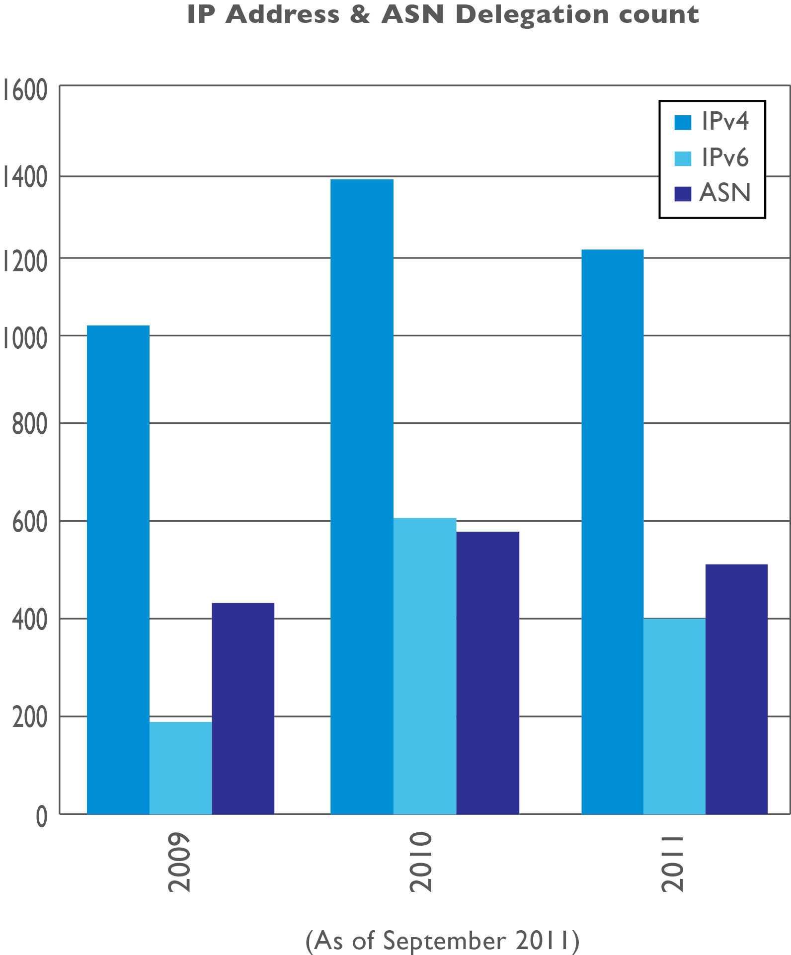
Resource Delegations

Slide 3
IPv4 Exhaustion
In stage 3, as 15 April 2011
APNIC final block: 103.0.0.0/8
Each account holder may receive a max. of /22
From 15 April to 27 August 2011, made 583 delegations to 30 economies

Slide 4
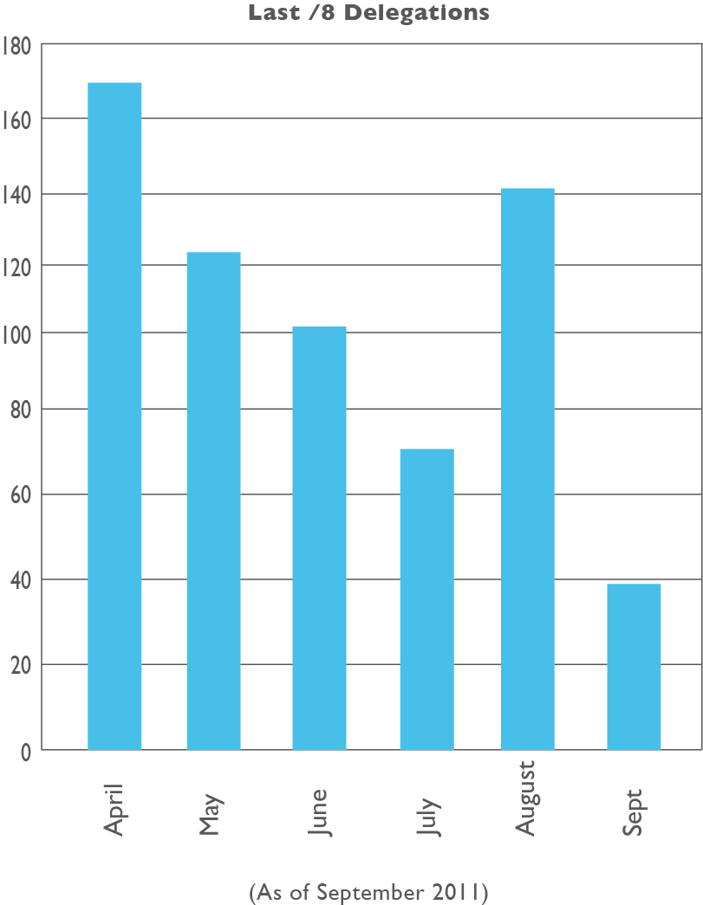
Use of Last /8

Slide 5
Implemented Policies During 2011
Implemented in May 2011
prop-088: Distribution of IPv4 Addresses Once the Final /8 Period Starts
prop-093: Reducing the Minimum Delegation Size for the Final /8 Policy
prop-094: Removing Renumbering Requirement from Final /8 Policy
Implemented in August 2011
prop-083: Alternative criteria for subsequent IPv6 allocations
prop-095: Inter-RIR IPv4 address transfer proposal

Slide 6
Policies at APNIC 32
Reached consensus at APNIC 32:
prop-096: Maintaining Demonstrated Needs Requirement in Transfer Policy after the Final /8 Phase
Did not reach consensus at APNIC 32 - returned to mailing list for further discussion:
prop-100: National IP Address Plan – Allocation of Country-wide IP Address Blocks
prop-099: IPv6 Reservation for Large Networks
prop-098: Optimizing IPv6 Allocation Strategies (simplified)

Slide 7
APNIC Labs
Supporting R&D with remote measurement techniques
Software expertise provided for client-side IPv6 capability measurements
Google analytics measurements for IPv6 client capability targeted at website owners
http://labs.apnic.net
Notes:
Measuring whether or not you can or can’t use IPv6

Slide 8
Innovation Society Information Fund
ISIF is a small grants and awards program aimed at stimulating creative solutions to ICT development needs in the Asia Pacific region
23 projects from 12 AP economies, showcasing innovation, cooperation, and technical knowledge. Reports available for download
ISIF Award ceremony held at 2011 IGF in Nairobi on 28 September 2011
APNIC, LACNIC, AfriNIC and IDRC to launch a global alliance to start early in 2012

Slide 9
New Corporate Identity
New image for a new era
:: representing our new IPv6 world
() representing our collaborative community
Changing icon represents our dynamic and diverse community

Slide 10
Next Conference – APNIC 33
Where: Delhi, India
When: 27 February – 2 March 2012
Notes:
Change in the original dates, now starting a day before.

