Slide 1
Treasurer Update
Paul Andersen

Slide 2
2011 Budget
Personnel |  | $7,626,048
Salaries and Employee Benefits |  | $7,626,048
Operations |  | $3,647,587
Communications |  | $904,511
Software & Equipment Support and Licenses |  | $581,009
Depreciation |  | $2,162,067

Slide 3
2011 Budget
General Office and Administration |  | $4,657,079
Professional Fees/Outreach |  | $1,219,125
Contingency |  | $100,000
General Office |  | $570,406
Bad Debt Expense |  | $180,767
Legal Fees |  | $500,000
Members Meetings |  | $420,499
Merit/NANOG Meeting Support |  | $16,670

Slide 4
2011 Budget
Rent & Occupancy |  | $382,237
NEWNOG Support |  | $33,330
Travel |  | $1,234,044
Internet Support |  | $481,446
Funds committed to ICANN |  | $203,446
Internet Support |  | $93,000
Research & Development |  | $100,000
NRO Expenses |  | $85,000
Total 2011 Expenses |  | $16,412,160
Total 2011 Revenues |  | $14,678,418

Slide 5
2011 Budget
Revenue
Registration Revenue |  | $13,566,400
Budgeted Expense |  | $16,412,160
Net from Operations |  | ($2,845,760)
Investment Revenue |  | $1,112,018
Reserve Impact (Assumption 4% Yield) |  | ($1,733,742)

Slide 6
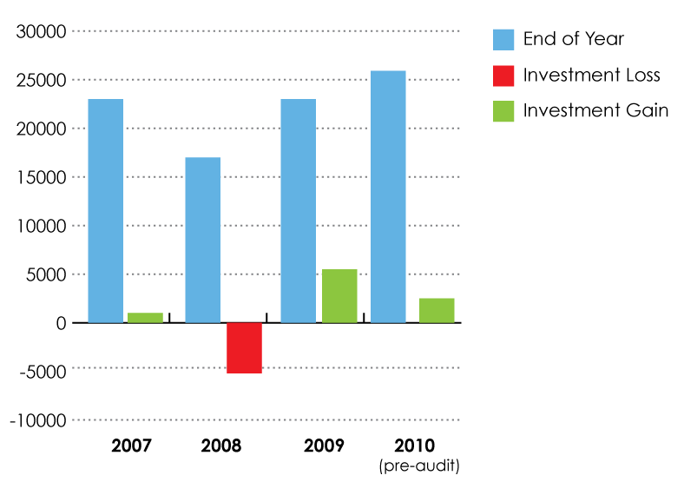
Reserves

Slide 7
On the Finance Committee Agenda
Suggestions submitted
Review Fees
Review Insurance
Analyze Investment Results
Review Advisor Guidance
2012 Budget

Slide 8
Questions?

