Slide 1
RPKI Engineering Update
Mark Kosters

Slide 2
Pilot
Available since June, 2009
http://rpki-pilot.arin.net
ARIN branded version of RIPE NCC software
45 organizations participating
#2 (behind RIPE) on prefixes/roas

Slide 3
General Architecture
ARIN Online
Database Persistence
RPKI Engine
HSM
Tight coupling between resource certificate / ROA entities and registration dataset at the database layer. Once certs/ROAs are created, they must be maintained if the registered dependents are changed.

Slide 4
Development before ARIN XXVI
With a few finishing touches, ready to go Jan 1, 2011 with Hosted Model, Delegated Model to follow end of Q1.
ARIN Online
Highly influenced by RIPE NCC entities.
Database Persistence
RPKI Engine
RIPE NCC RPKI Engine with a few tweaks.
HSM
Sun SCA 6000
Everything is Java, JBoss, Hibernate.

Slide 5
From ARIN XXVI
RPKI Services
ARIN to sign (assert) directly assigned/allocated resources
Other related services such as storing signatures/assertions for downstreams under review
Board of Trustees, along with ARIN General Counsel, are evaluating risks associated with these services
ARIN is seeking input from community regarding the these services

Slide 6
As a Result…
Completely new requirements for non-repudiation in ROA generation for hosted CAs
Completely new requirements to thwart “Evil Mark” (rogue employee)
Further intense review of liabilities by legal team and Board of Trustees

Slide 7
Changes Underway
In-browser ROA request signing via AJAX.
ARIN Online
Message driven engine which delegates to the HSM.
Database Persistence
RPKI Engine
Minor
changes.
HSM
Custom programming on IBM 4764’s to enable all DER encoding and crypto.
HSM coding is in C as extensions to IBM CCA. Libtasn1 used for DER coding.

Slide 8
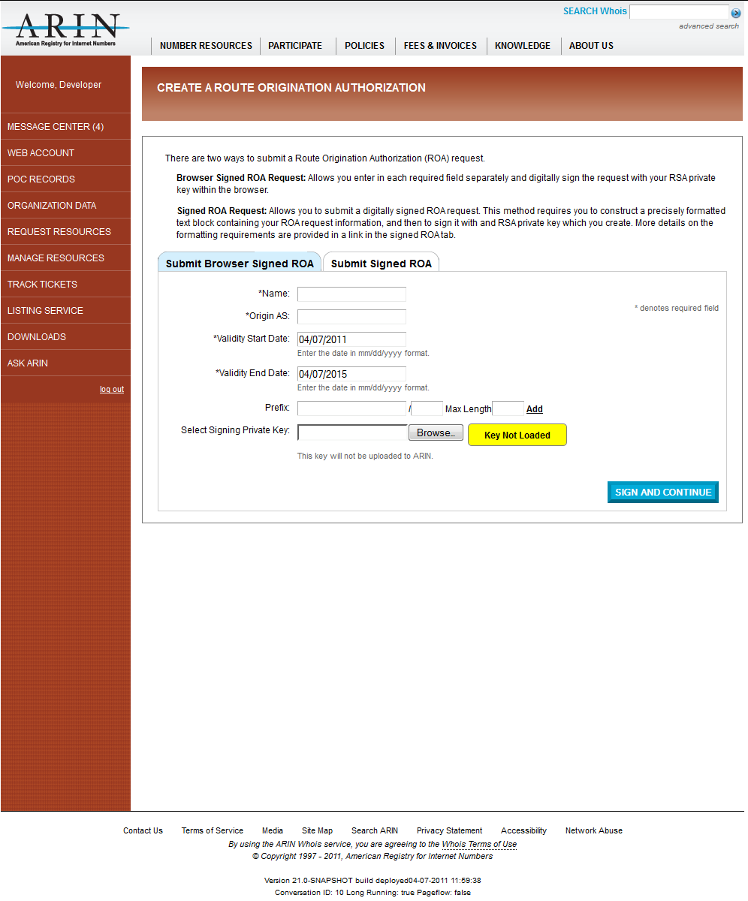
Example – Creating a ROA

Slide 9
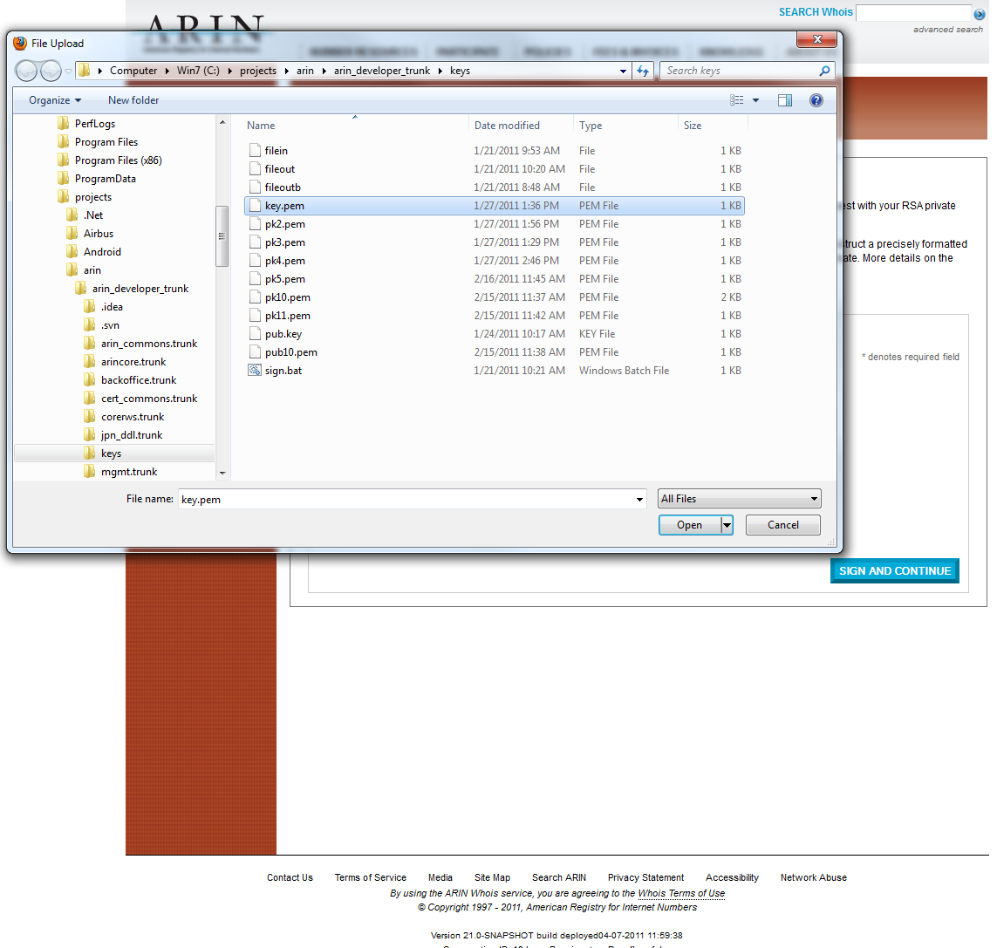

Slide 10
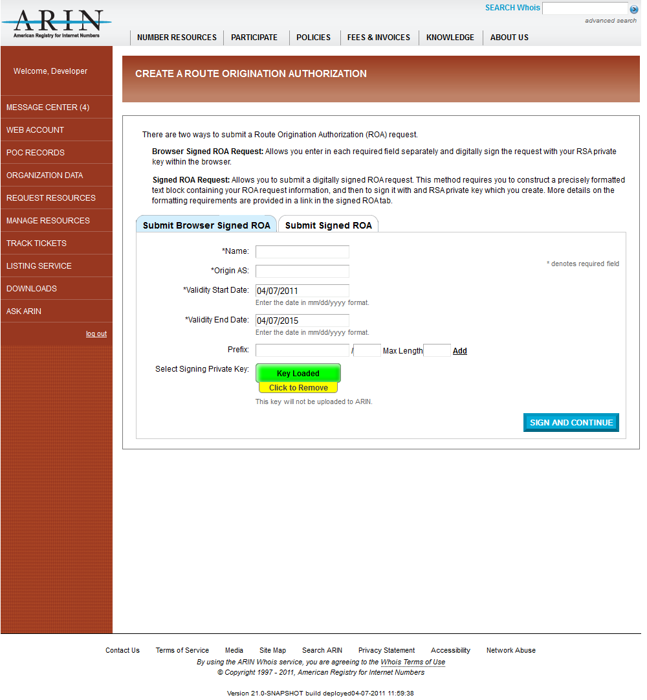

Slide 12
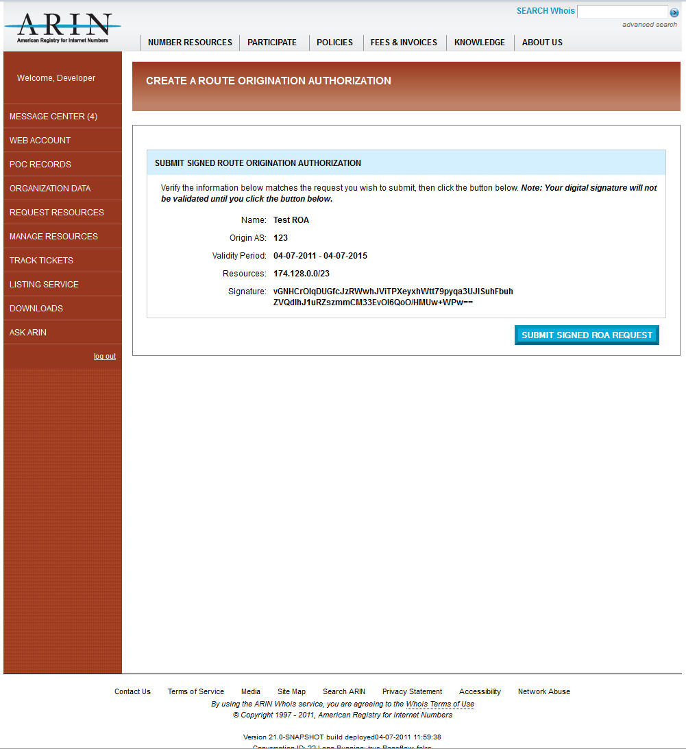

Slide 13
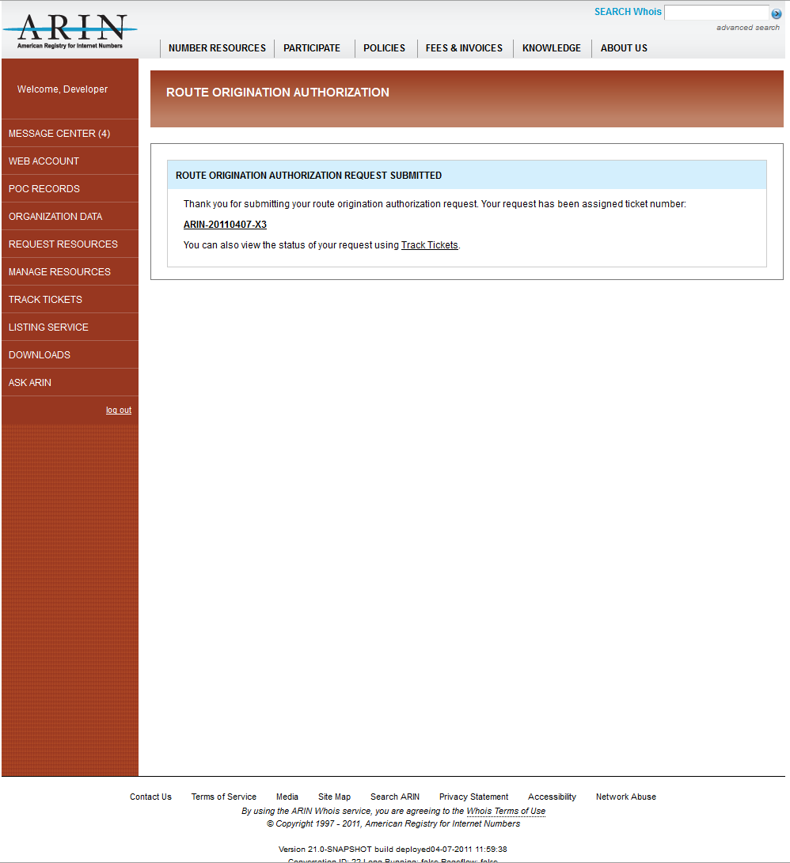

Slide 14
Updates within RPKI outside of ARIN
The four other RIRs are in production with Hosted CA services
Major routing vendor support being tested
Announcement of public domain routing code support

Slide 15
ARIN Status
Hosted CA anticipated in May at the earliest
We intend to use RIPE NCC up/down code for delegated model
Awaiting approval by our Board of Trustees for both models of deployment

