Slide 1
Introduction to ARIN and
the Internet Registry System

Slide 2

Self- Introductions

Slide 3
Regional Internet Registries
The Regional Internet Registry (RIR) system began in 1992
There are five RIRs
All RIRs are nonprofit, community-driven organizations
RIRs coordinate closely with IANA, and are part of the Internet Registry System
Notes:
Mention the 2002 formation of LACNIC out of the ARIN region and
AfriNIC in 2005 which evolved from the RIPE NCC and ARIN , ARIN formerly included sub-Saharan Africa

Slide 4
Internet Registry System
ICANN(IANA) | Top level coordination of the Internet identifiers (domain names, numbers) Manage global unallocated IP address pool Allocate number resources to RIRs
RIR | Manage regional unallocated IP address pool Allocate number resources to ISPs/LIRs Assign number resources to End-users
ISP/LIR | Manage local IP address pool for use by customers and for infrastructure Allocate number resources to ISPs Assign number resources to End-users

Slide 5

Number Resource Provisioning Hierarchy
ICANN / IANA
(Internet Assigned Numbers Authority)
Manage global unallocated IP address pool
Allocate
RIRs
(AfriNIC, APNIC, ARIN, LACNIC, RIPE NCC)
Manage regional unallocated IP address pool
Allocate
Assign
ISPs
End Users
Re-Allocate
Re-Assign
ISPs
End Users

Slide 6
RIR Structure
Nonprofit | Membership Organization | Community-regulated
Fee for services, not number resources 100% community funded | Open Broad-based - Private sector - Public sector - Civil society | Community developed policies Member-elected executive board Open and transparent

Slide 7
RIR Services
Number Resources | Organization | Policy Development
IP address allocation & assignment ASN assignment Directory services Whois IRR Reverse DNS | Elections Meetings Information dissemination Website Newsletters Roundtables Training | Maintain email discussion lists Conduct public policy meetings Publish policy documents

Slide 8
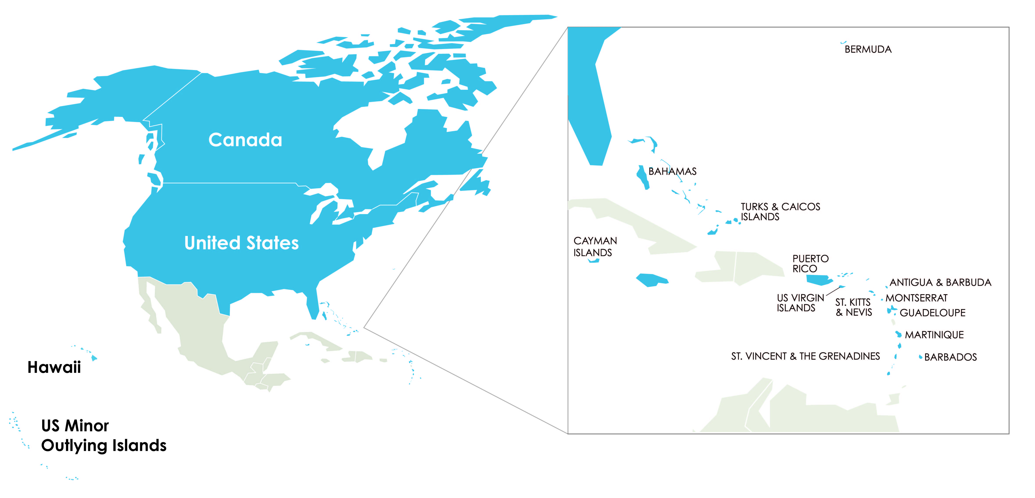
About ARIN
Established December 1997
100% community funded
ARIN’s region includes Canada, many Caribbean and North Atlantic islands, US Minor Outlying Islands and the United States.

Slide 9
ARIN’s Mission
Applying the principles of stewardship, ARIN, a nonprofit corporation:
  allocates Internet Protocol resources;
  develops consensus-based policies; and
  facilitates the advancement of the Internet through information and educational outreach.

Slide 10
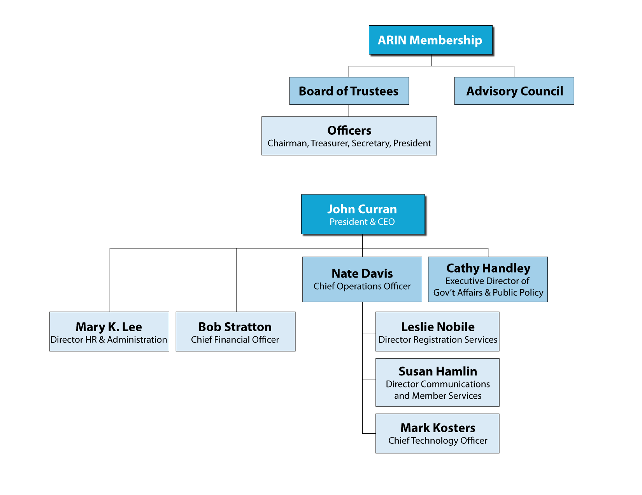
Organizational Chart

Slide 11
Registration Services
Directory Services
Registration transaction information (Whois)
Record maintenance
Routing information (Internet Routing Registry)

Slide 12
Registration Services
Coordination & management of Internet number resources
Internet number resource transfers

Slide 13

Technical Services
ARIN Whois/RWhois
ARIN Online
Internet Routing Registry
Reverse DNS Services
All public services also available over IPv6
IT support for organization
Emerging Technologies: DNSSEC, RPKI, Whois-RWS
Community Software Project Repository

Slide 14
Organization Services
Public Policy & Members Meetings
Information publication and dissemination
Executive Board Elections
Education & Outreach

Slide 15
Policy Development Services
Manage the Policy Development Process
Maintain email discussion lists
Publish policy documents

Slide 16
What’s Ahead in San Juan
This afternoon and evening:
ARIN "Get Automated!" Tutorials, 3:30 – 5:00 PM (here)
Tutorial I: Take a Tour of the New Registration Services System
Tutorial II: ARIN's RESTful Provisioning Interface
Foosball Tournament, 6:00 - 9:00 PM in Las Oalas Ballroom
Monday: ARIN Public Policy Meeting, 9:00 AM – 5:00 PM
ARIN Social at THE LATIN ROOTS, 6:30 -10:30 PM
Tuesday: ARIN Public Policy Meeting, 9:00 AM - 5:30 PM
Wednesday: ARIN Members Meeting (open to all),
9:00 AM – Noon

Slide 17

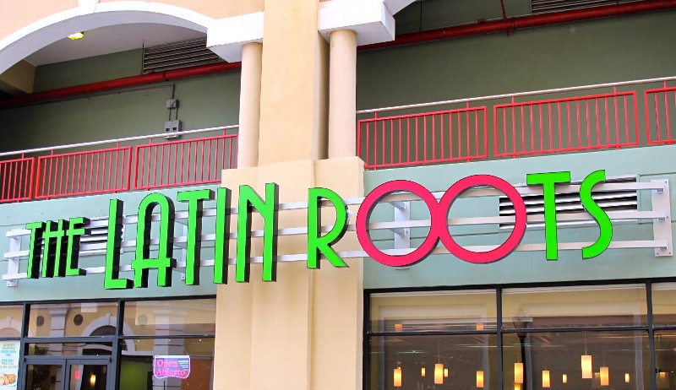
Socials
Tonight, 6-9 PM
Las Oslas Ballroom 2nd floor
Drinks and pizza
Come play or cheer on your favorite team
Monday night
6:30-10:30 PM in Old San Juan
Buses depart at 6:15 PM

Slide 18
Please complete the survey form and drop it in the bowl.
Tomorrow morning at the start of the meeting there will be a drawing for a $100 Think Geek gift certificate.

Slide 19

Overview of the Policy Development Process coming next.
ENJOY!

