Slide 2
INTERNET NUMBER RESOURCE STATUS REPORT
As of 30 June 2010
Prepared by
Regional Internet Registries
AfriNIC, APNIC, ARIN, LACNIC and the RIPE NCC

Slide 3
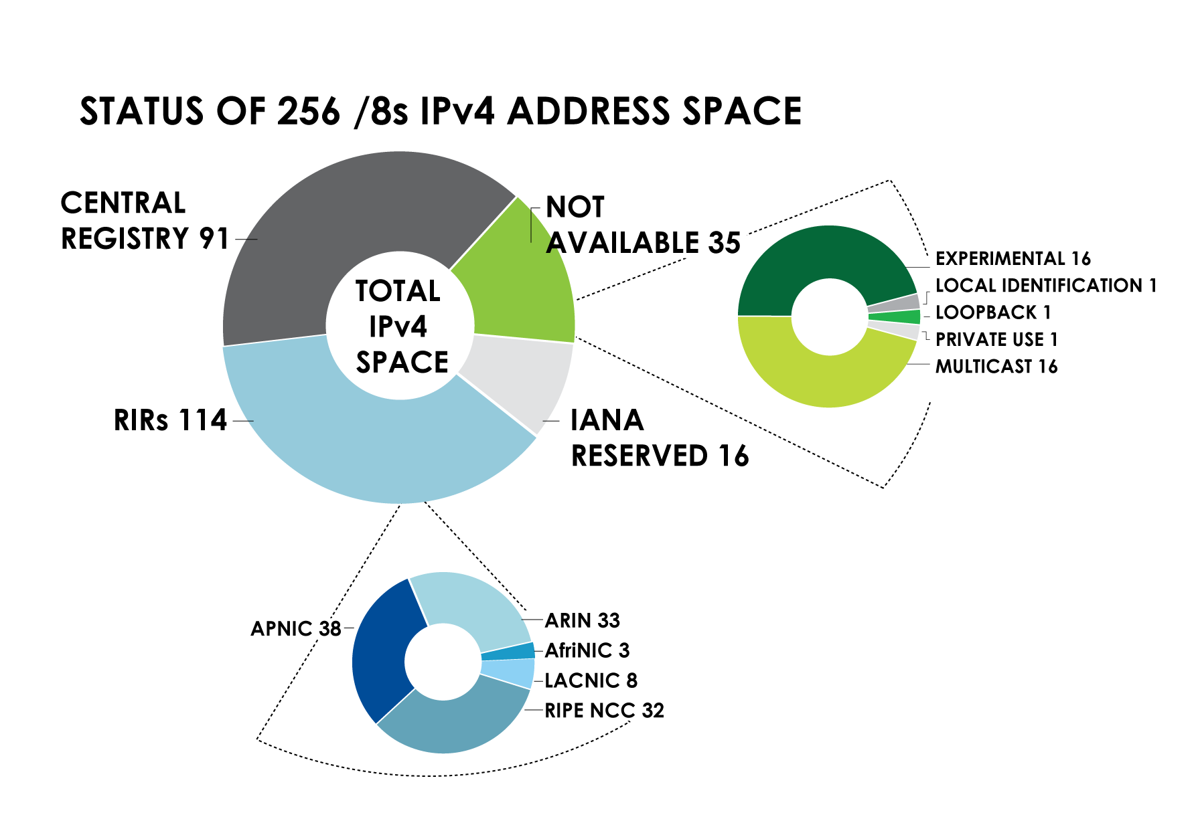
IPv4 ADDRESS SPACE What is the status of each of the 256 /8s?

Slide 4
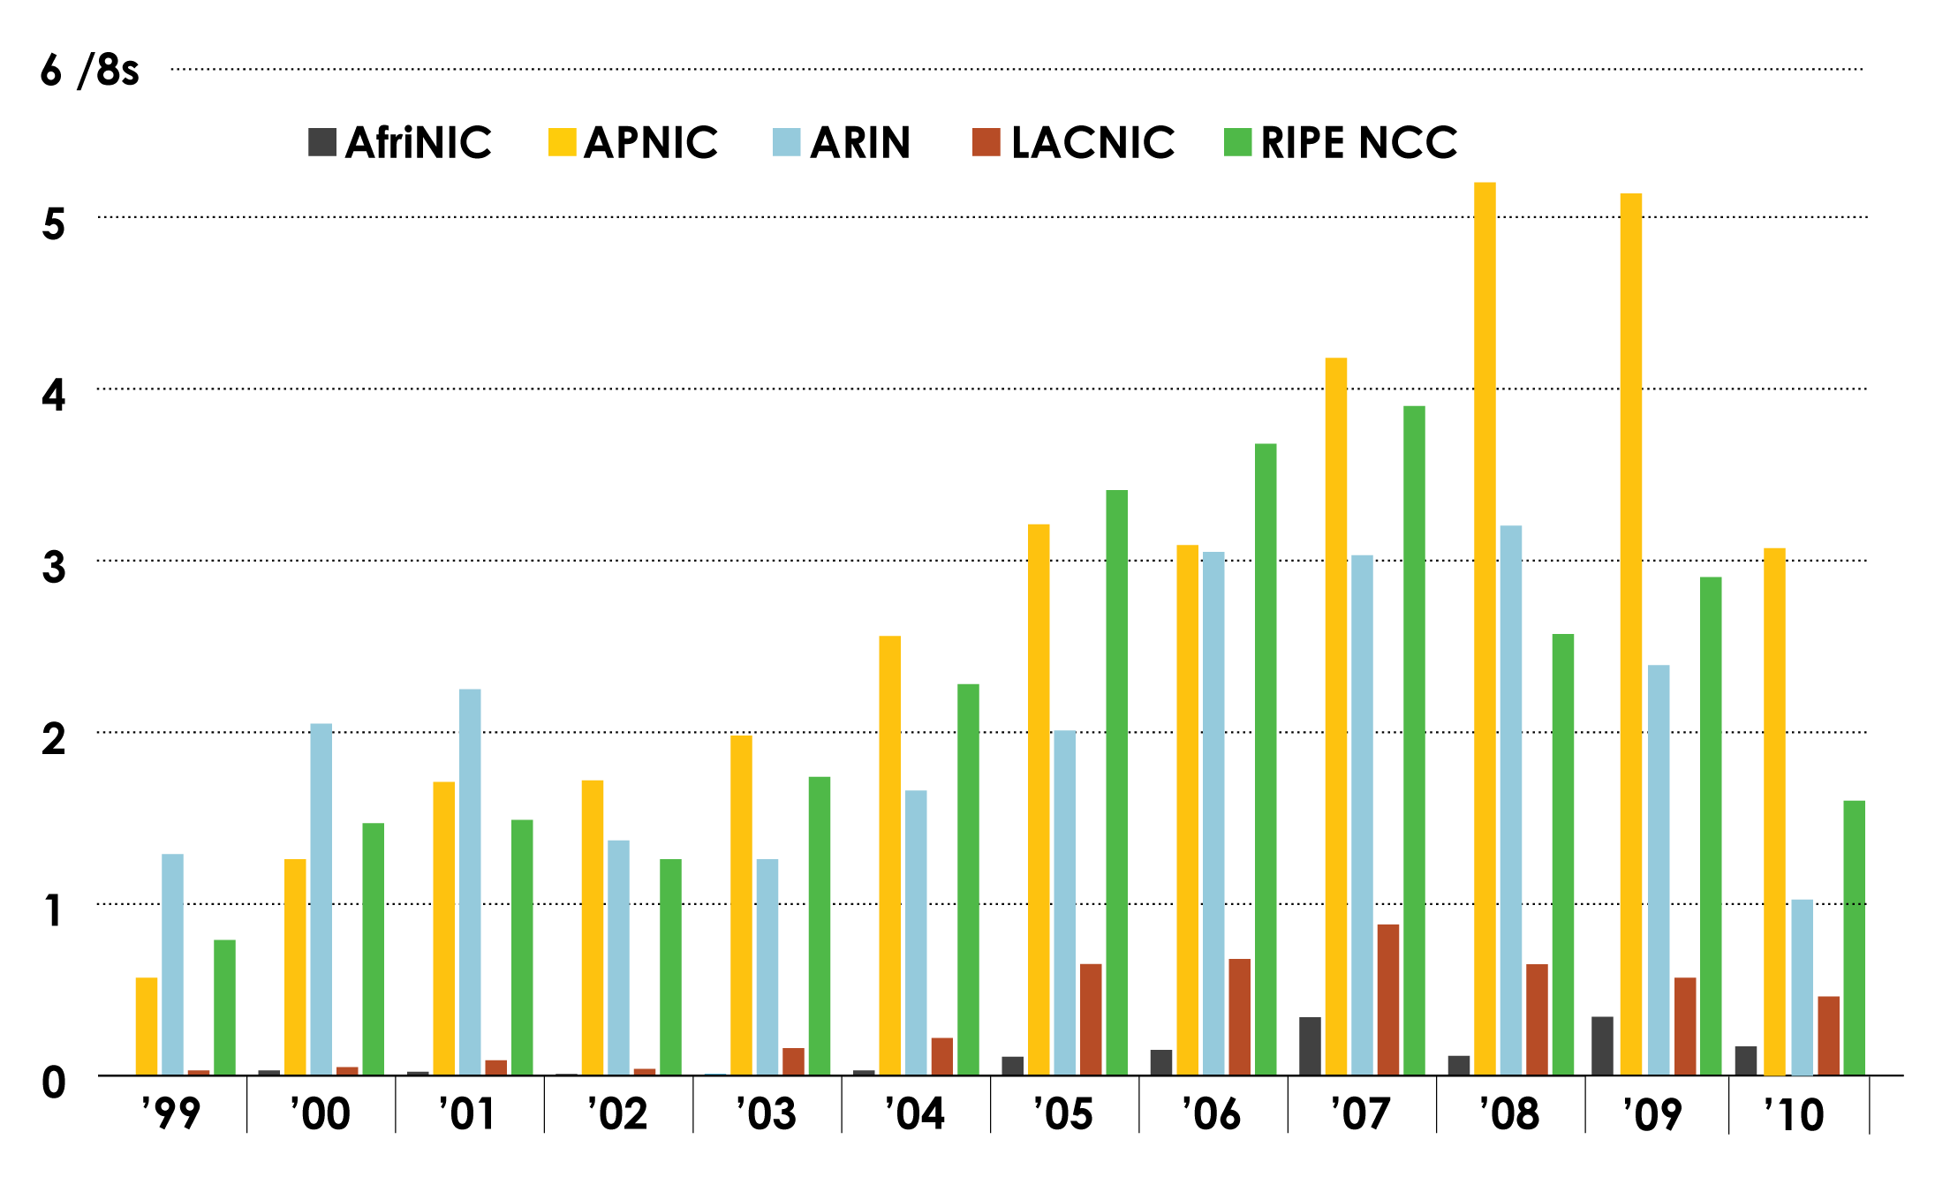
IPv4 ADDRESS SPACE ISSUED (RIRs TO CUSTOMERS) In terms of /8s, how much space did each RIR issue by year?

Slide 5
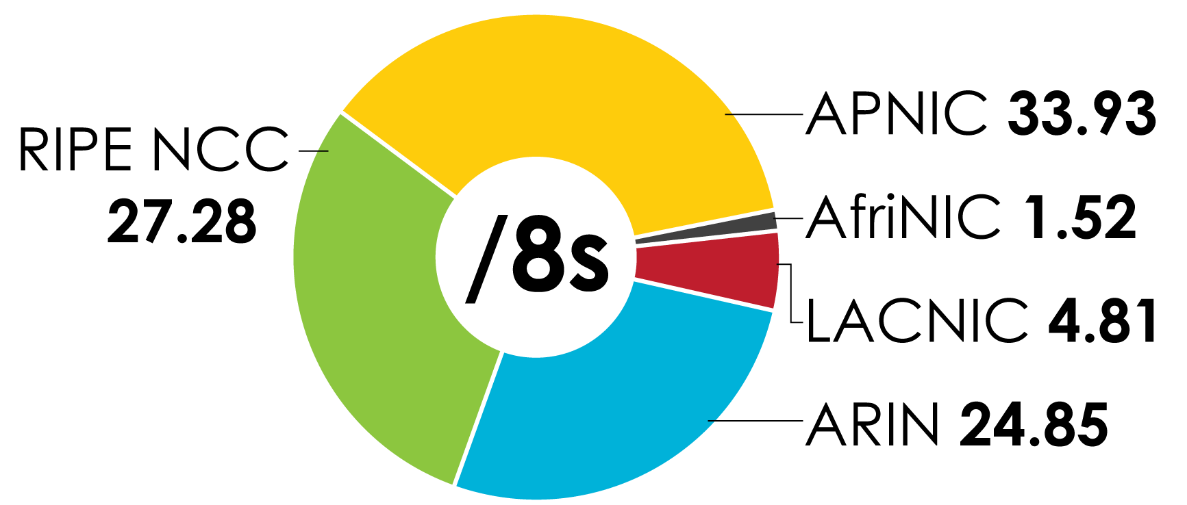
IPv4 ADDRESS SPACE ISSUED (RIRs TO CUSTOMERS) In terms of /8s, how much total space has each RIR issued? (Jan 1999 – June 2010)

Slide 6
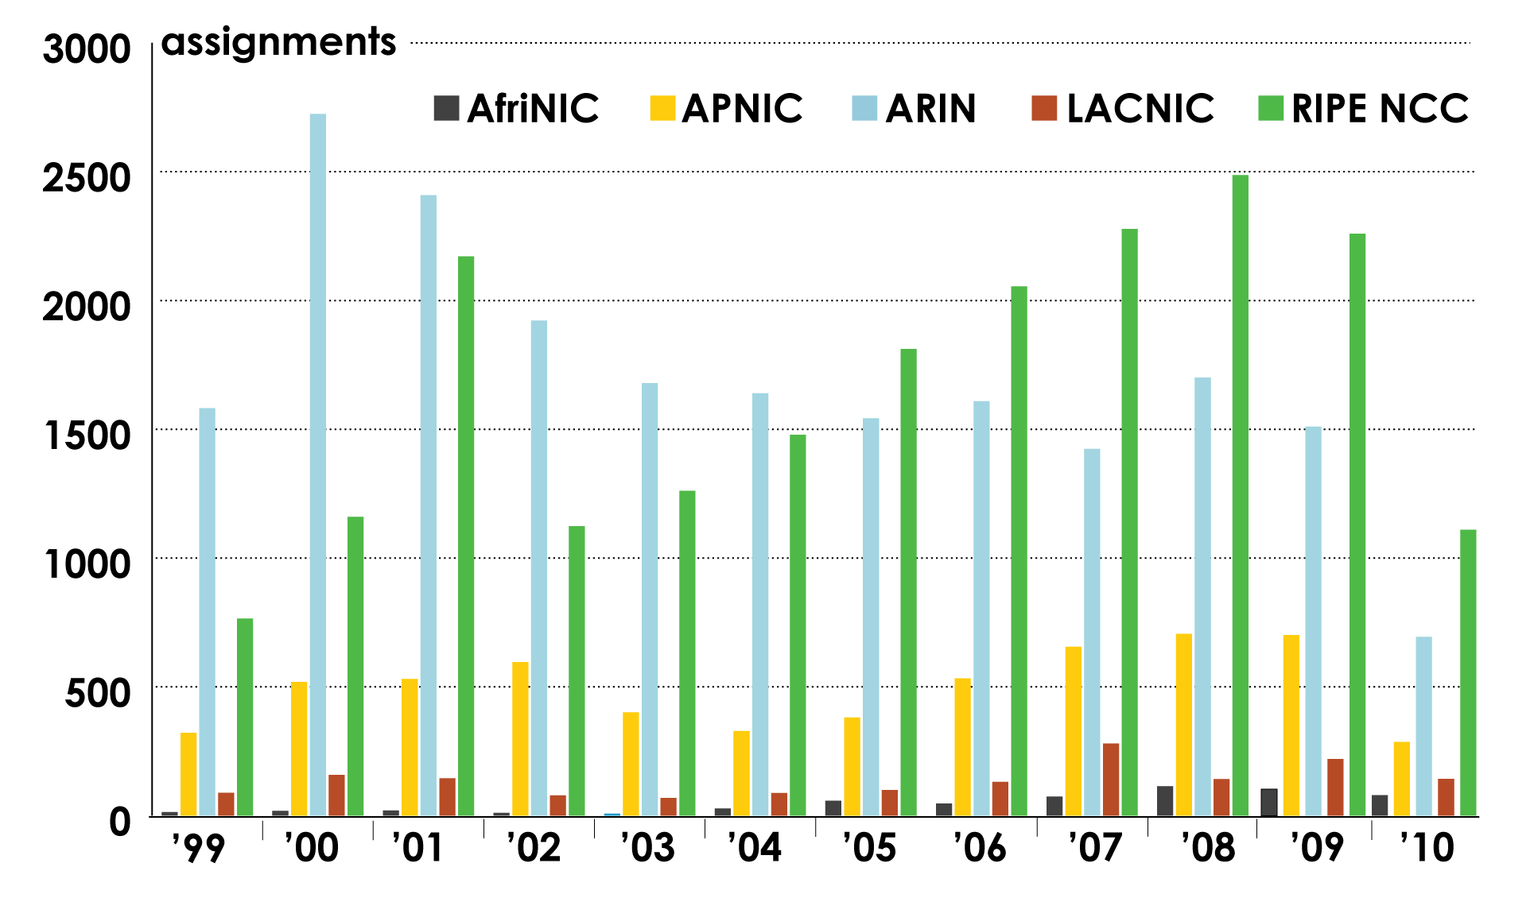
ASN ASSIGNMENTS (RIRs TO CUSTOMERS) How many ASNs has each RIR assigned by year?

Slide 7
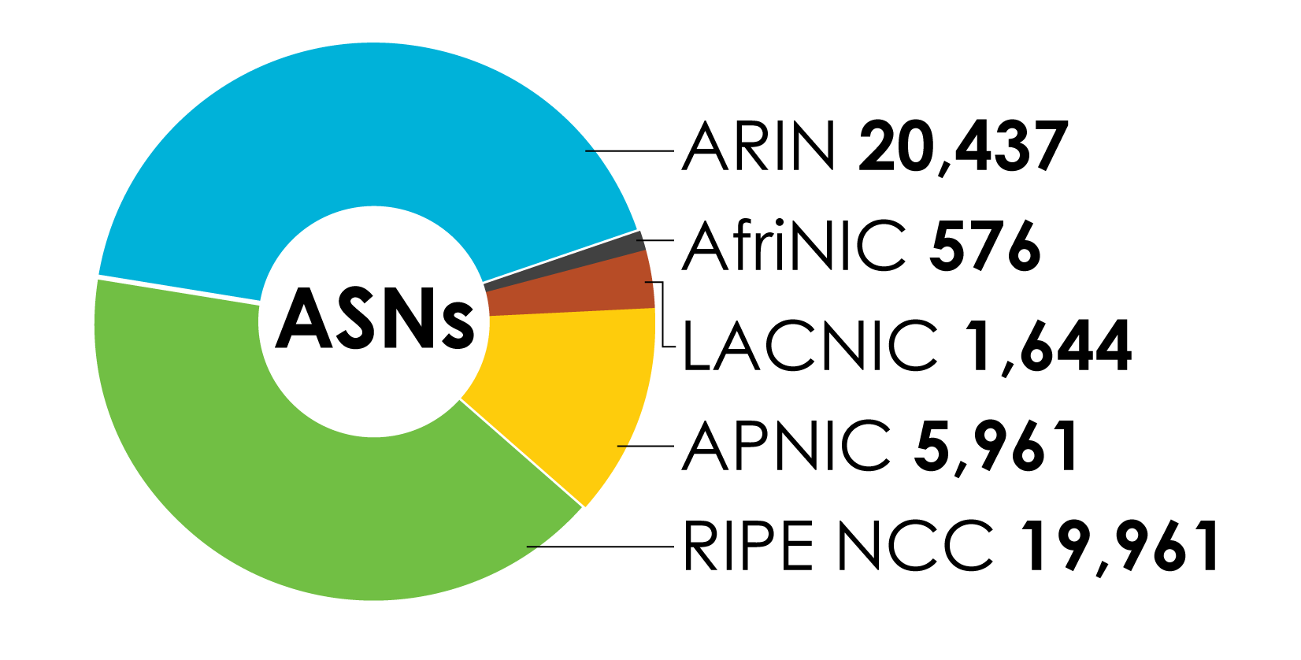
ASN ASSIGNMENTS (RIRs TO CUSTOMERS) How many total ASNs has each RIR assigned? (Jan 1999 – June 2010)

Slide 8
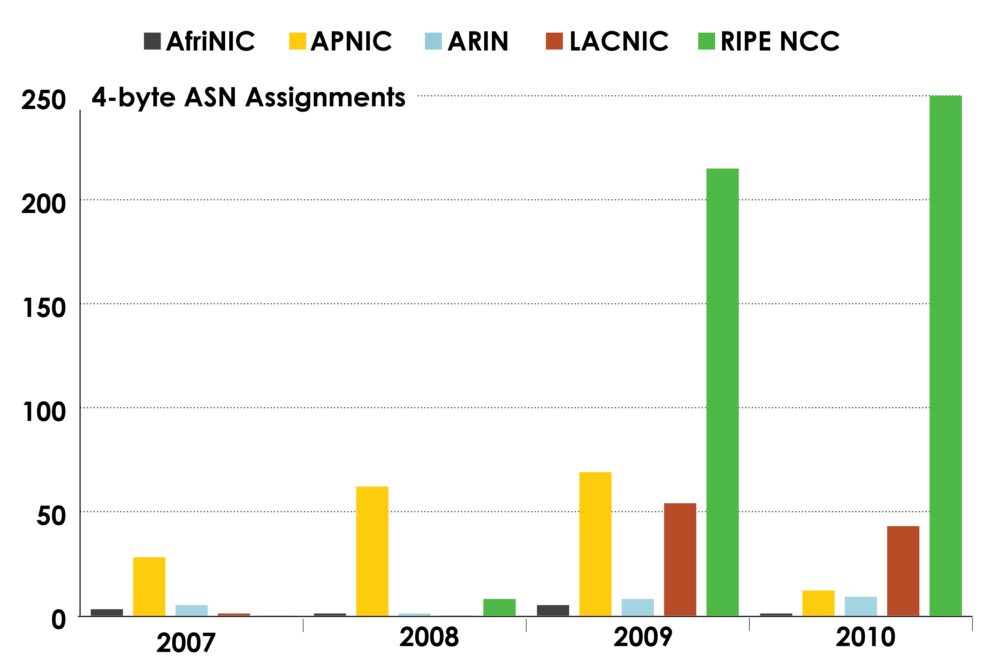
4-BYTE ASN ASSIGNMENTS How many 4-byte ASNs has each RIR assigned by year?

Slide 9
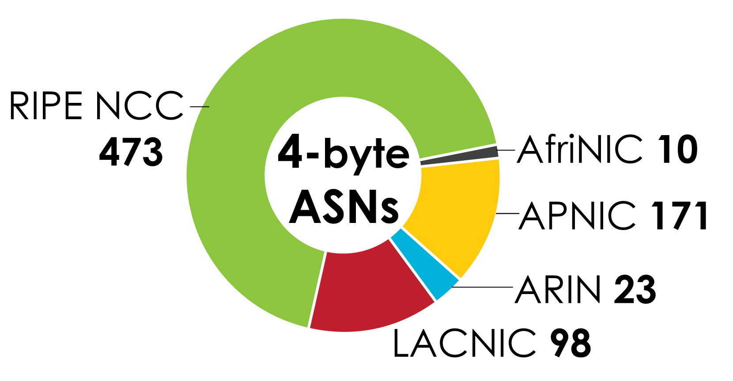
4-BYTE ASN ASSIGNMENTS How many total 4-byte ASNs has each RIR assigned? (Jan 2007 – June 2010)

Slide 10
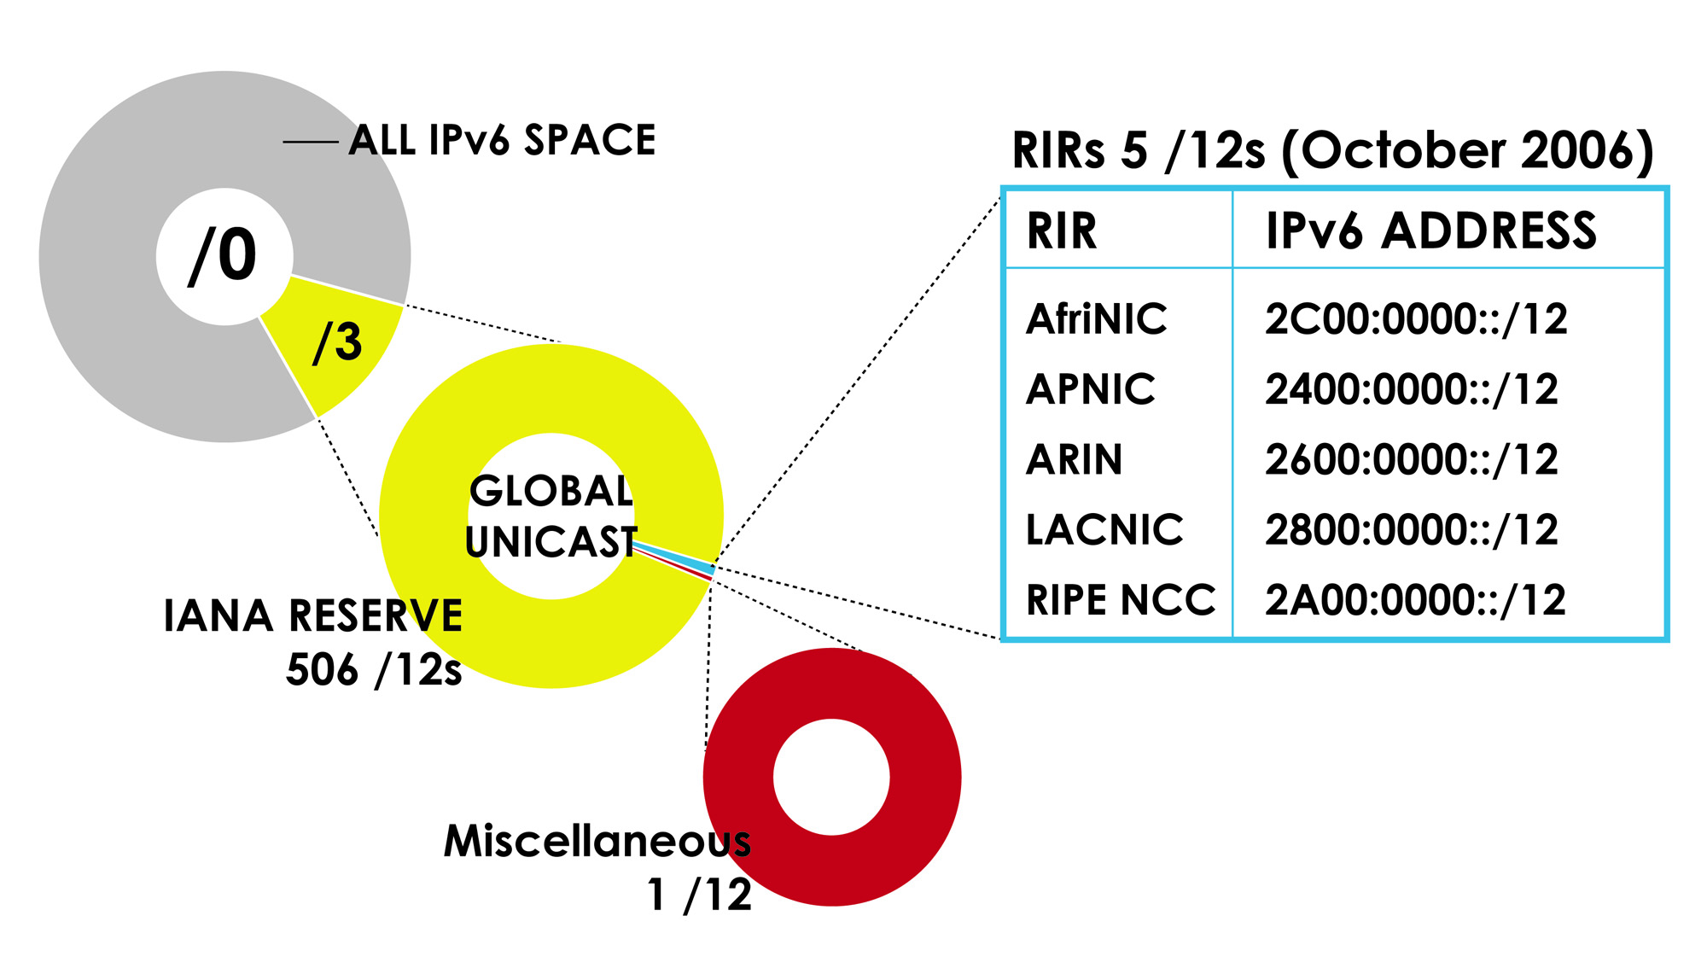
IPv6 ADDRESS SPACE How much has been allocated to the RIRs?

Slide 11
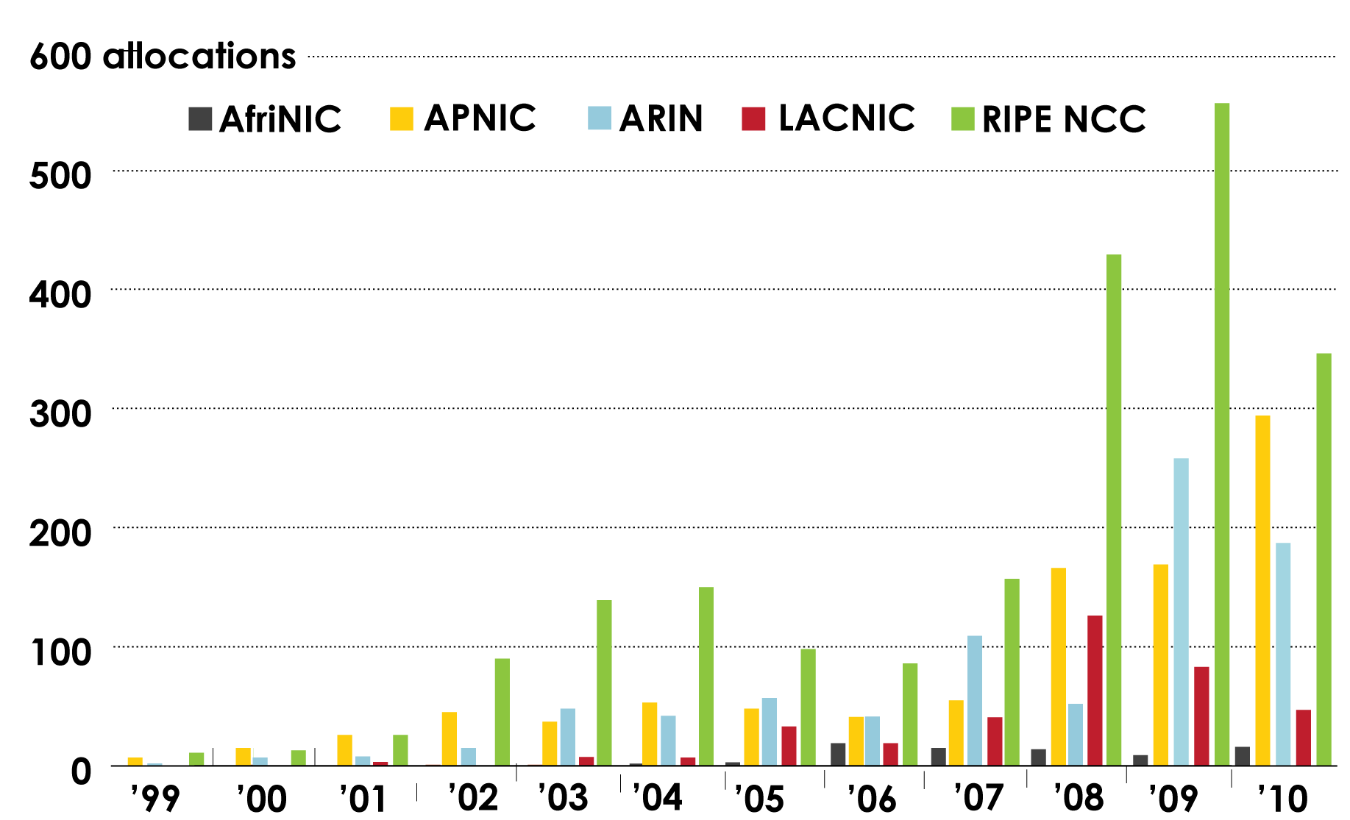
IPv6 Allocations RIRs to LIRs/ISPs How many allocations have been made by each RIR by year?

Slide 12
IPv6 ALLOCATIONS RIRs to LIRs/ISPs (Jan 1999 – June 2010)
How many total allocations have been made by each RIR?
In terms of /32s, how much total space has each RIR allocated?

Slide 13
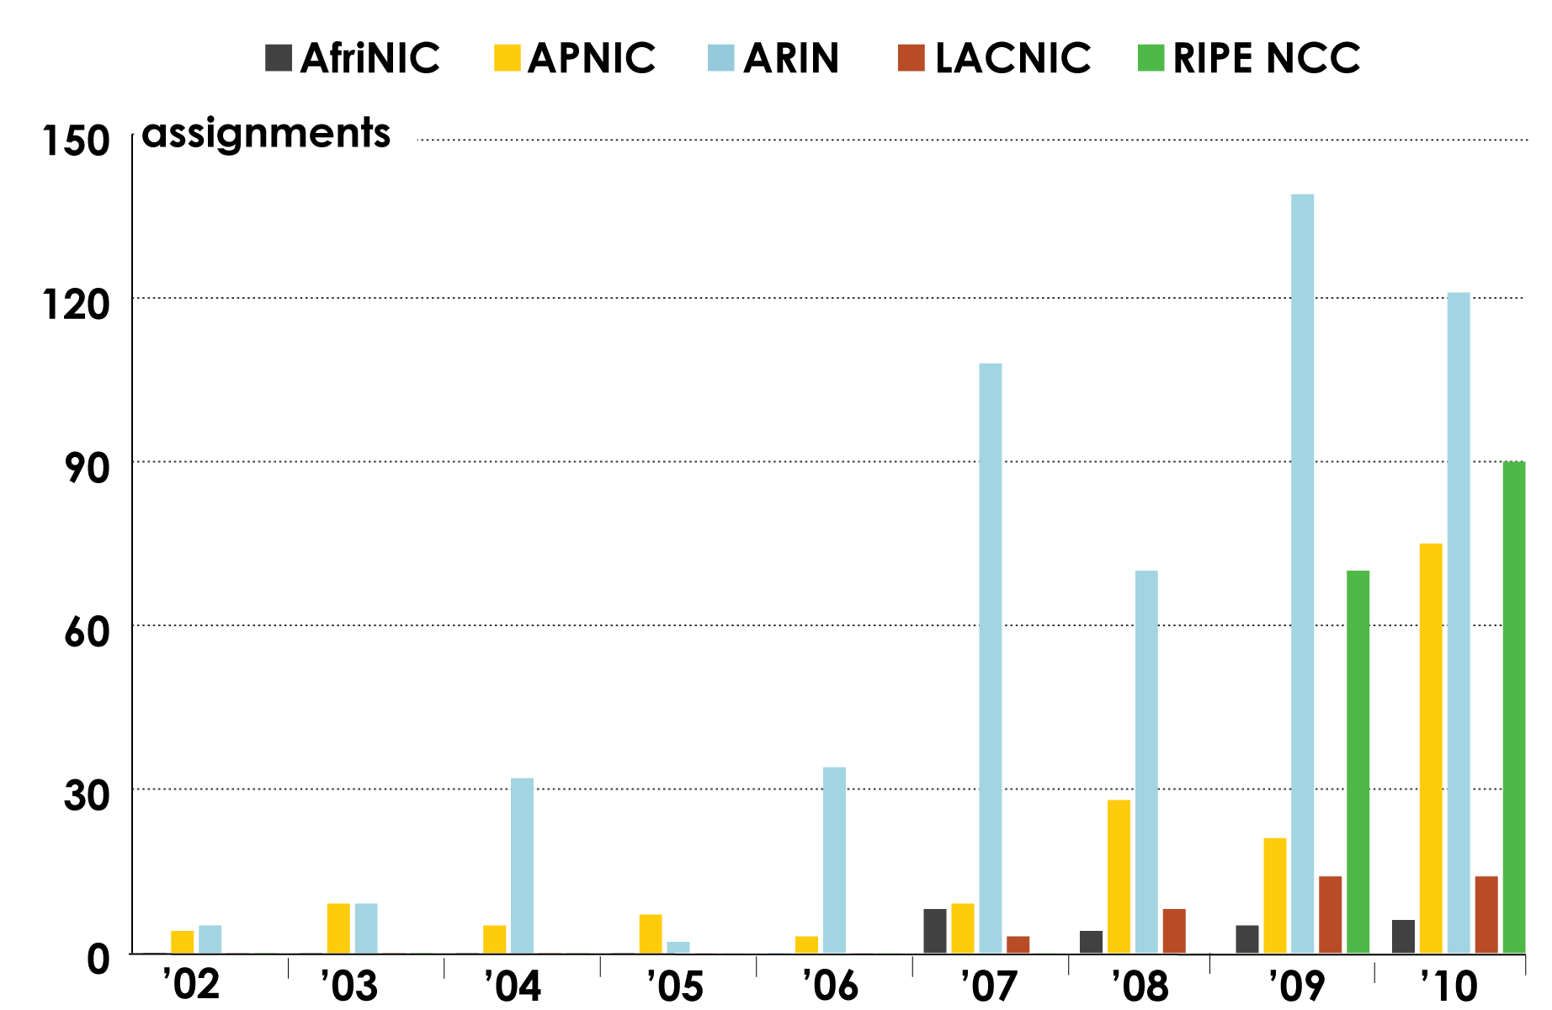
IPV6 ASSIGNMENTS RIRS TO END-USERS

Slide 14
LINKS TO RIR STATISTICS
RIR Stats: www.nro.net/statistics
Raw Data/Historical RIR Allocations: www.aso.icann.org/stats
www.iana.org/assignments/ipv4-address-space
www.iana.org/assignments/as-numbers
www.iana.org/assignments/ipv6-unicast-address-assignments

Slide 15
thank you

