Slide 1
IANA Status Update
ARIN XXVI meeting, Atlanta
Barbara Roseman
October 2010

Slide 2
Overview
New IANA Whois Server
IDN ccTLDs
Root DNSSEC
AS Numbers Global Policy
IPv4 Status
Root Zone Management
DNSSEC Key Ceremony
In other news… multicast

Slide 3
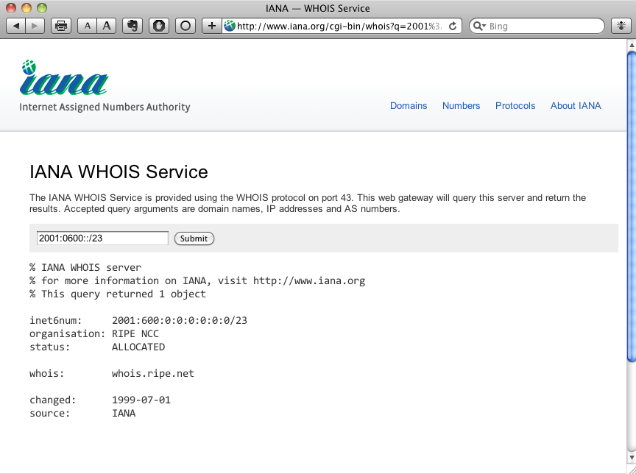
A new whois.iana.org
It now provides responses for:
Unicast IP addresses
Multicast registrations
AS Numbers
DS records

Slide 4
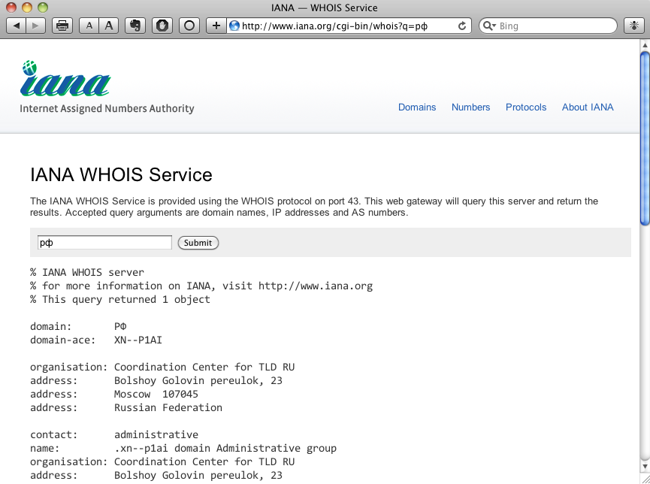
We’ve started delegating ccIDNs
So whois.iana.org also shows the U-label in responses and accepts it in queries

Slide 5
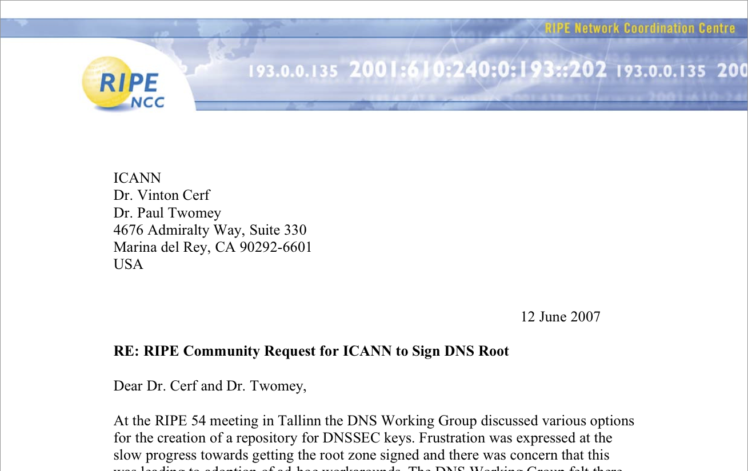
You asked us to sign the root

Slide 6
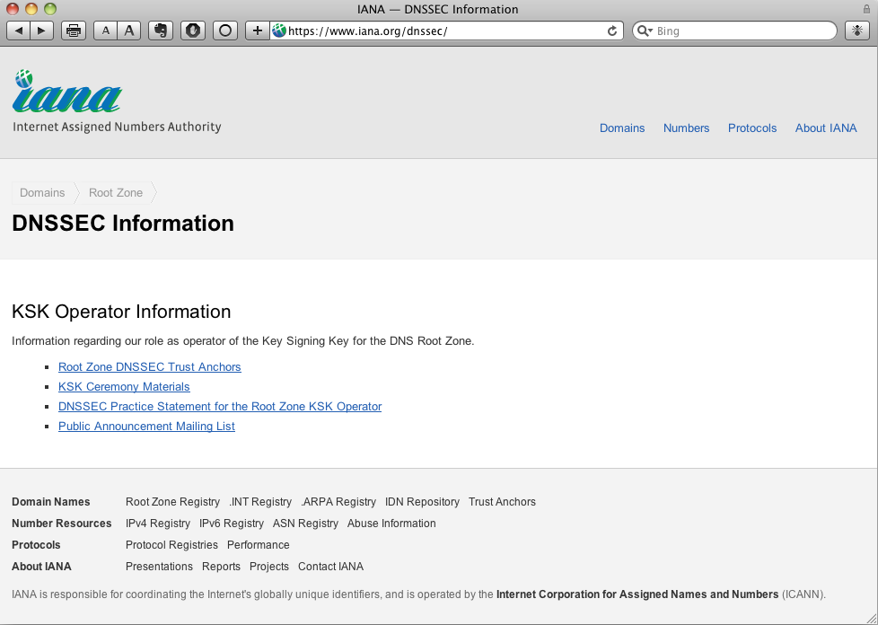
So that’s what we did
You can get the root Trust Anchor, along with KSK ceremony materials, statements of practice and other important information from the IANA web site

Slide 7
AS Numbers Global Policy
The policy allows each RIR to maintain 2 separate pools of AS Numbers until the end of 2010
The ASO AC sent a proposal (ripe-496) to the ICANN board
The public comment period ended on 13 August
The proposal was ratified in September and is now policy

Slide 8
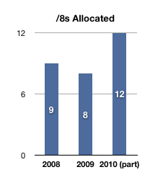
IPv4 Status
12 /8s have been allocated so far this year
6 have been allocated to APNIC
ARIN, LACNIC & RIPE NCC have each received 2

Slide 9
IPv4 Status
14 unallocated /8s remain
9 will be allocated under the global policy that was ratified in 2005
Then the last 5 blocks will be allocated simultaneously as per the special global policy ratified in 2009

Slide 10
DNSSEC Key Ceremony
1st ceremony held on 16 June
The next DNSSEC key ceremony will be held on 1-2 November in Culpeper, VA, USA
The KSR for Q1 2011 will be processed

Slide 11
Root Zone Workflow Automation
Aim to automate as much of the root zone change process as possible
Roles and responsibilities do not change
TLD operators get new web based interface to interact with ICANN

Slide 12
Root Zone Workflow Automation
ICANN will communicate with VeriSign using EPP
A period of parallel operations ongoing leading to full deployment expected Q1 2011

Slide 13
In other news… multicast
draft-ietf-mboned-ipv4-uni-based-mcast-06 approved
Everyone with a /24 of IPv4 unicast space also has a multicast /32
234/8 is used for this algorithmic assignment mechanism

Slide 14
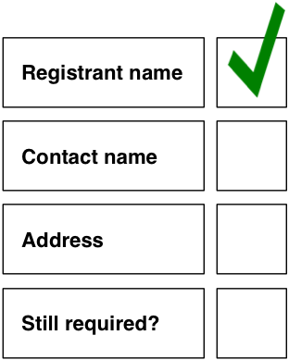
In other news… multicast
We are introducing an annual review process for multicast address assignments
We’ll be updating registrant names and contact information as appropriate

Slide 15
Thank you

Slide 16
Questions

