Slide 1
Treasurer
Scott Bradner

Slide 2
FINANCE COMMITTEE OVERVIEW
Reviewed Financial Audit and recommended full board accept the Audit
Reviewed Regulatory Filings and Recommended Changes
Reviewed Insurance and Recommended Changes
Discussed Fees for Strategic Planning Purposes
Recommended Board Support NewNog’s Launch
Reviewing Audit Proposals from Vendors

Slide 3
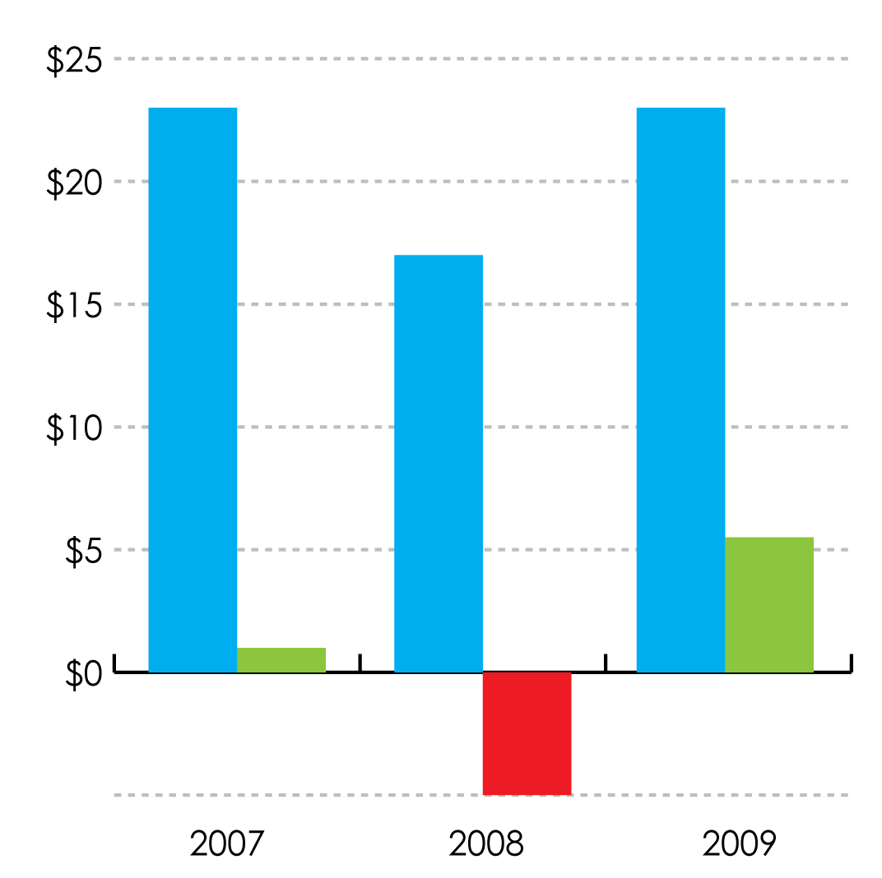
Reserves Value at end of periods Currently @ 1½ Years of Expenses
Numbers in Millions

Slide 4
2009 Revenue & Investments Net Effect on Reserves
Years Ended December 31, 2009
Revenue and Support
Total operating expenses
Net to Reserves
Investment Gains and
Dividends
Net Gain in unrestricted assets
Unrestricted net assets end of year 2008
Unrestricted net assets –
End of year 2009
$12,438,107
$12,141,253
$296,854
$5,464,899
$5,761,753
$17,385,815
$23,147,568

Slide 5
Reserve Funds 2009
December 31, 2009
Legal Defense Fund $ 2,300,750
Operating Reserve $ 1,322,677
Long-Term Reserve $21,022,150
TOTAL $24,645,577
Full Audited results can be found here:
https://www.arin.net/about_us/corp_docs/annual_rprt.html

Slide 6
2010 Budget and Projection for Year End
Budget Presented in Toronto’s Meeting and the details can be found here: https://www.arin.net/about_us/corp_docs/budget.html
Budget Projected YR/End
Revenue $13,529,334 $13,740,000
Expense $15,018,669 $13,880,000

Slide 7
Questions?

Slide 8
Thank You

