Slide 1
Registration Services
Leslie Nobile, Director

Slide 2
RSD Team
Principal Resource Analyst
Cathy Clements
Resource Analysts
Doreen Marraffa
Sue Dobert
Mike Pappano
Lisa Liedel
Chad Eastman
Technical Specialist
David Huberman
Senior Resource Analyst
Jon Worley

Slide 3
Current Focus
ARIN On-line
  Creating “user stories” and features for future releases
  Processing Q&A, POCs, Orgs
  Developing new processes and procedures
Process Enhancements
Resource Revocation and Reclamation
Legacy RSA
And business as usual of course…

Slide 4
Process Enhancements
Stringent data verification procedures
  New Orgs vetted up front, Org mods vetted every 12 months
“Officer Attestation”
Peer review of IPv4 resource requests
Checking utilization on all past allocations
Asking about future IPv4 and IPv6 plans on IPv4 requests
Fraud detection and follow up

Slide 5
Recovered Resources Jan 1, 2005 – Mar 31, 2010
 | /16 equivalents | ASNs
*Returned | 429.33 | 1,342
*Revoked | 87.83 | 4,427
*Reclaimed | 2.04 | 9
*Returned = Voluntarily by registrant
*Revoked = For non-payment
*Reclaimed = For fraud, misappropriation, or business dissolution

Slide 6
Legacy RSA Status
  Total Resources and Organizations covered under Legacy RSA:
      ASNs 176
      IPv4 Blocks 1,215 (6.49 /8 equivalents)
      OrgIDs 444

Slide 7

IPv4 Depletion and
IPv6 Uptake

Slide 8
New /8s from IANA
Received 50/8 and 107/8 in Feb 2010
  Will begin issuing in near future
MERIT conducted testing to “investigate the properties of unwanted traffic being sent to destinations in these ranges”
  Results to be published at
  http://software.merit.edu/darknet/

Slide 9
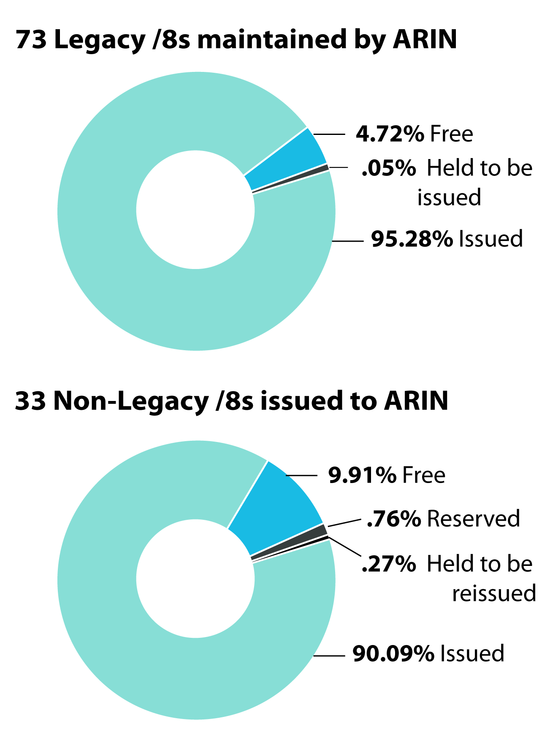
Current
Inventory

Slide 10
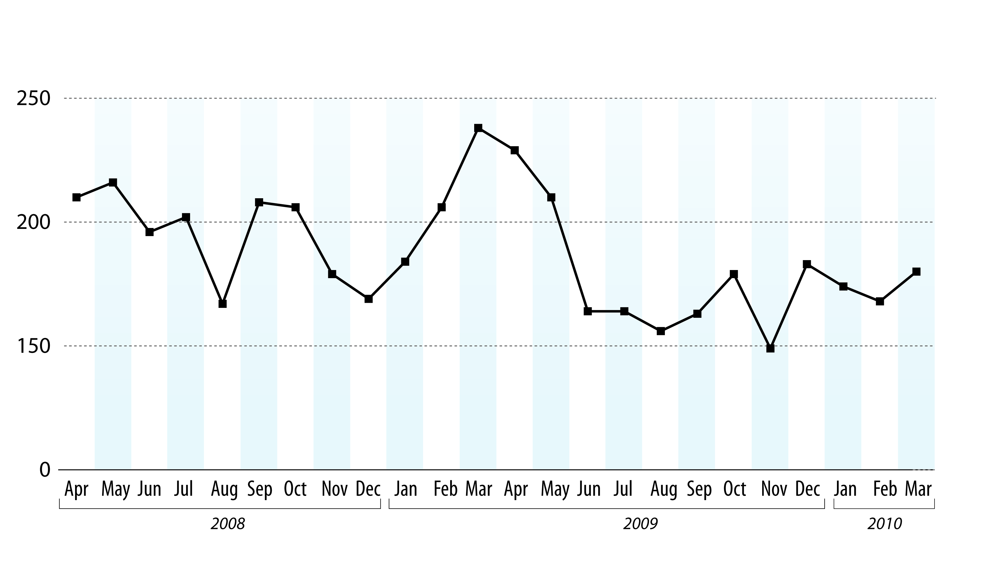
IPv4 Requests Received

Slide 11
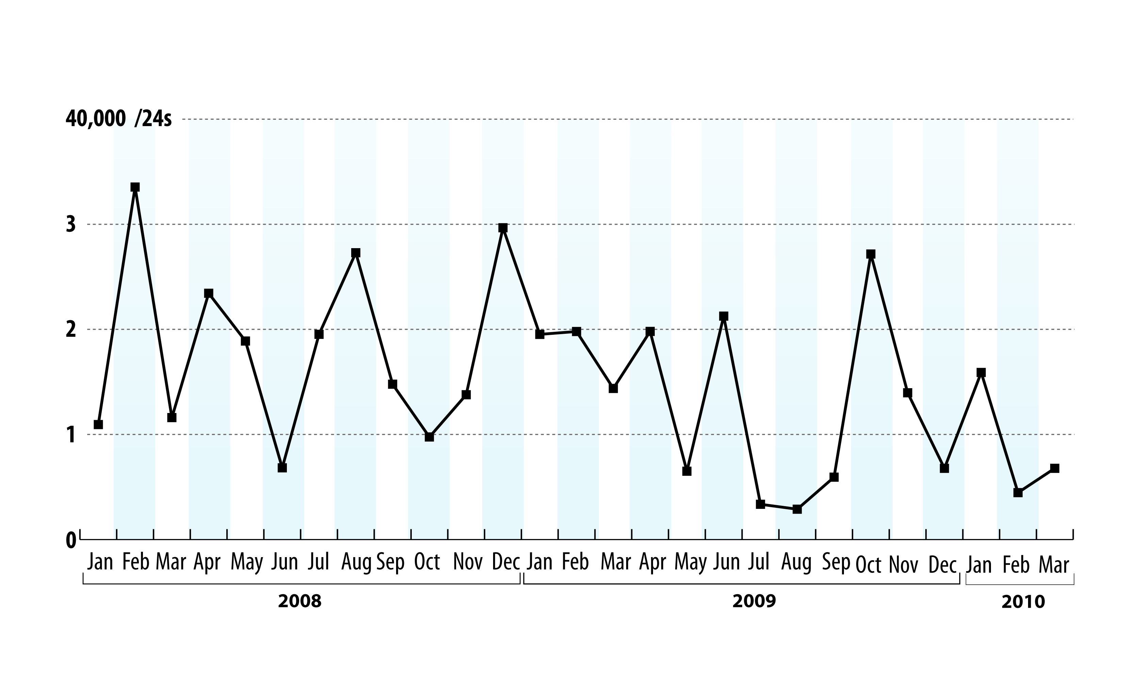
IPv4 Addresses Issued (/24s)

Slide 12
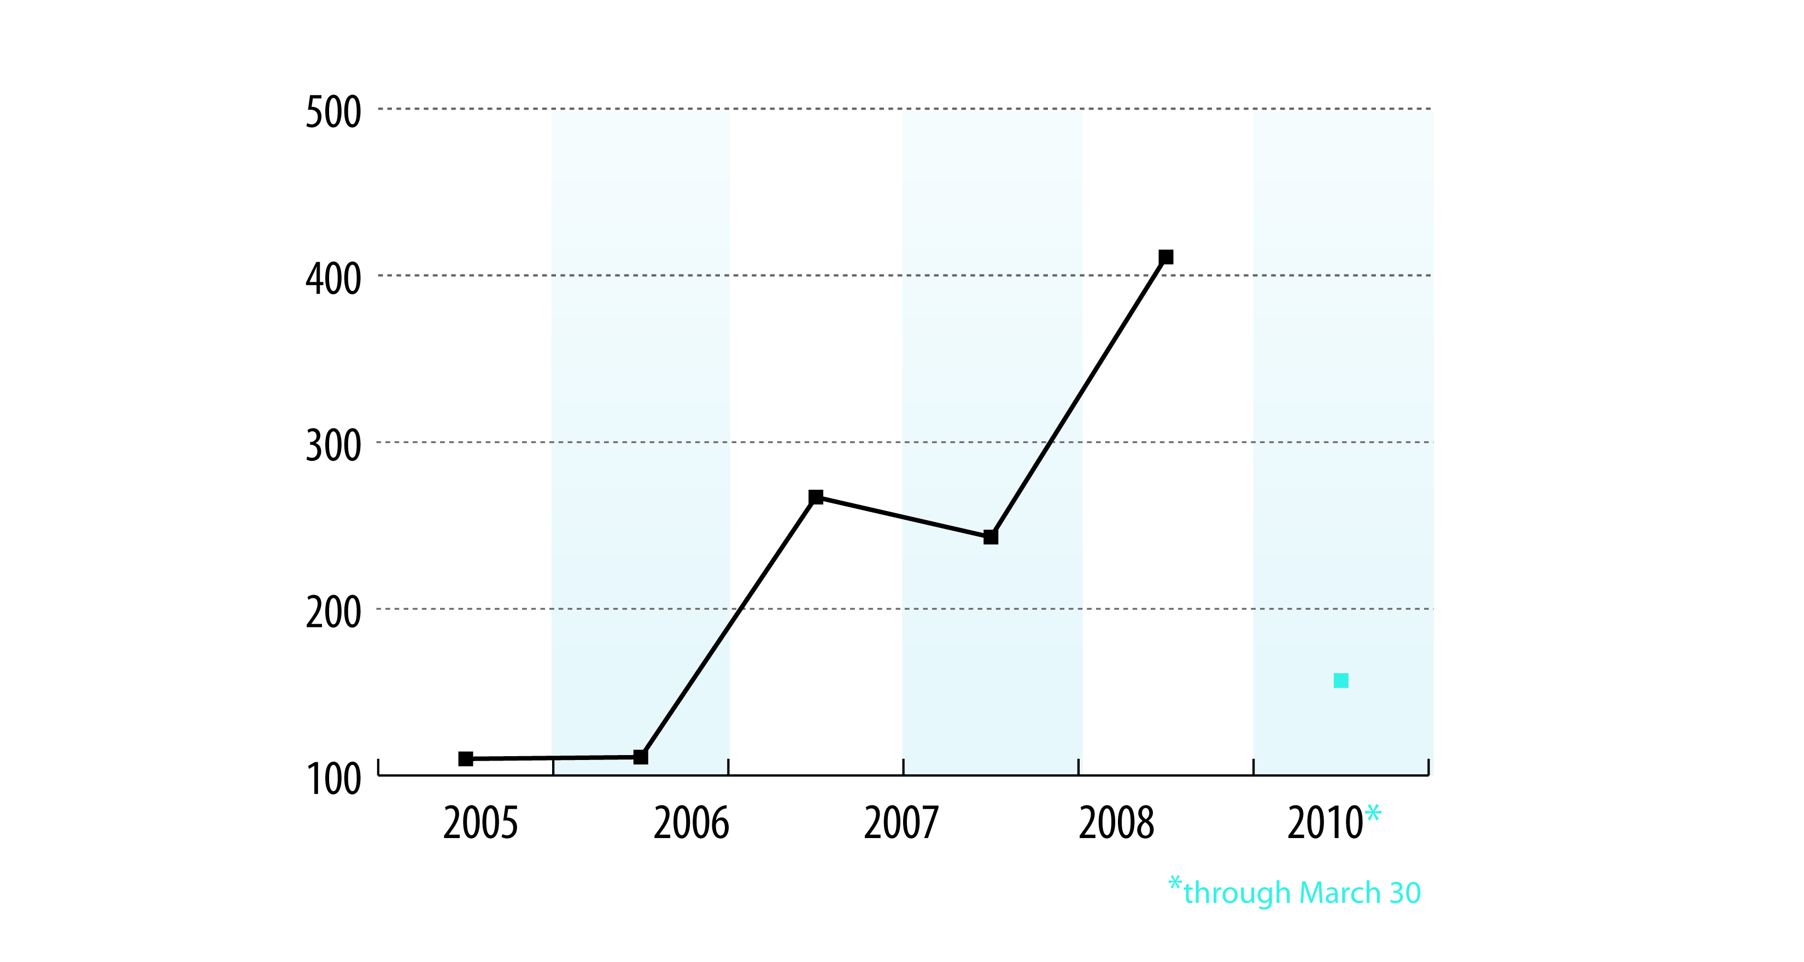
IPv6 Requests Received

Slide 13
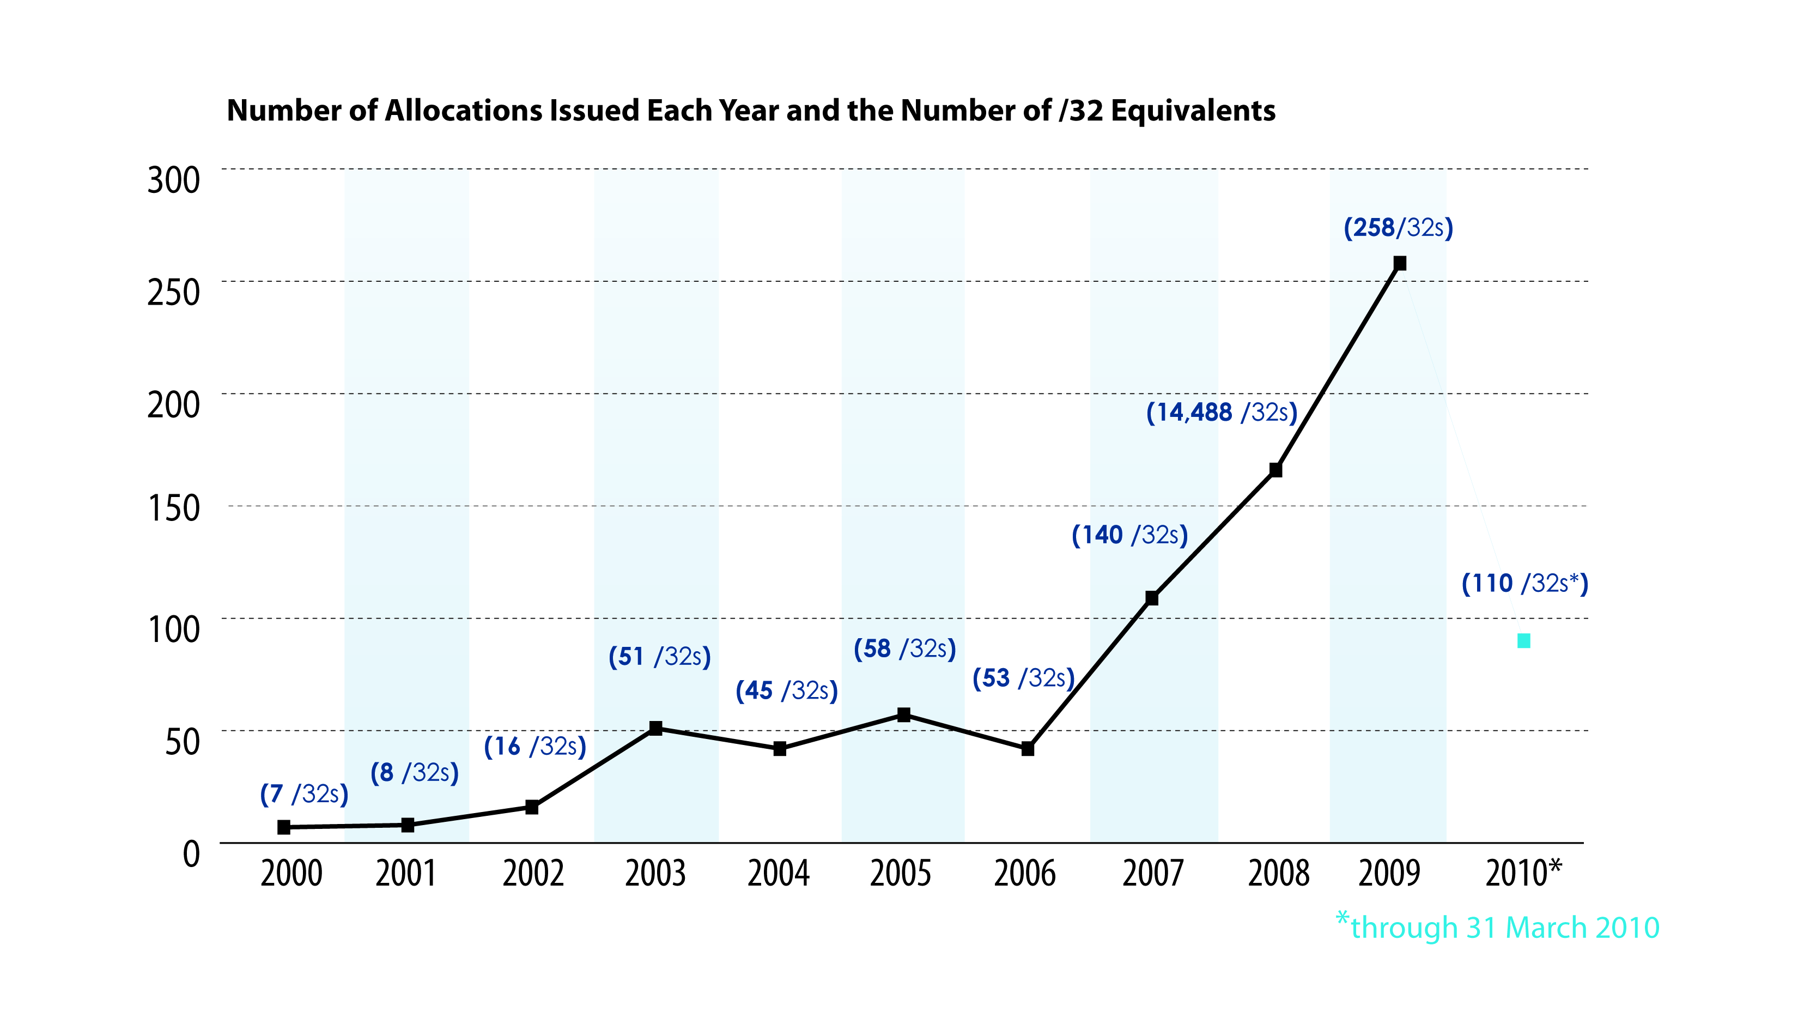
IPv6 Allocations Issued (/32s)

Slide 14
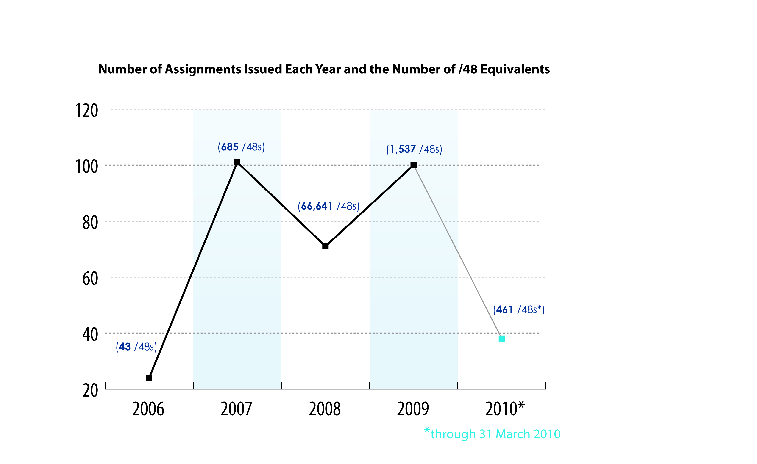
IPv6 Assignments Issued

Slide 15
IPv4 vs IPv6 Subscribers
3,366 IPv4 ISP subscribers today
  2,295 (80%) do not have IPv6 allocations
  **At our current allocation rate (~30 new IPv6 subscribers per month), it will take over 7 years for every v4 ISP to get v6

Slide 16


