Slide 1
Introduction to ARIN and
the Internet Registry System

Slide 2
Regional Internet Registries
The Regional Internet Registry (RIR) system began in 1992
There are five RIRs
All RIRs are nonprofit, community-driven organizations
RIRs coordinate closely with IANA, and are part of the Internet Registry System

Slide 3
Internet Registry System
ICANN(IANA) | Top level coordination of the Internet identifiers (domain names, numbers) Manage global unallocated IP address pool Allocate number resources to RIRs
RIR | Manage regional unallocated IP address pool Allocate number resources to ISPs/LIRs Assign number resources to End-users
ISP/LIR | Manage local IP address pool for use by customers and for infrastructure Allocate number resources to ISPs Assign number resources to End-users

Slide 4

Number Resource Provisioning Hierarchy
ICANN / IANA
(Internet Assigned Numbers Authority)
Manage global unallocated IP address pool
Allocate
RIRs
(AfriNIC, APNIC, ARIN, LACNIC, RIPE NCC)
Manage regional unallocated IP address pool
Allocate
Assign
ISPs
End Users
Re-Allocate
Re-Assign
ISPs
End Users

Slide 5
Regional Internet Registries
Notes:
5

Slide 6
RIR Structure
Nonprofit | Membership Organization | Community-regulated
Fee for services, not number resources 100% community funded | Open Broad-based - Private sector - Public sector - Civil society | Community developed policies Member-elected executive board Open and transparent

Slide 7
RIR Services
Number Resources | Organization | Policy Development
IP address allocation & assignment ASN assignment Directory services WHOIS IRR Reverse DNS | Elections Meetings Information dissemination Website Newsletters Roundtables Training | Maintain e-mail discussion lists Conduct public policy meetings Publish policy documents

Slide 8
About ARIN
One of five Regional Internet Registries
Services 25 Economies in the Canada, the Caribbean and United States
Nonprofit corporation based in Chantilly, VA
Established December 1997
100% community funded

Slide 9
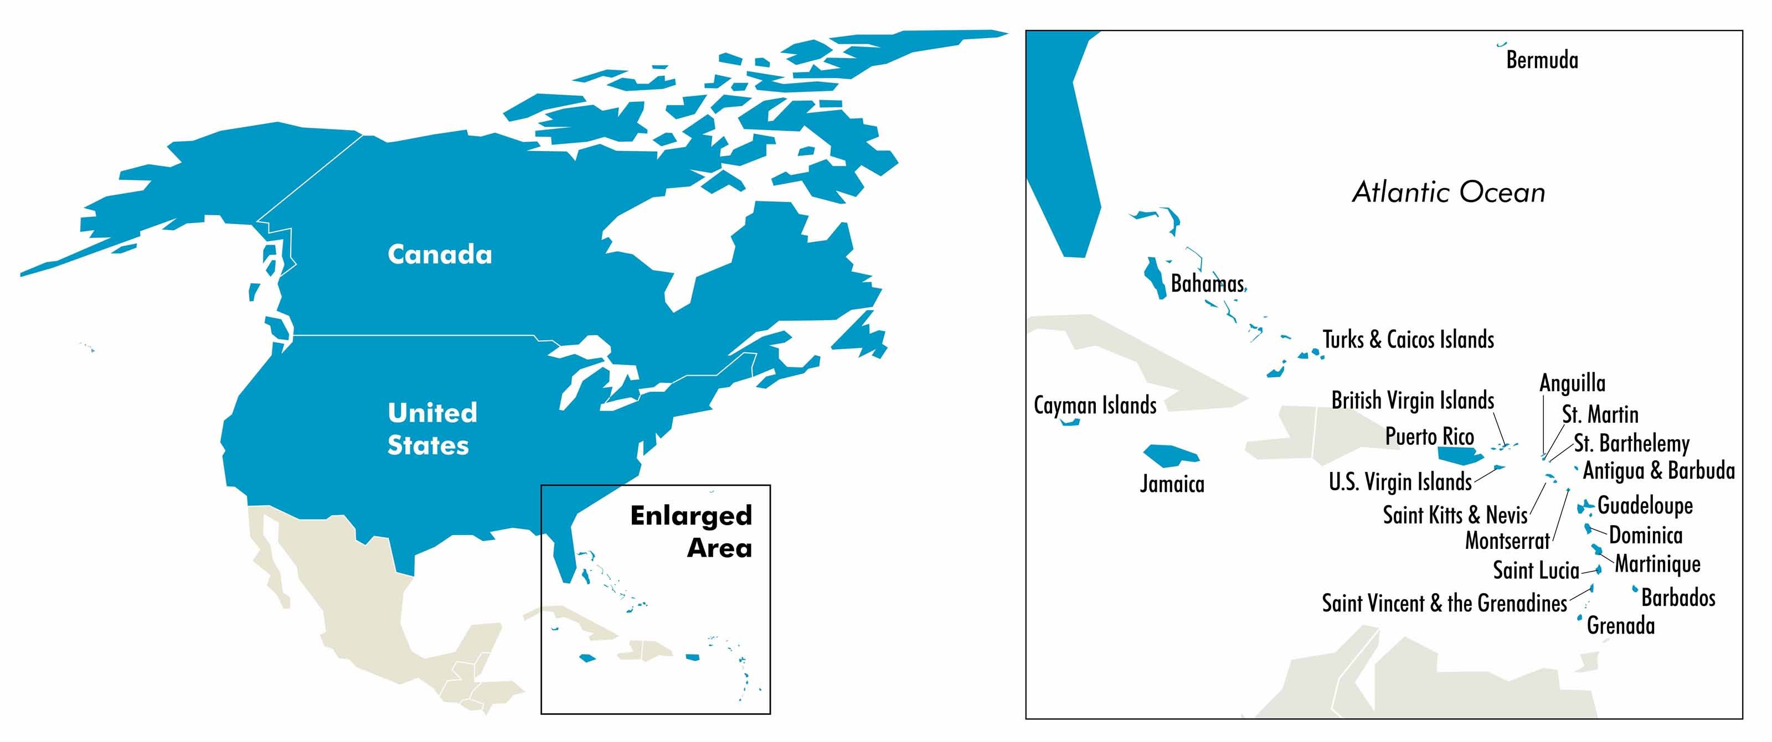
The ARIN Region
ARIN’s region includes Canada, many Caribbean and North Atlantic islands, and the United States.

Slide 10
ARIN’s Mission
Applying the principles of stewardship, ARIN, a nonprofit corporation:
  allocates Internet Protocol resources;
  develops consensus-based policies; and
  facilitates the advancement of the Internet through information and educational outreach.

Slide 11
ARIN’s Services
Like the other RIRs, ARIN:
  Allocates and assigns Internet number resources
  Participates in the global Internet community
  Facilitates policy development
  Is a nonprofit, membership organization
  Is governed by an elected executive board

Slide 12
Organizational Chart

Slide 13
Registration Services
Directory Services
Registration transaction information (WHOIS)
Record maintenance
Routing information (Internet Routing Registry)

Slide 14
Registration Services
Coordination & management of Internet number resources
Internet number resource transfers

Slide 15

Technical Services
ARIN WHOIS/RWHOIS
ARIN Online
Internet Routing Registry
Reverse DNS Services
All public services also available over IPv6
IT support for organization
Emerging Technologies: DNNSEC, RPKI, Whois-RWS
Community Software Project Repository

Slide 16
Organization Services
Public Policy & Members
Meetings
Executive Board Elections

Slide 17
Organization Services
Information publication
and dissemination
Education
& Training

Slide 18
Policy Development Services
Manage the Policy Development Process
Maintain e-mail discussion lists
Publish policy documents

Slide 19
Policy Development Process
BOTTOM-UP
Community Proposes, Discusses, and Approves Policy
OPEN
Open Participation
  Inclusive
  Accessible
TRANSPARENT
Documented, Published & Accessible PDP, Policies, and Procedures

Slide 20
This afternoon’s program in the Ballroom
  1:30 PM - Hosting Providers & ARIN
  3:45 PM - ARIN Online: New Functionality Demo
  4:45 PM - Introduction to ARIN Policy Development Process
  5:00 PM - Open Policy Hour

Slide 21

Caledon & Oakville Rooms
up one level on main floor

Slide 22
Please complete the survey form and drop it in the bowl.
Tomorrow morning at the start of the meeting there will be a drawing for a $100 Think Geek gift certificate.

Slide 23


