Slide 1
First Timers’ Breakfast
Susan Hamlin
Director, Communications and Member Services

Slide 2
First Timers Breakfast
Brief introductions
Introduction to ARIN and the Internet registry system
Policy development at a glance
What to expect and how to participate at this meeting
Q&A at your table

Slide 3

Self - introductions

Slide 4
Regional Internet Registries (RIRs)
The system began in 1992
There are five RIRs
  - LACNIC formed in 2002 out of ARIN region
  - AfriNIC formed in 2005 out of ARIN and RIPE NCC regions.
All RIRs are nonprofit, community-driven organizations

Slide 5
RIR Structure
Nonprofit | Membership Organization | Community-regulated
Fee for services, not number resources 100% community funded | Broad-based - Private sector - Public sector - Civil society | Community developed policies Member-elected executive board Open and transparent

Slide 6
RIR Services
Number Resources | Organization | Policy Development
IP address allocation & assignment ASN assignment Directory services Whois IRR Reverse DNS | Elections Meetings Information dissemination Website Newsletters Roundtables Training | Facilitate policy development process Maintain email discussion lists Conduct public policy meetings Publish policy documents

Slide 7
Who Provisions IP Addresses and ASNs?
ICANN IANA | Top level technical coordination of the Internet Names, Numbers, Root Servers Manage global unallocated IP address pool Allocate number resources to RIRs
RIR | Manage regional unallocated IP address pool Allocate number resources to ISPs/LIRs Assign number resources to End-users
ISP/LIR | Manage local IP address pool for use by customers and for infrastructure Allocate number resources to ISPs Assign number resources to End-users
Notes:
These are the organizations responsible for the distribution of IP number resources. The IANA (Internet Assigned Numbers Authority) is actually a US Government contract held by ICANN (Internet Corporation for Assigned Names and Numbers). IANA has always been responsible for the global pool of IP number resources.

Slide 8

Number Resource Provisioning Hierarchy
ICANN / IANA
(Internet Assigned Numbers Authority)
Manage global unallocated IP address pool
Allocate
RIRs
(AfriNIC, APNIC, ARIN, LACNIC, RIPE NCC)
Manage regional unallocated IP address pool
Allocate
Assign
ISPs
End Users
Re-Allocate
Re-Assign
ISPs
End Users

Slide 9
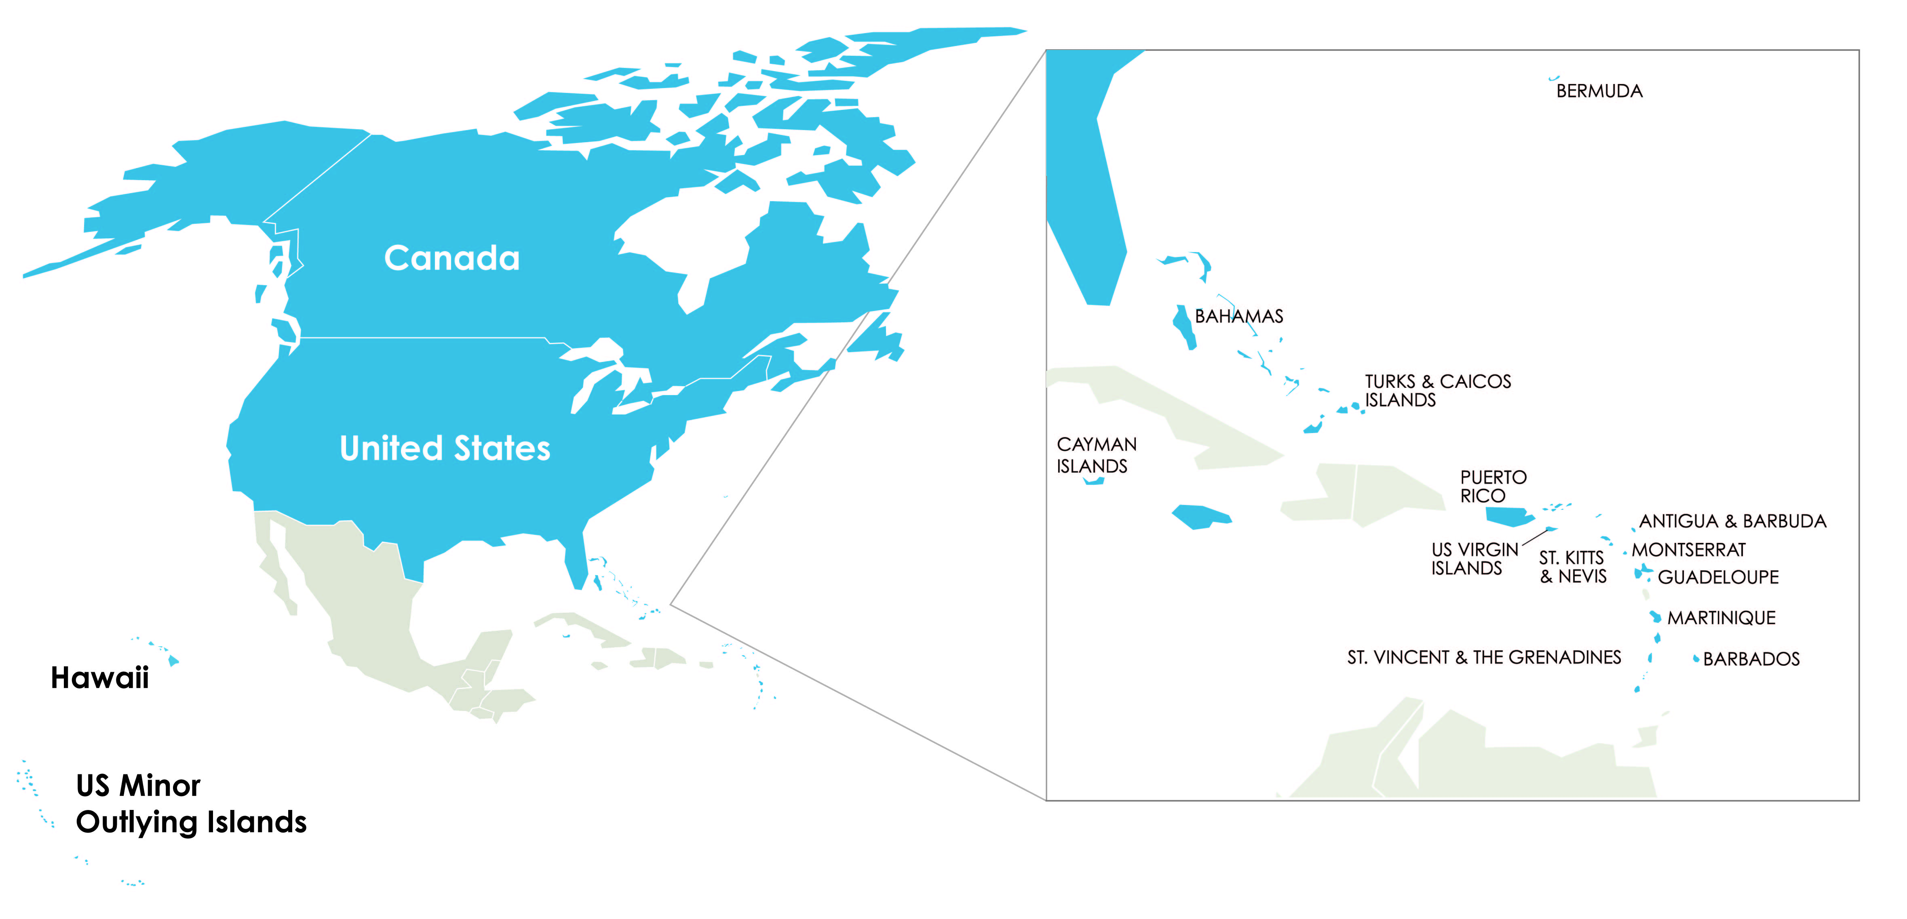
About ARIN
Established December 1997
100% community funded
ARIN’s region includes Canada, many Caribbean and North Atlantic islands, US Minor Outlying Islands and the United States.

Slide 10
ARIN’s Mission
Applying the principles of stewardship, ARIN, a nonprofit corporation:
  allocates Internet Protocol resources;
  develops consensus-based policies; and
  facilitates the advancement of the Internet through information and educational outreach.

Slide 11
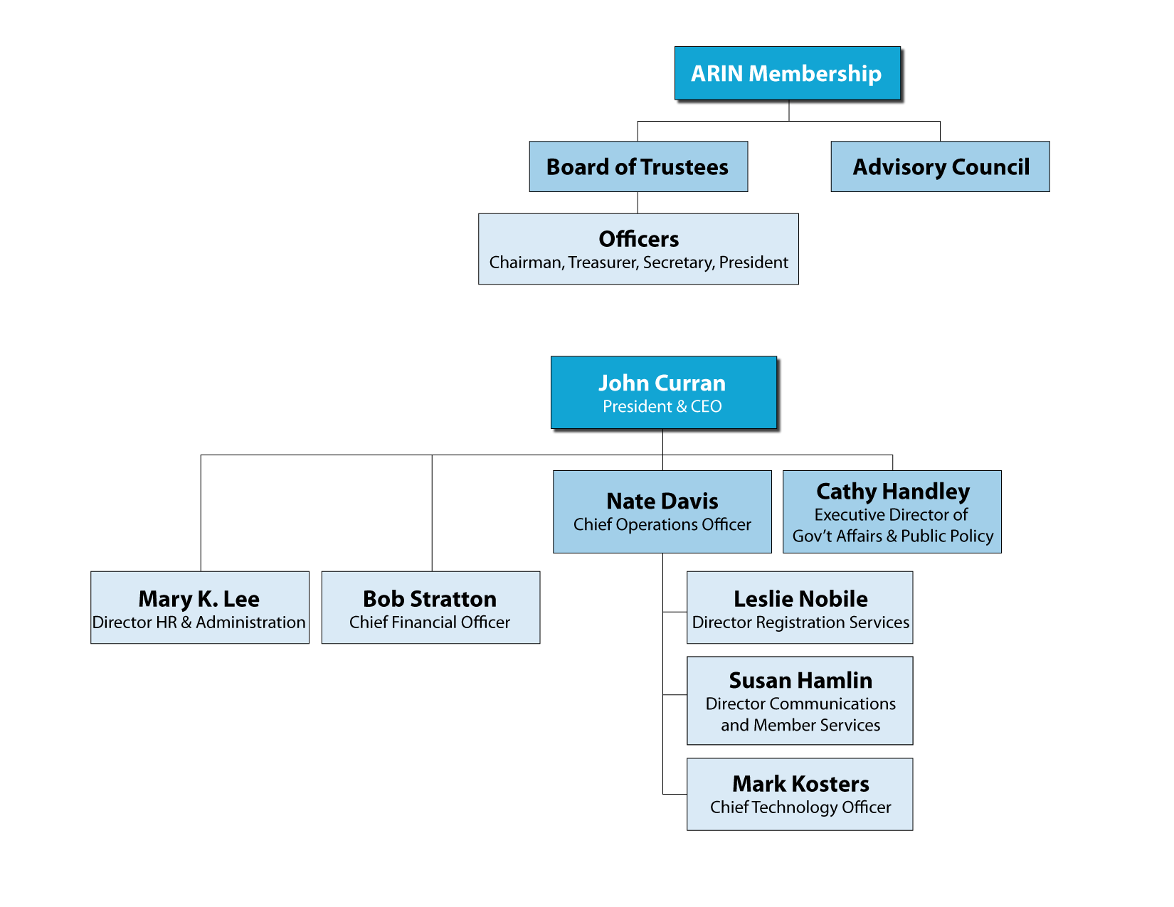
Organizational Chart

Slide 12
Registration Services
Coordination & management of Internet number resources
Internet number resource transfers
Directory Services
Registration transaction information (Whois)
Record maintenance
Routing information (Internet Routing Registry)

Slide 13

Technical Services
ARIN Whois/RWhois
ARIN Online
Internet Routing Registry
Reverse DNS Services
IT support for organization
Emerging Technologies: DNSSEC, RPKI

Slide 14
Organization Services
Information publication and dissemination
Education & outreach
Elections (Board, AC, NRO NC)
Policy development process
Public Policy and Member Meetings

Slide 15
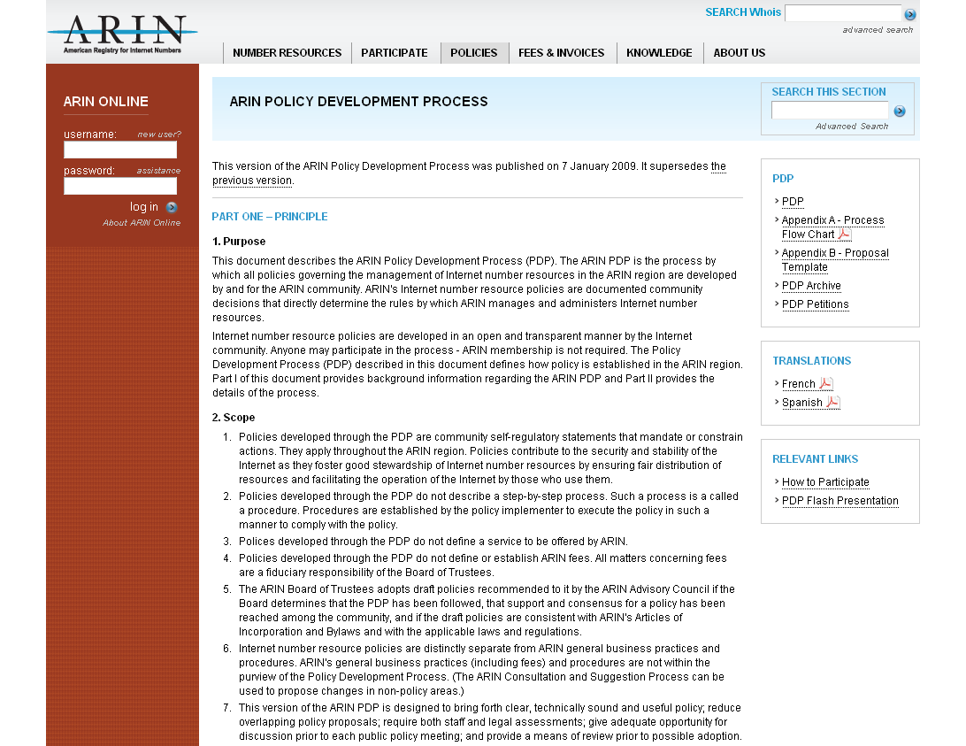
Policy Development Process (PDP)
Flowchart
Proposal Template
Archive
Movie
https://www.arin.net/policy/pdp.html

Slide 16
Policy Development Principles
Open
  Developed in open forum
    Public Policy Mailing List
    Public Policy Meetings
  Anyone can participate
Transparent
  All aspects documented and available on website
    Policy process, meetings, and policies
Bottom-up
  Policies developed by the community
  Staff implements, but does not make policy

Slide 17
Who Plays a Role in the
Policy Process?
Community
  Participate in discussions and petitions
  Submit proposals
Advisory Council (elected volunteers)
  Develop policy from proposals; goal is “clear, technically sound and useful” policy
  Determine consensus based on community input

Slide 18
Roles…
ARIN Board of Trustees (elected volunteers)
  Provide corporate fiduciary oversight
  Ensure the policy process has been followed
  Ratify policies
ARIN Staff
  Provide feedback to community/AC
    Clarity and Understanding Reports
    Staff and legal assessments
    Policy experience reports
  Implement ratified policies

Slide 19
Basic Steps
Community member submits a proposal
Community discusses the proposal on the “List”
AC creates a draft policy (*petition process)
Community discusses the draft policy on the “List” and at the meeting
AC conducts its consensus review
Community performs last call
Board adopts
Staff implements
Notes:
*Anyone dissatisfied with a decision by the AC can petition in order to keep a proposal moving forward
Occurs between proposal and draft policy stage
5 day petition period
Needs 10 different people from 10 different organizations to publicly support the petition
There have been 8 petitions to date, 1 successful ??

Slide 20
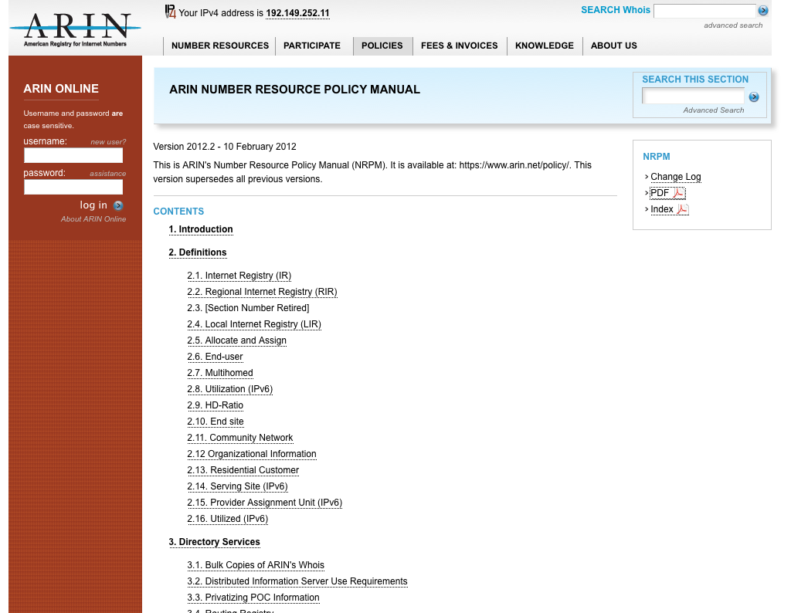
Number Resource Policy Manual
http://www.arin.net/policy/nrpm.html
Policies Covered:
IPv4 Address Space
IPv6 Address Space
Autonomous System Numbers (ASNs)
Directory Services (WHOIS)
Reverse DNS (in-addr)
Transfers
Experimental Assignments
Resource Review Policy

Slide 21
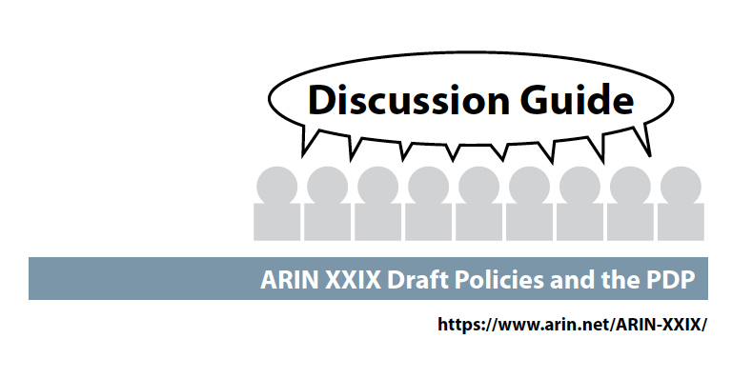
Draft policies at this meeting:
ARIN-2011-1: ARIN Inter-RIR
Transfers
ARIN-2011-7: Compliance
Requirement
ARIN-2012-3: ASN Transfers
ARIN-2012-1: Clarifying Requirements for IPv4 Transfers
ARIN-2012-2: IPv6 Subsequent Allocations Utilization Requirements
ARIN-2012-4: Return to 12 Month Supply and Reset Trigger to /8 in Free Pool

Slide 22
How to monitor and not be overwhelmed?
Once a month:
Front page of the website leads to proposals and draft policies under discussion
  New proposals need feedback for the AC’s initial decision
  Web site can help you focus on what’s important to you and your company
Twice per year:
Check the ARIN Public Policy Meeting site in the weeks leading up to the meeting
  Proposals/Draft Policies on Agenda
  Discussion Guide (summaries, text, staff assessments)
  Attend in Person/Remote
AC meeting last day: Watch list for AC’s decisions, Last Calls –
State your opinion, are you For or Against?

Slide 23

What’s Ahead this week
Today: ARIN Public Policy Meeting, 9:00AM – 5:00 PM
ARIN social tonight – Grouse Mountain
Tuesday: ARIN Public Policy Meeting, 9:00 AM - 5:30 PM
Wednesday: ARIN Members Meeting (open to all),
9:00 AM – Noon

Slide 24
Ways to participate this week:
Membership is not required ☺
Meet your fellow attendees at meals and during breaks
Join a lunch table topic discussion led by the AC on Monday or Tuesday
ARIN Board, Advisory Council, NRO Number Council and Staff all have ribbons on our name tags – seek us out and ask questions
Go the floor microphones in the meeting room , be sure to state name and org. upfront
Raise your hand to voice your opinion when votes are taken during policy discussions

Slide 25


Slide 26
Don’t Forget Your Survey
Please complete the survey form and drop it in the bowl.
Be present in the meeting room this morning for the drawing – you might win a $100 Think Geek gift certificate.

Slide 27
Questions?

Slide 28
Reference Material

Slide 29
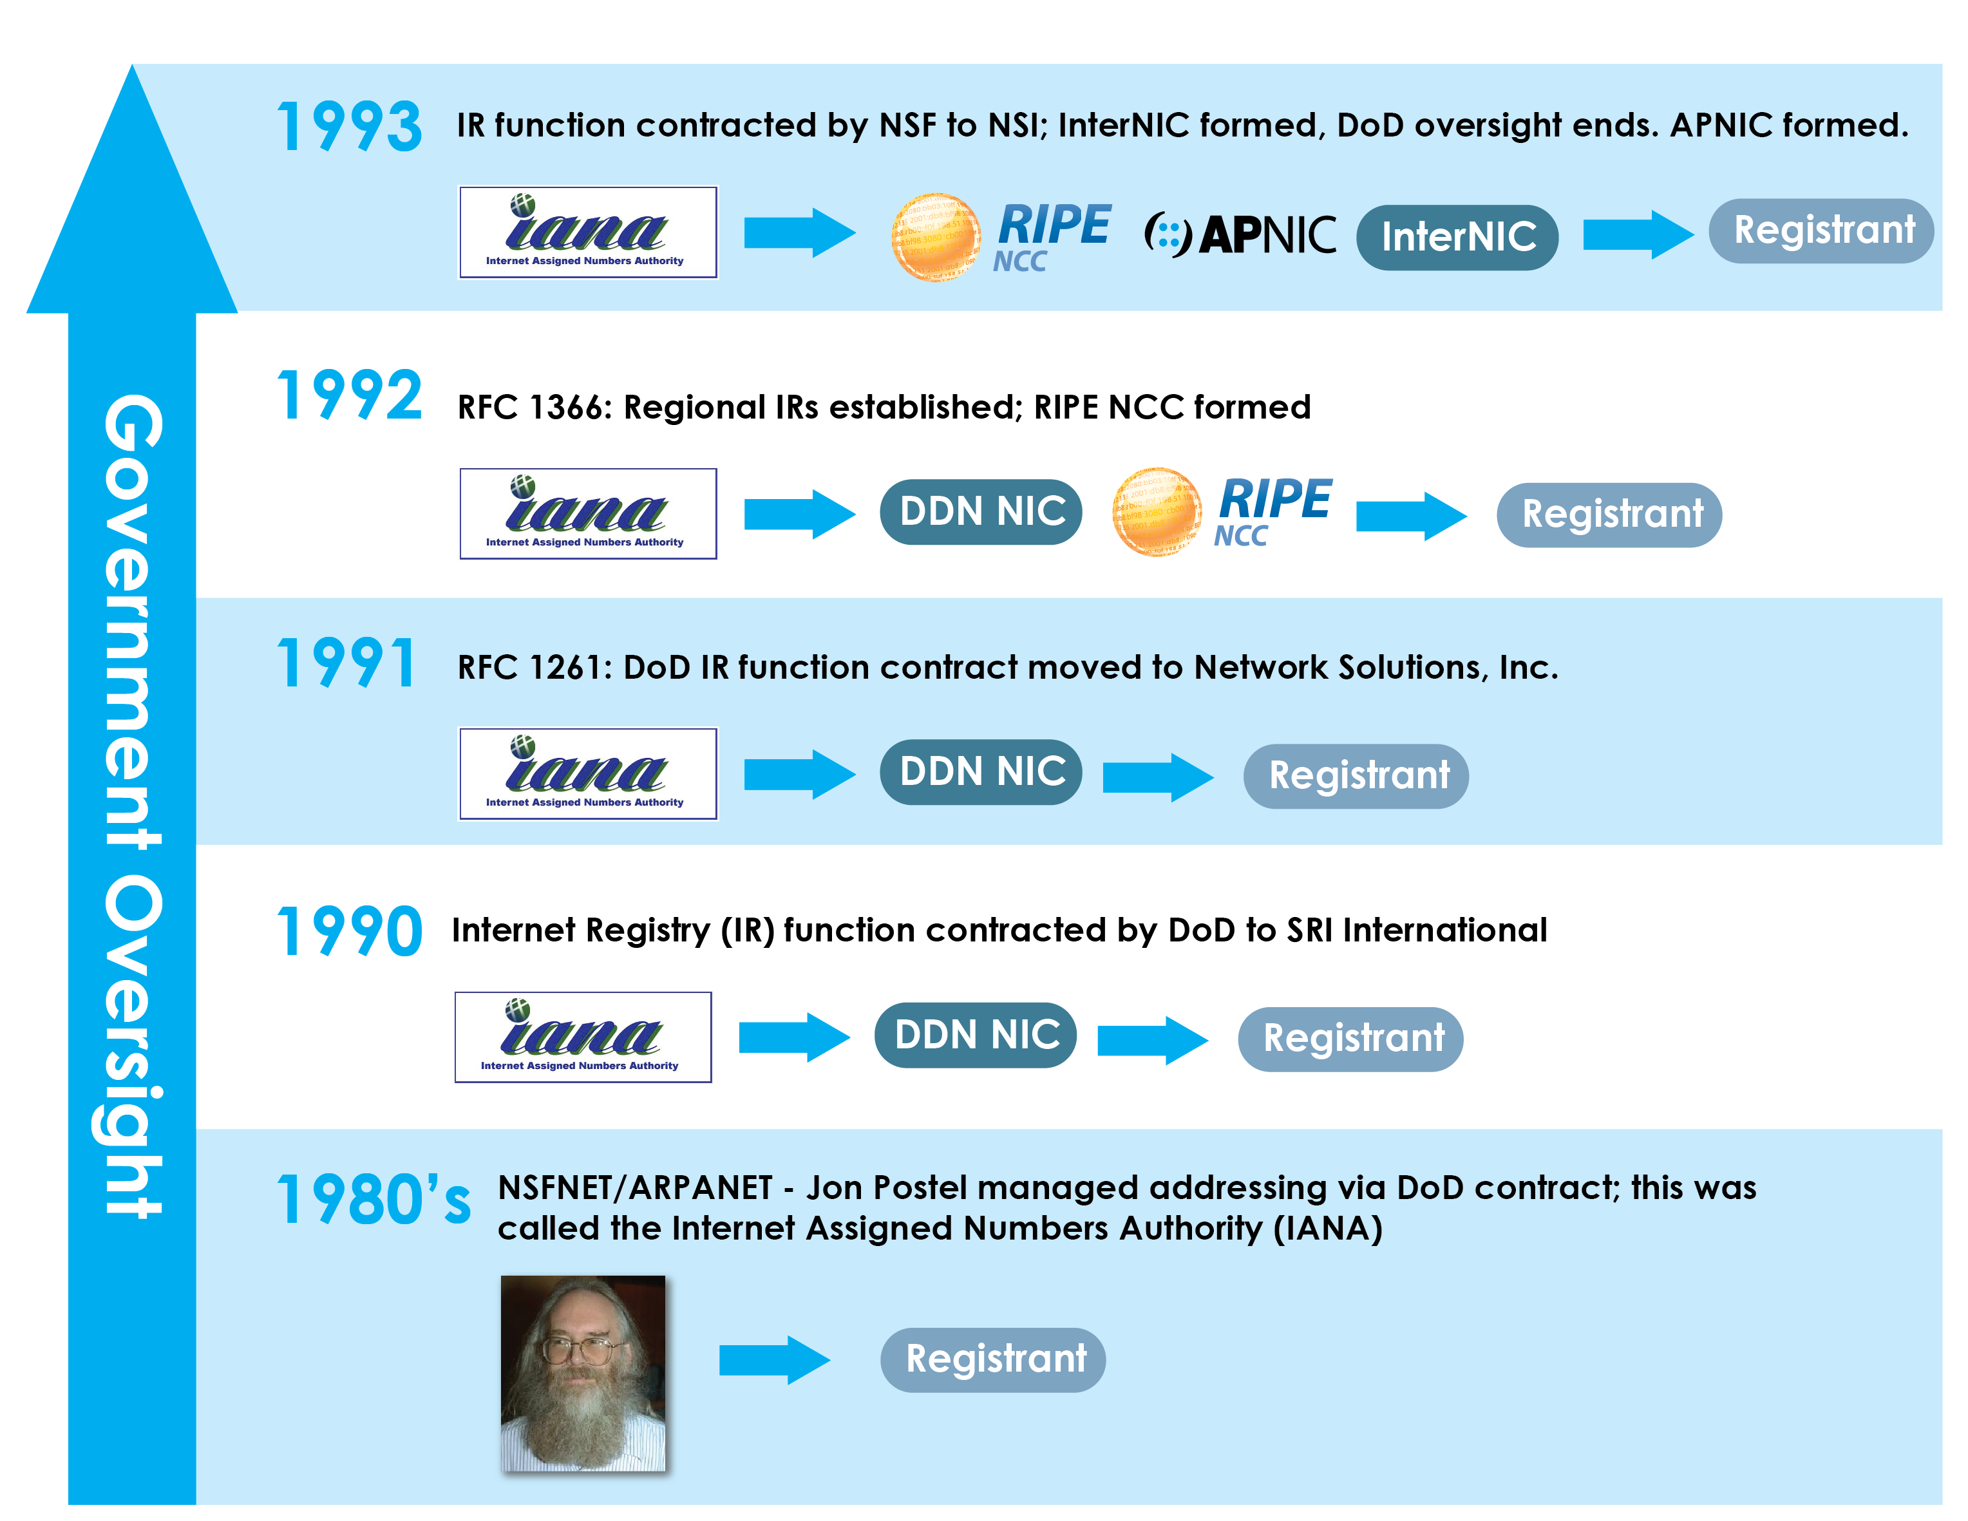
Historical Timeline

Slide 30
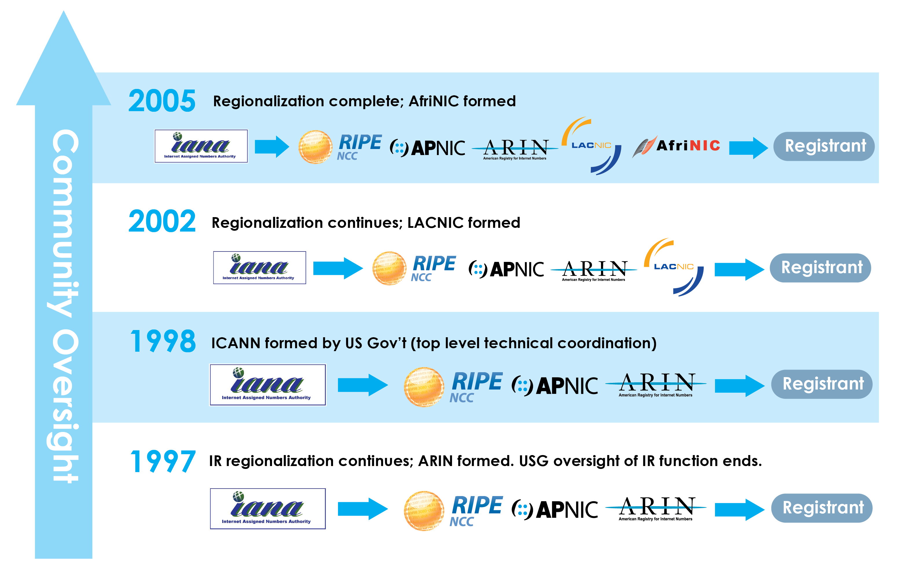
Historical Timeline

