Slide 1
IANA Update
Mark McFadden IANA Resource Specialist
October 2009
ARIN XXIV / Gorgeous Dearborn, MI
1

Slide 2
Overview
IANA pools’ status
Special addresses
Throwing some back
Mechanism for selecting which /8s to allocate to RIRs
Introduction of reverse DNS self-management system
IDN ccTLDs
IANA Business Excellence
2

Slide 3
IANA Free Pool Status
Unicast
IPv4 /8s
16-bit ASN blocks
3

Slide 4
Special Addresses
Thanks to APNIC for providing 2 new /24s for use as documentation prefixes
198.51.100.0/24
203.0.113.0/24
Details in draft-iana-ipv4-examples, which is in the RFC Editor queue
4

Slide 5
Throwing some back
We reclaimed 14.0.0.0/8 with the X.25 operator community in 2007
We have been working with ARIN & the IESG on returning smaller blocks this year:
128.66.0.0/16
192.128.0.0/17
192.0.48.0/20
192.0.64.0/18
parts of 192.0.0.0/19
5

Slide 6
Mechanism for selecting which /8s to allocate to RIRs
Remaining /8s split into 2 pools based on Duane Wessels 2008 research
RIRs get 1 /8 from each pool, when justified
Selection mechanism is random & based on RFC 2777
2 less used /8s set aside for each of AfriNIC & LACNIC
6

Slide 7
Introduction of reverse DNS self-management system
Beta testing complete
Deployment being scheduled
Security is based on HTTPS transport & X.509 PKI
Allows in-addr.arpa & ip6.arpa to be DNSSEC signed
Allows RIRs to manage their delegations in real time
7

Slide 8
IDN ccTLD Fast Track Launch
Launch proposed for 16 November
Requests go through the fast track evaluation and then the regular IANA delegation process
Expect 50-60 requests for TLDs representing 15-20 languages
8

Slide 9
IANA Business Excellence
ICANN 2009-2011 Strategic Plan includes “Strive for excellence in core operations” as a priority
http://www.icann.org/en/strategic-plan/strategic-plan-2009-2012-09feb09-en.pdf
Introducing a Business Excellence work program to make sure there is systematic, sustainable framework for improvement
9

Slide 10
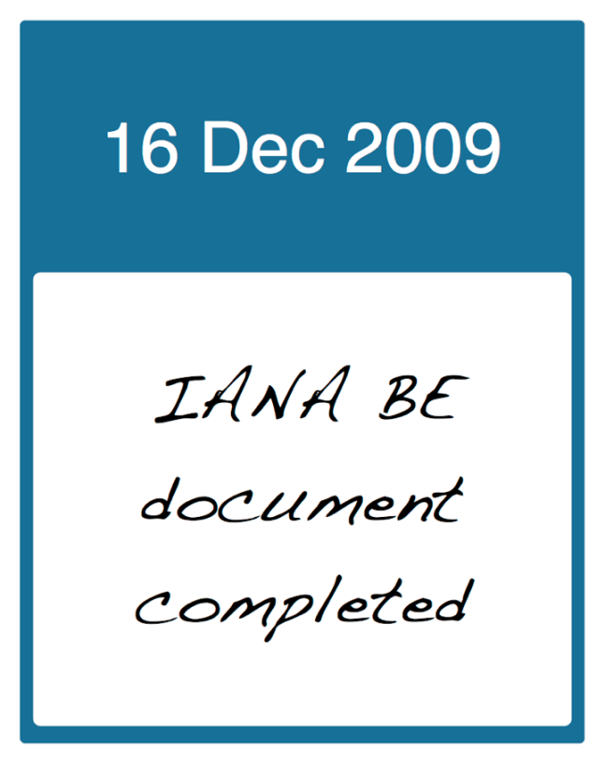
Timeline
10

Slide 11
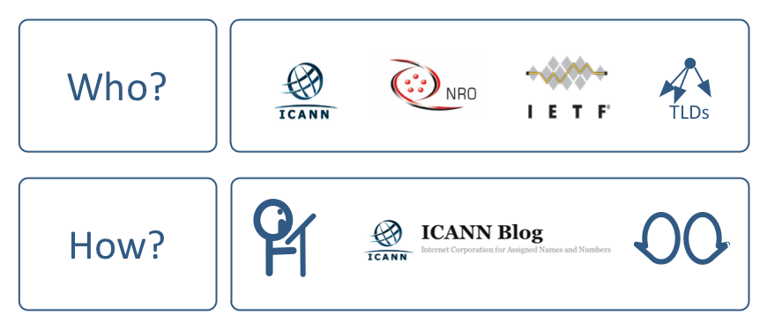
2009 Communication Plan
Continuing communication as work proceeds
11

Slide 12
More ways to keep up with us
Significant IANA news is now posted to Twitter
http://www.twitter.com/theiana
12

Slide 13
Thank you
13

