Slide 1
Member Services Department
Susan Hamlin,
Director

Slide 2
Composition
Happy People
You Are
What’s Going On
Lately
It Takes Two
Get Ready

Slide 3
Happy People
Susan Hamlin, “Just My Imagination”
De Harvey, “Signed, Sealed, Delivered”
Hollis Kara, “You Keep Me Hanging On”
Lawson Parker, “Lady Soul”
Einar Bohlin, “You Are the Sunshine of My Life”
Jason Byrne, “What’s Going On?”
Scott Gordon, “I Heard It Through The Grapevine”
Jud Lewis, “I Heard It Through the Grapevine”

Slide 4
You Are
3497 ARIN Members 9/30/09
340
3114
Outside ARIN region: 7
36

Slide 5

What’s Going On
General ARIN communications
Outreach support
Facilitating and administering:
  - Policy Development Process
- Suggestion and Consultation Process
- ARIN Meeting Fellowship Program
- Elections and Corporate Documents
Notes:
Outreach support – documentation creation and inventory, swag, shipping coordination
General ARIN communications – website, announcements, wiki’s

Slide 6
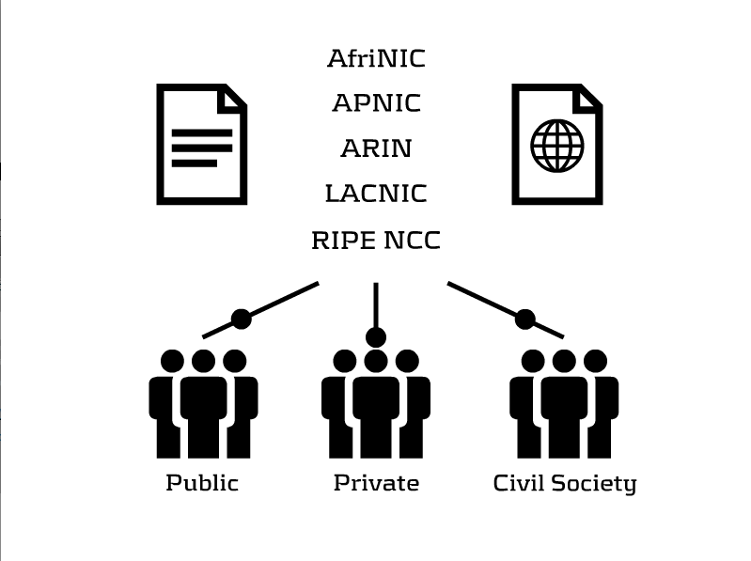
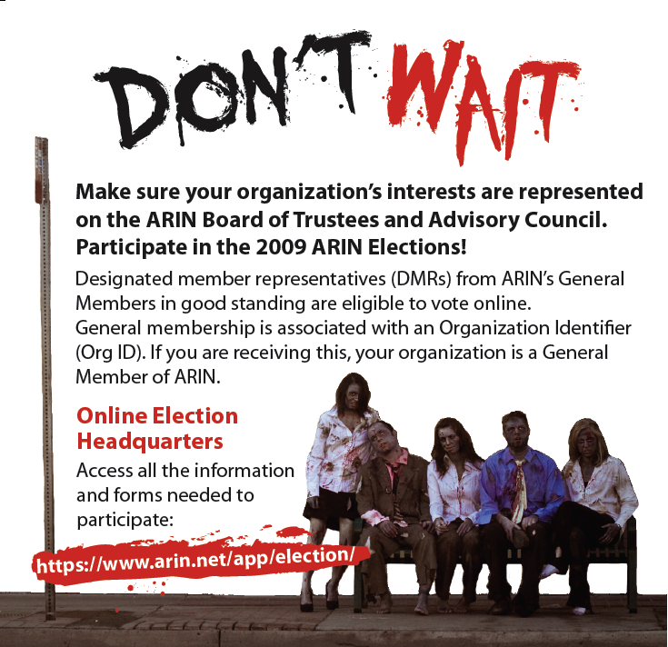
Lately
New flash piece –
- Managing Internet
Number Resources
NRO communications support
  - ITU Telecom World Geneva
  - NRO website additions
Supporting ARIN elections

Slide 7
Reach Out I'll Be There and
It Takes Two
info@arin.net
ARIN-Discuss mailing list
The ARIN Consultation and Suggestion Process
Through Q&A in ARIN Online
ARIN’s gone social avenues

Slide 8





Get Ready
https://www.arin.net/participate/meetings/fellowship.html

