Slide 1
In-Person Outreach Efforts

Slide 2
In-Person Outreach Purpose
Reach out to various stakeholder types
Raise awareness of ARIN and key messages
Break through rumor/innuendo and create a more positive perception of ARIN
Provide education

Slide 3
Our Messages
The ARIN organization and RIR system
Industry self-regulation
PDP and how to participate
IPv4 Depletion and IPv6 Adoption
Other targeted messages as needed
  Legacy RSA
  4-byte AS Numbers

Slide 4
Audiences
Providers of Internet services
  ISPs
  Content providers
  Application service providers
Equipment and software vendors
Enterprise companies
Governments
Media / Press

Slide 5
Our Methods
In-person presentations
Exhibits
  Direct
  Reverse
Media Interviews
  In-person, Telephonic, Radio, TV (future)
Event attendance and participation
  Microphone time
  Hallway outreach

Slide 6
Our Materials
Fact and information sheets (and CDs)
Audio / Video
Giveaways (pens, stickers, etc.)
Slide decks
Comic books
More…

Slide 8
Sample Events
Usenix / LISA
HostingCON
Non-Profit Technology Conference
CANTO
CompTEL
CES
Cable Show
ITEC Conference
Joint Techs
IPv6 Summit Meetings
FOSE
Caribbean Internet Forum Meetings
CTU Events
VoiceCON
SC2009
WIMAX Forum Americas

Slide 9
Public Relations Firm
Request for Proposals for PR firm
  published April 21, 2009
  proposals due May 29, 2009
  selection by close of June, 2009
Assist ARIN in spreading key messages
Other PR support as needed

Slide 10
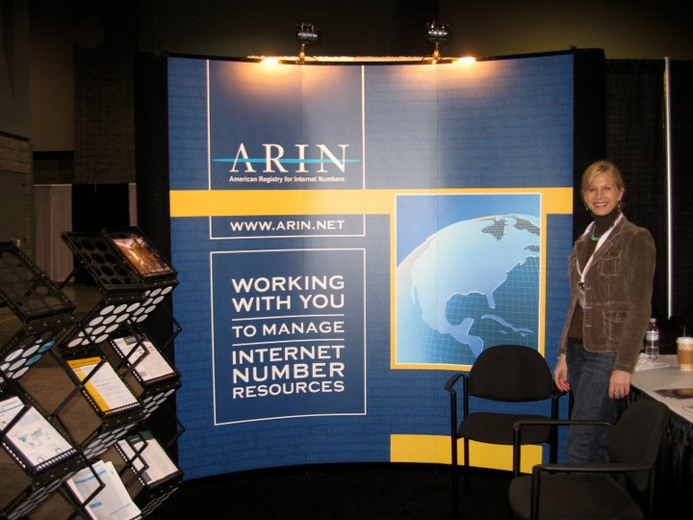

Slide 11
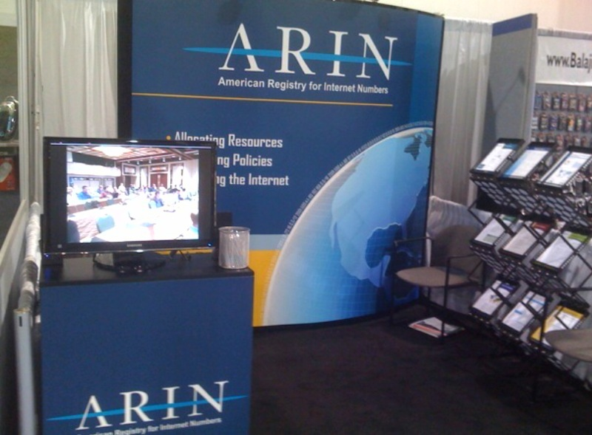

Slide 12
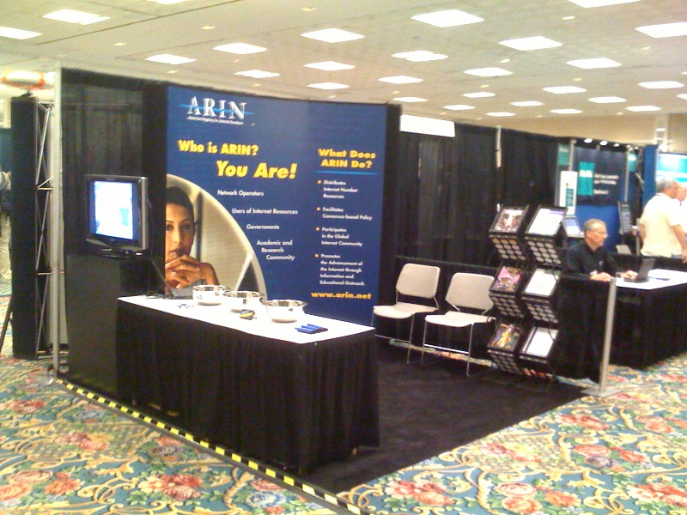

Slide 13
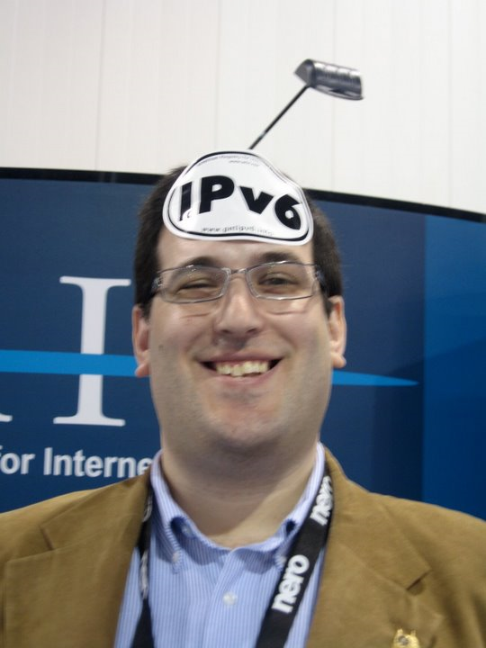

Slide 14
Thank You

