Slide 1
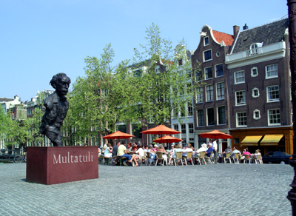
Update from the RIPE NCC

Slide 2

RIPE 57, Dubai
Good attendance
  320 people from 50 countries
Focus IPv6, IPv4 depletion
Outreach
  Previously: Enhanced Cooperation Task Force
  First meeting of Cooperation Working Group

Slide 3
General Meeting October
Good Attendance
  72 votes
Charging Scheme 2009 adopted
  No changes to fees
  Including PI in algorithm
Draft Budget 2009: 15.3 M EUR
  Approved by board in December

Slide 4
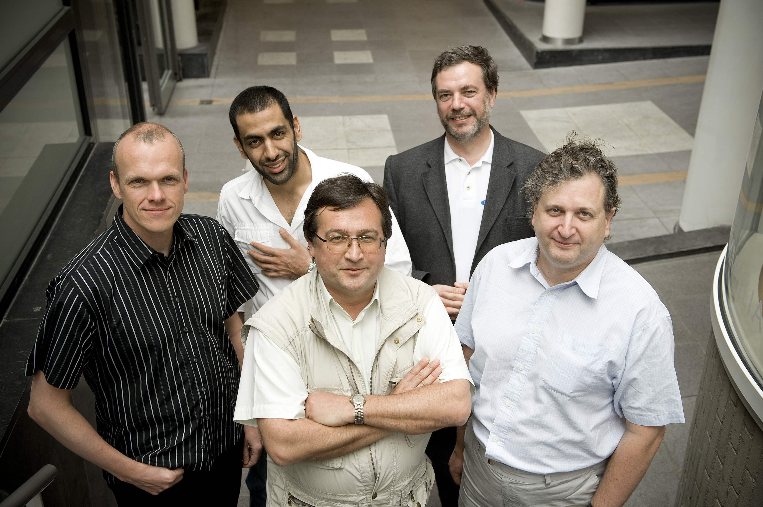
Executive Board (since May 2008)
Two open seats
Seven Candidates
Four / five rounds of elections ☺
  Calls for electronic voting since…
Left to right: Andreas Wittkemper, Fahad AlShirawi, Dmitry Burkov, János Zsakó, Nigel Titley

Slide 5
Ongoing Preparations for the Future
Following Strategy Workshops with Executive Board
Working on three main areas of attention
  Role of the RIPE NCC: Community Building, Outreach, PR
  Trusted Source of Data: Hardening Registry, Reporting Tools
  Number Resource Lifecycle Management: Allocation, Auditing, Reclamation, Certification
Developing and adjusting priorities accordingly
  Deriving operational priorities from strategic outlook

Slide 6
What is keeping us busy…
Certification
Support for Policy Development
Developing Information Services
Outreach and PR

Slide 7
Certification in the RIPE Region
Developing with Input from Community
  RIPE Certification Task Force
Discussing processes
Have announced limited testrun at RIPE 57
  Several dozen participants
Plan to deploy this year
  But…
Coordinating with other RIRs
  Semantics
  Processes
  Policies

Slide 8
Policy Development Support
2007-01 proves more complex than expected
  “Direct Internet Resource Assignments to End Users from the RIPE NCC”
  Contracts with LIRs needed
    Last resort with RIPE NCC directly
  Member vs Non-Member
  Accepted in October 2008, Phase 1 implemented February 2009
2007-08
  “Enabling Methods for Reallocation of IPv4 Resources” (a.k.a Transfer proposal)
  Accepted in December 2008

Slide 9
Some more Policy Development
2006-01, “Provider Independent (PI) IPv6 Assignments for End User Organisations”
  Accepted in April 2009
2008-08, “Initial Certification Policy for Provider Aggregatable Address Space Holders”
2008-06, “Use of final /8”
2008-07, “Ensuring Efficient Use of Historical IPv4 Resources”
2009-01, “Global Policy for the allocation of IPv4 blocks to Regional Internet Registries”

Slide 10
Even More Policy Development
2008-05, “Anycasting Assignments for TLDs and Tier 0/1 ENUM”
2009-02, “Allocating/Assigning Resources to the RIPE NCC”
2009-03, “Run Out Fairly”
2009-04, “IPv4 Allocation and Assignments to Facilitate IPv6 Deployment”
2009-05, “Multiple IPv6 /32 Allocations for LIRs”

Slide 11
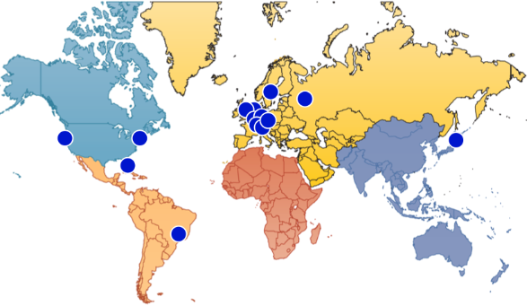
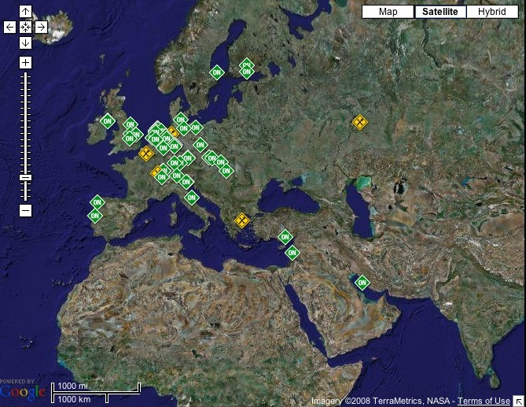
Information services
RIPE NCC Information services
  http://is-portal.ripe.net
Routing Information Service (RIS)
  http://www.ripe.net/ris
Test Traffic Measurements (TTM)
  http://www.ripe.net/ttm
DNSMON
  http://dnsmon.ripe.net/
NCC Science Group analysis
  http://www.ripe.net/projects/reports/2008cable-cut
  http://www.ripe.net/news/study-youtube-hijacking.html

Slide 12
Membership & Regional Outreach
Exceeded 6.064 members by the end of 2008
  Noticing lower conversion rate (application -> member)
RIPE NCC Regional Meetings 2008
  Salmiya, Kuwait, 15-17 April
  Moscow, Russia, 23-24 September
Middle East Operators Group (MENOG)
  MENOG 4 / RIPE 57 Meeting in Dubai
  MENOG 5 / RIPE NCC Regional Meeting, Bahrain, 6-9 April
Membership Survey
  Results at: http://www.ripe.net/news/2008-survey.html

Slide 13
PR / Outreach
Working closely with PR agency
    Racepoint / London
Campaigns on IPv6 uptake and ASN32
  Press releases and sustained briefings
Support for events
  OECD, Seoul
  ITU Telecom Africa, Cairo, with AfriNIC
  ITU Telecom Asia, Bangkok, with APNIC
Developing Branding for Information Services

Slide 14
Governments & “Enhanced Cooperation”
RIPE Cooperation Working Group
  Resulting from Enhanced Cooperation Task Force
  Co-chaired by Maria Häll / Martin Boyle
External Relations
  Activities targeted towards and with governments
  Continued Cooperation with the OECD
RIPE NCC Roundtable for Governments and Regulators
  29 September 2008, Amsterdam
  16 February 2009, Amsterdam
Workshop with Law Enforcement Agents
  17 February 2009, Amsterdam
  Demand for better understanding and closer cooperation

Slide 15

RIPE 58
RIPE 58, Amsterdam, 4-8 May 2009
RIPE 59, Lisbon, Portugal, 5-9 October 2009
For 2010, preparing Prague and Rome ☺

Slide 16
Oh, and one more thing…
The Challenge…
… came to me from APNIC:
  “We are challenging the staff of the NCC to try to beat the APNIC staff in the Global Corporate Challenge!”
  “APNIC would understand if you’d have to decline taking this up, competing against super fit Queenslanders would be daunting! At least the weather would be on your side, you’ll soon have a European summer! “
  RIPE NCC mustered 5 teams so far…
  125 days, 10.000 steps / day
So, the RIPE NCC staff is challenging ARIN staff!
See www.gettheworldmoving.com

Slide 17

Questions?

