Slide 1
APNIC Update
George Kuo
Member Services Manager
ARIN XXIII
28 APR 2009

Slide 2
Overview
APNIC 27 policy outcomes
APNIC Member and Stakeholder Survey
IPv6 Program
Research and development activities
New APNIC website
Next APNIC meeting

Slide 3
APNIC 27 policy outcomes
Last call for comments
Proposal | Change | Overview
Prop-050 – Reached consensus (with modifications) | Remove restrictions on transferring IPv4 address space | Must be in APNIC administered range. /24 or larger. Subject to APNIC policies after transfer
Prop-069 – Reached consensus | Global policy for the allocation of IPv4 blocks to RIRs | Provides RIRs with a mechanism to retro-allocate recovered IPv4 address space to IANA. IANA approved the policy to allocate it back to the RIRs on a needs basis
For more information http://www.apnic.net/policy/proposals
Notes:
3

Slide 4
APNIC Member and
Stakeholder Survey
Section 1 - assessment of APNIC services and activities
Ranked highest were:
APNIC’s services (reverse DNS, whois)
APNIC liaison activities with the technical community, government, regulators and other Asia Pacific stakeholders

Slide 5
APNIC Member and
Stakeholder Survey
Section 2 - allocation of resources
Members want to see investment in three areas
Research & Development
Training
Support for IPv6 deployment
Notes:
5

Slide 6
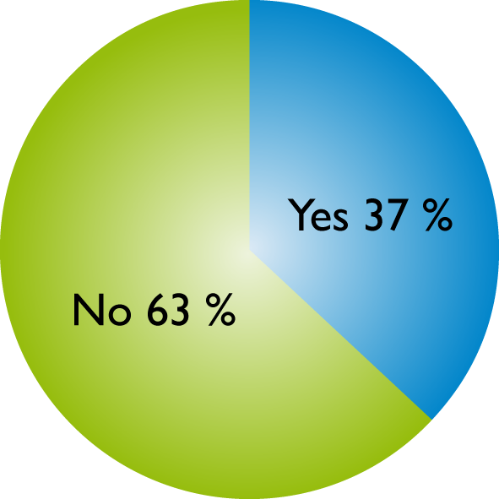
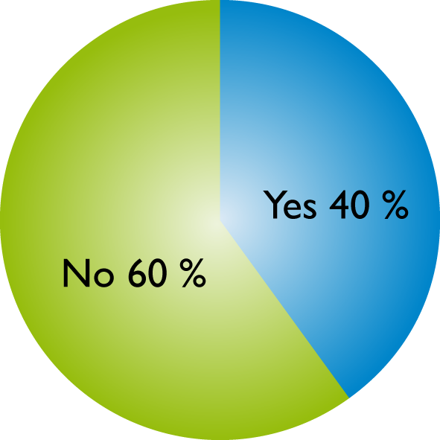
APNIC Member and
Stakeholder Survey
Section 3 - IPv6 readiness
Factual responses
Have you deployed or are you ready for immediate IPv6 deployment?
Does your organization have a formal plan to deal with the deployment of IPv6?
6
Notes:
6

Slide 7
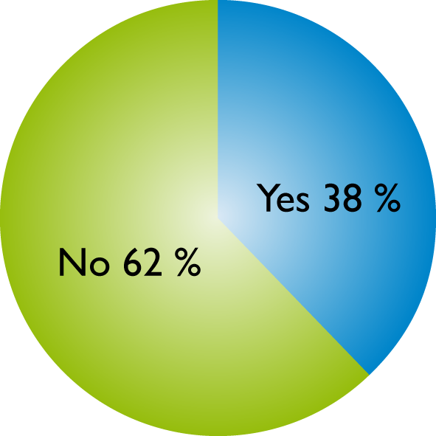

APNIC Member and
Stakeholder Survey
Section 3 - IPv6 readiness
Factual responses
Has your organization budgeted for future resource allocation for IPv6 deployment?
Has your organization allocated resources (human or financial) for IPv6 deployment?
7
Notes:
7

Slide 8
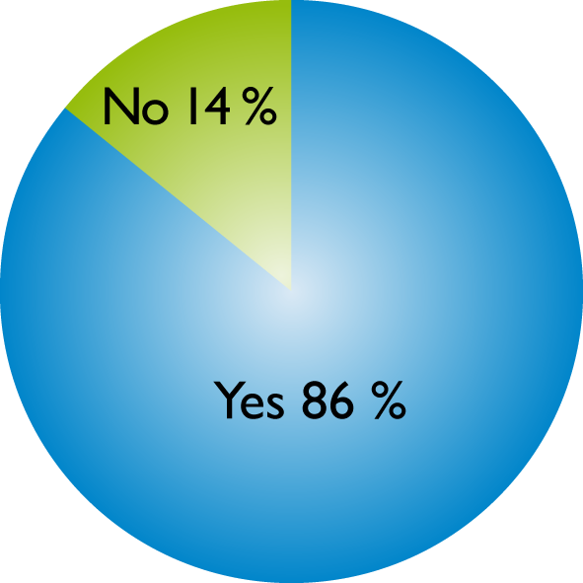
APNIC Member and
Stakeholder Survey
Section 3 - IPv6 readiness
Propositional responses
APNIC should have a bigger role in promoting IPv6 deployment within the AP region
  Mean: 8.44, Standard deviation: 1.72
Governments should require IPv6 compliance within entities under their control
  Mean: 7.32 Standard Deviation: 2.38
Do you believe that it is important to have government support for IPv6 deployment?

Slide 9
APNIC Member and
Stakeholder Survey
Conclusions
APNIC should provide training, education, and information that will help make IPv6 information more available to those that currently can not access information easily.
APNIC should liaise with regulators and governmental organizations to build their understanding and support for a smooth IPv6 transition.
APNIC should provide support for the community to take the important initial actions to integrate IPv6 into their future business planning.
For more information http://www.apnic.net/survey

Slide 10

Miwa Fujii, APNIC IPv6 Program Manager <miwa@apnic.net>
Coordinating and promoting IPv6 activities across the whole of APNIC
Current activities
Launch of ICONS IPv6 Wiki
Participation in APEC Tel Meeting

Slide 11
Research and development activities
Test Traffic Measurement (TTM)
  Collaboration with RIPE NCC
  Currently dispatching TTM nodes across the region
Day in the Life of the Internet (DITL)
  Over 468 Gigabytes of data
  Packet flows from Brisbane, Hong Kong, and Tokyo
  Three (3) days of collected data, covering all inbound requests

Slide 12
Highlights of new apnic.net
Easier access to
  Resource Services
  Statistics
  News and events
Alternative access
  Low bandwidth version
Better management
  CMS based allows timely update
Notes:
12

Slide 13

Preview of new apnic.net
Notes:
13

Slide 14
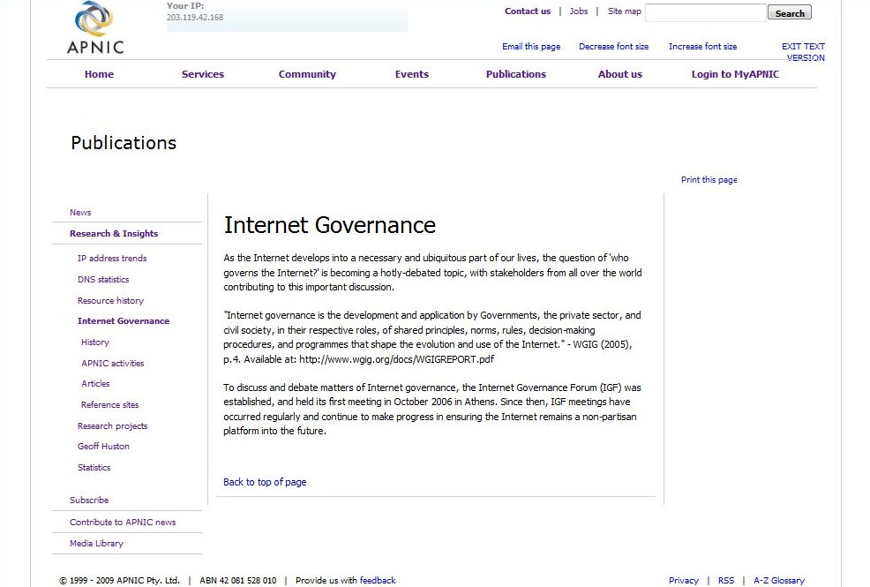
Low bandwidth version
Notes:
14

Slide 15

Next APNIC meeting
First APNIC meeting in China
Applications for fellowships open
Registration opens soon
Participate remotely via webcast, audio streaming, live transcripts
For more information http://meetings.apnic.net

