Slide 1
Business Process Reengineering
Erika Goedrich
Requirements Analyst
Notes:
-As moving services online, also taking the opportunity to look at our business processes.
-Processes built over 10 years, with different components added at different times without looking at big picture

Slide 2
Definitions
Business Process
Collection of interrelated tasks that takes one or more kinds of input and creates an output that is of value to the business and achieves a specific result for the customer
Workflow
The flow of information and control in a business process
Notes:
-Who does what, and when

Slide 3
Definitions
“If you can’t describe what you are doing as a process, you don’t know what you’re doing.”
– Dr. W. Edwards Deming
Notes:
- Deming – Leader in quality movement

Slide 4
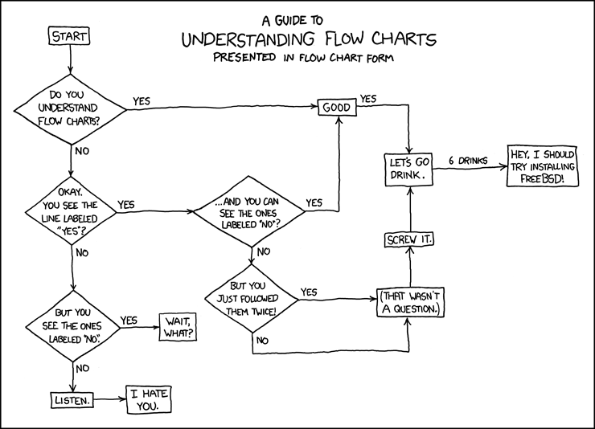
Flow Charts

Slide 5
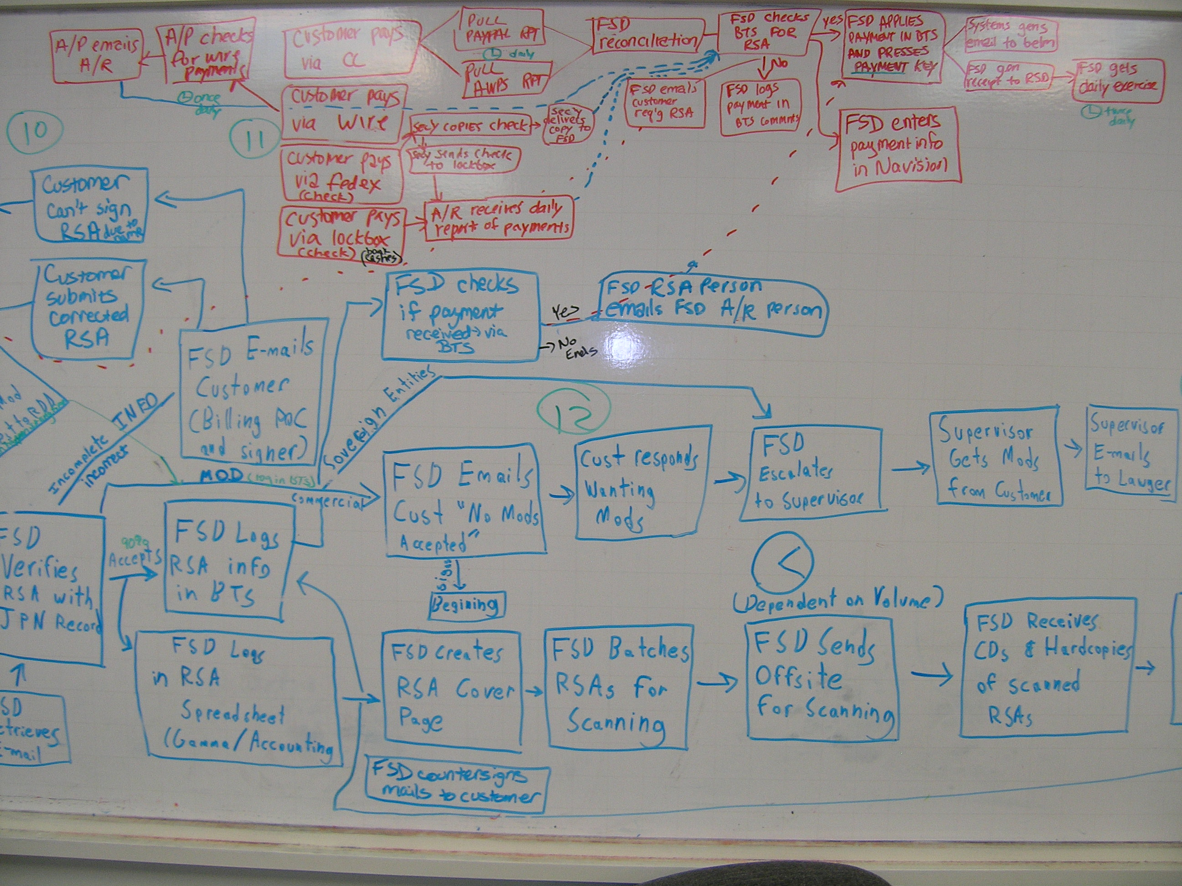
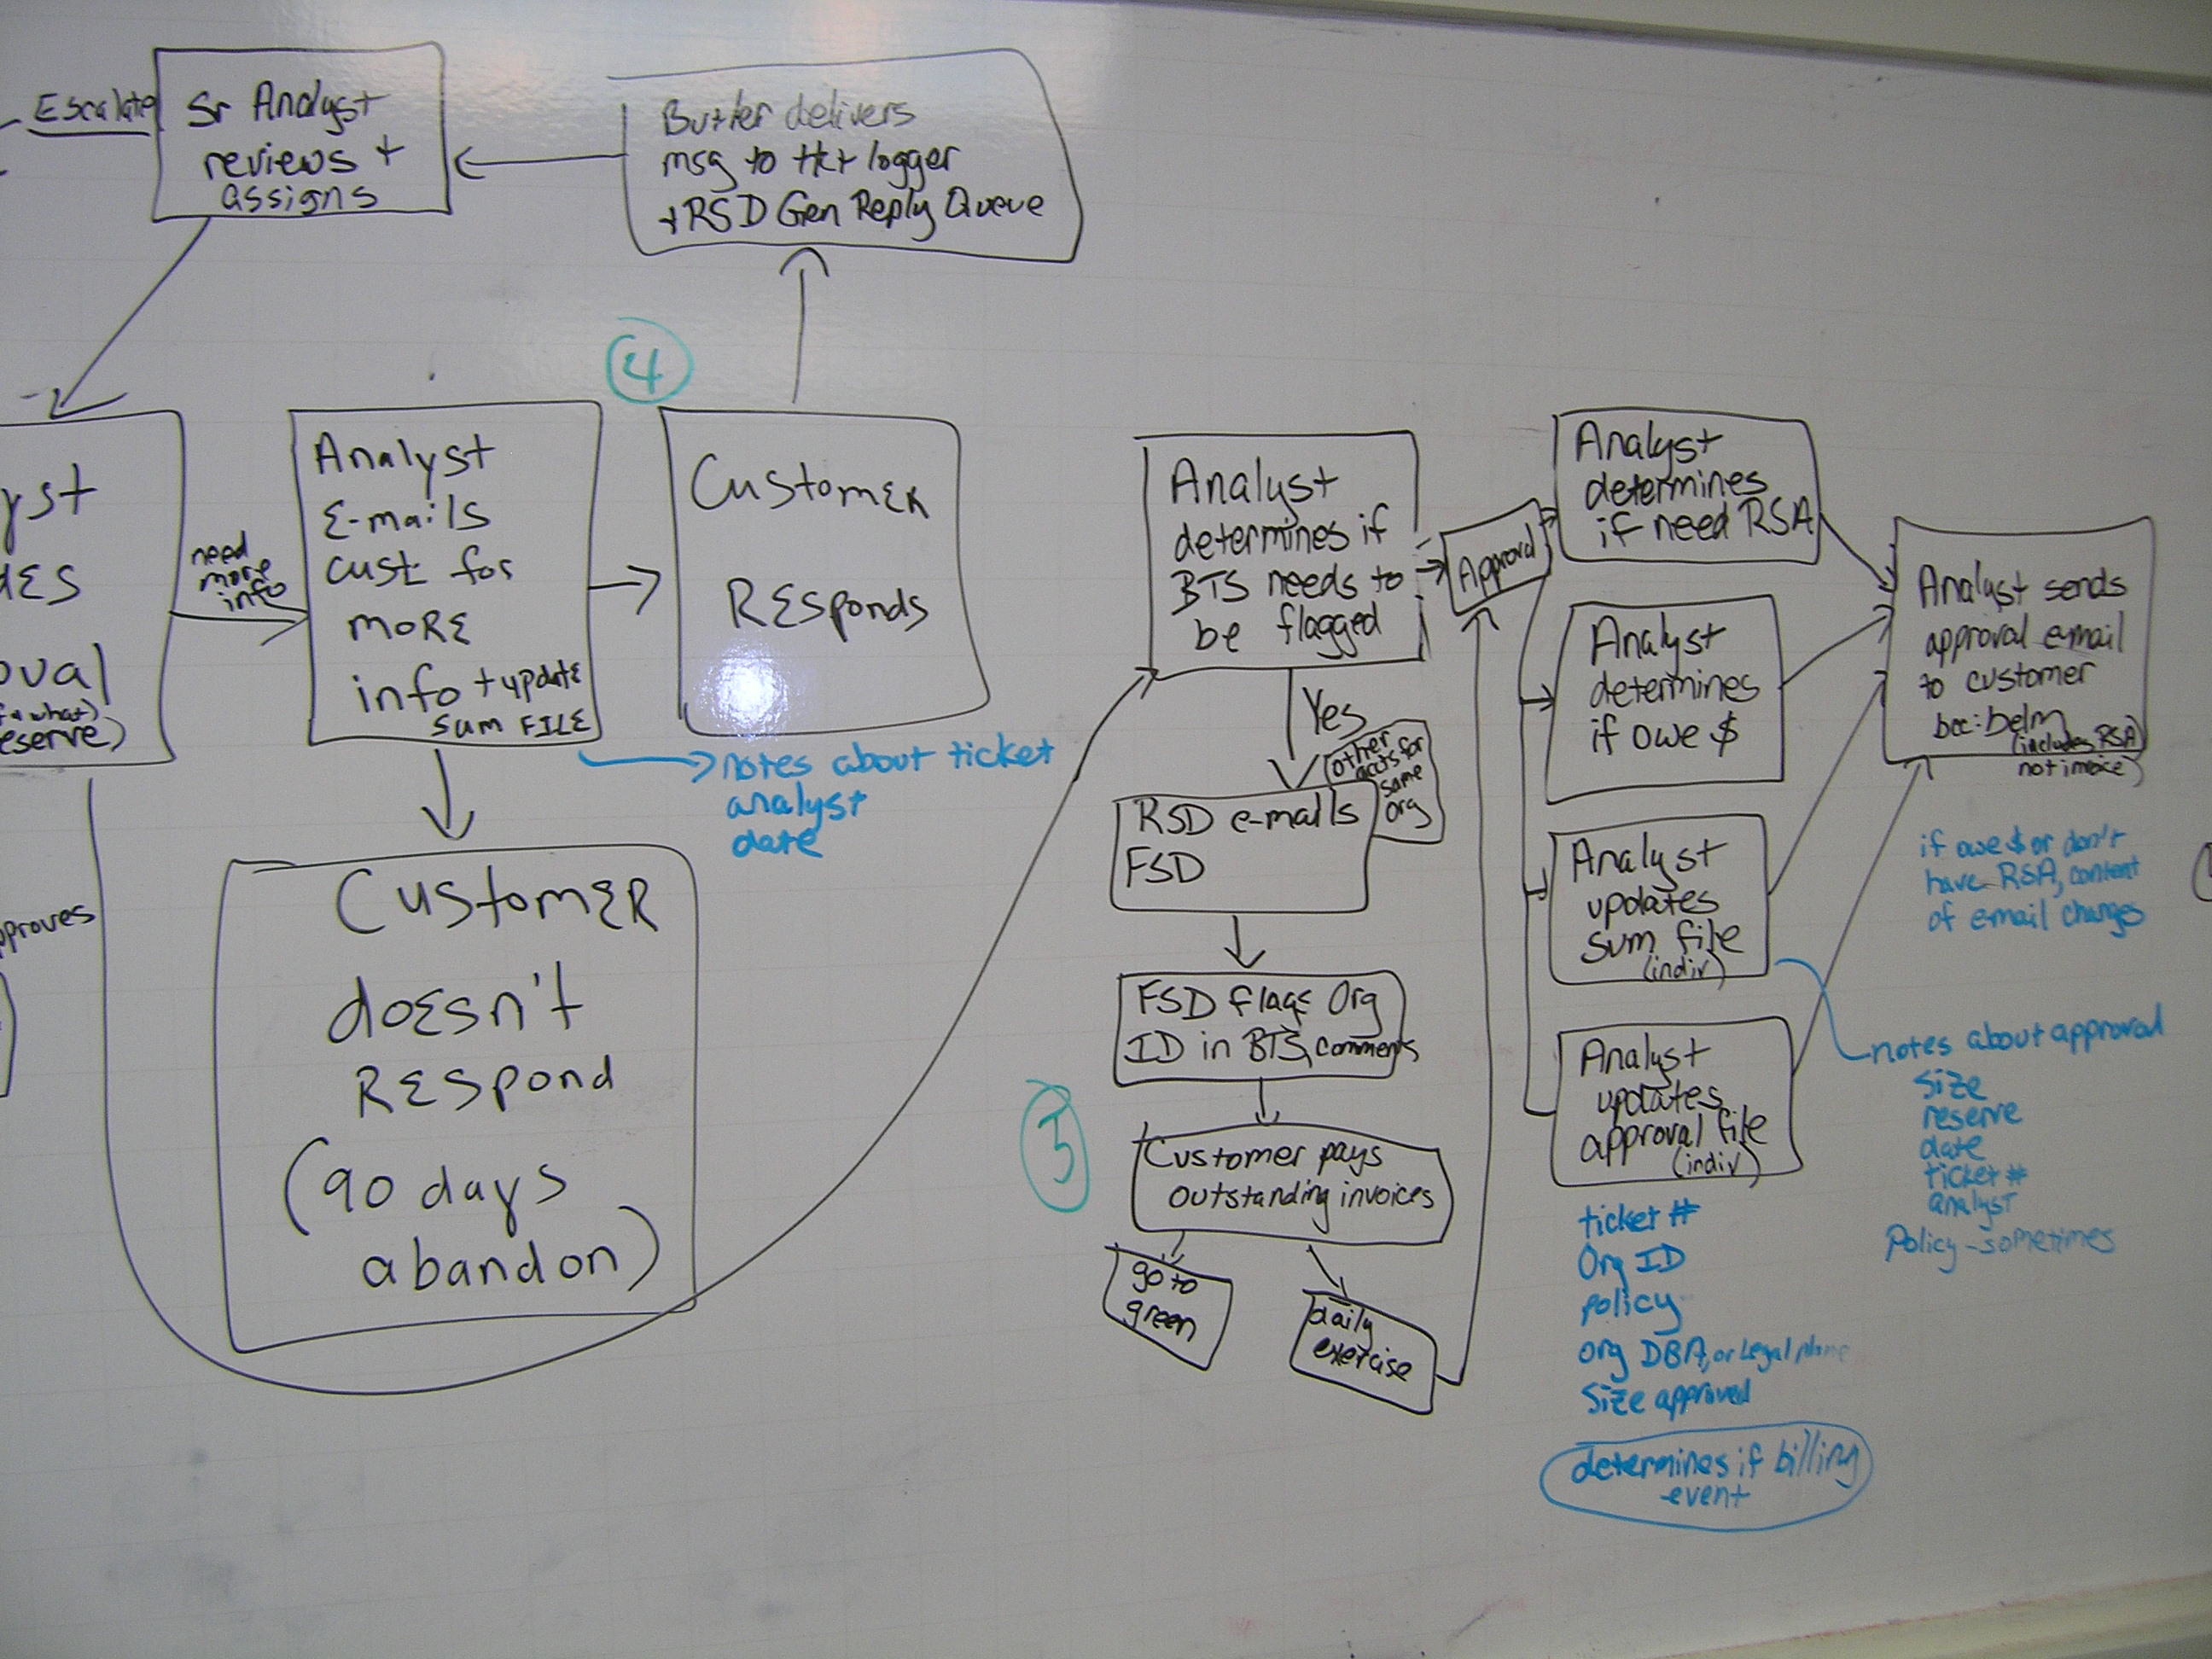
Flow Charts
Notes:
-During the last 8 weeks, mapping out our current processes across the organization

Slide 6
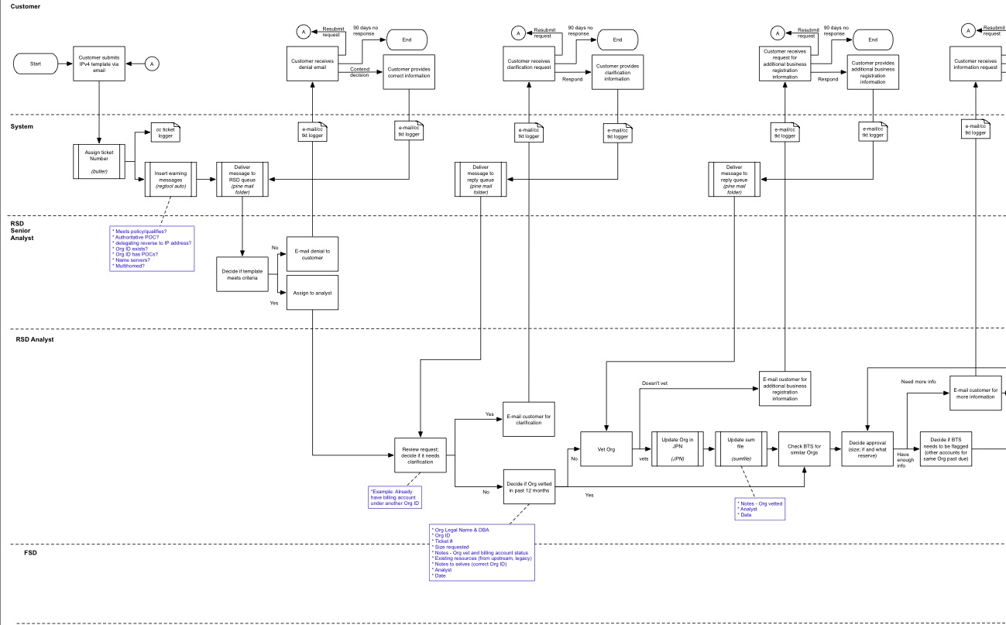
Swimlanes
Notes:
-Show actors, tasks, handoffs and interactions with other actors

Slide 7
As-Is Process Progress Report
23 Completed
6 In Progress

Slide 8
As-Is Assessment
Identify good elements to keep and bad elements to eliminate, improve, or replace
Maintain interfaces to other systems and dependencies to other processes
Notes:
- Lots of interconnections between systems and processes; can’t do everything at once, phased approach

Slide 9
As-Is Assessment
Too many actors?
Most appropriate actor?
Too many handoffs? Too much back-and forth?
Do handoffs introduce error, expense or delay?
Notes:
-One process: 137 steps, with 16 go-backs to the customer

Slide 10
As-Is Assessment
Where are the bottlenecks?
Sequential steps instead of parallel?
Exceptions holding up norm?
Policies and rules?

Slide 11
As-Is Assessment
Nonvalue-added steps?
Duplication? Redundancy?
Manual activities that could be automated?
Lack of shared data?
Data structures that have inconsistent formats, structures, or semantics?
Notes:
-(rekeying info, reconciling)

Slide 12
Goals – To-Be Process
How do we organize our activities so that we can minimize inputs, maximize outputs, and maximize value?
Increase
Efficiency
Effectiveness
Control
Agility
Process compliance
Notes:
--Collection of interrelated tasks that takes one or more kinds of input and creates an output that is of value to the business and achieves a specific result for the customer

Slide 13
Goals – To-Be Process
Improve
Communication
Cooperation
Handoffs
Customer service
Provide visibility into process pipeline
Operational forecasting
Measurable results
Allow for continuous improvement

Slide 14
Questions?

