Slide 1

MEMBER SERVICES DEPARTMENT
Susan Hamlin, Director

Slide 2
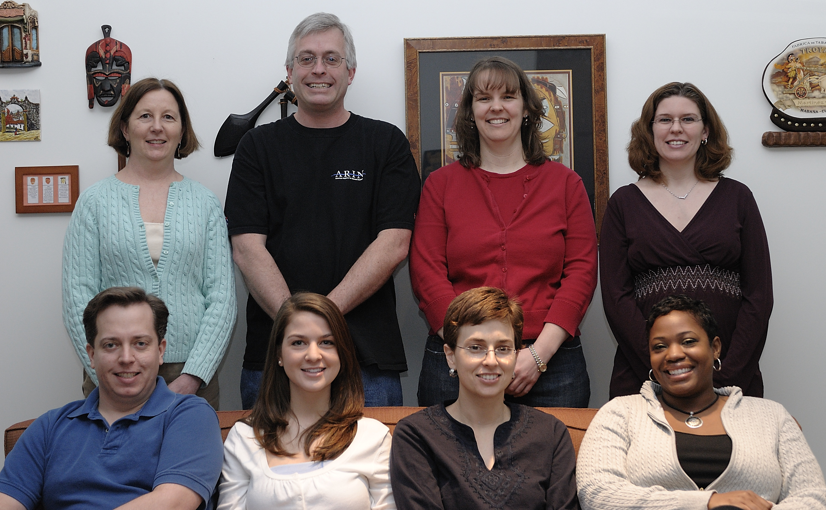

Staff
Membership
Statistics
Services
What’s New
Group photo here
Looking Ahead

Slide 3
Staff
Geographic Distribution
Membership Type
Membership
Statistics
Services
What’s New
Looking Ahead

Slide 4




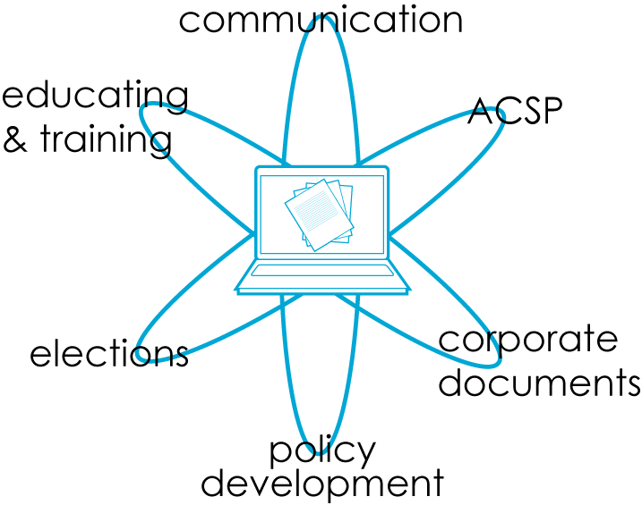



Staff
Membership
Statistics
Services
What’s New
Looking Ahead

Slide 5


Staff
Membership
Statistics
Services
About ARIN
What’s New
Looking Ahead

Slide 6


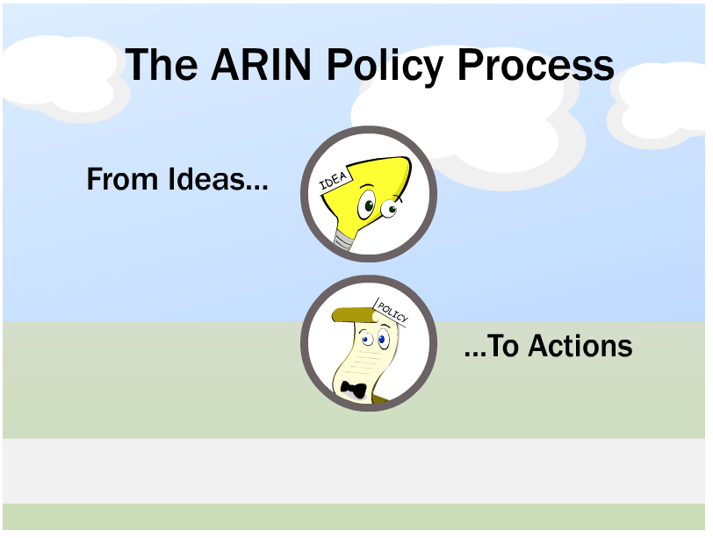

Staff
Membership
Statistics
Services
What’s New
Looking Ahead
ARIN XXII – Los Angeles
15-17 October

Slide 7
thank you

