Slide 1
HUMAN RESOURCES AND ADMINISTRATION DEPARTMENT
Mary K Lee, Director

Slide 2
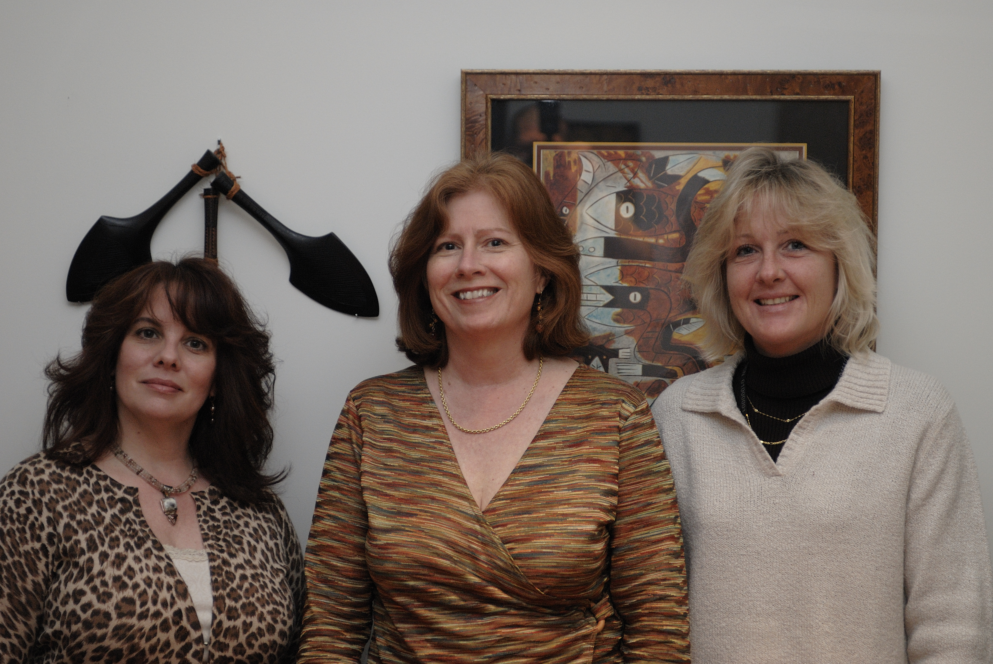

Department Staff
Current Projects
General Staff Update
Survey

Slide 3


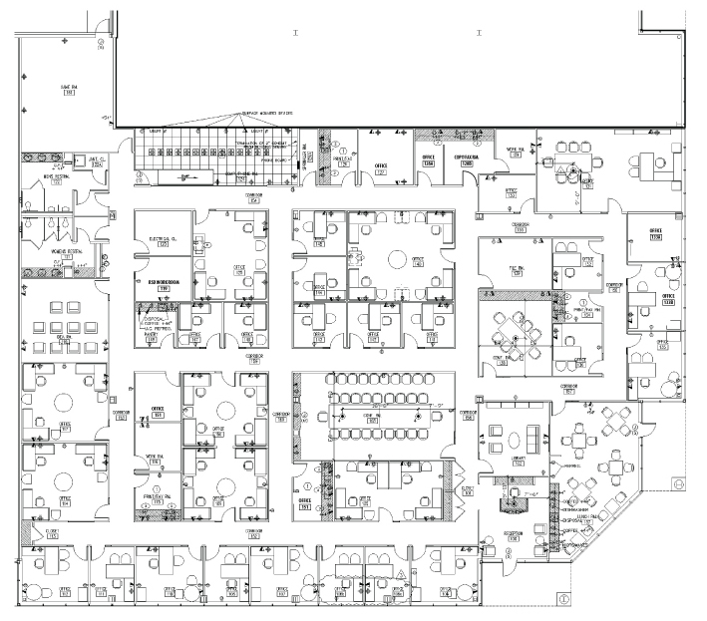
Department Staff
Current Projects
General Staff Update
Survey

Slide 4


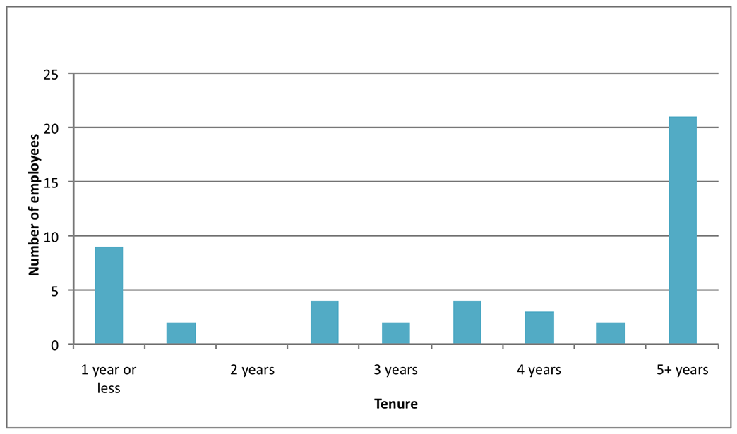
Department Staff
47
23
Employee Longevity
9 hires
Current Projects
General Staff Update
25
Survey
6 mo.

Slide 5



Department Staff
Current Projects
General Staff Update
Survey

Slide 6
thank you

