Slide 1
APNIC Update 2014
Guangliang Pan
[31 March 2014]
[1]

Slide 2
Overview
APNIC’s Vision:
“A global, open, stable, and secure Internet that serves the entire Asia Pacific community”
Serving APNIC Members
Supporting Internet development in the Asia Pacific region
Collaborating with the Internet community

Slide 3
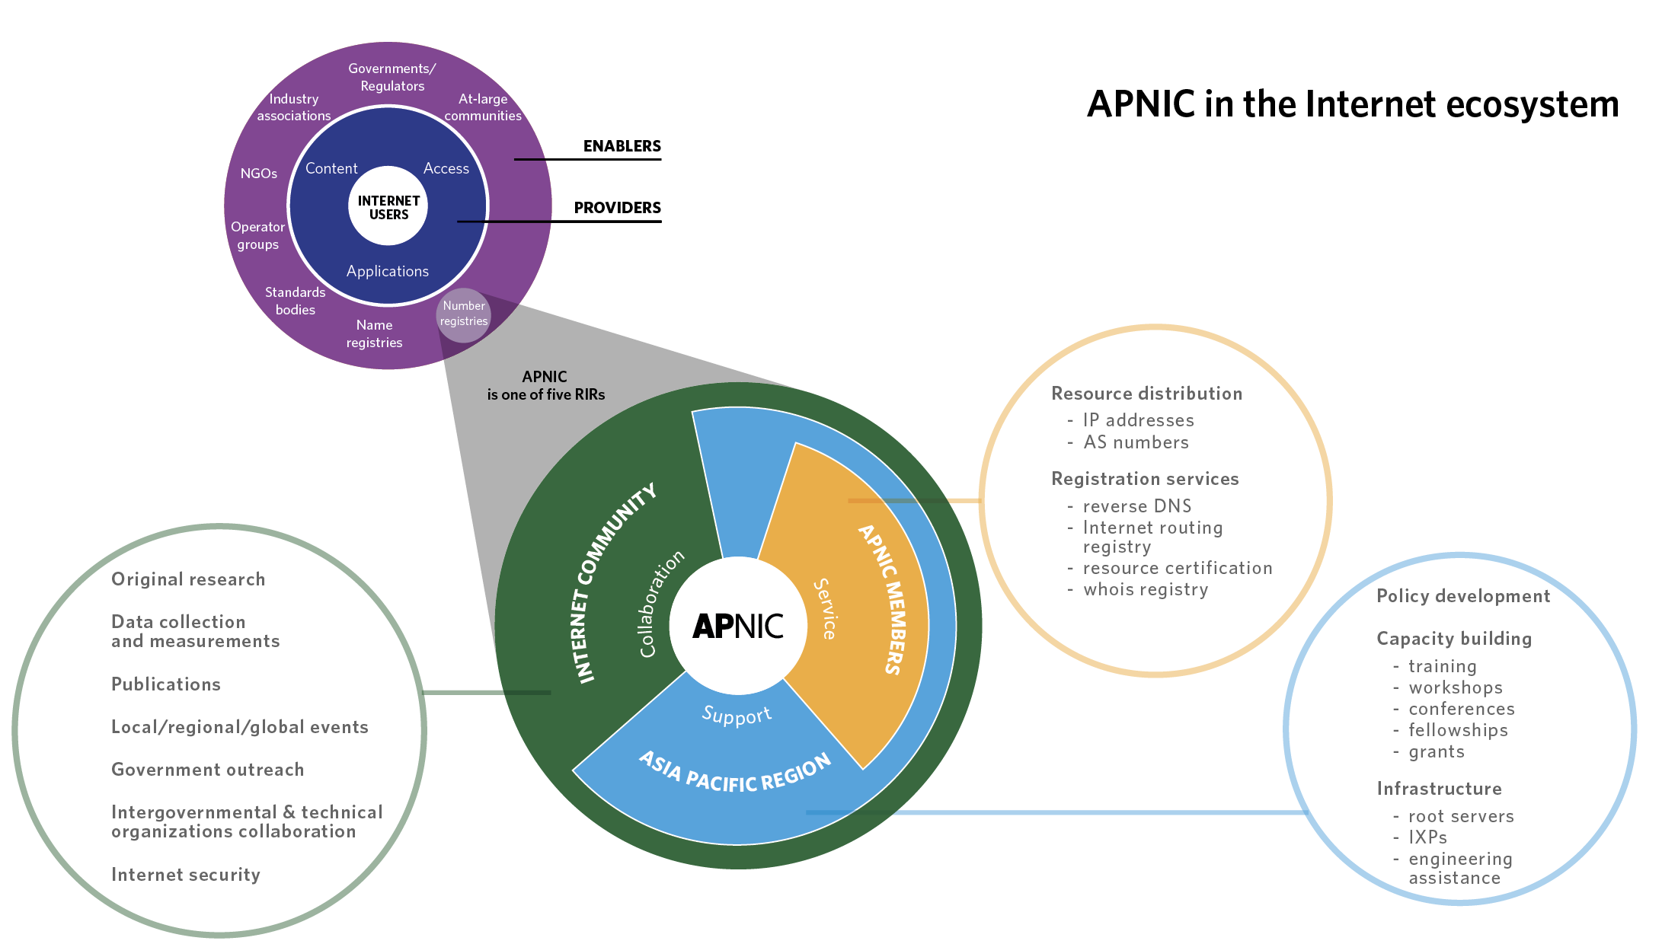

Slide 4
APNIC’s Mission
Function as the RIR for the Asia Pacific, in the service of the community of Members and others
Provide Internet registry services to the highest possible standards of trust, neutrality, and accuracy
Provide information, training, and supporting services to assist the community in building and managing the Internet
Support critical Internet infrastructure to assist in creating and maintaining a robust Internet environment
Provide leadership and advocacy in support of its vision and the community
Facilitate regional Internet development as needed throughout the APNIC community

Slide 5
Serving APNIC Members
“Function as the RIR for the Asia Pacific, in the service of the community of Members and others”
“Provide Internet registry services to the highest possible standards of trust, neutrality, and accuracy”
IPv6 statistics
IPv4
Last /8 statistics
Market transfer statistics
ASN statistics
Membership growth
Services update
Whois
MyAPNIC updates

Slide 6
Cumulative IPv6 Delegations (/32s)
Number of /32s
Date
Notes:
IPv6 delegations continue to illustrate a steady liner increase since 2011.
As at 31 March 2014, the cumulative figure was 45,561, an of 99 delegations.

Slide 7
IPv6 Delegations by Year
Number of delegations
Date
Notes:
While there was an initial surge in v6 delegations as a result of the one-click policy, there has been a gradual decline in delegations per year
As at 31 March 2014, there have been 134 delegations.

Slide 8
IPv4 Last /8 Delegations
Delegations
Date
As at 31 March 2014
Notes:
The initial surge in delegations reflects the run-out of IPv4 in the AP region. Since then we have continued steady demand of over 100 new “last /8s” per month.
As at 12 March 2014, there have been 43 last /8 delegations.

Slide 9
IPv4 Market Transfers
Number of transfers
Date
As at 31 March 2014
Notes:
While not a clear linear growth over the last few months in 2013, there was an increase in v4 transfers, peaking at 19 in March of this year.

Slide 10
Cumulative ASN Delegations
Delegations
Date
Notes:
Both 4-byte and 2-byte ASN growth remains steady, with 7,391 2-bytes assigned cumulatively by 2013.
As at 31 March 2014, 2-byte has increased by 71 to 7480; 4-byte has increased by 240 to 2174

Slide 11
Membership Growth
Members
Date
Notes:
Membership continues to increase with an increase of 542 Members from 2012 to 2013.
As at 31 March 2014, we now have a total of 4194 Members, up 141 from the 2013 figure of 4053.

Slide 12
Whois Updates
New features
‘geoloc’ and language attributes
‘whowas’ functionality
RDAP
WEIRDS
Pilot service available
Contribution to RIPE whois server
Notes:
New whois features allows Members and their customer more precision in indicating to content providers where their users are and what languages they speak
whowas – users can query previous versions of resources and the dates the objects were changed to see how a specific object was changed over time
Registration Data Access protocol - RDAP – pilot service available to test RDAP protocol
APNIC contributed to the RIPE whois server

Slide 13
MyAPNIC Improvements
Referral application
Bulk feature for IRT added
Interface improvements
Notes:
New 'Referral Application' allows a Member to refer their customers to become APNIC Members
Referral application – downstream customer remains the custodian of the INRs and has their own Member account
Interface improvements
Improved profile layout page
New whois object template to whois updates section
Simplified certificate management page

Slide 14
Supporting Internet Development in the Asia Pacific Region
“Provide information, training, and supporting services to assist the community in building and managing the Internet”
“Support critical Internet infrastructure to assist in creating and maintaining a robust Internet environment”
“Facilitate regional Internet development as needed throughout the APNIC community”
Policy development
IPv6 support
Training
APNIC Events
Infrastructure capacity building
Information Society Innovation Fund (ISIF Asia)

Slide 15
Policies in 2013
Implemented
prop-108: Suggested changes to the APNIC Policy Development Process
Pending Implementation
prop-107: AS Number transfer policy proposal
prop-105: Distribution of returned IPv4 address (Modification of prop-088)

Slide 16
Policy Proposals at APNIC 37
prop-111: Request-based expansion of IPv6 default allocation size
Proposal did not reach consensus at the Policy SIG and was returned to the author for further development
prop-110: Designate 1.2.3.0/24 as Anycast to support DNS Infrastructure
The proposal reached consensus at the Policy SIG, but failed to reach consensus at the AMM
Returned to mailing list for further consideration
prop-109: Allocate 1.0.0.0/24 and 1.1.1.0/24 to APNIC Labs as Research Prefixes
The proposal reached consensus at the Policy SIG and again at the AMM
Sent to the mailing list for a further four-week comment period

Slide 17
IPv6 Support
Outreach
IPv6 Event by ISOC HK, Hong Kong
APIPv6TF
IPv6 for Decision Makers
White paper published
www.apnic.net/ipv6-decision-makers
APNIC continues to provide Secretariat services
Met at APNIC 36 and APRICOT 2014/APNIC 37
Asia Pacific IPv6 Task Force
Global IPv6 and Next Generation Summit 2014, Beijing
ICANN 49, IPv6 Roundtable, Singapore
APEC TEL 49
ASEAN ICT SMEs Conference, Hanoi
www.apnic.net/ipv6
Notes:
APIPv6FT - Established to encourage IPv6 deployment and serve as a platform for knowledge exchange

Slide 18
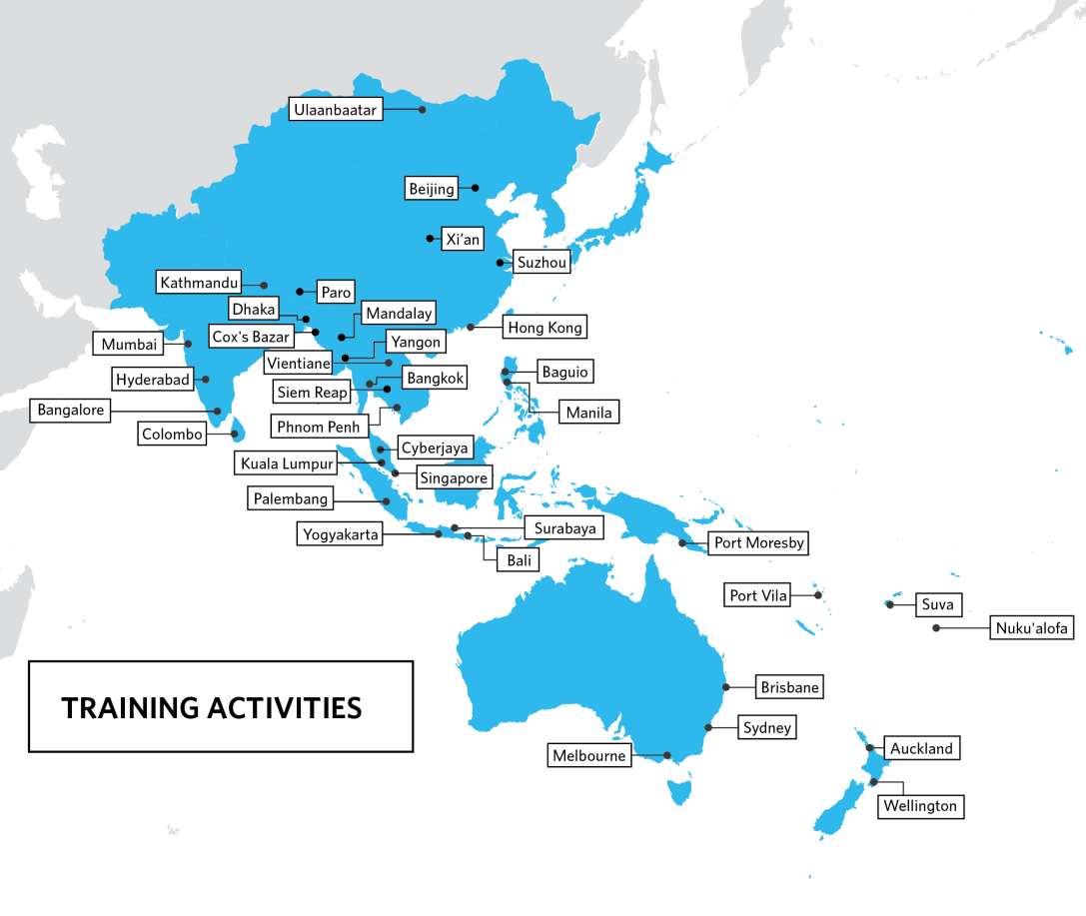
Training
IPv6
Continuing focus on IPv6 deployment
Hands-on
Extensive exercises in virtual and physical training labs
eLearning
Every Wednesday is IPv6 day; 179 hours training provided
Notes:
3,591 participants trained in 2013;
Face-to-Face: 89 courses in 37 locations; 2622 participants
eLearning - 179 hours of training provided; 135 courses; 969 participants

Slide 19
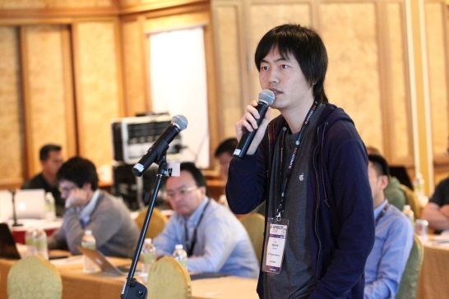
APNIC Events
APNIC 36: Xi’an, China
Total on-site delegates: 251
Total remote participants: 409
APRICOT 2014/APNIC 37: Petaling Jaya, Malaysia
Total on-site delegates: 466
Total remote participants: 262
NEW: APNIC Regional Meetings (ARM)
Free one-day events
ARM 1 with MyNOG 3 in Kuala Lumpur on 29 November 2013
ARM 2 - in conjunction with Internet20PH on 4 April 2014 in Manila
Notes:
ARMs - updates on APNIC services, policy outcomes and more; includes training

Slide 20
Infrastructure Capacity Building
IXP Workshop held in Bangkok, Thailand - working towards establishing the country’s first IXP
Provided training and equipment to help establish the Vanuatu IXP
Helped establish an I-Root server instance in Port Vila, Vanuatu
APNIC supported the establishment of bdNOG and BTNOG, new network operators groups in Bangladesh and Bhutan

Slide 21
ISIF and Seed Alliance
ISIF Asia
Small grants and awards
Seed Alliance
Joint project of ISIF (APNIC), Frida (LACNIC), FIRE (AFRINIC)
AUD 1.3m over 3 years (IDRC, Canada)
So far, AUD 1.2m to 38 projects in 17 economies
2014 Call for Grants: 11 projects selected for implementation in 2014
AUD 1.5m over 3 years (Sida, Sweden)

Slide 22
Collaborating with the Internet Community
“Provide leadership and advocacy in support of APNIC’s vision and the community”
APNIC Labs
Strategic Engagement
Internet cooperation

Slide 23
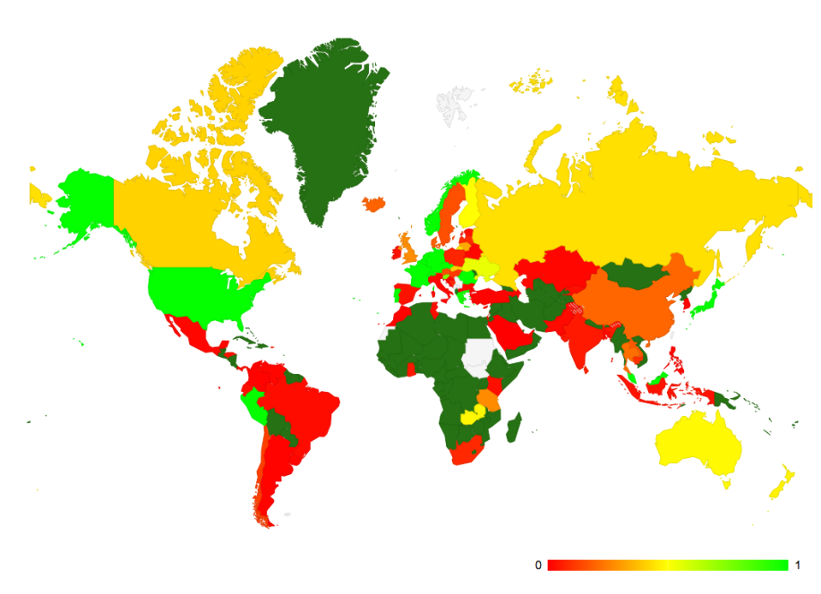
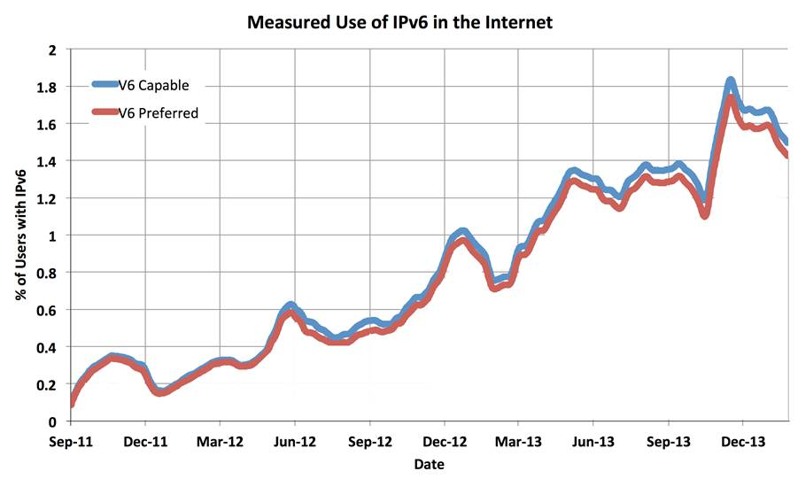
APNIC Labs
Measurement activities
IPv6 readiness by economy and ISP; IPv6 performance
Repurposed IPv6 measurement for DNSSEC validation by economy and ISP
Tracking growth of routing table in IPv4 and IPv6
RPKI use across the Internet
Long-term investigation exercise into evolving nature of dark traffic in both IPv4 and IPv6
Internet number resource reporting and analysis
labs.apnic.net
blabs.apnic.net

Slide 24
Strategic Engagement
Technical community
Governmental
IGF
NOGs, NIR OPMs, I*, CERTs, ISOC Chapters, PACINET, PICISOC, PTC
APEC-TEL 47 and 48, ITU WTPF, APT, WSIS+10, ITU Connect Asia Pacific Summit, ITU Telecom World 2013
National IGFs (Nethui, auIGF), APrIGF
Bali IGF - significant support given for fundraising and logistics
Notes:
Outreach and collaboration activities across the region

Slide 25
IANA Oversight Transition
October 2013: Internet’s technical organizations signed Montevideo Statement calling for globalization of ICANN and IANA functions
January 2014: APNIC EC endorsed statement
March 2014: US Government announced IANA functions will be transferred to global Internet community
Open community discussion process on IANA transition underway
For resources and to join the discussion on the mailing list:
www.apnic.net/ianaxfer
Notes:
Montevideo Statement:
Signed by ICANN, IETF, IAB, W3C, ISOC and 5 RIRS
Warned against Internet fragmentation
Catalyze community-wide efforts toward the evolution of global multistakeholder Internet cooperation
Globalization of the the ICANN and IANA functions where all stakeholders participate on an equal footing
Transition to IPv6 must remain a key priority globally.
IANA Transfer
Will replace existing IANA Contract with new arrangements to be implemented by September of 2015. Expected since the establishment of ICANN, in 1999.

Slide 26
You’re Invited!
APNIC 38: Brisbane, Australia, 9-19 September 2014
APRICOT 2015: Fukuoka, Japan
24 February to 6 March 2015
With APNIC 39 and APAN 39
conference.apnic.net

Slide 27
THANK YOU
www.facebook.com/APNIC
https://twitter.com/apnic
www.youtube.com/user/apnicmultimedia
www.flickr.com/photos/apnic

