Slide 1
2013 ARIN Elections
Jud Lewis
Membership Coordinator

Slide 2
What’s New?
New Election System! Voting is easier with no separate login credentials needed.
Elections are now streamlined, all closing at the same time.
DMR Eligibility Cutoff moved earlier (from 14 to 60 days before election).

Slide 3
Voting Details
What? | Who? | How? | When?
Number Resource Organization Number Council (NRO NC) | NANOG 59 and ARIN 32 Attendees (non DMR) | Through link emailed directly to you. | 9am EDT 7 Oct- 5pm EDT 20 Oct
Board of Trustees, Advisory Council, &NRO NC | Eligible Designated Member Representatives (DMRs) | Follow instructions emailed directly to you. | 5pm EDT 10 Oct- 5pm EDT 20 Oct

Slide 4
What Makes a DMR Eligible?
Member on Record as of 12 August 2013
DMR’s email has name/initials and Organization’s Domain
Be in Good Standing (no overdue invoices)

Slide 5
October 2013
Sunday | Monday | Tuesday | Wed. | Thursday | Friday | Saturday
6 | 7 | 8 | 9 | 10 | 11 | 12
13 | 14 | 15 | 16 | 17 | 18 | 19
20 | 21 | 22 | 23 | 24 | 25 | 26
27 | 28 | 29 | 30 | 31
NRO Election Open For Meeting Attendees
Speeches Posted Online
Voting Closes at 5pm ET

Slide 6
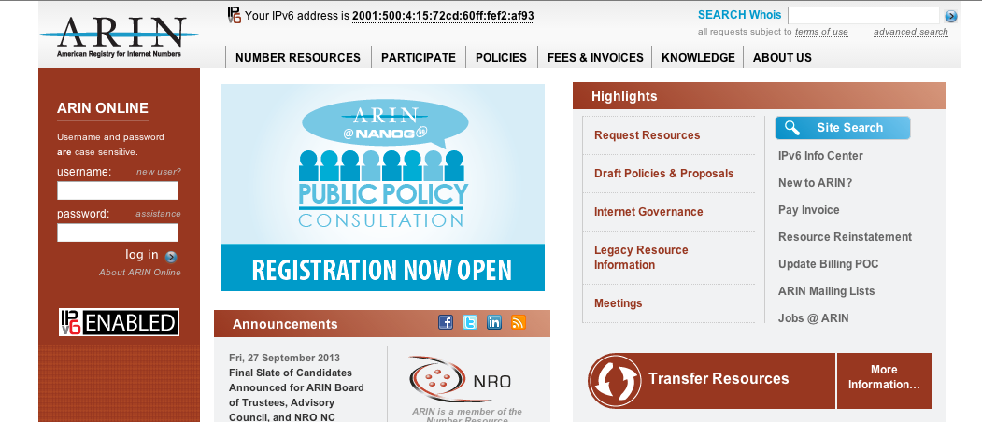
Logging In – DMRs with ARIN Online Accounts
Step 1: Go to www.arin.net
Step 2: Login

Slide 7
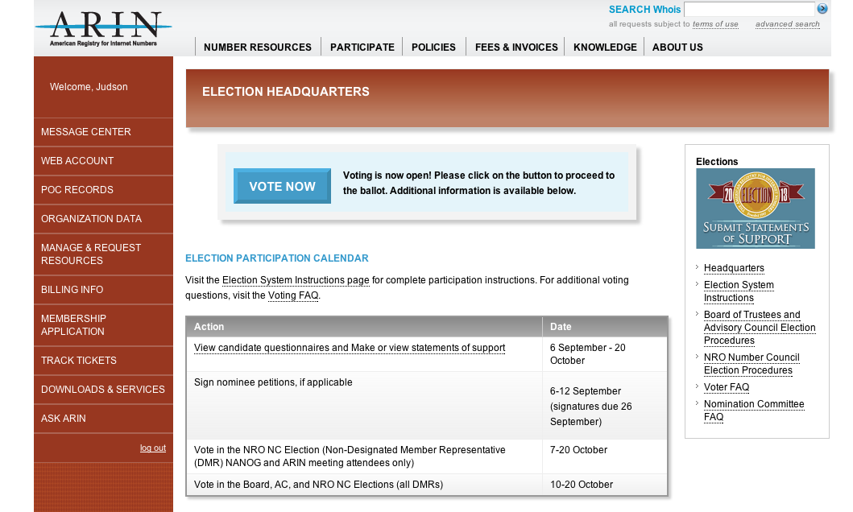
Step 3: Go to: www.arin.net/public/election/
Step 4: Click “Vote Now” Button

Slide 8
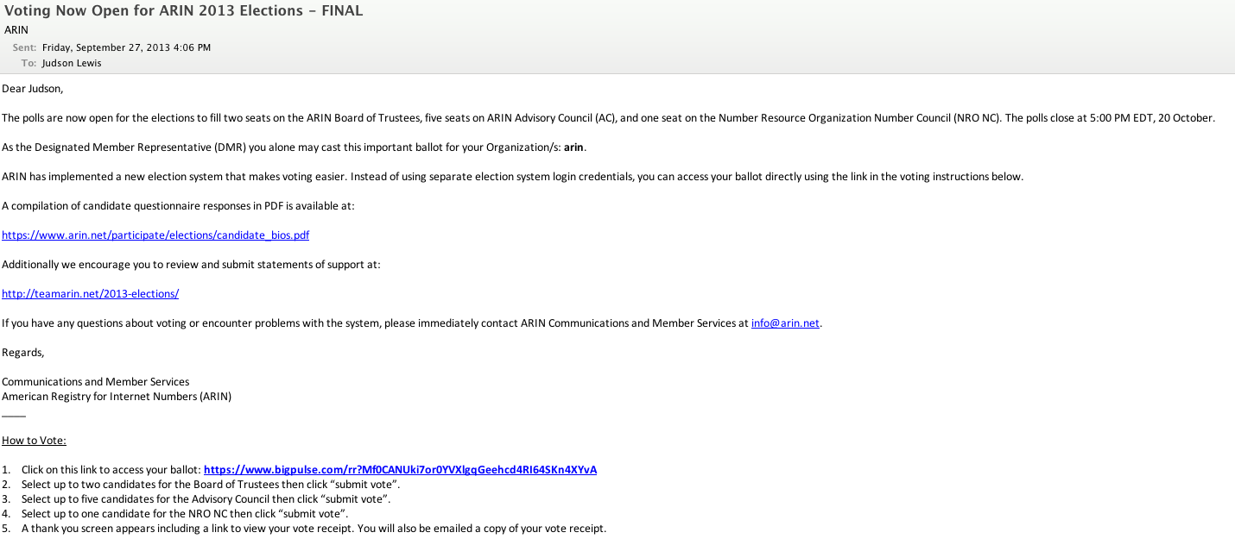
Logging In – DMRs without ARIN Online Accounts & Attendee Voters
Step 1: Open Email from info@arin.net
Step 2: Click URL and Access Your Ballot

Slide 9
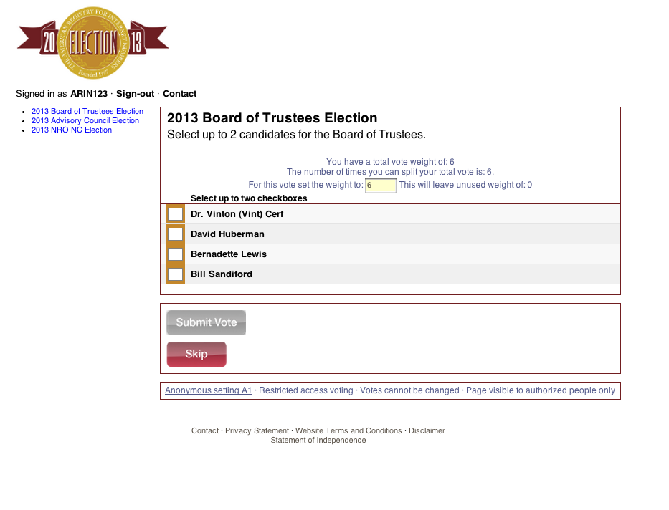
Voting Process
Select up to 2 Candidates for the Board
Click “Submit Vote”

Slide 10
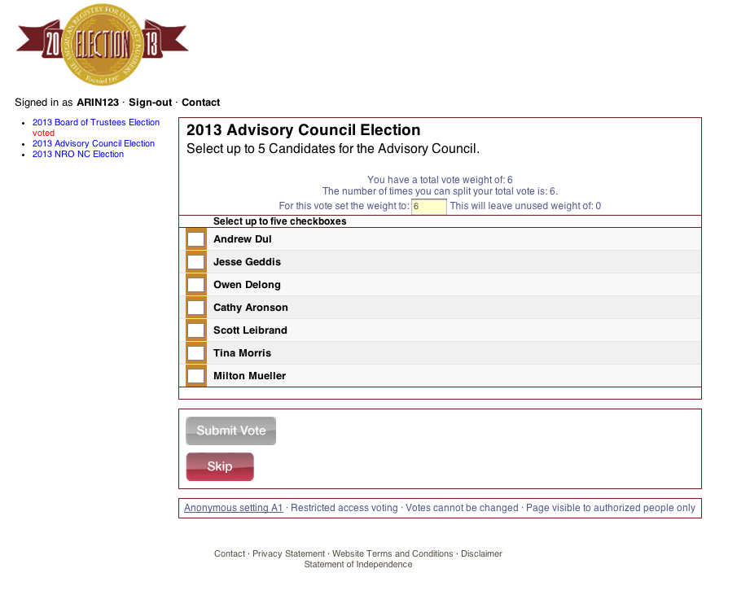
Select up to 5 Candidates for the AC
Click “Submit Vote”

Slide 11
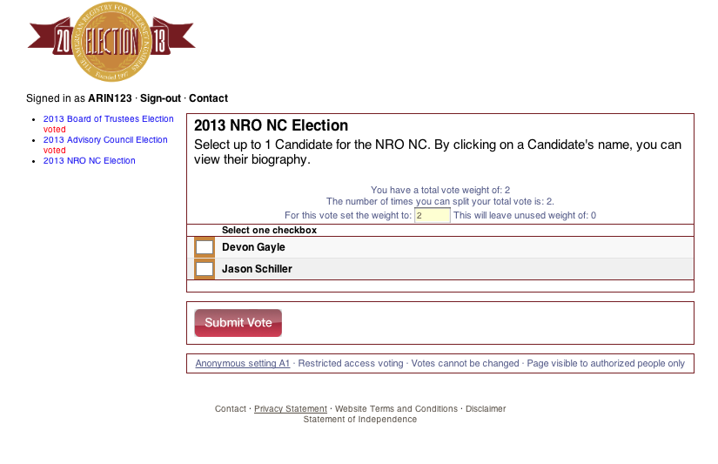
Select up to 1 Candidate for the NRO NC
Click “Submit Vote”

Slide 12
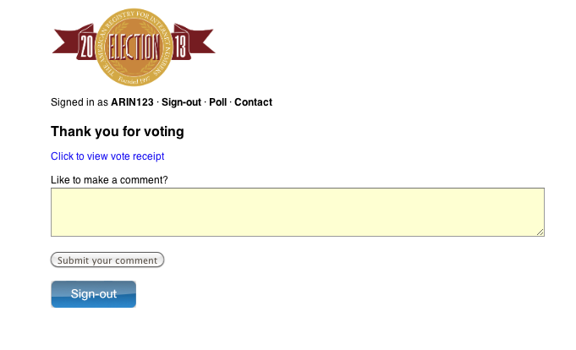
Click Here to View Your Voting Receipt
Click Here and return to Election Headquarters

Slide 13
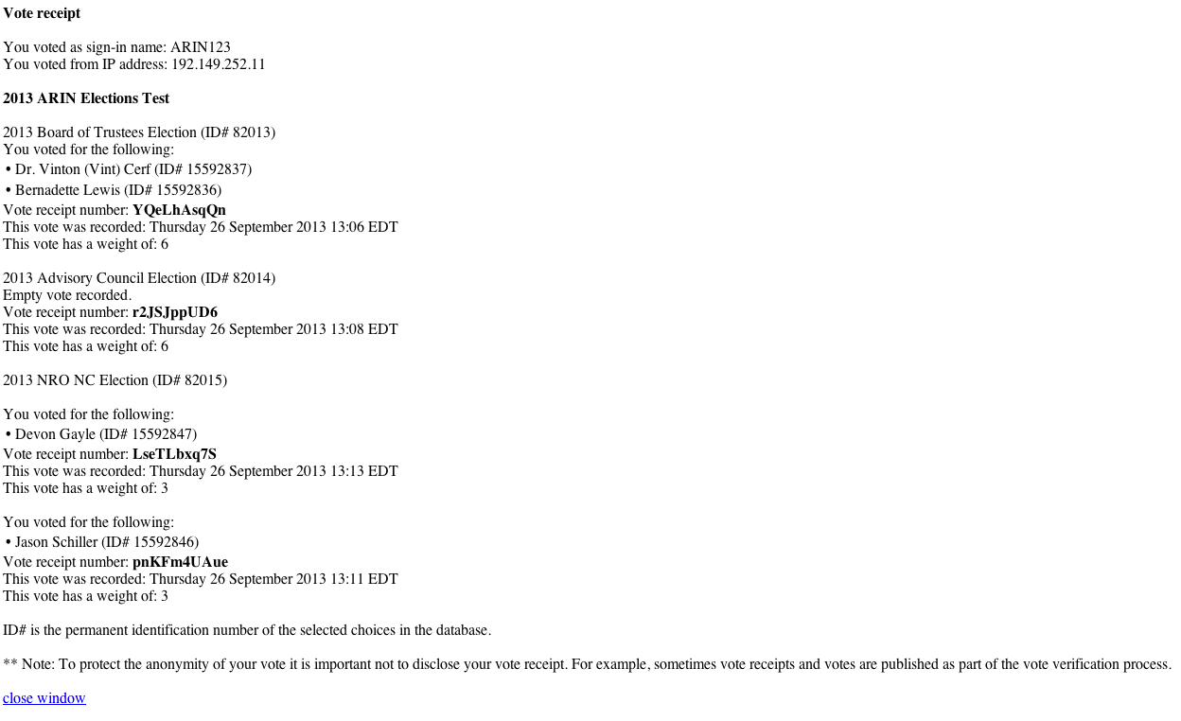
Note that a Voting Receipt will be automatically emailed to you for each election.

Slide 14
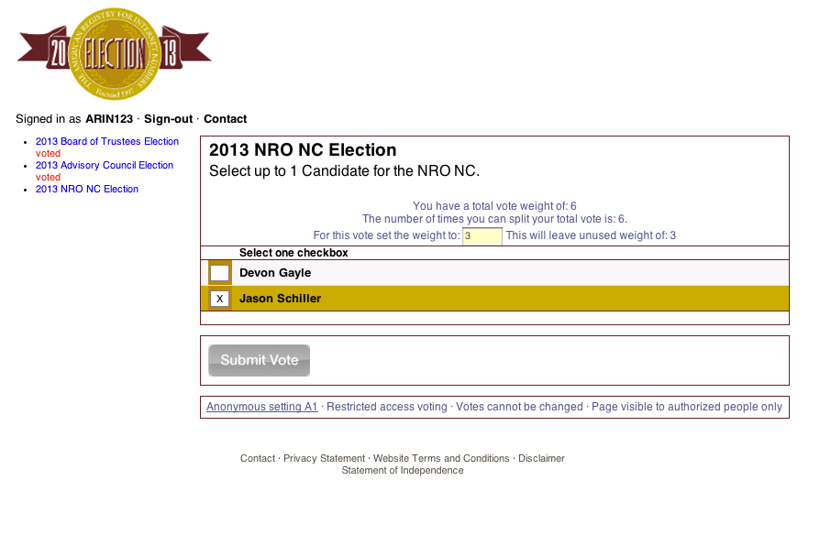
Multiple Voting Explained
If you want to cast all of your ballots for the same group of candidates, then leave the “set the weight to” field as is (by default, this field will match your total vote weight).
Reduce Vote Weight #
Select Candidates
Click “Submit Vote”

Slide 15
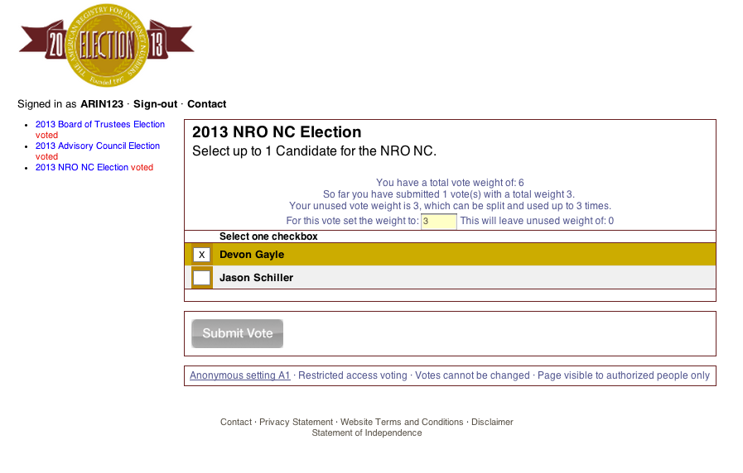
The ballot screen will reappear, allowing you to repeat this process until you have cast a ballot for each organization you are eligible to vote on behalf of.
Input New Vote Weight less than your unused vote weight
Select Candidates
Click “Submit Vote”

Slide 17
Number Resource Organization Number Council (NRO NC)

Slide 18
NRO NC Candidates
Devon Gayle (not in attendance)
Jason Schiller

Slide 19
Devon Gayle
I am a strong advocate for the advancement of technology for humanity. Therefore, serving on the NRO Number Council would provide me with an opportunity to bring passionate support and dedication in assisting with ensuring that the internet continue to grow and develop for the benefit of humanity globally. This goal I would be able to achieve while providing visibility and bringing focus to Jamaica and the Caribbean Region as a valuable member of the Global Internet Community.

Slide 20
Jason Schiller
Motivation to serve
Need to solve IPv4 depletion IPv6 adoption issues
Avoid tragedy of commons
Provide better sheepherding of global policy proposals
Cross pollinate ideas and concerns between regions
Support good policy - best interest of the Internet as a whole
Level headed operations and engineering mentality
CDN expereince
Google production network engineering, design and operations
ISP experience
UUNET / VZB engineering and design
UUNET High Speed Install
Enterprise experience
ManorCare WAN engineering
Georgetown University and Medical Center Network Support
American University LAN Engineering

Slide 21
Advisory Council

Slide 22
Advisory Council Candidates
Cathy Aronson
Owen Delong
Andrew Dul
Jesse Geddis
Scott Leibrand
Tina Morris
Milton Mueller

Slide 23
Cathy Aronson
I have been on the Advisory Council almost since the beginning. I know why things are the way they are because I was there. I believe that this institutional knowledge is important as we try to make policy for IPv6 and work our way through exhaustion of IPv4. I also served a term on the first ASO Address Council and worked with other regions on the globally coordinated IPv6 policy. I have been a customer of ARIN as well as RIPE and APNIC so I have experienced the policies first hand. All of this work is directly related to the work of the advisory council and the ARIN community.

Slide 24
Owen Delong
I have a lot of experience as a network engineer in a variety of operational roles ranging from very small businesses and SOHO operations up to and including very large ISPs. I have a tremendous amount of experience with IPv4 dating back to days when we did not have NAT in IPv4 and I now also have several years of experience with IPv6. I teach IPv6 courses and help others to deploy and understand IPv6 on a regular basis. My broad understanding and association with many different subgroups in the ARIN community allows me to better understand the diversity in the community and try to shape policies that are fair and designed to benefit the broadest possible range of the community.

Slide 25
Andrew Dul
Active in the ARIN region since 1999
Served on the AC 2002-2005
http://www.ipaddressnews.com
Is this this right way to IPv6?

Slide 26
Jesse Geddis
I have worked at all levels in business from Tech Support to building and owning a local carrier from nothing. I have worked in healthcare, movie studios, enterprise, and carriers serving millions of customers. This has given me a broad understanding of what many of the members go through when taking on network and business projects that are affected by ARIN. I am here to help. My goal is to listen to the membership, do my best to translate your feedback into policy proposals for further feedback, then serve as your advocate for those policies to the board. After listening and engaging with the community regarding the new fee schedule I have already submitted a proposal for an equitable overhaul of the current fee structure.

Slide 27
Scott Leibrand
In my last 6 years on the AC, I believe I have proven myself a good facilitator of community consensus, a strong advocate for what is right, and have not been afraid to take on responsibilities to make sure the AC gets done whatever needs to be done. My record should speak for itself: if you think I’m exceptionally well qualified for another term on the AC, I would appreciate your vote and/or statement of support. There is also once again a strong slate of candidates for election to the AC: please go and do your part to support the candidates you think will best serve the community.

Slide 28
Tina Morris
My experience as a Network Engineer is relevant to the Advisory Council because real world networks and routing must be considered when making some policy decisions. Also I have experience as an end user who understands the effort involved in making IP requests, distributing IP space, reclaiming and renumber IP ranges as well as, achieving and documenting proper IP utilization. I believe that policy needs to be vetted by actual users to ensure that it is effective, and to ensure that we are not over complicating the processes, thereby making compliance even more difficult.

Slide 29
Milton Mueller
Long term experience in Internet governance
Telecommunications policy (1982 - present)
ICANN (1996 - present)
RIRs (2006 - present)
Familiarity with key stakeholders shaping Internet resource policies
Government policy makers
Small-scale ISPs
Large telecom firms
Civil society digital rights advocates
Critical and independent research on policy choices
One year of service on the Advisory Council

Slide 30
Board of Trustees

Slide 31
Board Candidates
Dr. Vinton (Vint) Cerf
David Huberman
Bernadette Lewis (Not in Attendance)
Bill Sandiford

Slide 32
Dr. Vinton (Vint) Cerf
Co-inventor of the Internet, it’s architecture and the TCP/IP protocols. Served as chairman of the Board of ICANN from 2000-2007. Founded the predecessor of the Internet Architecture Board. A founder and first president of the Internet Society. Served at MCI from 1994-2005, during which time the MCI Internet backbone and NSF VBNS were developed by the teams reporting to me. Currently VP and Chief Internet Evangelist of Google. Chairman of the Board of StopBadWare (non-profit helping to clean infected websites). Presently serving a term on the ARIN Board.

Slide 33
David Huberman
I’ve worked in the backbone engineering industry for 14 years, most of which has been spent at ARIN. I served ARIN as a senior analyst in 1999 and 2000, then again from 2003 to 2013, ending my tenure there as a Principal. Today I am part of Vijay Gill’s AS8075 at Microsoft Corporation, where I am developing and running a program to fully integrate native IPv6 inter-connectivity across all services and devices.
The most important thing you can know about my experiences is that while I was paid as an ARIN staffer for many years (and am thus intimately familiar with everything-ARIN), ARIN is a huge part of who I am. It is a company I care deeply about, and the role it performs in the backbone engineering world is of paramount importance. ARIN was never just a job for me. It was something I was, and am uncommonly passionate about.
In turn, I am running for a Board seat because my love of ARIN is so deep that I wish to continue being part of ARIN in a meaningful way. I want to be part of ARIN’s future and help shape its direction in 2014 and beyond. The best way I know how to do this is as a member of the Board.

Slide 34
Bernadette Lewis
In August 2003, I was appointed as the Secretary General of the Caribbean Telecommunications Union (CTU). My early work was dedicated to revitalising the organisation and transforming it into a multi-stakeholder, relevant and vibrant ICT organization and putting it at the forefront of regional activities to harmonise policies and practices for the development of the Caribbean ICT sector.
In 2005, under my direction, the Caribbean achieved a worldwide first by initiating a regional, multi-stakeholder Internet Governance Forum (IGF). The Caribbean IGF has since met annually, with one of its major achievements being the promulgation of a Caribbean Internet Governance Policy Framework. The CTU has successfully implemented many of the policies in the Framework, one of the more significant being the proliferation of Internet Exchange Points (IXPs) in the Caribbean.
I believe that development of ICTs and the Internet is a collective responsibility. Therefore, since 2005, the CTU has worked in strategic partnerships with many Internet-related organisations. Of particular importance is the CTU’s partnership with ARIN, with which it has a co-operation agreement. The two organisations have come together to further the growth and effective use of the Internet and its resources in the Caribbean.
In 2012, the Latin American and Caribbean Internet Registry’s (LACNIC) conferred on me an Outstanding Achievement Award for my efforts towards developing the Internet in the region.

Slide 35
Bill Sandiford
I am the President and CTO of Telnet Communications, a growing CLEC and ISP operating in the Greater Toronto Area of Canada. I have over 17 years of experience in the ISP and telecommunications business with expertise not only in technology but also regulatory and business processes. In my current role, responsibilities include the design, deployment, and operation of all aspects of Telnet’s network and overseeing Telnet’s application development and professional services departments.
I have extensive group governance experience. Currently I serve as President and Chairman of the Board of the Canadian Network Operators Consortium (CNOC), a trade association for network operators and service providers in Canada. I also serve on the Board of Directors for the Canadian Internet Registration Authority (CIRA) a member-driven organization that manages Canada’s .CA domain name registry, develops and implements policies that support Canada’s Internet community, and represents the .CA registry internationally. In addition, I serve on the board of the newly formed AlbertaIX, an organization that is in the process of founding an Internet exchange in Alberta. I am a former member of the board of the Toronto Internet Exchange and I have 4 years of experience as a valued member of the ARIN Advisory Council.

