Slide 1
AFRINIC Update
Anne-Rachel Inné
COO, AFRINIC
ARIN 32, Phoenix
October 2013

Slide 2
AFRINIC at Glance
40 full time staff (11 joined since Jan-2013)
Continue to develop and diversify our Training activities (http://learn.afrinic.net)
Resources issued at Q3
 | Q1 2013 | Q2 2013 | Q3 2013
Number of IPv4 /32 issued | 387,584 | 414,720 | 4,265,472
 | Q1 2013 | Q2 2013 | Q3 2013
Number of IPv6 prefixes issued | 16 | 17 | 19
 | Q1 2013 | Q2 2013 | Q3 2013
Number of ASN issued | 46 | 32 | 48

Slide 3
Ongoing activities
A New Member Registration Portal as a more intuitive membership form;
WHOIS database clean up
Extension of MYAFRINIC to associate members (new bylaws) .
Members Contacts Update ongoing
Improvement of service delivery to members

Slide 4
Ongoing activities - Core Infrastructure
Reorganising core AFRINIC infrastructure to better support services provided to the community:
Migration to a full virtualised environment
Continue RPKI & DNSSEC service deployment
Routing Registry for AFRINIC service region
Implementation of a proper environment for efficient service with a full DEV/TEST/QA/PROD
ISO certification- Documentation and standardisation of processes
Creation and soon launching of a Research and Development Area
Notes:
Alain & Neriah

Slide 5
Ongoing activities - Global Infrastructure
Engagement in various global Infrastructure Projects:
AXIS: support ISOC in IXP capacity building project with AU.
Deploy AFRINIC DNS Anycast infrastructure to support our own rDNS service but also make available to ccTLDs in the region
Partnership with Root Servers Operators for Anycast copy deployment in AFRICA
Working on a partnership with RIPE-NCC for enhanced measurement programme in AFRICA
Notes:
Alain & Nishal

Slide 6
Policies under discussion
 | Proposal | Date
1. | IPv4 Allocation for Academic Network-Last Call – chairs sending back to list | 2013.06.26
2. | Inter RIR IPv4 address Transfers- under discussion | 2013.01.09
3. | Anycast Assignments in the AFRINIC region-Last Call –waiting board ratification | 2012.04.17
4. | No Reverse Unless space is assigned-Last Call – waiting board ratification | 2012.04.10
5. | Remove requirement to announce entire v6 block as single aggregate-Last Call –waiting board ratification | 2013.05.15

Slide 7
Community development
Capacity Building activity
Workshop for Policy makers (public and Private)
Training on new services (RPKI, DNS & DNSSEC, RR)
Partnership with intergovernmental organisations for tailored workshops to Governments and Regulators.
Programme to hold local/regional AFRINIC meetings in country (eg: Tunisia)
AIS: successful launch of the Africa Internet Summit.
New IPv6 and training portals to better communicate of our activities in these areas

Slide 8
Community development
Promoting AFRICA Internet ecosystem and core Internet across the region and beyond:
RIRs/ICANN
ATU
AU
ITU
Running high level workshops at events where government are represented.

Slide 9
Challenges
Conduct a smooth organisation structure change so not to impact services.
Push for a better understanding of Internet Number resources challenges within top managers (Public and Private)
Pressure due to IPv4 exhaustion in other regions.
Hiring of talented staff ready to engage with our community oriented culture.

Slide 10
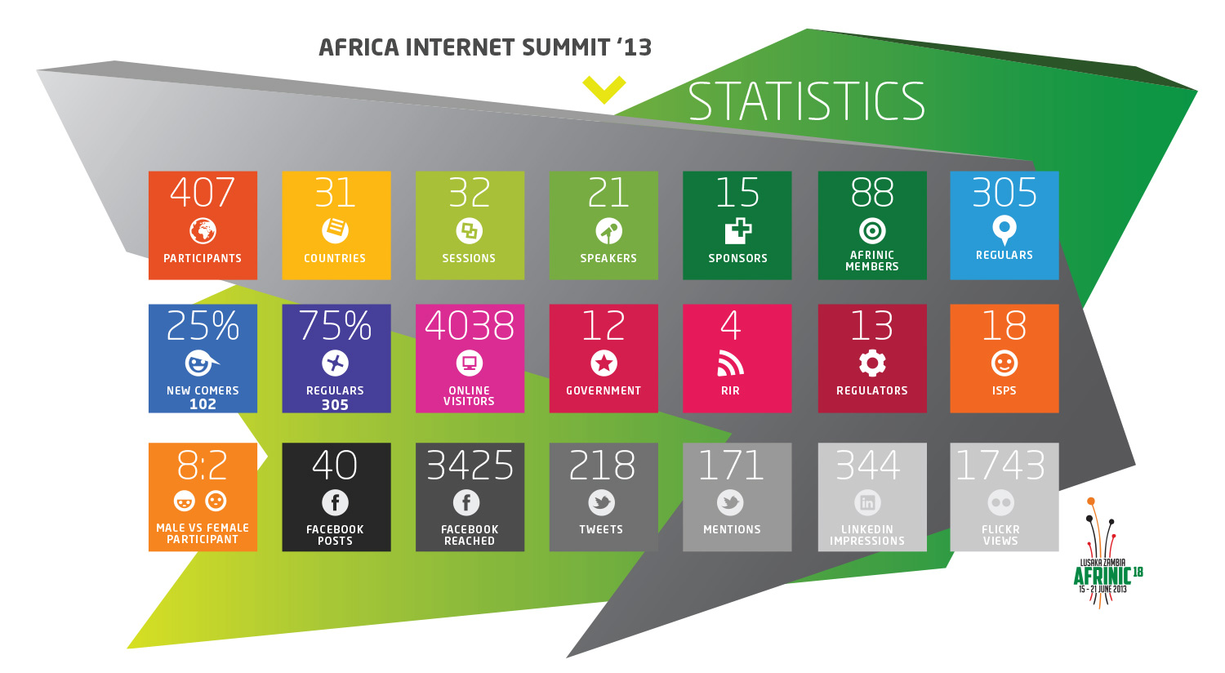
Last event summary
internetsummitafrica.org
http://meeting.afrinic.net/afrinic-18/

Slide 11
Join us – next event

Slide 12
Questions

