Slide 1
APNIC Update
Philip Smith
Director of Learning & Development, APNIC
ARIN 31
21st to 24th April 2013

Slide 2
IPv4 Address Transfer Services
Support for intra and inter-RIR transfers
Pre-approval service, with opt-in anonymous listing
Broker listing; four registered so far
apnic-transfers@apnic.net mailing list
Public transfer log
Transfer fees applied
20% of the transferred block’s annual fee (other holdings not included in the calculation)
Payable by the recipient, or by the source if transferred out of the APNIC region

Slide 3
Inter-RIR Transfers
Completed transfers: 6 from ARIN to APNIC (Nov 2012 – April 2013)
Transfer time (including evaluation): 1 – 2 weeks
Successfully transferred live network
ARIN and APNIC stats overlap one day after the transfer due to the time zone difference

Slide 4
IPv4 Market Transfers
As at 15 April 2013

Slide 5
IPv4 Market Transfer Size
Number of addresses
As at 15 April 2013

Slide 6
IPv4 Last /8 Delegation Trend

Slide 7
IPv6 Delegations
As at 31 Dec 2012

Slide 8
ASN Delegations
As at 31 Dec 2012

Slide 9
Membership Growth
As at 31 Dec 2012

Slide 10
IPv4 Distribution by Economy

Slide 11
APNIC Policies in 2013
Implemented:
prop-104: Clarifying demonstrated needs requirement in IPv4 transfer policy (Feb 2013)
prop-101: Removing multihoming requirement for IPv6 portable assignments (Feb 2013)
Did not reach consensus at APNIC 35:
prop-105: Distribution of returned IPv4 address (modification of prop-088)
Returned to author for further development
prop-106: Restricting excessive IPv4 address transfers under the final /8 block
Abandoned

Slide 12
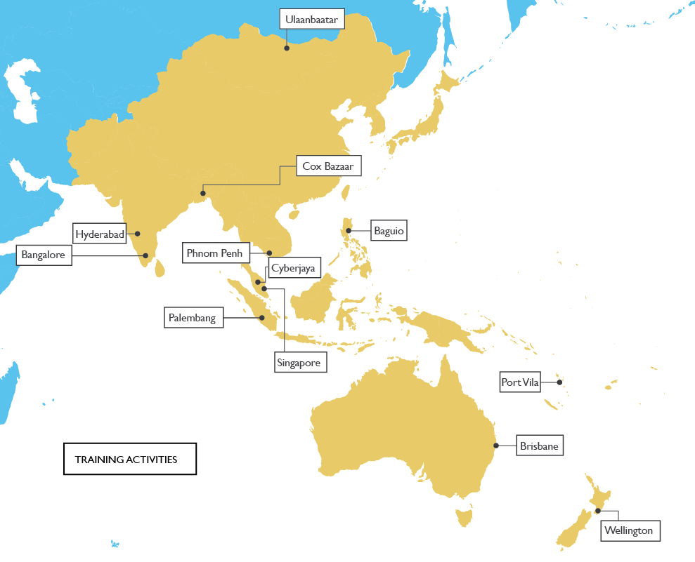
Training delivered in 2013 (Jan to Apr)
Face-to-face training
30 courses in 12 locations
614 participants
eLearning
39 courses
326 participants
As at 15 April 2013

Slide 13
IPv6 in the Community
IPv6@APNIC Conferences
IPv6 Plenary at APNIC 35 in Singapore, Feb 2013 focused on mobile network deployment
Workshop at ICANN 46, Beijing
Asia Pacific IPv6 Task Force (APIPv6TF)
Continued provision of Secretariat services
Met at APNIC 34 and 35

Slide 14
APNIC Labs: IPv6 measurement
IPv6 Capability Tracker
Google Analytics tracking tool to enable website operators to measure client IPv6 capabilities
Measuring IPv6
Measuring the end-to-end capability of IPv6 clients per economy
Readiness data at end-user level for various intergovernmental organizations and economies
IPv6 preference by AS Number
Measures IPv6 client capability per autonomous system
IPv4 address report
Measuring IPv4 free pool address exhaustion
http://labs.apnic.net
http://blabs.apnic.net

Slide 15
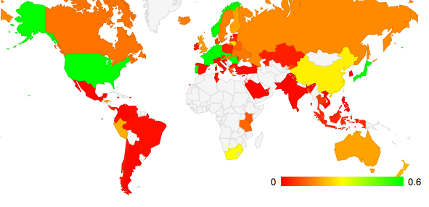
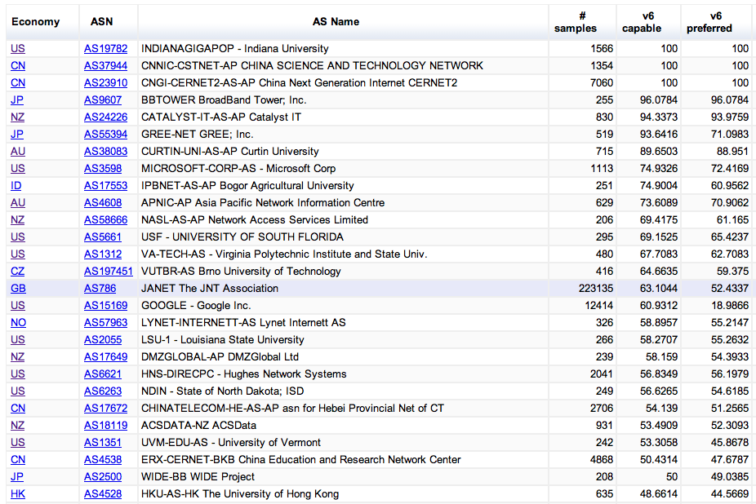
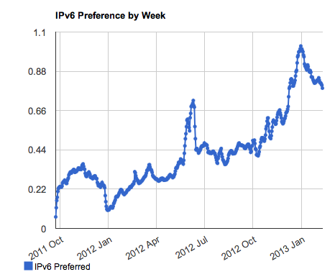
Measuring IPv6
We’ve been conducting a large
scale IPv6 measurement across
the Internet to provide baseline
data about the rate of deployment
of IPv6 across countries and
individual networks
Percent of users using IPv6
http://labs.apnic.net/ipv6

Slide 16
Upcoming Conferences
APNIC 36: Xi’an, China
20 to 30 August 2013
APRICOT 2014 Bangkok, Thailand
18 to 28 February 2014 (includes APNIC 37)
Notes:
Cambodia Banner

Slide 17
Internet Governance Forum
Predominant global forum for discussing Internet governance issues
Includes all sectors of society
Eighth Annual IGF will be held in Bali, Indonesia in October 2013
Paul Wilson, APNIC DG, is participating this year on the IGF’s Multistakeholder Advisory Group (MAG)
Internet organizations such as APNIC have supported the IGF process intensively since its inception
The NRO has doubled its annual contribution to the IGF
Notes:
APNIC maintains a strong support to the Internet Governance Forum.
We believe that The IGF is the best incarnation of the Geneva principles and the best example of a multi-stakeholder dialogue.
APNIC position is to keep it alive and ongoing, respecting its original foundations.
But our support is not only ideological but also material.
APNIC as part of the NRO has doubled its annual contribution to the IGF to 75,000 US dollars this year.
Additionally Paul Wilson, APNIC DG is participating this year on the IGF’s Multi-stakeholder Advisory Group.

Slide 18
Thanks
Philip Smith
philip@apnic.net

